Slide 1
Post-Secondary Planning
October 2023
Testing & College Search
Notes:
Welcome to our Post-Secondary Planning session focusing on Testing and the College Search Process.
Before we begin, I’d like to introduce myself- I’m Taryn Barrett and this is Jess Kirwan-Shaw. I have a junior here at South, so I want you to know that I’m am literally going through the same things your families are going through with post-secondary planning. I’m Jess Kirwan-Shaw (please feel free to shorten that to Shaw), and I just wanted to introduce myself to you all since I’m new to South. I’ve been a school counselor for several years, many of them in CB, and I’m really happy to be part of the CB South team. I’ve met many of your kids already, and it’s been great getting to know them.
Our presentation tonight is focused on standardized testing and the college search process. Our goal is to help families start the conversation about what is the best fit for our teens. We understand that many of you are at various stages of the college exploration process. The conversation tonight is very much geared toward students who are starting to think about their college options as well as standardized testing.
There is no need to take pictures of the slides tonight, we will be posting this presentation along with all of our notes on our Student Services site in the next few days.

Slide 2
AGENDA
Success Plan
Junior Year Timeline
Standardized Testing
College Search Process
Resources
Notes:
As we share this information tonight, our hope is that you leave ready to have open conversations as a family about the path that is best for your student.
Every student is unique as is their readiness to enter the workforce, military, or post-secondary education.
While the topics tonight do focus on preparing for college, we also understand that the “University for All” philosophy is not the best fit for all. And while SAT/ACTs and college planning may be a part of your family conversation, we want to stress the importance of the individual timeline and individual path.
We encourage everyone to proceed with testing when it is appropriate and timely for your student and as you discuss post-secondary options consider the options that are right for your student and family.

Slide 3
introduction
At Contoso, we empower organizations to foster collaborative thinking to further drive workplace innovation. By closing the loop and leveraging agile frameworks, we help business grow organically and foster a consumer-first mindset.
Notes:
We would strongly consider watching this video in its entirety. Due to time constraints, we will not show the video live, but feel the content is incredibly relevant for our families to have. The live link will be available on the slides when we share them.
In reviewing our CB South graduate statistics, we are seeing a trend of more students pursuing the trades/workforce upon graduation. Furthermore, we are seeing an increase in the number of students who go to college for a semester or year, only to drop out to enter the workforce.
It begs the question of whether it would’ve been better for those students to take time before going to college to determine the best path for themselves.
We hope that this video will give perspective on the importance of CAREER and interest exploration alongside post-secondary education exploration. This video helps confront the “University Fits All” philosophy.

Slide 4
Success Plan
10th Grade
Strengths Explorer & Reflection
Career Interest Profiler & Reflection
Achieve Works Skills & Reflection
Resume Building- 10
11th Grade
Game Plan
Postsecondary Goals
SuperMatch College Search
Resume Building- 11
Add Colleges to My List
Notes:
Success Plan is a requirement of all Central Bucks students. This is what we call all of the Career Development activities that students will be required to complete in Naviance. The tasks that students complete over the course of their high school experience include a series of surveys that revolve around self-exploration, career exploration, and post-secondary planning. Each year, students will engage in various activities to help them explore careers or personal interests. The exploration you will take part in through your Success Plan journey will help you make more informed decisions about your career path and post-secondary education goals.
If there are any students who want to retake any of their surveys, they can see their counselor about that.
This year, juniors will be required to explore their post-secondary goals and update their resume which can be used when completing college applications next year. They will be required to do a college search in Naviance and identify which schools from their search that they are thinking of looking into more closely. We encourage juniors to put some time and reflection into these Success Plan tasks because they can help their college/career search tremendously.
Parents can see their student’s progress by logging into their student’s account or by getting their own “shadow” account.
Email cforbes@cbsd.org to get a parent Naviance account of your own.

Slide 5
Junior year timeline
​ | Fall​ | Winter/Spring​ | Summer​
Testing​ | PSAT October. Scores available online in November. ​ AP Registration (if applicable).​ | Take the SAT/ACT & if applicable AP exams.​ | Register for fall SAT/ACT as needed.​ ASVAB for those considering military.​
Naviance​ | Research careers/majors from surveys completed in 10th; update resume, complete Super Match college search and add schools to “Colleges I’m Thinking About”.​ | College search process. ​ ​ Identify colleges of interest.​ ​ Success Plan Activities.​ ​ | Parent & Student Complete “Counselor Letter of Recommendation" Survey.​ ​
College​ | Meet with College Admission Reps Visiting South.​ ​ | Attend Open Houses @ Colleges.​ Tour Colleges.​ Virtual College Fairs.​ View Online Virtual Tours.​ | Contact admissions to set up Campus Tours and Visit Schools of Interest.​ Begin College Applications.​
General​ | Create helpful accounts:​ E-Prep (Library)​ College Board/ACT​ Khan Academy and ACT Academy​ | Inquire about recommendations from 11th grade teachers.​ Save college essay and graded writing sample.​ Program Planning.​ | Write/Edit College Application Essay.​ Update Activity Resume.​ ​
Notes:
These are general guidelines to help students/families focus on time-relevant tasks throughout the year. This timeline will be posted in our presentation slides for future reference.
Testing in particular may be on a more individual timeline depending on when the student completes certain levels of math (Algebra 2/Trig specifically). For those who took the PSAT this past Saturday, scores will be available sometime by mid-November in waves determined by CollegeBoard.
Students shouldn't feel pressure to take the SAT or ACT until they feel ready because not all students are at the same place in their curriculum. Generally speaking though we see Juniors testing from January through June of the senior year.
Students should take advantage of the college exploration opportunities that are brought to them throughout the year. Specifically, College Rep Visits to South (sign up in Naviance- Research Colleges- College Visits), virtual college fairs or college tours that are online, or by using the three “excused absences” allowed to attend college open houses or do campus tours.
We would really encourage that you take a look at the college representative visits list in Naviance if you have not done so already. We still have about 100 reps still to come between now and mid-November and these are excellent opportunities to learn more about a college and show your interest in a particular school.

Slide 6
College-Related Testing Timeline
PSAT
SAT/ACT
Advanced Placement
(AP) Tests
Winter/Spring junior year; Summer/Fall senior year; Immediately after prep course. *Register through ACT/College Board
Oct 14
Review results online (Nov) to prepare for future SAT
First 2 weeks of May; same year as AP course
Notes:
There are a number of assessments used by colleges in the admissions process. PSAT and PreACT are practice tests for the SAT and ACT. The PSAT is being held on Saturday for those who registered. Scores will be on the College Board website in about a month.
Registration for ACT and SAT are done directly through the College Board or ACT site and not through CBSD.
When to test is a personal decision. We suggest waiting to take the SAT or ACT in the spring because the more academic work the students have completed, the better they do on the exams. However, this is a personal decision based on readiness. Students should minimally complete Algebra 2 which is covered on the math portion of both tests.
Some students are taking prep classes and their instructors are encouraging them to take the exams sooner, which is fine.
Students do not need to take the SAT or ACT if they are going to be attending a Community College. However, if students want to transfer, typically they will need either the SAT or ACT if they have not yet completed an associate's degree or equivalent (unless they are applying to a school that offers a “test optional” model).

Slide 7
SAT vs ACT
SAT
3 Hours and 15 Minutes with Breaks As of 2024- Digital SAT will be a little over 2 hours long.
Reading, Writing and Language, Math (Algebra 1&2, Geometry, Trig, Data Analysis)
No essay
Scored 400-1600
ACT
3 Hours and 30 Minutes with Breaks (40 minute optional essay which brings test to just over 4 hours)
English, Reading, Science Reasoning, Math (Arithmetic, Algebra 1&2, Geometry, Trig, Probability and Statistics)
Essay: Optional (West Point only school our students tend to apply to who want it)
Scored 1-36
Notes:
There are subtle differences between the SAT and ACT. Both, however, are regarded EQUALLY by colleges in the admissions process. There is no advantage to one over the other.
Major difference is the SCIENCE section on the ACT.
You can compare scales by looking at SAT/ACT Concordance Chart online.
We recommend taking practice tests in advance to deciding which test(s) you will take.
Some students do better on one over the other and should therefore focus their energies towards taking their strongest test more than once to “superscore”.
Superscoring is something that colleges do during the admissions process- taking the best subcore from one test date and combining it with a stronger subscore from another date to get a higher overall composite.

Slide 8
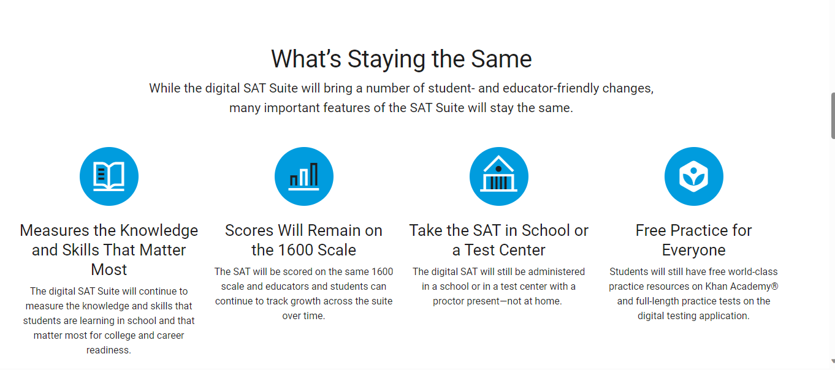
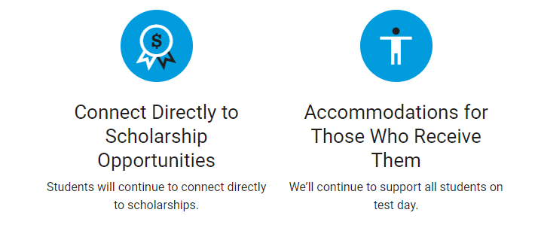
DIGITAL SAT & PSAT

Slide 9
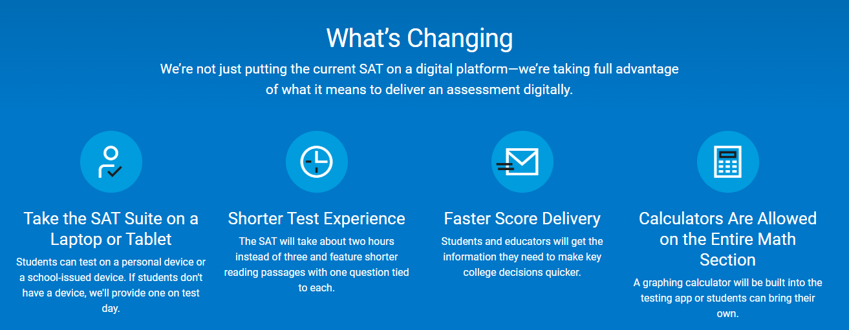
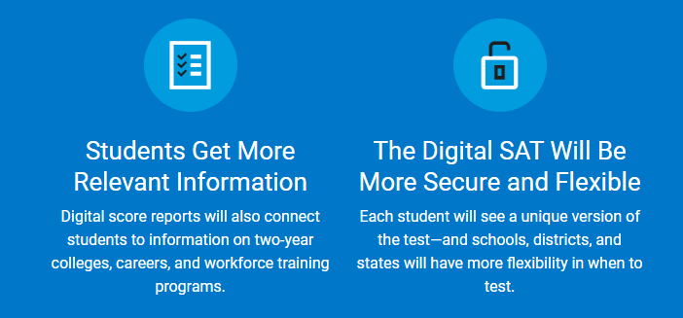
DIGITAL SAT & PSAT

Slide 10
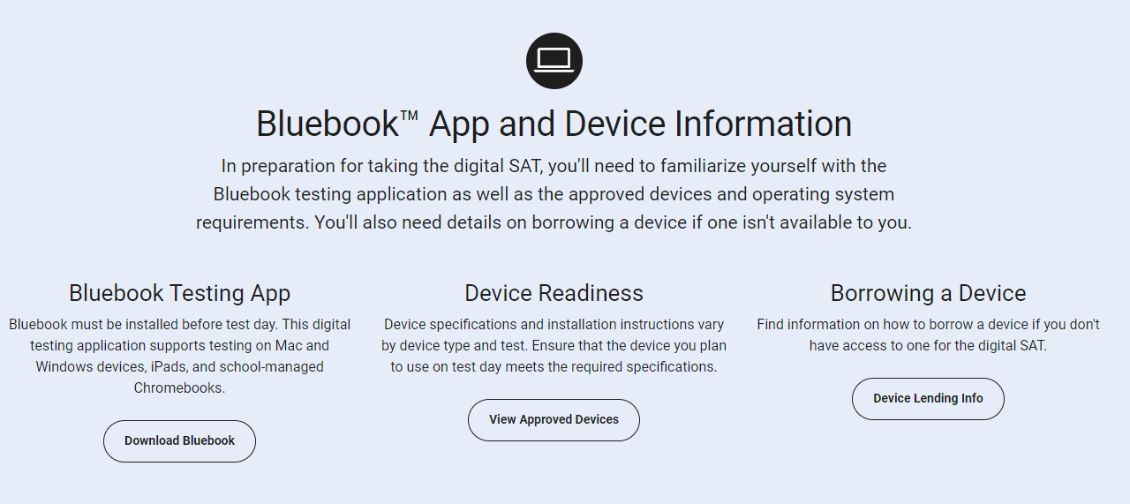
Notes:
Blue Book has automatically been pushed to all CBSD Issued laptops. All juniors were given time during Titan Forum to log into BlueBook onto their laptops. We recommend that students become familiar with the platform and the testing experience prior to any testing day. There are practice questions on BlueBook that students can work through to prepare. Those who took the PSAT at South last week were the first to experience the digital platform, and things went very smoothly.

Slide 11
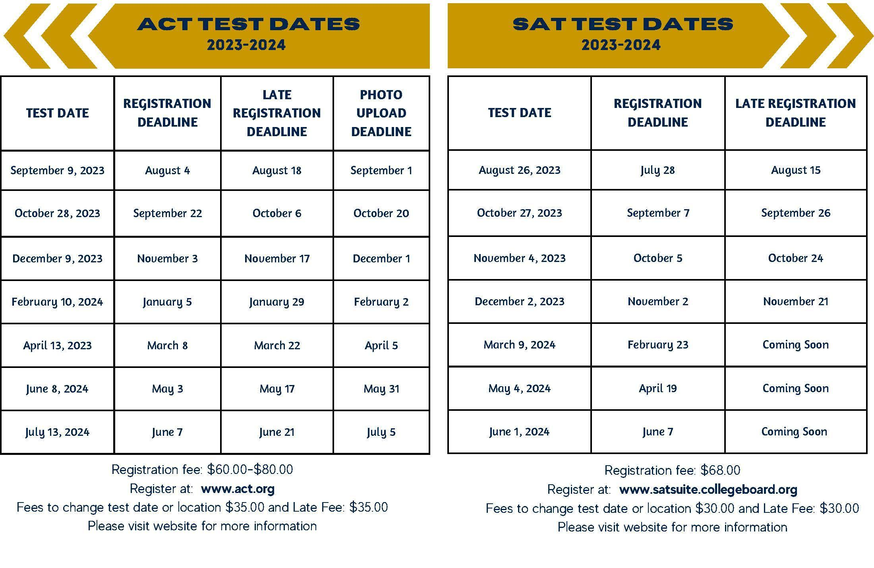

Slide 12
From Registration to Test day
Create an account at CollegeBoard (SAT) or ACT
Search for test date at CB West or East
CB South School Code 394-992
Upload a digital photo
Print admission ticket
Arrive on time with all testing materials, ticket, and PHOTO ID
Walk-in testing is NOT permitted
Register early to assure first choice test site and avoid late fees
Notes:
Follow all directions, register early, be prepared.
Registration is through the testing company website directly for SAT and ACT.
This is different from PSAT and AP tests, which you will do directly through South on MyPaymentsPlus accounts.
Keep your username and password in a safe place and do not create multiple accounts.

Slide 13
Test prep resources
Fairtest.org
ACT Academy
Through ACT
EPrep
Khan Academy
Private test Prep
CB South Electives
See CB South Librarian
Through CollegeBoard
Math and English
Notes:
There are dozens of resources available, most for free, that students can access to prepare for the SAT or ACT. These are just a few.
Check out Fairtest.org for a list of colleges that do not require standardized tests for admissions. These schools are called “TEST OPTIONAL” schools. We will discuss Test Optional in a moment.

Slide 14
Reporting Test Results to Colleges
Directly to college from testing company upon student request
May take up to 4-6 weeks
When registering for tests, students can request scores be sent to up to 4 colleges for FREE. Scores rec’d by college in 2 weeks
Test scores are NOT ON YOUR TRANSCRIPT
Is “Score Choice” the right choice or should I send all scores?
“Super-scores” are calculated by most colleges
Official
Score
Reports
Growing trend in admissions
Option to take picture of score report and submit
Official score report required by college you choose to attend
Self-Report
When registering for any standardized test, be sure to include
CB South school code 394-992 and check Parent Portal to make sure scores have been sent to South to include in your Naviance statistics.
Notes:
SAT/ACT Scores are NOT on the High School Transcript.​
If you want a college to receive scores, you must have them sent directly from CollegeBoard or ACT. Once your SAT scores are available online (about 13 days after the test), if you order your score reports it will take approximately 1-2 weeks for a college to receive your SAT scores.​
While they will give you 4 free score reports to send to colleges at the time of registration, sending score reports after the scores are released will cost upwards of $16/school.​
SCORE CHOICE: You can pay an additional fee to “hide” the scores from a particular test date. However, most colleges want to see all scores and will just pull the best scores for consideration, so don’t feel you need to pay to “hide” lesser scores.​
​
SUPER-SCORES: Most colleges “super-score” the SAT – take the highest math, verbal, and writing and combine those scores. (Penn State takes highest test DATE, not super score).​

Slide 15
Notes:
During COVID, many schools went test-optional as testing centers became scarce and students could not access centers.
This blew the lid off of whether SAT/ACT scores were really good predictors of college success or whether they simply favored those who had means and access to test-prep opportunities.
Many schools have continued to stay test-optional, though we may not know for our Class of 2025 what the policies will be for institutions until later in the spring.
It would be important to research if any specific merit scholarships at a college require SAT/ACT scores. It is also very important to know that while a college might be test optional, there might be specific majors that do require scores, such as nursing and engineering.
It is important for Juniors to get involved at least 3 activities and give those activities their full commitment. Having a part-time job is amazing, as well as any research, internships, shadowing experiences.
Juniors are also encouraged to save a graded writing sample from one of their classes in case a college asks the to submit additional materials to be considered.

Slide 16
When? May 6-17, 2024 @ CB South during school day.
How? Register through Mypaymentsplus
Cost? $103
Fall course registration deadline is 10/31/2023 (spring courses register later)
Potential benefits of AP
College credit
Course level placement
“Place out” of college courses.
Advanced academic standing
Rigorous preparation for college coursework
Who takes AP Credits?
www.collegeboard.org/ap/creditpolicy
Notes:
We will have two mypaymentsplus collection periods. One for the AP courses that begin 1st marking period, and one for AP courses that begin 2nd or 3rd marking periods- usually end of January/Beginning of February.
Join code is provided by teacher.
There are some benefits of taking the AP exam if a student is taking an AP course:
Will they be given elective credit?
Core credit?
Exemption from a pre-req
Registration and payment information will be sent out through Mr. Bucher’s newsletter and Canvas.
October 31st is the deadline to register for classes that began in the 1st MP; Registration for later courses will open at a later date.
Students should check each college’s individual policies about how/if they will accept AP credit.

Slide 17
Beginning the search process
No worries… there are
almost 4,000 degree granting post-secondary schools in the United States from which to choose!

Slide 18
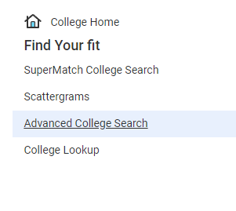
The College Search: Find Your Fit...
Selection Criteria
2 or 4 year
Academics
Competitiveness/Admissions
Public vs private
Size
Cost
Coed vs single sex
Enrollment
Location & distance from home
Religious affiliation
Sports & Divisions & Intramurals
Diversity
Resources/Opportunities
Notes:
Finding FIT is the priority. Starting to research schools now to determine what types of schools are best for YOU is important to do this year so by spring and summer, you can determine which schools you'd like to visit. The more research you do now, the more you can narrow down a manageable list for yourself. Going into senior year with dozens of schools on your list or applying to more schools than you're truly interested in can make it more challenging to make decisions later. Not to mention, all those college application fees can be pricey at $50-70/each!
Feel free to make an appointment to see your counselor to review the list and see if we have any other suggestions.
2 or 4 year: Associates, Bachelors degrees
PUBLIC v PRIVATE: cost factors to consider but don't rule out more expensive schools until you search scholarship criteria. 4 PA State related universities vs. 14 State owned universities vs public universities as an out of state resident.
COST: We strongly encourage families to talk about financial contributions sooner than later.
Do they offer a college MAJOR that relates to your career field?
SIZE of school and faculty:student
DISTANCE from home for comfort and also the cost of travel
SPORTS/ACTIVITIES- School Spirit

Slide 19
A Valuable Resource
An online notebook to do research, track your progress, keep personal records...
Research
Colleges
Careers
Scholarships
Enrichment & Summer Programs
Analyze & Compare Data
Visit College Websites
Requesting Transcripts and Letters of Recommendation Senior Year
Notes:
NAVIANCE is an online resource where you can keep track of all your research, compare options, and monitor the records submission process when applying to schools.
College Search can be done on Naviance and students can “Favorite” colleges in their List of Colleges I’m Thinking About to help them organize their search. Students will have to complete the Advanced College Search for Success Plan this year.
Career Exploration (Success Plan)- multiple surveys to help students determine
Scholarships: national search databases, our CB South Scholarship List of private scholarships are posted in Naviance.
Typically the scholarships sent to us are for senior applicants, but occasionally we’ll see an essay contest come through for juniors. Juniors are encouraged to check out the scholarship list this year so they are aware of the criteria for the following year.
Come senior year, all records requests for transcripts and recommendations will be done through Naviance.

Slide 20
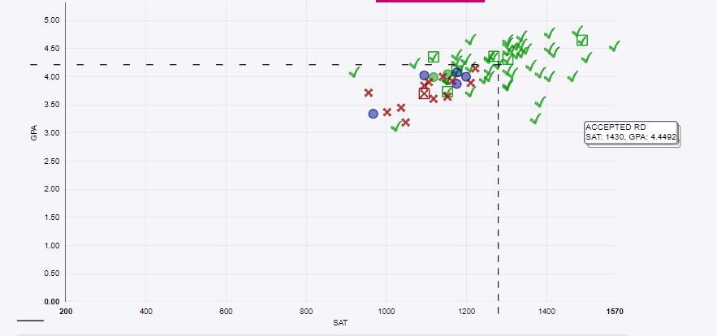
Research & Comparison Tools
Keep track of your research in one place.
Colleges I’m Thinking About
& Scatterplots
Notes:
Scattergram provides visual comparison to you and South applicant history.
Once you add schools to your Colleges I’m Thinking About list, you can find the scattergram for the college by going to “MORE”.
The Scattergrams include student decisions going back the past 5 years of CB South students, so you are comparing your student to others who have been assessed based on our curriculum and culture.
Green means they were accepted, Red indicates denied decision. You are the little blue “person” icon based on your PSAT last year or SAT/ACT as soon as you take them with your Cumulative GPA.

Slide 21
Check Out the Statistics
Notes:
Once you click on the College itself, you can find information about tuition; acceptance rates; admissions criteria; general information like size, locale, public/private, degrees offered; college overlaps (students that apply to this college also apply to these similar colleges", app deadlines, compare yourself to others from South who have applied...), faculty : student ratio; majors, student life etc.
Use these stats to guide your questions when you go on campus visits or meet with reps. How many graduate in 4 years? 5 years? What is your retention rate? Do you pull a lot of students from Bucks County PA?
Can you identify a common thread that connects you to the colleges you are researching?
Look at admission requirements and let that also assist you with course selection for senior year.

Slide 22
Online College Search Tools: Ratings, Discussion Boards, Search Engines
College Board/Big Future
Common App/Explore Colleges
Cappex
Unigo
Niche
TheCollegeTour.com
College Confidential
College Navigator
HS Navigator
US News and World Report’s Best Colleges Report
The Princeton Review
Forbes Magazine’s America’s Top Colleges
Kiplinger’s Best College Values
Notes:
There are hundreds of search tools online that can help families broaden their search. Some online resources are based on data while others focus on student feedback and anecdotal information gathered from current students and alumni. This slide provides a variety of search engines that provide different information and perspectives. Some of these sites provide rankings while others provide search options and information about colleges and universities.
We urge students and families to investigate any website with a critical eye when using any online resource to help with your college search. These are all excellent tools to use as you are building your college list or can be useful to narrow down a list based on specific criteria that is important to you.

Slide 23
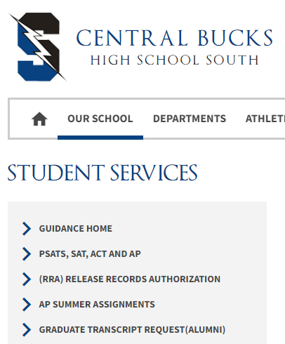
RESOURCES
Student Services Webpage
Naviance- College and Military visits, Statistics, College Search tools, Virtual campus tours
School Counselor – Students should schedule individual appointments
Open House Bulletin Board
College Rep Visits
Check your CBSD email!
ACT and College Board (SAT & PSAT) websites
Notes:
So many resources to guide your family through the process…
Student Service Website- Presentations (College Planning, Financial Aid Night), Application Process documents
Access Naviance through Clever- is the college and career research tool we primarily use in CB. There is an immense amount of information for career exploration (see Success Plan surveys from sophomore and junior year) as well as college exploration tools to help start the search process all the way through the application process where students will request records and organize their records and recommendations.
Individual Appointments- We ask that students initiate appointments with us as needed, as often as they need, to ask questions about the process, their own testing timeline, advice on schools, etc. We are specifically asking that students make an effort to see us in person. As lovely as it is to get emails, meeting in person is more effective and gives us a chance to get to know the student much better. After all, some day soon we may need to write the student a letter of recommendation! There are QR codes around the building to help students schedule appointments online. They can also stop in to the 1st or 3rd floor Student Services Office.
College Representatives- Students should sign up to meet with reps who come to South through Naviance under the Colleges Link at the top of the page. The representatives that visit South are the same individuals who will be reading our student’s applications.
ACT/CollegeBoard Websites- Students register for SAT/ACT directly on the site (not at school). Find everything from admissions to financial aid and more on these sites- very helpful!
CBSD Email- If we send an email, it’s usually about something important so we really need students to check their student account minimally once per week. If not, they may miss timely and important information from us!

Slide 24
Notes:
We thought this deserved its own slide. A LOT of important emails go out to seniors, from important updates to deadlines, and helpful information. Counselors will be sending emails to students throughout senior year with questions about their applications, letting them know things we’ve noticed are missing or they still need to do, etc. It’s really important that kids make a habit of regularly checking BOTH their CB email AND their personal email that they list on college applications.

Slide 25
Additional Information Sessions
Lunch & Learn Sessions for Students
PHEAA Virtual Financial Aid Session
NOVEMBER 1st
7pm
(Details in newsletter)
Essay Writing Sessions or Assistance in Writing Center
College Panel @ CB South
(Winter)
Notes:
There are a number of information sessions and resources available for students throughout Junior year that we encourage our students to access to help them through the process.
The more they attend/explore, the easier the application process will be.

