Slide 1
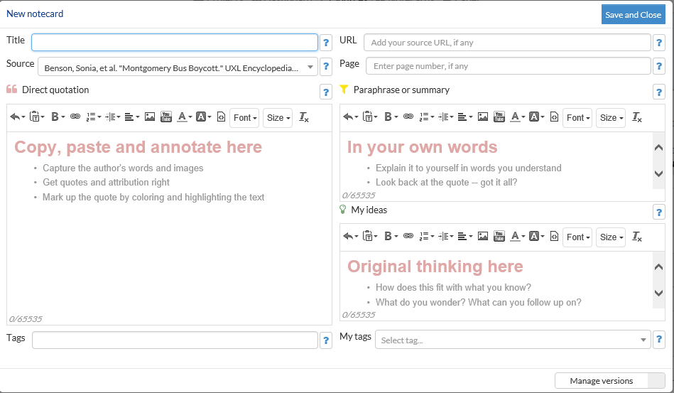
Creating Notecards in Noodletools
Step 1: Citation: Cite your source correctly in Noodletools
Step 2: Create a New Notecard: Click on “New” Notecard next to the citation on the Bibliography page (NOT the Notecard page).
TITLE: ONE MAIN IDEA PER CARD
PARAPHRASE: Explain the ideas from the Direct Quote section in your own words.
This is where the real work occurs of thinking and making meaning.
DIRECT QUOTATION:
READ AND HIGHLIGHT THE AUTHOR’S WORDS
My Ideas: Note to self to guide your research . Make connections, ask questions etc…

