Slide 1
Chapter 7
Ionic and Metallic Bonding

Slide 2
Chapter 7 and 8 Vocab
Alloys
Chemical formula
Coordination number
Electron dot structure
Formula unit
Halide ion
Ionic bonds
Ionic compounds
Metallic bonds
Octet rule
Valence electron
Covalent Bond
Coordinate Covalent Bond
Diatomic Molecule
Dipole
Dispersion Forces
Double Covalent Bond
Hydrogen Bonds
Molecular Compound
Molecular Formula
Molecule
Nonpolar Covalent Bond
Polar Covalent Bond
Polar Molecule
Polyatomic Ion
Resonance Structure
Single Covalent Bond
Structural Formula
Triple Covalent Bond
Unshared Pair
Van der Waals forces
VSEPR Theory
Define all of them for
5 EC points
Define the red ones for
3 EC points

Slide 3
Section 1 - Ions
Read pages 187-193

Slide 4
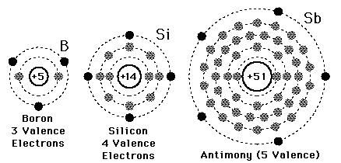
Valence Electrons
electrons in the last energy level
involved in bonding

Slide 5
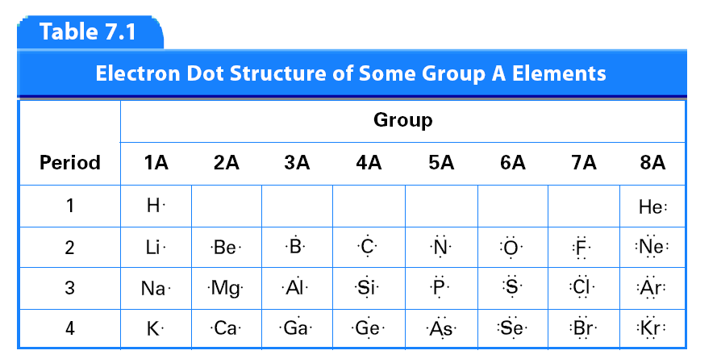
Page 188, Table 7.1
Do You See a Pattern?
1
2
13
14
15
16
17
18

Slide 6
  Group 1 = 1 Valence Electron
  Group 2 = 2 Valence Electrons
  Groups 3-12 = VARY in Valence Electrons
  Group 13 = 3 Valence Electrons
  Group 14 = 4 Valence Electrons
  Group 15 = 5 Valence Electrons
  Group 16 = 6 Valence Electrons
  Group 17 = 7 Valence Electrons
  Group 18 = 8 Valence Electrons

Slide 7
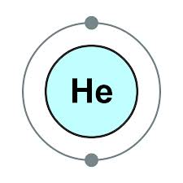
ONE exception to this pattern
Helium
  Why?
    only has 2 valence electrons

Slide 8
Electron Dot Structures
diagram that shows the valence electrons as dots
one dot (electron) on each side before start pairing up
O
O

Slide 9
Electron Dot Structures Practice
Draw the electron dot structures for:
I
Rb
Ba
P

Slide 10
Octet Rule
atoms want to acquire 8 electrons in their outermost energy level to become stable
  Again, the idea of full s and p sublevels
atoms will react with each other in some bonding way to obtain these 8 valence electrons
2 Exceptions:
H & He
Only need 2 valence electrons

Slide 11

Cation
atom loses electrons, metals
a positively charged ion
name stays the same

Slide 12
Example
Na (atom) structure Na )2e⁻ )8e⁻ )1e⁻
  What does Na need to become stable (happy)?
    8 Valence Electrons
  Is it easier for Na to lose its 1 ve⁻ or gain 7 electrons?
    LOSE 1
So the Na atom becomes Na ion:
Na⁺¹ (ion – cation) Na )2e⁻ )8e⁻ (lost the outer e⁻)
  Now Na is stable and the name stays sodium
  Looks like Ne but still has Na properties

Slide 13
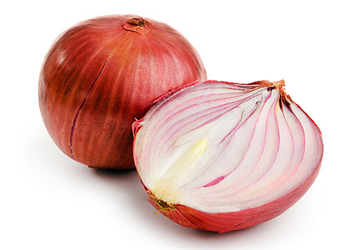
Anion
atom gains electrons, nonmetals
a negatively charged ion
name changes to –ide ending

Slide 14
Example
Cl (atom) structure Cl )2e⁻ )8e⁻ )7e⁻
  What does Cl need to become stable (Happy)?
    8 Valence Electrons
  Is it easier for Chlorine to lose its 7 ve⁻ or gain 1 electron?
    GAIN 1
So the Cl atom becomes Cl ion:
Cl⁻¹ (ion – anion) Cl )2e⁻ )8e⁻ )8e⁻ (gained 1 e⁻)
  Now Cl is stable and the name changes to chloride
  Looks like Ar but still has Cl properties

Slide 15
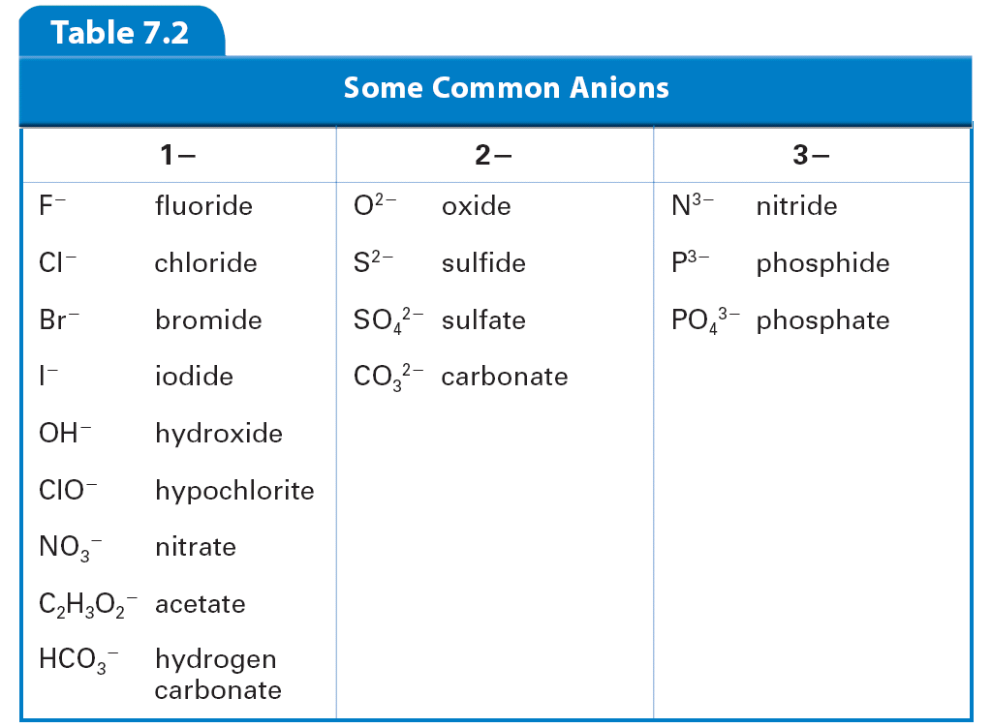

Slide 16
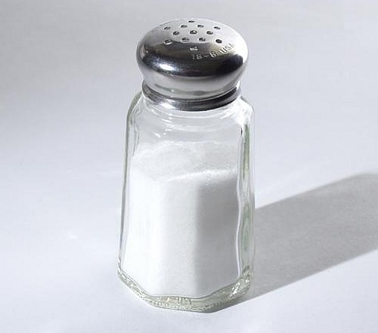

Slide 17
Practice Problems
nitride, N³⁻
calcium, Ca²⁺
fluoride, F⁻
arsenide, As³⁻
beryllium, Be²⁺
Give the name and symbol of the ion formed when:
A nitrogen atom gains three electrons
A calcium atom loses two electrons
A fluorine atom gains one electron
An arsenic atom gains three electrons
A beryllium atom loses two electrons

Slide 18
Charges based on groups
Group 1 = Ions with a +1 charge (lost 1 electron)
Group 2 = Ions with a +2 charge (lost 2 electrons)
Groups 3-12 = Ions with various charges (all cations)
Group 13 = Ions with a +3 charge (lost 3 electrons)
Group 14 = Ions with a +/- 4 charge (lost or gained 4 electrons)
Group 15 = Ions with a -3 charge (gained 3 electrons)
Group 16 = Ions with a -2 charge (gained 2 electrons)
Group 17 = Ions with a -1 charge (gained 1 electron)
Group 18 = Does not form ions (already stable)

Slide 19
Add to your Periodic Table Reference Sheet!
+1 |  |  |  |  |  |  |  |  |  |  |  |  |  |  |  |  | N/A
1 | +2 |  |  |  |  |  |  |  |  |  |  | +3 | ±4 | -3 | -2 | -1 | 8
 | 2 |  |  |  |  |  |  |  |  |  |  | 3 | 4 | 5 | 6 | 7
Charge
Number of Valence Electrons

Slide 20
What will the charge be?
Also, name the ion formed.
+
Li
Lithium
3+
Aluminum
Al
-
Br
Bromide

Slide 21
Quick quiz
Section 7.1

Slide 22
1. How many valence electrons are there in an atom of oxygen?
2
4
6
8

Slide 23
2. Atoms that tend to gain a noble gas configuration by losing valence electrons are
metals.
nonmetals.
noble gases.
representative elements.

Slide 24
3. When a magnesium atom forms a cation, it does so by
losing two electrons.
gaining two electrons.
losing one electron.
gaining one electron.

Slide 25
4. When a bromine atom forms an anion, it does so by
losing two electrons.
gaining two electrons.
losing one electron.
gaining one electron.

Slide 26
What’s Next?
Book Work:
  Page 193 #3-10

Slide 27
Page 193 #3-10
How can you determine the number of valence electrons in a representative element?
Atoms of which elements tend to gain electrons? Atoms of which elements tend to lose electrons?
How do cations form?
How do anions form?
How many valence electrons are in each atom?
  Potassium
  Carbon
  Magnesium
  Oxygen
Draw the electron dot structure for each element in Question 7.
How many electrons will each element gain or lose in forming an ion?
  Calcium
  Fluorine
  Aluminum
  Oxygen
Write the name and symbol of the ion formed when:
  Potassium loses one electron
  Zinc loses two electrons
  Fluorine gains one electron

Slide 28
#3 – How can you determine the number of valence electrons in the atom of a representative element?
Look at the group number
  Group 1 = 1 valence
  Group 2 = 2 valence
  Group 13 = 3 valence
  Etc.

Slide 29
#4 – Atoms of which elements tend to gain electrons? Atoms of which elements tend to lose electrons?
Nonmetals tend to gain electrons
Metals tend to lose electrons

Slide 30
#5 – How do cations form?
An atom loses valence electrons to form a positive ion

Slide 31
#6 – How do anions form?
An atom gains valence electrons to form a negative ion

Slide 32
#7 – How many valence electrons are in each atom?
Potassium
Carbon
Magnesium
Oxygen
1
4
2
6

Slide 33




#8 – Draw the electron dot structure for each element in Question 7.
K, C, Mg, O

Slide 34
#9 – How many electrons will each element gain or lose in forming an ion?
Calcium
Fluorine
Aluminum
Oxygen
lose 2
gain 1
lose 3
gain 2

Slide 35
#10 – Write the name and symbol of the ion formed when:
Potassium loses one electron
Zinc loses two electrons
Fluorine gains one electron
K⁺
Zn²⁺
F⁻

Slide 36
Section 2 -
Ionic Bonds and Ionic Compounds
Read pages 194-199

Slide 37
Ionic Bonds
opposite charges attract
transfer of electrons
between a metal and a nonmetal
called a salt

Slide 38
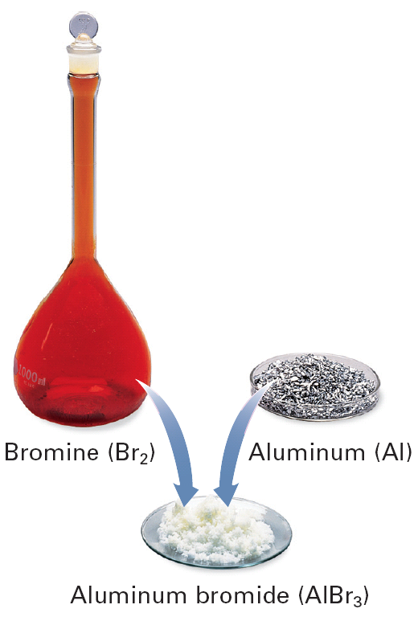

Slide 39

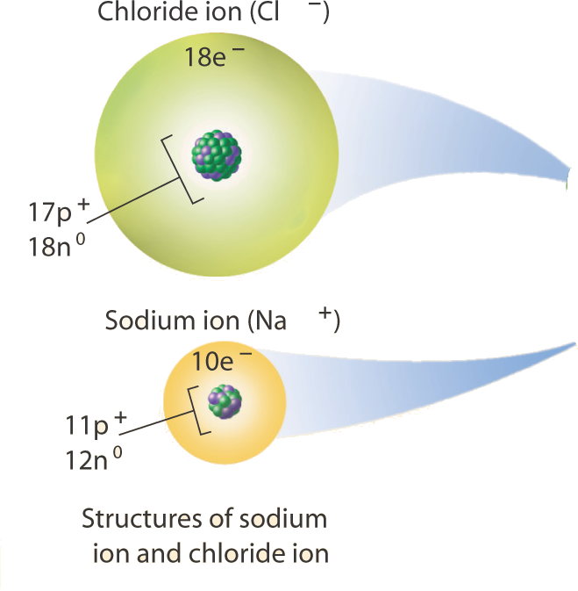
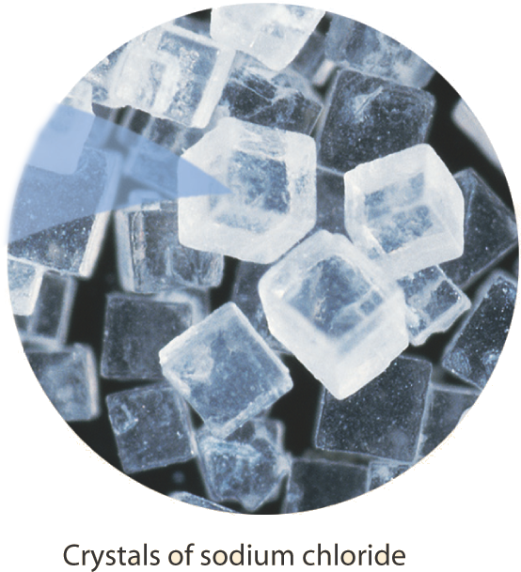
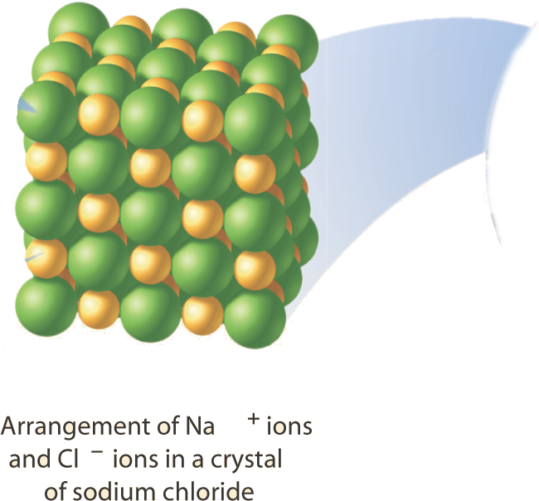
How Ionic Bonds Form:
Sodium and Chlorine
**
*Cl**
**
** ₋₁
Na⁺¹ •*Cl**
**
Na•
=
=
NaCl
Sodium Chloride

Slide 40
Example: Sodium and Oxygen
**
*O**
*
** ₋₂
Na⁺¹ •*O**
Na⁺¹ •*
Na•
=
=
Na₂O
Sodium Oxide
Na•

Slide 41
Example: Magnesium and Oxygen
**
*O**
*
** ₋₂
Mg⁺² •*O**
•*
Mg•
•
=
=
MgO
Magnesium Oxide

Slide 42
Formula Unit
lowest whole-number ratio of ions in an ionic compound
NaCl
Ratio of Na to Cl is 1:1
Ratio of Mg to Cl is 1:2
MgCl₂

Slide 43
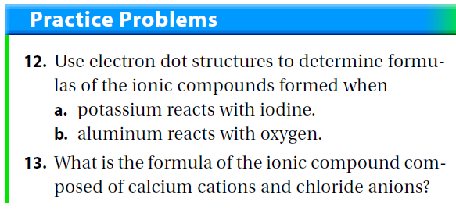
And NAME them
a. KI – Potassium Iodide
b. Al₂O₃ – Aluminum Oxide
CaCl₂ – Calcium Chloride

Slide 44
Short Cut – Crisscross Method
Determine the charge on each ion.
Cross the charges.
Reduce if necessary.
Name the compound.

Slide 45
Example 1 – Barium and Nitrogen
2+
3-
Ba N
Ba₃N₂
Barium Nitride

Slide 46
Example 2 – Magnesium and Oxygen
2+
2-
Mg O
Mg₂O₂
MgO
Magnesium Oxide

Slide 47
Practice Problems
Determine the chemical formulas and names of the ionic compounds formed when the following elements combine:
  magnesium and chlorine
    MgCl₂ = Magnesium Chloride
  aluminum and sulfur
    Al₂S₃ = Aluminum Sulfide

Slide 48
Ionic Compounds Properties
crystalline solids
high melting points
conduct electricity when dissolved in water

Slide 49
Let’s review

Slide 50
Short Cut – Crisscross Method
Determine the charge on each ion.
Cross the charges.
Reduce if necessary.
Name the compound.

Slide 51
Example – Aluminum and Chlorine
3+
-
Al Cl
AlCl₃
Aluminum Chloride

Slide 52
Write the correct chemical formula for the chemical compounds formed from each pair of ions. Name the compound that is formed.
Rb⁺, O²⁻
Ca²⁺, N³⁻
Fr⁺, F⁻
Al³⁺, P³⁻
Rb₂O
Rubidium Oxide
Ca₃N₂
Calcium Nitride
FrF
Francium Fluoride
AlP
Aluminum Phosphide

Slide 53
Write formulas for each compound.
Strontium iodide
Lithium boride
Beryllium sulfide
Potassium selenide
Srl₂
Li₃B
BeS
K₂Se

Slide 54
Decide whether or not the following pairs of elements will form ionic bonds. If not, explain.
Na and Ne
K and Br
N and S
Rb and Be
No
Ne is a noble gas
Yes
No
Both are nonmetals
No
Both are metals

Slide 55
Quick Quiz
Section 7.2

Slide 56
1. Which chemical formula is incorrect?
KF₂
CaS
MgO
NaBr

Slide 57
2. At room temperature, most ionic compounds are
crystalline solids.
liquids.
gases.
soft, low melting-point solids.

Slide 58
What’s Next?
Book Work:
  Page 199 #14-20, 22

Slide 59
#14 – How can you describe the electrical charge of an ionic compound?
Electrically neutral

Slide 60
#15 – What properties characterize ionic compounds?
crystalline solids
high melting points
conduct electricity when dissolved in water

Slide 61
#17 – How can you represent the composition of an ionic bond?
formula unit

Slide 62
#18 – Write the correct chemical formula for the chemical compounds formed from each pair of ions:
K⁺, S²⁻
Ca²⁺, O²⁻
Na⁺, O²⁻
Al³⁺, N³⁻
K₂S
CaO
Na₂O
AlN

Slide 63
#19 – Write formulas for each compound.
Barium chloride
Magnesium Oxide
Lithium Oxide
Calcium Fluoride
BaCl₂
MgO
Li₂O
CaF₂

Slide 64
#20 – Which pairs of elements are likely to form ionic compounds?
Cl, Br
Li, Cl
K, He
I, Na
Both are nonmetals
No
Yes
No
He is a noble gas
Yes

Slide 65
#22 – Why do ionic compounds conduct electricity when they are melted or dissolved in water?
Ions become free to move around

Slide 66
Section 3 -
Bonding in Metals
Read pages 201-203

Slide 67
Metallic Bond
attraction of the free-floating valence electrons
  “sea of electrons”
between a metal and a metal

Slide 68
Metallic Bond Properties
good conductors of electricity
ductile - drawn into wire
  example: copper wire
malleable - hammered into sheets
  example: aluminum foil
atoms are compacted with an orderly pattern

Slide 69
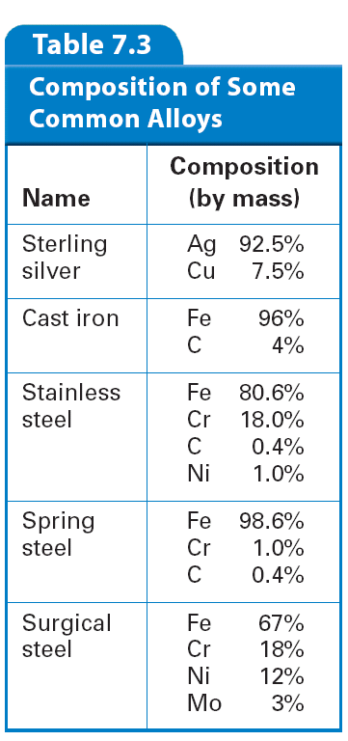
Alloy
mixture of metals
properties are superior to those of their component elements
More durable than pure silver, but is still soft enough to be made into jewelry

Slide 70

    Bicycle frames are often made of titanium alloys that contain aluminum and vanadium.

Slide 71
Quick Quiz
Section 7.3

Slide 72
1. The valence electrons of metals can be modeled as
a body-centered cube.
octets of electrons.
a rigid array of electrons.
a sea of electrons.

Slide 73
2. In most metals, the atoms are
free to move from one part of the metal to another.
arranged in a compact and orderly pattern.
placed at irregular locations.
randomly distributed.

Slide 74
3. Alloys are important because they
are pure substances.
are the ores from which metals can be refined.
can have properties superior to those of their components.
are produced by the combustion of metals.

Slide 75
What’s Next?
Book Work:
  Page 203 #23-26

Slide 76
#23 – How do chemists model the valence electrons in metal atoms?
A sea of electrons

Slide 77
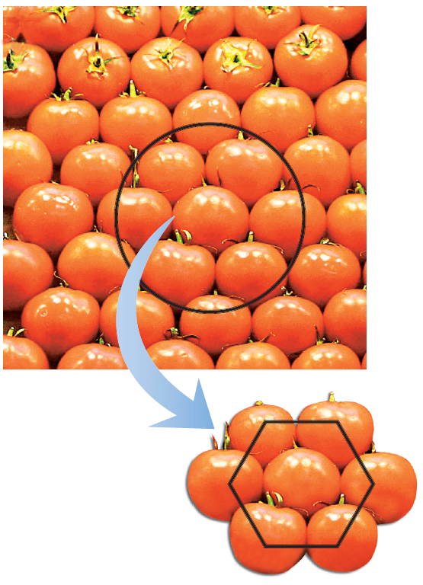
#24 – How can you describe the arrangement of atoms in metals?
Compact, orderly patterns
    These tomatoes have a closed-packed arrangement. Similar arrangements can be found in the crystalline structure of metals.

Slide 78
#25 – Why are alloys more useful than pure metals?
Their properties are often superior to those of their component elements

Slide 79
#26 – Describe what is meant by ductile and malleable.
Ductile
  can be drawn into wires
Malleable
  can be hammered or forced into shapes

Slide 80
Chapter 8
Covalent Bonding

Slide 81
Section 1 -
Molecular Compounds
Read pages 213-216

Slide 82
Covalent Bond
Sharing of electrons
  Sharing is Caring!
between a nonmetal and a nonmetal
called a molecule
  diatomic molecule – consists of the same two atoms
    examples: Br₂ I₂ N₂ Cl₂ H₂ O₂ F₂

Slide 83
Covalent Compounds Properties
gases or liquids
low melting points
do not conduct electricity when dissolved in water

Slide 84
Molecular Formula
Chemical formula for the molecular (covalent) compound
Shows how many atoms of each element are in a compound – does not show arrangement

Slide 85
Quick Quiz
Section 8.1

Slide 86
1. Compared to ionic compounds, molecular compounds tend to have relatively
low melting points and high boiling points.
low melting points and low boiling points.
high melting points and high boiling points.
high melting points and low boiling points.

Slide 87
2. A molecular compound usually consists of
two metal atoms and a nonmetal atom.
two nonmetal atoms and a metal atom.
two or more metal atoms.
two or more nonmetal atoms.

Slide 88
3. A molecular formula shows
how many atoms of each element a molecule contains.
a molecule's structure.
which atoms are bonded together.
how atoms are arranged in space.

Slide 89
What’s Next?
Book Work:
  Page 216 #1-6

Slide 90
#1 – How are the melting points and boiling points of molecular compounds usually different from ionic compounds?
The MP and BP of molecular compounds is usually relatively low compared to ionic compounds

Slide 91
#2 – What information does a molecular formula provide?
How many atoms of each element a molecule contains

Slide 92
#3 – What are the only elements to exist in nature as uncombined atoms? What term is used to describe such elements?
Noble Gases
  He, Ne, Ar, Kr, Xe, Rn

Slide 93
#4 – Describe how a molecule whose formula is NO is different from a molecule whose formula is N₂O.
1 nitrogen bonded to 1 oxygen
2 nitrogens bonded to 1 oxygen

Slide 94
#5 – Give an example of a diatomic molecule that is found in the Earth’s atmosphere.
Oxygen, Nitrogen

Slide 95
#6 – What information does a molecule’s molecular structure give?
The arrangement of atoms within a molecule

Slide 96
Section 2 -
The Nature of Covalent Bonding
Read pages 217-222

Slide 97
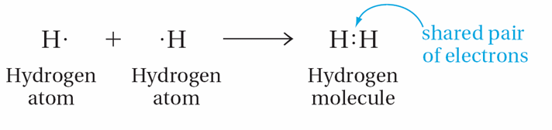
Structural Formula
represents the covalent bonds by dots and dashes
single bond
  sharing of 2 electrons
  one dash line
unshared pair or lone pair
  nonbonded pair of electrons

Slide 98
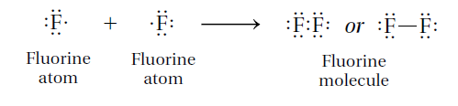
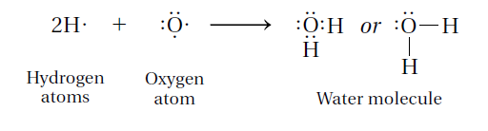
Page 218
Go through examples
Formula
F₂
Formula
H₂O

Slide 99
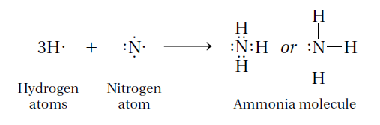
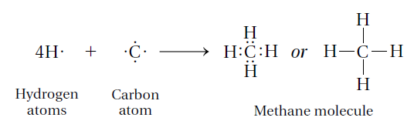
Page 219
Go through examples
Formula
NH₃
Formula
CH₄

Slide 100
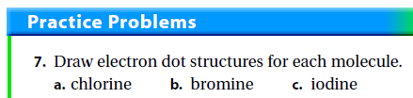
7. a. Cl₂ b. Br₂ c. I₂
Cl Cl
Cl Cl
or

Slide 101
Practice Problems
The following covalent molecules have only single covalent bonds. Draw an electron dot structure for each.
  NF₃
  SBr₂

Slide 102
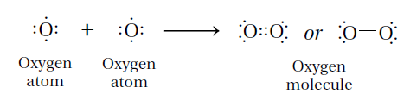
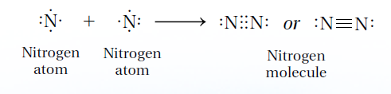
Double Vs. Triple Bonds
Double bond
Triple Bond
sharing of 4 electrons
two dash lines
sharing of 6 electrons
three dash lines

Slide 103
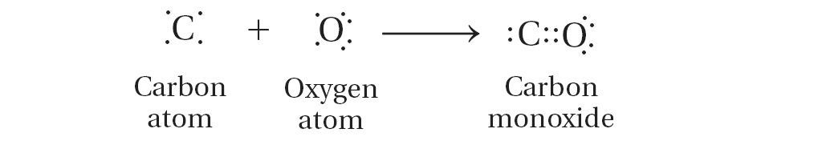
Coordinate Covalent Bond
A covalent bond in which one atom contributes both bonding electrons

Slide 104
Bond Dissociation Energies
Energy required to break the bond between two covalently bonded atoms
A large bond dissociation energy means the bond is difficult to break

Slide 105
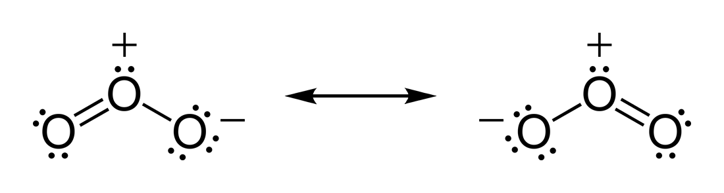
Resonance Structure
A structure that occurs when it is possible to draw two or more valid electron dot structures that have the same number of electron pairs for a molecule or ion

Slide 106
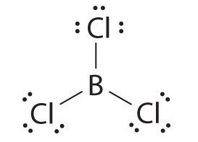
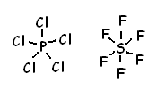
Exceptions to the Octet Rule
Limited and expanded octets can occur
Limited Octet Example:
  Boron
Expanded Octet Example:
  Phosphorus and Sulfur

Slide 107
Quick Quiz
Section 8.2

Slide 108
1. In covalent bonding, atoms attain the configuration of noble gases by
losing electrons.
gaining electrons.
transferring electrons.
sharing electrons.

Slide 109
2. Electron dot diagrams are superior to molecular formulas in that they
show which electrons are shared.
indicate the number of each kind of atom in the molecule.
show the arrangement of atoms in the molecule.
are easier to write or draw.

Slide 110
What’s Next?
Book Work:
  Page 229 #14, 16, 17, 20, and 21

Slide 111
#14 – How is an electron dot structure used to represent a covalent bond?
Represents the shared pair of electrons of the covalent bond by two dots

Slide 112
#16 – How is a coordinate covalent bond different from other covalent bonds?
The shared electron pair comes from one bonding atom

Slide 113
#17 – How is the strength of a covalent bond related to it’s bond dissociation energy?
Higher energy means stronger bond

Slide 114
#20 – What kinds of information does a structural formula reveal about the compound it represents?
The atoms that make up the compound
The nature of the bonds

Slide 115
#21 – Draw electron dot structures for the following molecules, which have only single covalent bonds.
H₂S
PH₃
ClF

Slide 116
Section 3 -
Bonding Theories
Read pages 230-236

Slide 117
Molecular Orbitals
Overlapping atomic orbitals form molecular orbitals
Remember the atomic orbitals: S, P, D and F from Chapter 5?

Slide 118
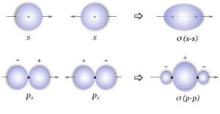
Sigma Bonds
Formed when two atomic orbitals combine to form a molecular orbital that is symmetrical around the axis connecting two atomic nuclei
Simply – a single overlap of orbitals end to end
Strong bonds
Symbol is Greek letter sigma (σ)

Slide 119
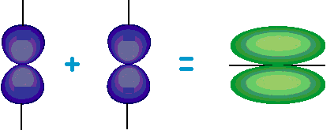
Pi Bonds
When two atomic orbitals combine to form a molecular orbital by overlapping side by side.
Simply – an overlap of orbitals side by side
Weaker than sigma bonds because of less overlap
Symbol is Greek letter pi (π)

Slide 120
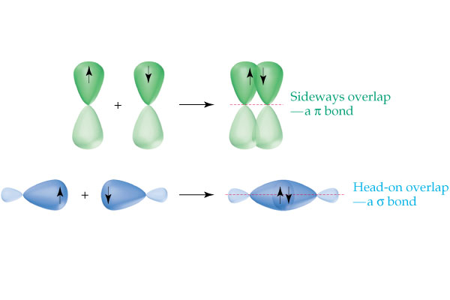
Comparison of
Sigma vs. Pi bonds in a P orbital
Thinking Further:
Do you think S orbitals can form pi bonds?
NO

Slide 121
VSEPR Theory
Valence Shell Electron-Pair Repulsion Theory
States that because electron pairs repel, molecules adjust their shapes so that valence electron pairs are as far apart as possible
Helps predict the 3D structure of an atom

Slide 122
There are multiple different shapes that a molecule can have:
Decide the shape by looking at characteristics of the CENTRAL atom
  Characteristics include:
    How many bonded pairs
    How many lone pairs

Slide 123
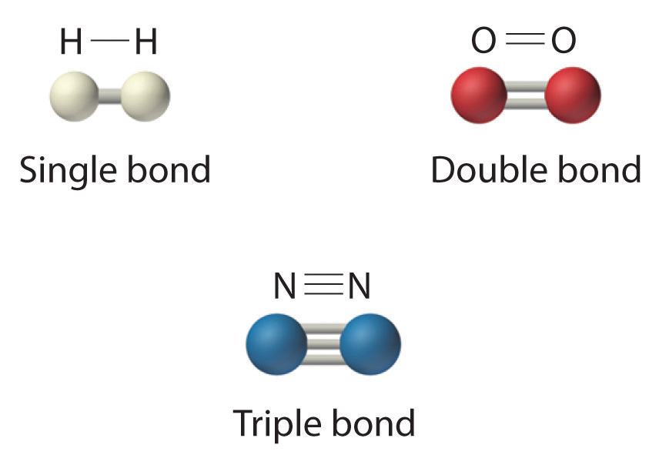
Codes for Molecular Geometry
All 2 atom molecules are linear!
Which type of bond is the strongest?

Slide 124
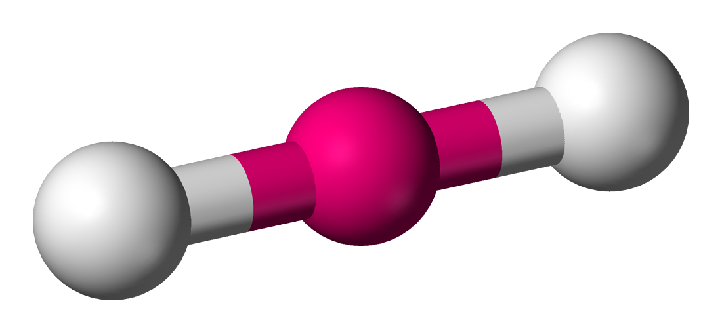
Linear
Number of Bonded Pairs: 2
Number of Lone Pairs: 0
Example: BeH₂

Slide 125
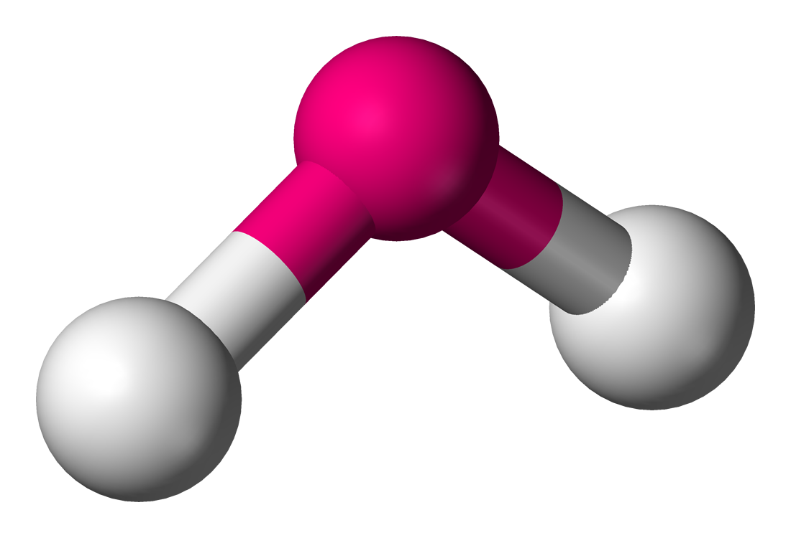
Bent
Number of Bonded Pairs: 2
Number of Lone Pairs: 2
Example: H₂O

Slide 126
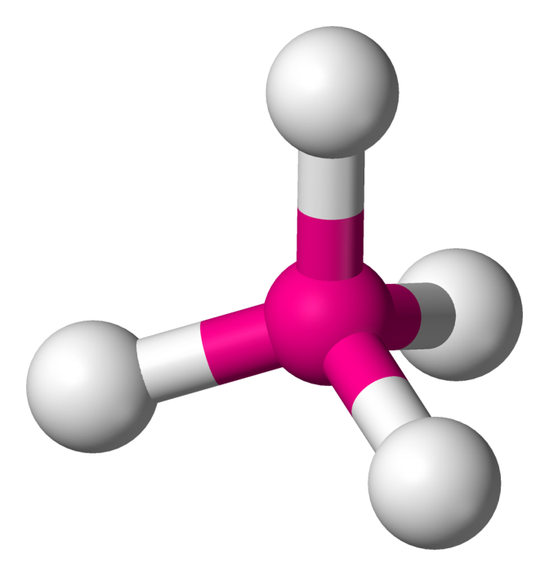
Tetrahedral
Number of Bonded Pairs: 4
Number of Lone Pairs: 0
Example: CH₄
Solid Line – Same Plane
Triangle – In Front of Plane
Dotted Line – Behind Plane

Slide 127
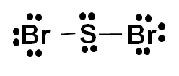
Practice Problems
Determine the molecular shape of the following molecules:
  SBr₂
    Bent
  HCl
    Linear
  SiF₄
    Tetrahedral

Slide 128

Practice Problems
Determine the molecular shape of the following molecules:
  SBr₂
    Bent
  HCl
    Linear
  SiF₄
    Tetrahedral

Slide 129
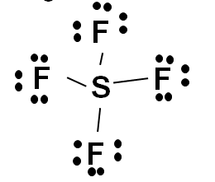
Practice Problems
Determine the molecular shape of the following molecules:
  SBr₂
    Bent
  HCl
    Linear
  SiF₄
    Tetrahedral
i

Slide 130
Quick Quiz
Section 8.3

Slide 131
1. The image below shows what type of geometry…
Tetrahedral
Octahedral
Square Pyramidal
Trigonal Bipyramidal

Slide 132
2. Which bond is stronger: Sigma or Pi?
Sigma
Pi
They are equally strong.
You cannot tell.

Slide 133
What’s Next?
Book Work:
  Page 236 #24 and 27

Slide 134
#24 – Explain how VSEPR theory can be used to predict the shapes of molecules.
Electron pairs repel one another so the shape is determined by the position where the valence electron pairs are as far away from each other as possible

Slide 135
#27 – What is a sigma bond? Describe, with the aid of a diagram, how the overlap of two half-filled 1s orbitals produces a sigma bond.
A sigma bond is the single overlap of two atomic orbitals end to end.

Slide 136
Section 4 -
Polar Bonds and Molecules
Read pages 237-241

Slide 137
Nonpolar Covalent Bond
atoms share the electron equally
consists of the same 2 atoms
  diatomic molecules

Slide 138
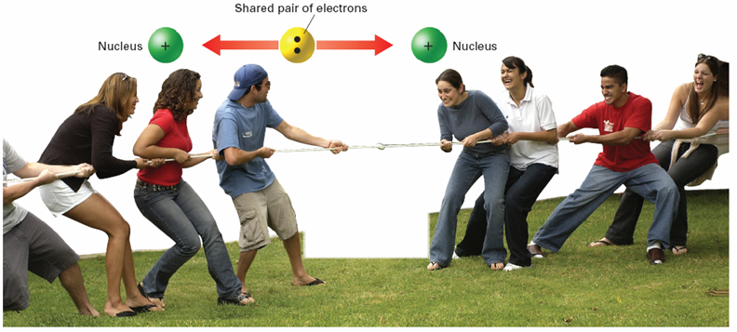
Polar Covalent Bond
Electronegativity –
The ability of an atom to attract electrons
atoms share the electron unequally
one atom has a higher electronegativity than the other and holds onto the electron more

Slide 139

Dipole
Delta (δ⁺)
  each atom is partially charged
  one atom is partially positive, written as δ⁺
    Less electronegative element
  one atom is partially negative, written as δ⁻
    More electronegative element

Slide 140
Beside properties, we can mathematically determine if a compound will be
Ionic
Polar Covalent
Nonpolar Covalent

Slide 141
What number are we interested in?
Electronegativity
Find this number on your periodic table.
We want the electronegativity difference between the two atoms, what math are we going to do?
  Subtraction

Slide 142
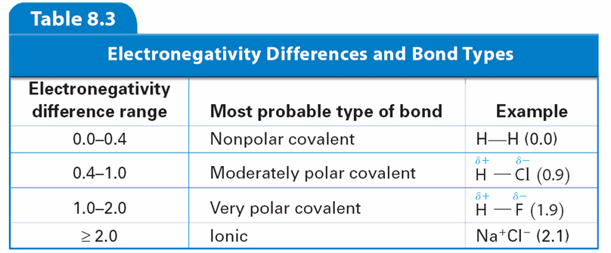
Do this notation on the back of your periodic table!
Nonpolar Covalent | Polar Covalent | Ionic
0 0.4 |  | 2.0 3.2

Slide 143
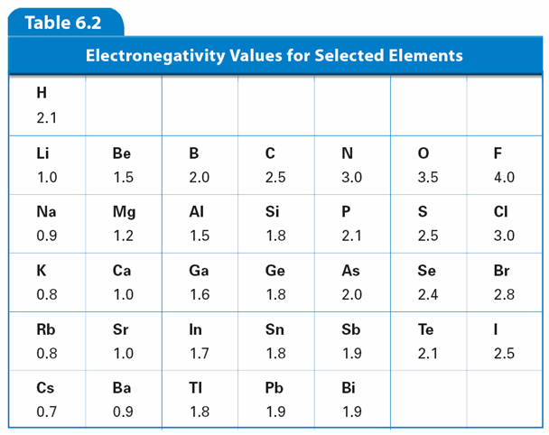
Try it!
What type of bond is formed by KCl?
FIRST
Find the electronegativity values for K and Cl.
SECOND
Find the difference in the values.
3.0 – 0.8 = 2.2
THIRD
Compare to chart.
Ionic
Nonpolar Covalent | Polar Covalent | Ionic
0 0.4 |  | 2.0 3.2

Slide 145
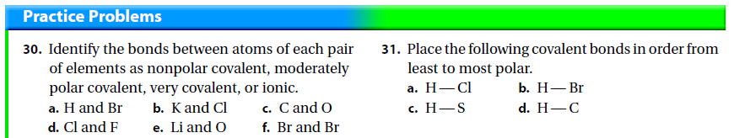
  polar covalent
  Ionic
  polar covalent
  polar covalent
  Ionic
  nonpolar
d = c, b, a

Slide 146
Hydrogen Bond
includes hydrogen
weak bonds
holds molecules together

Slide 147
Quick Quiz
Section 8.4

Slide 148
1. In a molecule, the atom with the largest electronegativity value
repels electrons more strongly and acquires a slightly negative charge.
repels electrons more strongly and acquires a slightly positive charge.
attracts electrons more strongly and acquires a slightly positive charge.
attracts electrons more strongly and acquires a slightly negative charge.

Slide 149
2. When polar molecules are placed between oppositely charged plates, the negative
molecules stick to the positive plates.
molecules stick to the negative plates.
ends of the molecules turn toward the positive plates.
ends of the molecules turn toward the negative plates.
Next Slide Shows This

Slide 150
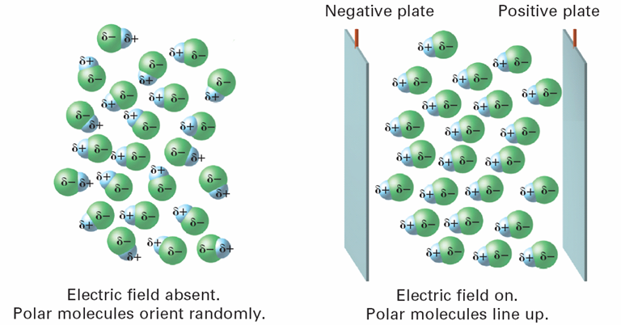
When polar molecules, such as HCl, are placed in an electric field, the slightly negative ends of the molecules become oriented toward the positively charged plate and the slightly positive ends of the molecules become oriented toward the negatively charged plate.

Slide 151
What’s Next?
Book Work:
  Page 244 #32, 37

Slide 152
#32 – How do electronegativity values determine the charge distribution in a polar covalent bond?
The more electronegative atom attracts electrons more strongly and gains a slightly negative charge.
The less electronegative atom has a slightly positive charge.

Slide 153
#37 – Draw the electron dot structure for each molecule. Identify polar covalent bonds by assigning slightly positive (δ⁺) and slightly negative (δ⁻) symbols to the appropriate atoms.
HOOH
BrCl
  δ⁺ - Br
  δ⁻ - Cl
HBr
  δ⁺ - H
  δ⁻ - Br
H₂O
  δ⁺ - H
  δ⁻ - O
δ⁻
δ⁻
O O
H H
δ⁺
δ⁺

Slide 154
Overall Review
Make a Review chart, mind map (web), flow chart, or foldable comparing the 3 types of bonds (ionic, metallic, covalent). Be sure to include:
  types of elements (metal, nonmetal)
  physical state of matter (solid, liquid, gas)
  what the electrons do (transferred, shared, free-flowing)
  melting points (high or low)
  conductivity (yes or no)

Slide 155
 | Ionic | Covalent | Metallic
Types of Elements
Physical State of Matter
Electrons
Melting Point
Conductivity

Slide 156
 | Ionic | Covalent | Metallic
Types of Elements | Metal and Nonmetal | Nonmetal and Nonmetal | Metal and Metal
Physical State of Matter | Solid | Liquid or gas | Solid
Electrons | Transferred | Shared | Shared, sea of electrons
Melting Point | High | Low | High
Conductivity | Solid – no Aqueous – yes | No | Yes

