Slide 1
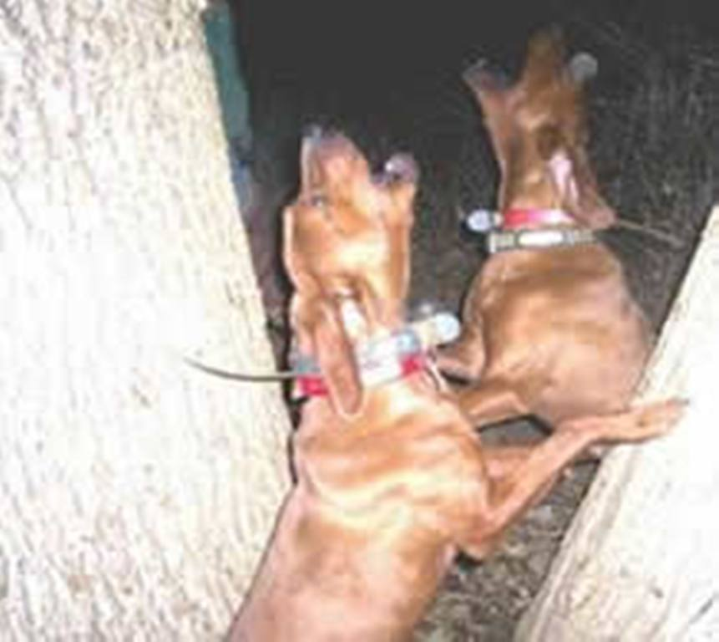
Where the Red Fern Grows – Round 2 (pages 84-183)

Slide 2
Chapter 9
Why is Billy crying?
What plan of action does Grandpa suggest?
What does Grandpa think about young boys chopping
down such large trees?
Describe what happens when Billy is wrapping his
hands to make a final attack on the tree.
Billy is crying because the raccoon is in the tree and his muscles ache from chopping.
Grandpa says to build a scarecrow.
Grandpa feels as though this is something that every young boy should have to do in life; it gives kids will power.
He asks for help, he looks to the trees, see the tree blowing at the top, and begins to hear the popping as the tree falls.

Slide 3
Chapter 10
What did Billy’s mother do with the first coon hide?
Which dog does Billy think is smarter?
What happened to the price of coonskins?
Describe what happens to Old Dan and how Billy managed to rescue him.
She made him a coonskin hat.
Billy thinks Little Ann is the smarter dog.
The price of a good coonskin jumped between $4 and $7.
Old Dan got trapped in an old muskrat den. Little Ann was able to find Old Dan so Billy was able to dig him out. Another “pickle” Old Dan got into was when he wedged himself up a hollowed out tree, out onto the limb. Billy had to climb the tree to get Old Dan down.

Slide 4
Chapter 11
Why was Billy unable to see his dogs?
What has happened to the dogs?
How does Billy rescue his dogs?
At the end of the chapter, why does Billy keep checking the handle of the lantern?
The fog was too thick.
Little Ann has fallen into the middle of the river.
Billy uses a long pole, a lantern hook, and the light to “fish” Ann from the water.
Billy wanted to see if the “unseen power” really helped him. He wanted to see if the lantern handle would fall.

Slide 5
Characters Setting
Problem
Event #1
Event #2
Event #3
Solution
Billy
Little Ann
Old Dan
River bottoms
Little Ann is caught in the river, clinging to the icy banks.
Billy asks for help from the unseen power.
Billy hears a metallic sound (lantern) triggering his idea to save Ann.
Billy cuts cane, and makes a hook from lantern to “fish Little Ann” from water.
Billy saved Little Ann with the “fishing pole” and creates a fire to bring her back to life.

Slide 6
Chapter 12
Describe the Pritchard family.
What bet do the Pritchard boys make with Billy?
Why does Billy agree to the bet?
Describe the ghost coon.
The family is very mean. The family is secluded in the hills and keeps to themselves.
The Pritchard boys bet Billy and his grandfather that Little Ann and Old Dan can’t tree the ghost coon. The bet is for $2.
Billy only agrees to the bet after grandfather agrees. The Pritchard boys really got under grandfather’s skin and that is why Billy agrees to the bet.
The ghost coon is a wiley, old coon that cannot be treed by any hunting dogs in the area.

Slide 7
Chapter 13
Why does Billy give Rubin the two dollars?
Where is Little Ann finally able to locate the ghost coon?
Why doesn’t Billy want to kill the ghost coon?
Describe the horrible scene Billy is confronted with after
breaking up the dogfight.
How does Billy pay his respects?
Billy doesn’t want to kill the ghost coon.
Little Ann is able to find the ghost coon at the gatepost.
Billy doesn’t want to kill the ghost coon because it has lived so many years.
Billy turns to see Rubin with the axe protruding from his stomach and blood coming from his mouth.
Billy decides to put flowers on the grave of Rubin, which is located on the Pritchard farm.

Slide 8
Chapter 14
Why does Grandpa blame himself?
How does Billy feel about entering the championship coon hunt?
Who will be going to the championship coon hunt with Billy?
What does Billy think his chances of winning are?
Why is Billy worried about Little Ann?
Grandpa let the Pritchard boys get to him and he was the one who made the bet.
Billy is very excited to enter the coon hunt.
Billy, grandfather, papa, and his dogs will be going on the hunt.
Billy is confident in his dogs and he feels as though no other dogs can be his dogs.
Billy is worried about Little Ann in this hunt because she is gun shy and all of the hunters will be using guns to scare the coons from the trees.

Slide 9
Chapter 15
How is Billy treated like a man on the way to the hunting grounds?
Explain the superstition about hearing a screech owl.
Why was Billy awarded a silver cup?
What night is Billy set to hunt?
Why did Billy crawl under the buggy?
Billy was being spoken to like a man and he was allowed to have coffee.
It is believed to be bad luck if you hear two screech owls in the night.
Little Ann won the beauty contest and Billy was award the cup.
Billy is going to hunt the 4th night.
Billy crawled under the buggy because grandfather discovered that he used his hair comb to groom Little Ann for the contest.

