Slide 1
SEQUENCING EVENTS
BRIDGE VALLEY ELEMENTARY
Learning Support

Slide 2
LESSON OBJECTIVES: 1. Identify the sequence of events using clue words 2. Distinguish important even from descriptive details

Slide 3
SEQUENCING EVENTS
https://www.raz-plus.com/projectable/book.php?id=1206&lang=1&type=book

Slide 5
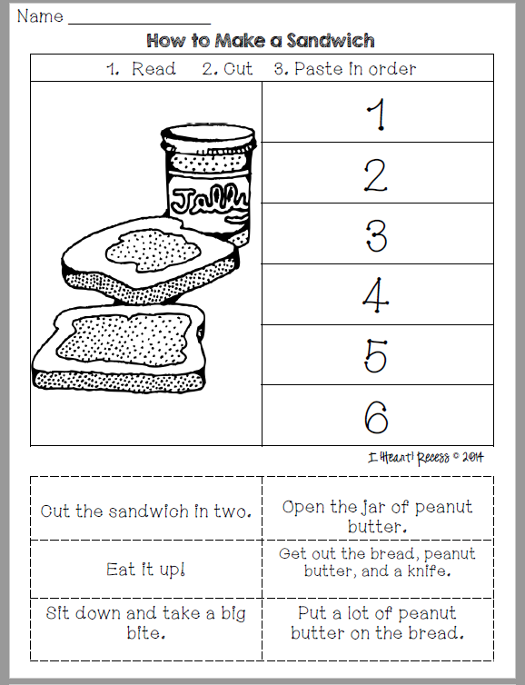
INDEPENDENT PRACTICE MAKE A PB & J SANDWICH
Read the steps at the bottom of the paper
Cut the steps out
Paste them on top of the corresponding number
Take a picture and upload it to your SeeSaw account

Slide 6
SEQUENCING EVENTS
DAY 2

Slide 7
LESSON OBJECTIVES: 1. Identify the sequence of events using clue words 2. Distinguish important even from descriptive details

Slide 8
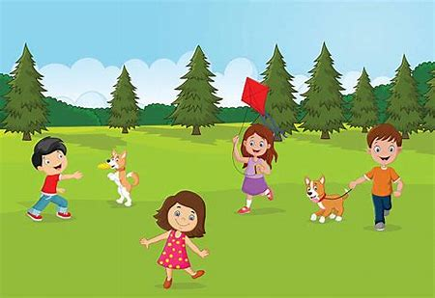
WHAT IS A SEQUENCE AND WHY IS IT IMPORTANT? A SEQUENCE is the order of events in a story or the process Knowing the SEQUENCE will help us understand what we are reading

Slide 10
DESCRIPTIVE DETAILS
Add more detail to my story
Make my story sound more interesting
BUT descriptive details are NOT NECESSARY for someone else to understand the story
She went for a walk in the woods.
Goldilocks was sleepy.
The yummy smelling food made her hungry.
The hungry, angry bears marched upstairs.
Goldilocks walked into the living room.
“Keep it down!” whined Goldilocks.

Slide 11
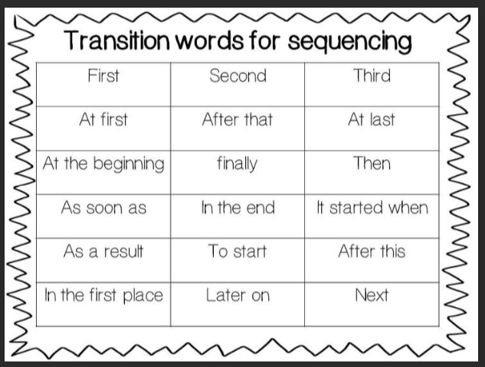
“CLUE WORDS”
This is not an extensive list of words, but it is a great start to helping us understand sequencing

Slide 12
INDEPENDENT PRACTICE GOLDILOCKS
Read Goldilocks and the Three Bears. Ask a parent or friend for help if you need
Highlight or circle any “clue words” you can find
Upload a picture of one of your pages to your SeeSaw account

Slide 13
SEQUENCING EVENTS
DAY 3

Slide 14
LESSON OBJECTIVES: 1. Identify the sequence of events using clue words 2. Distinguish important even from descriptive details

Slide 15
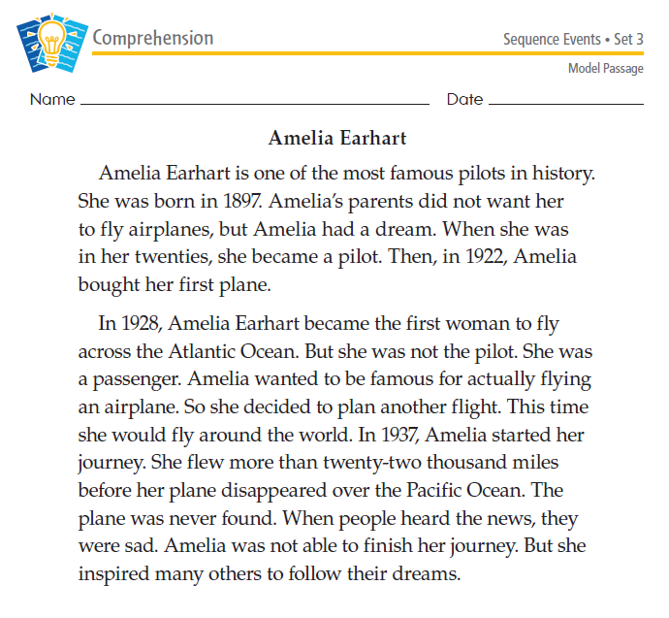
MODEL PASSAGE 1. Follow along with a highlighter to identify “clue words” in the first paragraph 2. Try to find at least three “clue words” in the second paragraph

Slide 16
CHECK YOUR WORK:

Slide 17
INDEPENDENT PRACTICE
Locate the passage provided to you by your teacher and labeled INDEPENDENT PRACTICE
Read this passage
Highlight or circle the “clue words” you were able to locate
Try to find at least three “clue words” and upload a picture of your passage to your SeeSaw account
CHALLENGE: Can you find a “detail”

Slide 18
SEQUENCING EVENTS
DAY 4

Slide 19
LESSON OBJECTIVES: 1. Identify the sequence of events using clue words 2. Distinguish important even from descriptive details

Slide 20
INDEPENDENT READING 1. Locate and complete the Reading A-Z book and/or Reading A-Z passage provided to you by your teacher 2. Upload a picture of your worksheets to your SeeSaw account

Slide 21
READING AND WRITING CONNECTION
Create a “how-to” paragraph and/or video to share via SeeSaw
Examples: How to wash the dishes
How to make your bed
How to walk your dog
How to make an ice cream sundae
How to make your favorite lunch

