Slide 1
What you need…
Pencil
Paper/Journal
Notes:
3rd grade friends, as we read today, you will need a pencil and either your journal or the Keeping Tracks of My Thinking Graphic Organizer your teacher shared with you.

Slide 2
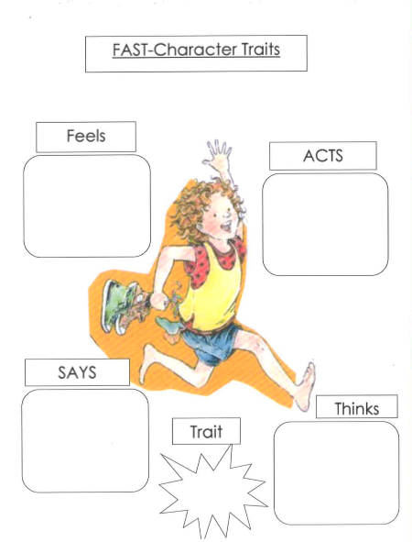
Jealous of her brother because he got to eat gummy worms and watch a video and she didn’t.
I scringed my eyebrows down like arrows and stuck my bottom teeth out as far as they could go.
“Excuse me, I am very mad about this journal. May I please have some Gummi Worms and a video?”
I pretended I was mad about it so my parents would sorry for me, too.
tricky
Notes:
As I read Chapter 8, I thought there was a moment that told me a lot about Clementine as a character. Remember when she pretended to have an assignment to write in her journal on Saturday? Well, that part in the story stood out to me and took notes about Clementine did, said, thought, and felt at that moment. For example, she …
In this moment the author didn’t tell us how Clementine was feeling, but I could infer, or understand what she was feeling because of how she acted, and what she said and thought. So, I know that Clementine was feeling…
What the character says, feels, does and thinks help us understand the traits of the character. A trait describes something about how a character is all the time. What the character says or does describes the character in the moment. In this example, Clementine was pretending to be mad in order to get her way. Clementine isn’t always pretending and she isn’t always mad, but this moment helps me understand something more about who Clementine is, or one of her character traits. And because she was pretending and trying to trick her parents into giving her gummy worms and a movie, I noted that Clementine is tricky. Now that I think about it, there were multiple times in the story when Clementine was tricky, like when she pretended to be asleep so her parents wouldn’t get mad at her. So, when we read a story we can use the characters’ actions and words to help us understand the character’s traits.

Slide 3
Feels
Acts
Says
Thinks
Trait
Notes:
Today, we will take notes a bit differently from before. At this time, please pause the video to create the chart I have made here. You can fold your paper into fourths, or just draw four boxes, and label them as I have, with Feels, Acts, Says, and Thinks. In the middle, you can draw a circle or box and label it Trait. Press pause now to create your chart. When it is ready come back and press play.
Now that your chart is ready, we can read chapter 9. As we do, take notes about the characters on your chart. Make sure to pause the video when you think there is an important moment for the character and note her feelings, actions, words, and thoughts. We’ll wait to add the character trait until after we read the chapter.

Slide 5
Feels
Acts
Says
Thinks
Trait
Relieved that Margaret made-up with her at the same time.
Gives Margaret a collection of all of the things she loves to make-up.
Forgiving
I’m sorry about your hair.
Then, without even a grown-up telling her to, she told me she was sorry she was mean to me at my birthday.
Notes:
Pause the video now to finish filling in your notes in the outside 4 boxes. Then come back and press play to continue.
I really loved this chapter because Margaret and Clementine made-up, so I wrote about the moment they make-up. I noted how Clementine…
All of this made see that Clementine is a forviging person. What did you notice about the characters? What did their feelings, actions, words, and thoughts tell you about their character trait? Remember, a character trait describes how a person is all the time. Examples of character traits are kind, generous, shy, respectful, humerous, loyal, dishonest, rude, polite, etc. What trait did you note about the character? Finish your notes in your chart and be prepared to share it with your teacher.

