Slide 1
What you need…
Pencil
Paper/Journal
Notes:
3rd grade friends, as we read today, you will need a pencil and either your journal or the Keeping Tracks of My Thinking Graphic Organizer your teacher shared with you.

Slide 2
Feels
Acts
Says
Thinks
Trait
Relieved that Margaret made-up with her at the same time.
Gives Margaret a collection of all of the things she loves to make-up.
Forgiving
I’m sorry about your hair.
Then, without even a grown-up telling her to, she told me she was sorry she was mean to me at my birthday.
Notes:
As we read chapter 10, we took notes about the characters in this 4-square chart we made. Today, as we read the last chapter, Chapter 10, we will be thinking about how to summarize the whole story. You don’t need to take notes as we read today, but we will work on a summary of the whole book when we’re finished reading.

Slide 4
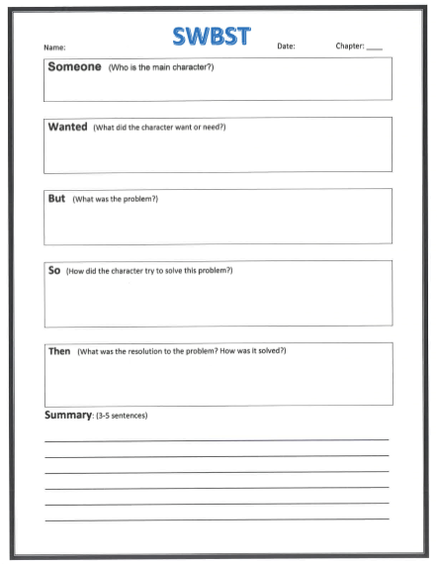
Clementine
To be just like Margaret. She wanted to have the same hair, get braces like her, and even wanted her mom to be more like Margaret’s mom.
She realized that she is different from Margaret and her family is different from Margaret’s.
She decides to be happy with everyone just as it is. In the end, she looks around at the party and realizes that everything is perfect.
All of the things she was worried about get resolved. She realizes her parents weren’t going to send her away and she and Margaret made-up. She also realizes her parents love her just the way she is.
Notes:
Now that we have finished the story, let’s summarize the novel. A fiction story can be summarized using this organizer. Somebody wanted but so then. Every story has a main character that wants or needs something, but has a problem getting it, so they try different things to solve the problem. In the end, the problem is solved. In the story Clementine…
Now it is your turn to write a 3-5 sentence summary of the whole novel. You can use the ideas I have here in this organizer, or you can write it in your own words. Write your summary in your journal and be prepared to share it with your teacher. As you write, remember to indent the first line of your paragraph, use a capital letter at the beginning of each sentence and for proper nouns, and to end each sentence with a period. You may also choose to draw a picture of Clementine or your favorite part of the story.

Slide 5
More Clementine Books
Notes:
Hope you enjoyed reading Clementine. If you would like to read more books about Chelmentine, check out these that are in the series!

