Slide 1
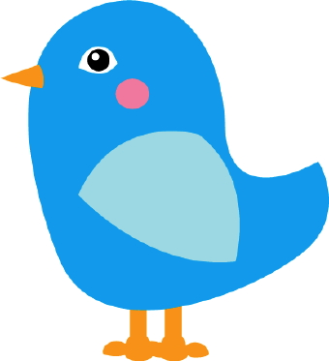
Bluebird, Bluebird
Bluebird, bluebird, through my window,
Bluebird, bluebird, through my window,
Bluebird, bluebird, through my window,
Oh, Johnny aren’t you tired?
Take a little partner, tap them on the shoulder,
Take a little partner, tap them on the shoulder,
Take a little partner, tap them on the shoulder,
Oh, Johnny aren’t you tired?

