Slide 1
Welcome
Find your child’s seat by identifying his/her self portrait and letter.
Write a note to your son or daughter. You can share about your second grade experience!

Slide 2
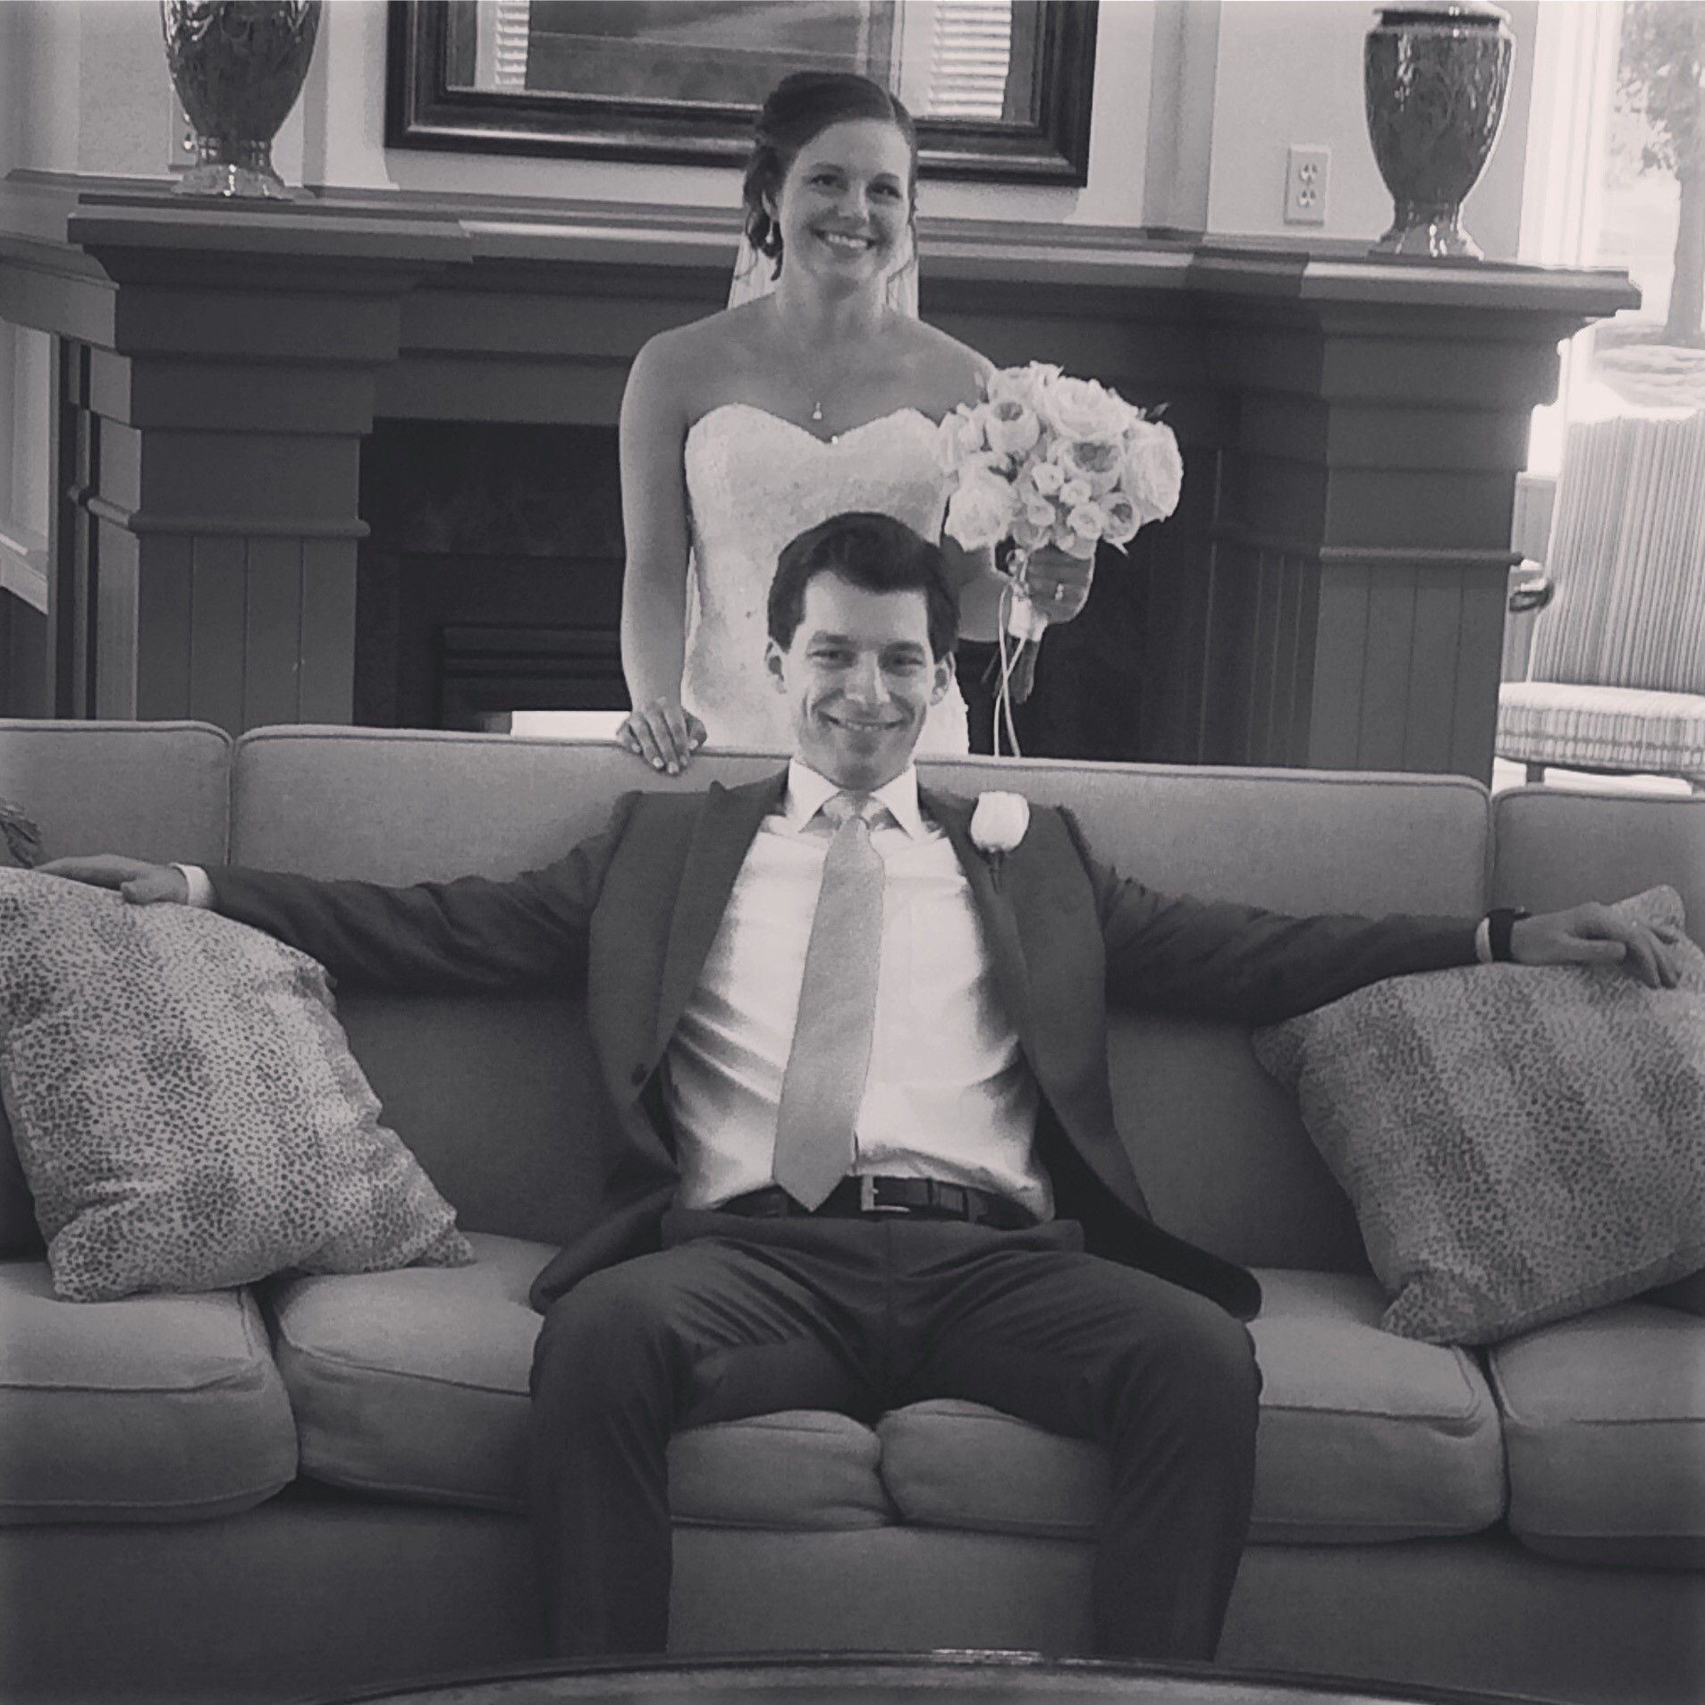
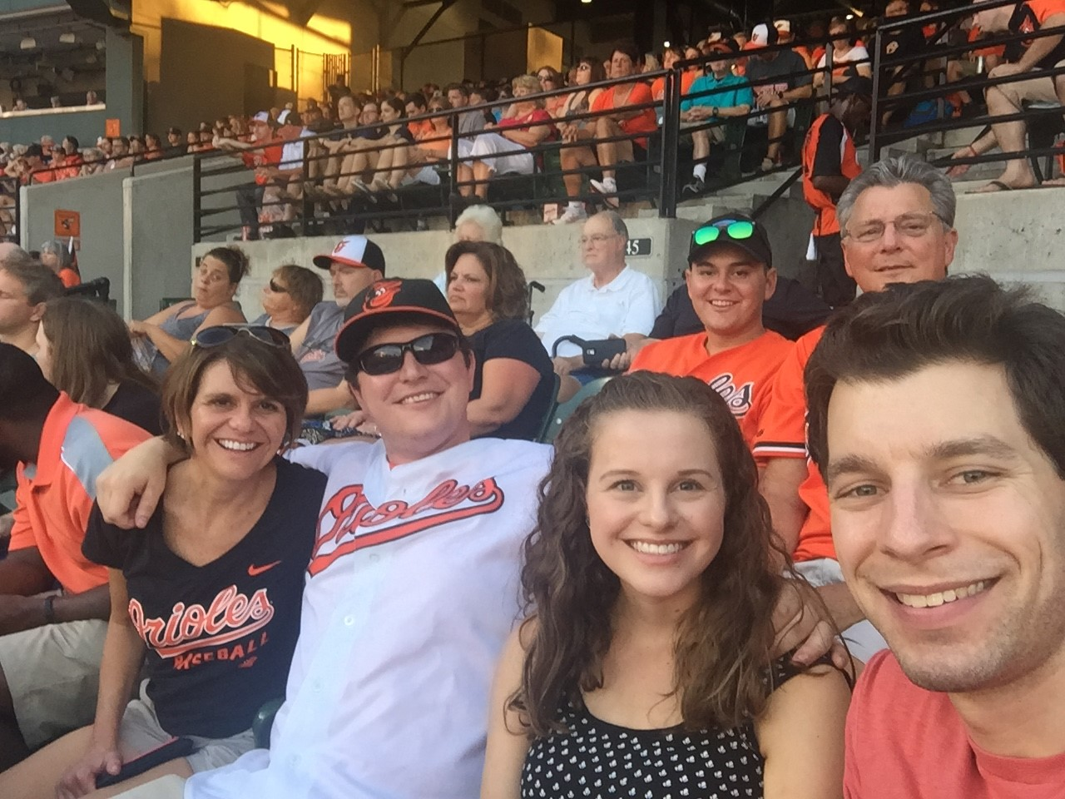
About Me
Kylee Ursomarso

Slide 3
About Me
Education
Penn State University- Elementary Education, Special Education minor
Slippery Rock University- Currently attending for a masters in reading instruction
Career
4 years in Fairfax County Public Schools, VA
2nd year at Doyle

Slide 4
Daily Schedule
8:15 Arrival and morning work
8:45 Morning Meeting
9:00 Math
10:30 Science/Social Studies (T, Th) or Writing (M, W, F)
11:20 Lunch
11:45 Recess
12:20 Reading
1:45 Specials
2:30 Finish reading groups
2:45 Read aloud/Snack (Nut free)

Slide 5
Our Pledge
We are here to learn, have fun, make friends, and support each other.
We will treat others how we want to be treated, with respect and kindness.
We will make others feel happy, smart, proud, appreciated, and included in school.
We will use materials carefully, the right way, and put them away when we’re done.
We will make safe choices and keep our hands to ourselves.

Slide 6
Math
Warm Up (number sense routines)
Whole Group mini lesson
BUILD rotations
B- Buddy games
U- Using manipulatives
I- Independent work
L- Learning about Numbers (iPads)
D- Doing Math with the teacher (Differentiated Groups)
Reflection

Slide 7
Math
Everyday Math Series
Math Journals
Math Toolkits
Home Links – information for parents in front of packet

Slide 8
Reading
Daily 5
Read to Self
Read to someone
Listen to reading
Word Work (phonics)
Writing
During these stations, I pull differentiated reading groups.

Slide 9
Reading
Series- Good Habits Great Readers
Strategy Instruction
Summarizing
Visualizing
Inferring
Connections
Predictions
Questioning
Monitoring Comprehension

Slide 10
Reading
Ways to Practice Fluency:
Fluent Readers read with expression, at
“just the right rate”, attend to punctuation,
and read in meaningful phrases.
Weekly Poems in their Poetry Notebook
Reader’s Theater
Rereading familiar books

Slide 11
Writer’s Workshop
Monday, Wednesday and Friday
Being a Writer Program
Mentor Texts to Model Writer’s Craft, Genres, and Grammar
Writer’s Notebooks
Writing Process – Brainstorming, Drafting, Revising, Editing and Publishing
Author’s Chair for Students to Share Their Writing

Slide 12
Social Studies
Tuesday/Thursday
Communities
Geography
Economics
Communities and change

Slide 13
Science
Tuesday/Thursday
Drugs and Poisons
Habitats
Rocks and Minerals
Sound

Slide 14
Snacks
Severe Food allergies ….
Please avoid sending in any peanut/tree nut foods
Remind your child not to trade or share food or snacks
Remind your child to wash his/her hands after eating lunch
We will have a snack in the afternoon following specials

Slide 15
Homework
Monday – Thursday
Approximately 20 minutes plus independent reading
Math home links/practice facts
Poetry Notebook
Words their Way
Binder will come home daily. Be sure to send it back to school.
Math homework will be checked daily.
Poetry and Words Their Way will be checked on Friday
Think sheets, conduct reports, behavior notices will be in the binder.

Slide 16
Responsive Classroom
Engaging Academics
Adults create learning tasks that are active, interactive, appropriately challenging, purposeful, and connected to students' interests.
Positive Community
Adults nurture a sense of belonging, significance, and emotional safety so that students feel comfortable taking risks and working with a variety of peers.
Developmental Awareness
Adults use knowledge of child development, along with observations of students, to create a developmentally appropriate learning environment.
Effective Management
Adults create a calm, orderly environment that promotes autonomy and allows students to focus on learning.
From www.responsiveclassroom.org

Slide 17
RC- What students see
Logical Consequences/Apology of Action
Teacher Language
“Show me how…”
“How might you….”
Interactive Modeling
Interactive Learning Structures (carousel, turn and talk)
Morning Meeting
Students Construct Class Rules
Energizers
Closing Circle
From www.responsiveclassroom.org

Slide 18
When poor choices are made…
Whole group warning
Individual Warning
Take a Break- Calm Down Area
Think Sheet/Apology of Action
Conduct Report
Behavior Notice with reflection session

Slide 19
Communication
Communication + Collaboration = Success
kursomarso@cbsd.org
Wednesday Folders
Notes in Planner
Weekly/biweekly emails
267-893-4300 x 4341

Slide 20
Field Trips
Three tentative field trips (walking field trip, Lost River Cavern, & Churchville Nature Center)
Need parent volunteers to chaperone
Parents will be contacted prior to trip to confirm
All volunteers will not be able to chaperone due to available bus seating (usually one parent for 5 or 6 students)

Slide 21
Volunteers
Homeroom parent
Organize signup genius
Class Parties (Halloween, Holiday, End of Year)
Class parties
Field Trips
Book Fairs

Slide 22
Doyle Dollars
Home and School
Homework books
Recess equipment
Young authors
Technology
Soaring Eagle Assemblies
Art Goes to School
Art Mobile
Field Trip Support
Library support- books/magazines

Slide 23
My goals for your child
Problem Solvers
Voracious Readers
Independent Thinkers
Cooperative
Respectful
Confident
Love learning

Slide 24
Thank you!
I know and truly appreciate that you are entrusting your child to me. I promise to do my best to nurture your child’s mind and spirit in my classroom each day. I am looking forward to being your child’s companion in learning and working alongside you this year. It is going to be a wonderful year filled with exciting learning activities!

Slide 25
Before Leaving
Finish the note to your child
Sign up for Giant Rewards for Doyle
Sign up if you’re interested in being our room parent!

