Slide 1
Dubrovnik, Croatia
52 Places to Visit in 2017

Slide 2
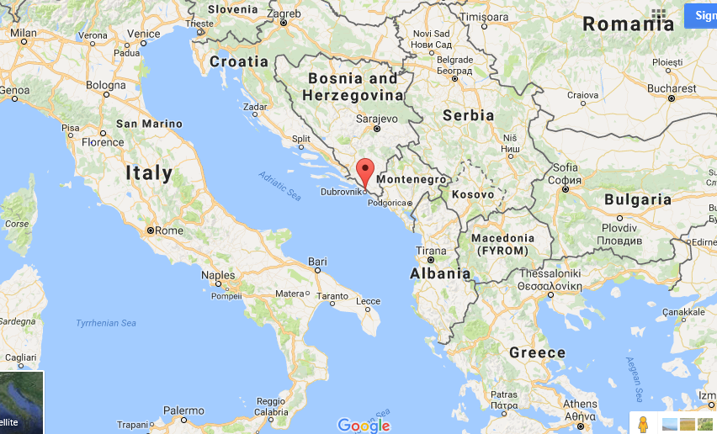
Dubrovnik, Croatia

Slide 3
Why?
I picked Dubrovnik, Croatia because I don’t know much about Croatia and would love to learn more. I also love to visit the Mediterranean and the history of the region.
It is also relatively inexpensive to stay there, and has a good climate.
It is full of historical places to visit and explore.
There are a lot of outdoor activities to do!

Slide 4
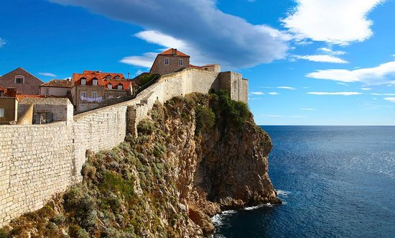
What to pack
1. Sneakers- Shoes good to walk around the city in
2. Suit- Kayaking and snorkeling!
3. Camera
4. Map- I plan on traveling around
5. Sweater for the cool nights in
the city

Slide 5
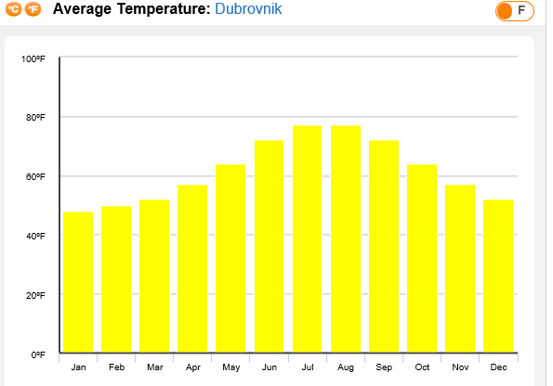
Climate and Best Time to Visit
The temperature is mild and ranges from around 50 degrees in the winter, to 75 degrees in the summer.
The best time to visit is from June –September when it is warm outside.

Slide 6
Flight
$861.16
roundtrip
  6:30p to 6:35a 7h 5m Overnight · Arrives Mon, Jul 10
  Philadelphia to London
  Philadelphia Intl. (PHL) to Heathrow (LHR)
  British Airways 66
  Economy / Coach (O)
  Boeing 747-400
layover 1h 40m stop London (LHR)
  8:15a to 11:35a 2h 20m
  London to Zagreb
  Heathrow (LHR) to (ZAG)
  British Airways 848
  Economy / Coach (S)
  Airbus A319
layover 2h 15m stop Zagreb (ZAG)
  1:50p to 2:55p 1h 5m
  Zagreb to Dubrovnik
  (ZAG) to (DBV)
  Croatia Airlines 300
  Economy / Coach (W)
Total distance
  4,636 mi

Slide 7
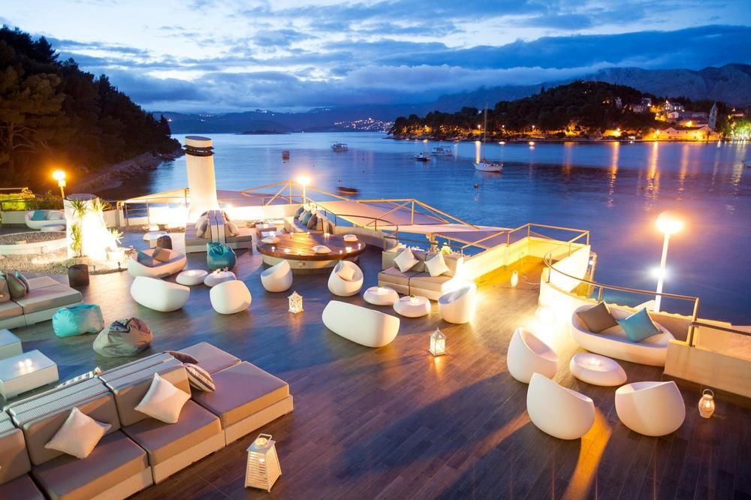
Hotel Accommodations
Hotel Croatia
5 stars
Address: Frankopanska 10, Cavtat, Konavle, 20210, Croatia, 866-538-9483
Beachfront hotel in Cavtat with spa, outdoor pool
$161/ night July 9th-16th

Slide 8
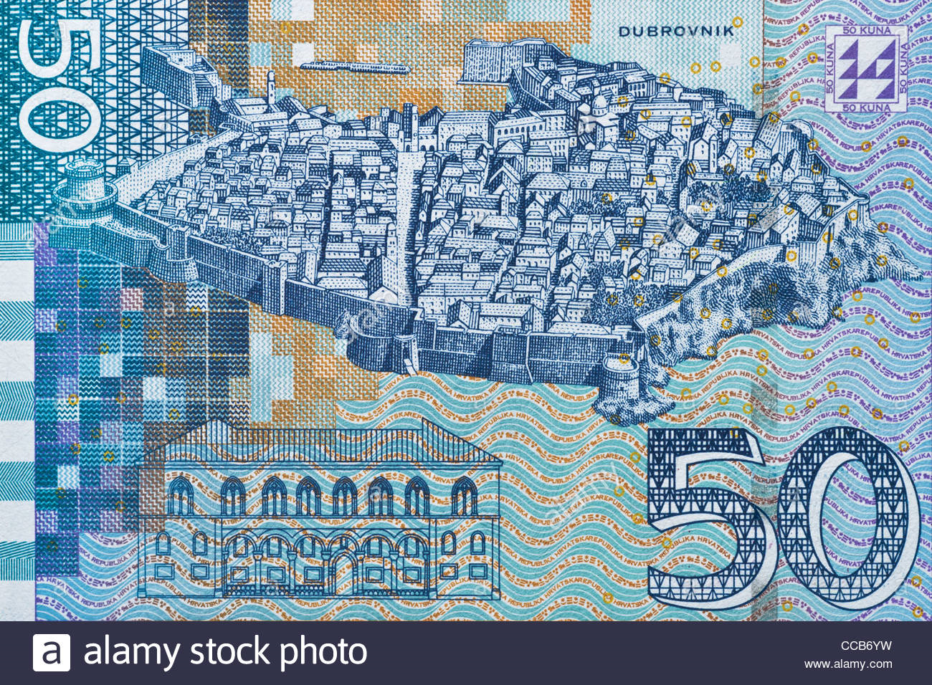
Language and Currency
Currency: Croatia's local currency is the kuna. ATM's are available at many locations all around the Old Town and surrounding districts.
Language: Naturally, Croatian is spoken in most homes in Dubrovnik, but you will find most locals able to converse in at least English. Efforts by visitors to speak Croatian will be welcomed warmly!

Slide 9
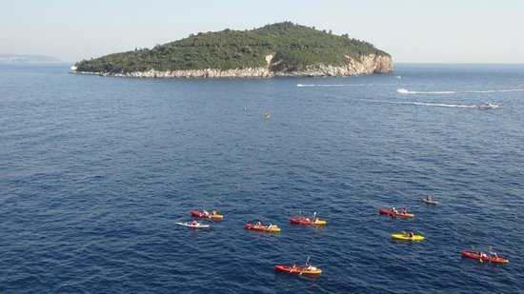
2 Activities
1. Dubrovnik Sea Kayaking and Snorkeling Tour: Spend a morning swimming, snorkeling and sea kayaking on this action-packed 3-hour tour from Dubrovnik. Escape the city and set out to explore the Adriatic coast, enjoying spectacular views of Dubrovnik’s city walls along the way. Paddle your way to Lokrum Island, peek into the Betina sea cave and stroll along palm-fringed beaches, before re-fuelling with a snack by the seafront. Paddle your way to Betina beach, a secret beach located at the mouth of a cave, and jump off to swim and snorkel around the coast. After working up an appetite, re-fuel with drinks and snacks on the beachside, before re-boarding your kayak.
-$32.61 per person

Slide 10
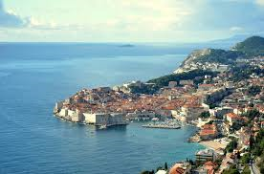
Activity #2: Drive Along Route E65
Scenic Drive on European Route E65
Pick a day with nice weather for the clearest views.
Numerous pit stops are available along the way, with really nice lookouts.
Drive slowly, as most of the time it's quite a congested route.
Bring your passport and all documents with you if you plan to cross borders.
Explore the country on your own time, not with a tourist group.
Make sure you are comfortable driving in a foreign country or hire a driver for a half day.

Slide 11
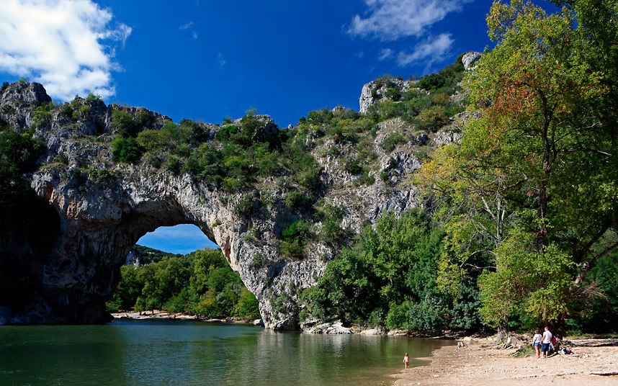
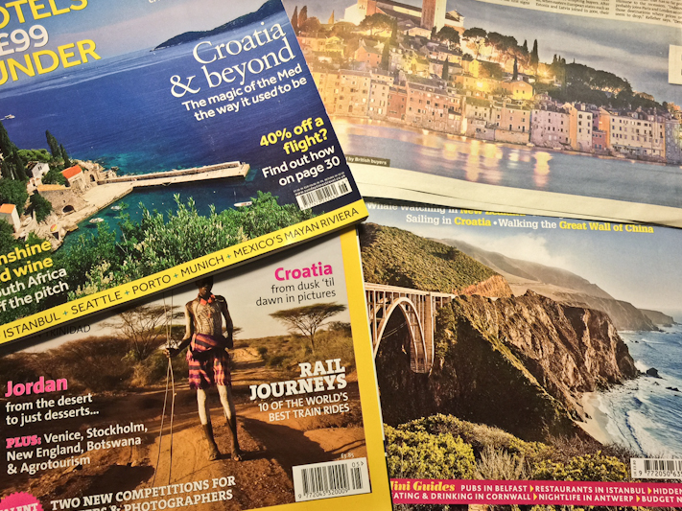
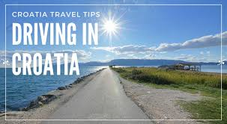
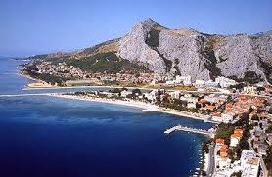

Slide 12
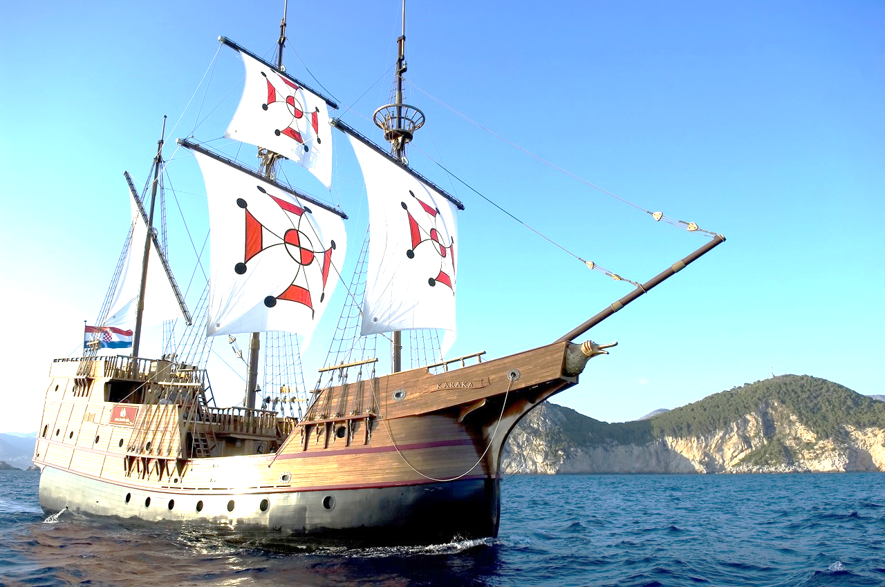
3 Other Activities
1. Cruises with Karaka: Take this Karaka replica boat cruise from the Old Town to experience beautiful views and feel like a sailor on a merchant ship back in the 16th century! The views of the coastline from an entirely different perspective, as well as the unique mode of transport, make this experience really worth it.

Slide 13
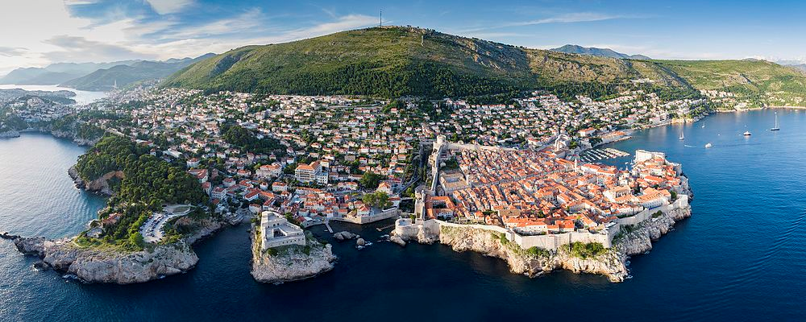
Additional Activities
2. Ancient City Tour: The ancient city walls of Dubrovnik are part of the magnificent Old Town, and devoting enough time to exploring them properly, and taking plenty of photos as you do, is a must. You will find stunning panoramic views to the Adriatic sea, pretty towers, and a real feel for the history of this place.

Slide 14
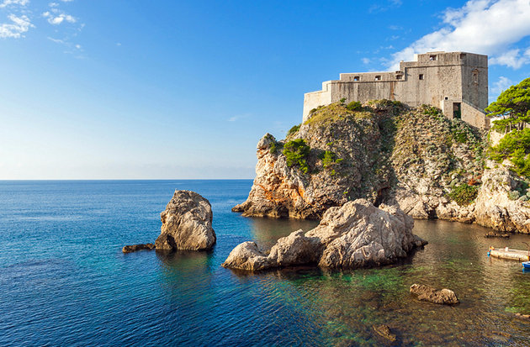
Other Activities
3. Fort Lavrijenak : The fort is a natural extension of the city walls in Dubrovnik. After the tough climb down numerous steps down to reach it, the inside of the fort is simple yet stunning, and the views over the Old Town from a different perspective are incomparable.

