Slide 1

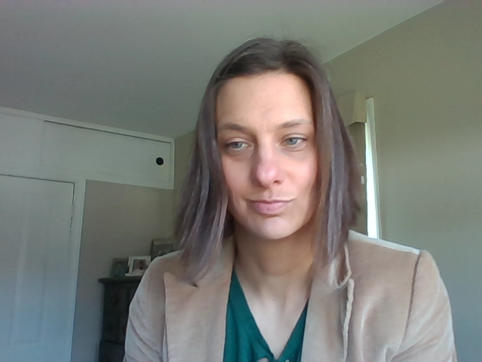
Hello!
Distance Learning with Mrs. Hutch

Slide 2
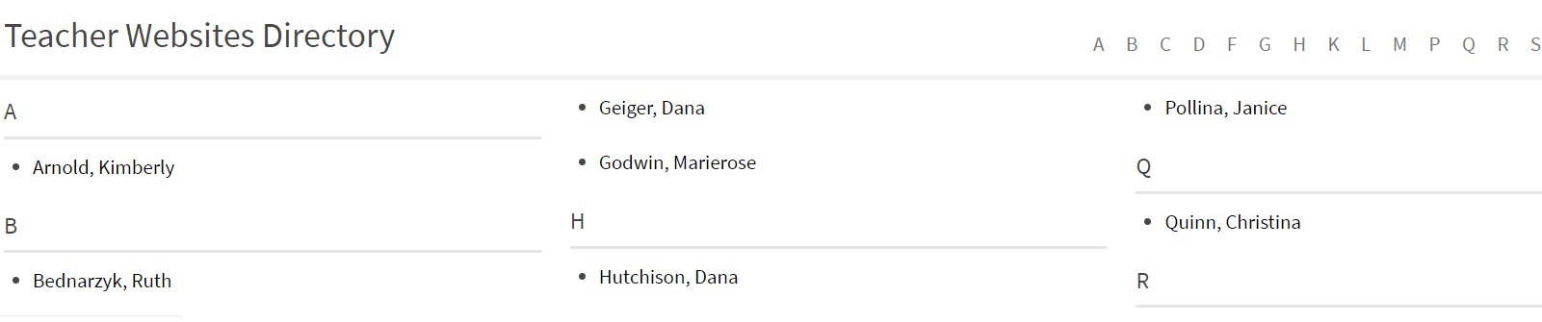
Teacher Websites
Check the Pine Run Teacher Website Page for Each Sixth Grade Teachers’ schedule.
https://www.cbsd.org/site/Default.aspx?PageType=1&SiteID=20&ChannelID=729&DirectoryType=6

Slide 3
Things to Know
Please Check In with Your Homeroom Teachers Monday Thru Thursday. They will do something like Morning Meeting.
You are on your own schedule, but we are here to help.
Each teacher will be recording and sharing lesson based on district guidelines.
It I am your primary teacher for math, I will be sending you information on Mondays and Wednesday
Students who do not see me for direct academics, will get a weekly check in (TEAMS or Email)

Slide 4
Schedule
Time | Monday | Tuesday | Wednesday | Thursday | Friday
7:30 |  |  |  |  | Students: Friday Special & Daily Reading SEW Activities Teachers: Planning & Collaboration with General Education and Special Education Teams
8:00
8:30
9:00 | Check in With Homeroom Teacher | Check in With Homeroom Teacher | Check in With Homeroom Teacher | Check in With Homeroom Teacher
9:30 -11:00 11:00 | IEP goal-based instruction Monday- Math, Reading, and Special Tuesday- Writing, SS/Sci, Special, and Independent Reading Wednesday- Math, Reading, and Special Thursday- Writing, SS/Sci, Special, and Independent Reading Friday- Independent Reading, Special, and Social Emotional Wellness (SEW) Activity (posted by Guidance Counselor) Related Services Teacher Planning/Collaboration
 | Office Hours TEAMS or Email dhutchison@cbsd.org
11:30-1:00 | IEP goal-based instruction Related Services Teacher Planning/Collaboration
1:30 | Office Hours TEAMS or Email dhutchison@cbsd.org
2:00-3:00 | IEP goal-based instruction Related Services Teacher Planning/Collaboration
My Schedule is Posted On My Website
During Instructional Time, Students can be accessing learning videos and completing lessons that have been taped/prerecorded and shared through TEAMS
Office Hours and Check in Times are Great times to Access Teachers for Assistance

Slide 5
Use ME as a Resource
Share
Share papers with me through WORD and I will provide comments and feedback
Email
Email me with questions, even if I am not your primary math teacher (think study sessions)
Ask
Ask for extended time from me and your homeroom teacher if you are having a hard time getting work done
Modify
Modify-Find the “JUST RIGHT”
Break
Break the work up into chunks
Submit
Submit SOMETHING and we will work with you
Communicate
Communicate—email us and let us know how you are doing

Slide 6

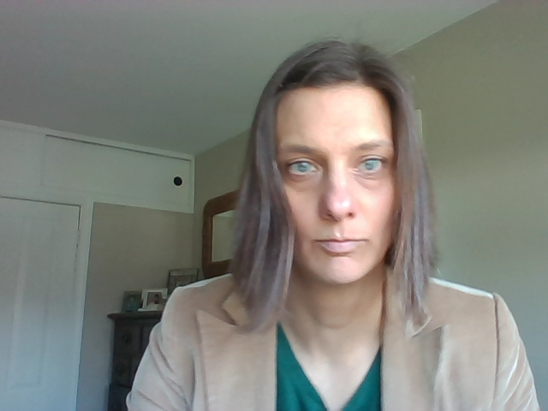
I am PROUD of YOU!
Try something
If it doesn’t go as plan, take a break, but try again
This is unchartered territory. We are doing our best and I am IMPRESSED!

