Slide 1
GRATITUDE
The Importance of Giving Thanks

Slide 2
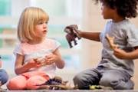
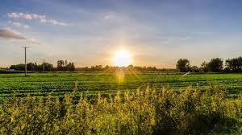
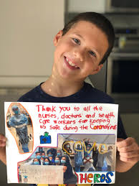
What does it mean to be grateful or show gratitude for something?
You feel happy about something that was done for you.
-Example: You feel thankful when your friend shares a toy with you.
You feel happy about something that you notice is around you.
-Example: You feel joyful when it is sunny and warm outside.
You want to do something or show appreciation for something through a form of kindness.
-Example: you want to say thank you to a nurse for helping sick people feel better.

Slide 3
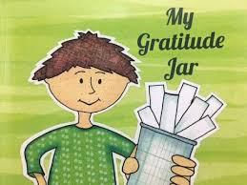
My Gratitude Jar- written and narrated by Kristen Wiens
Click here to watch this video read aloud about gratitude.

Slide 4
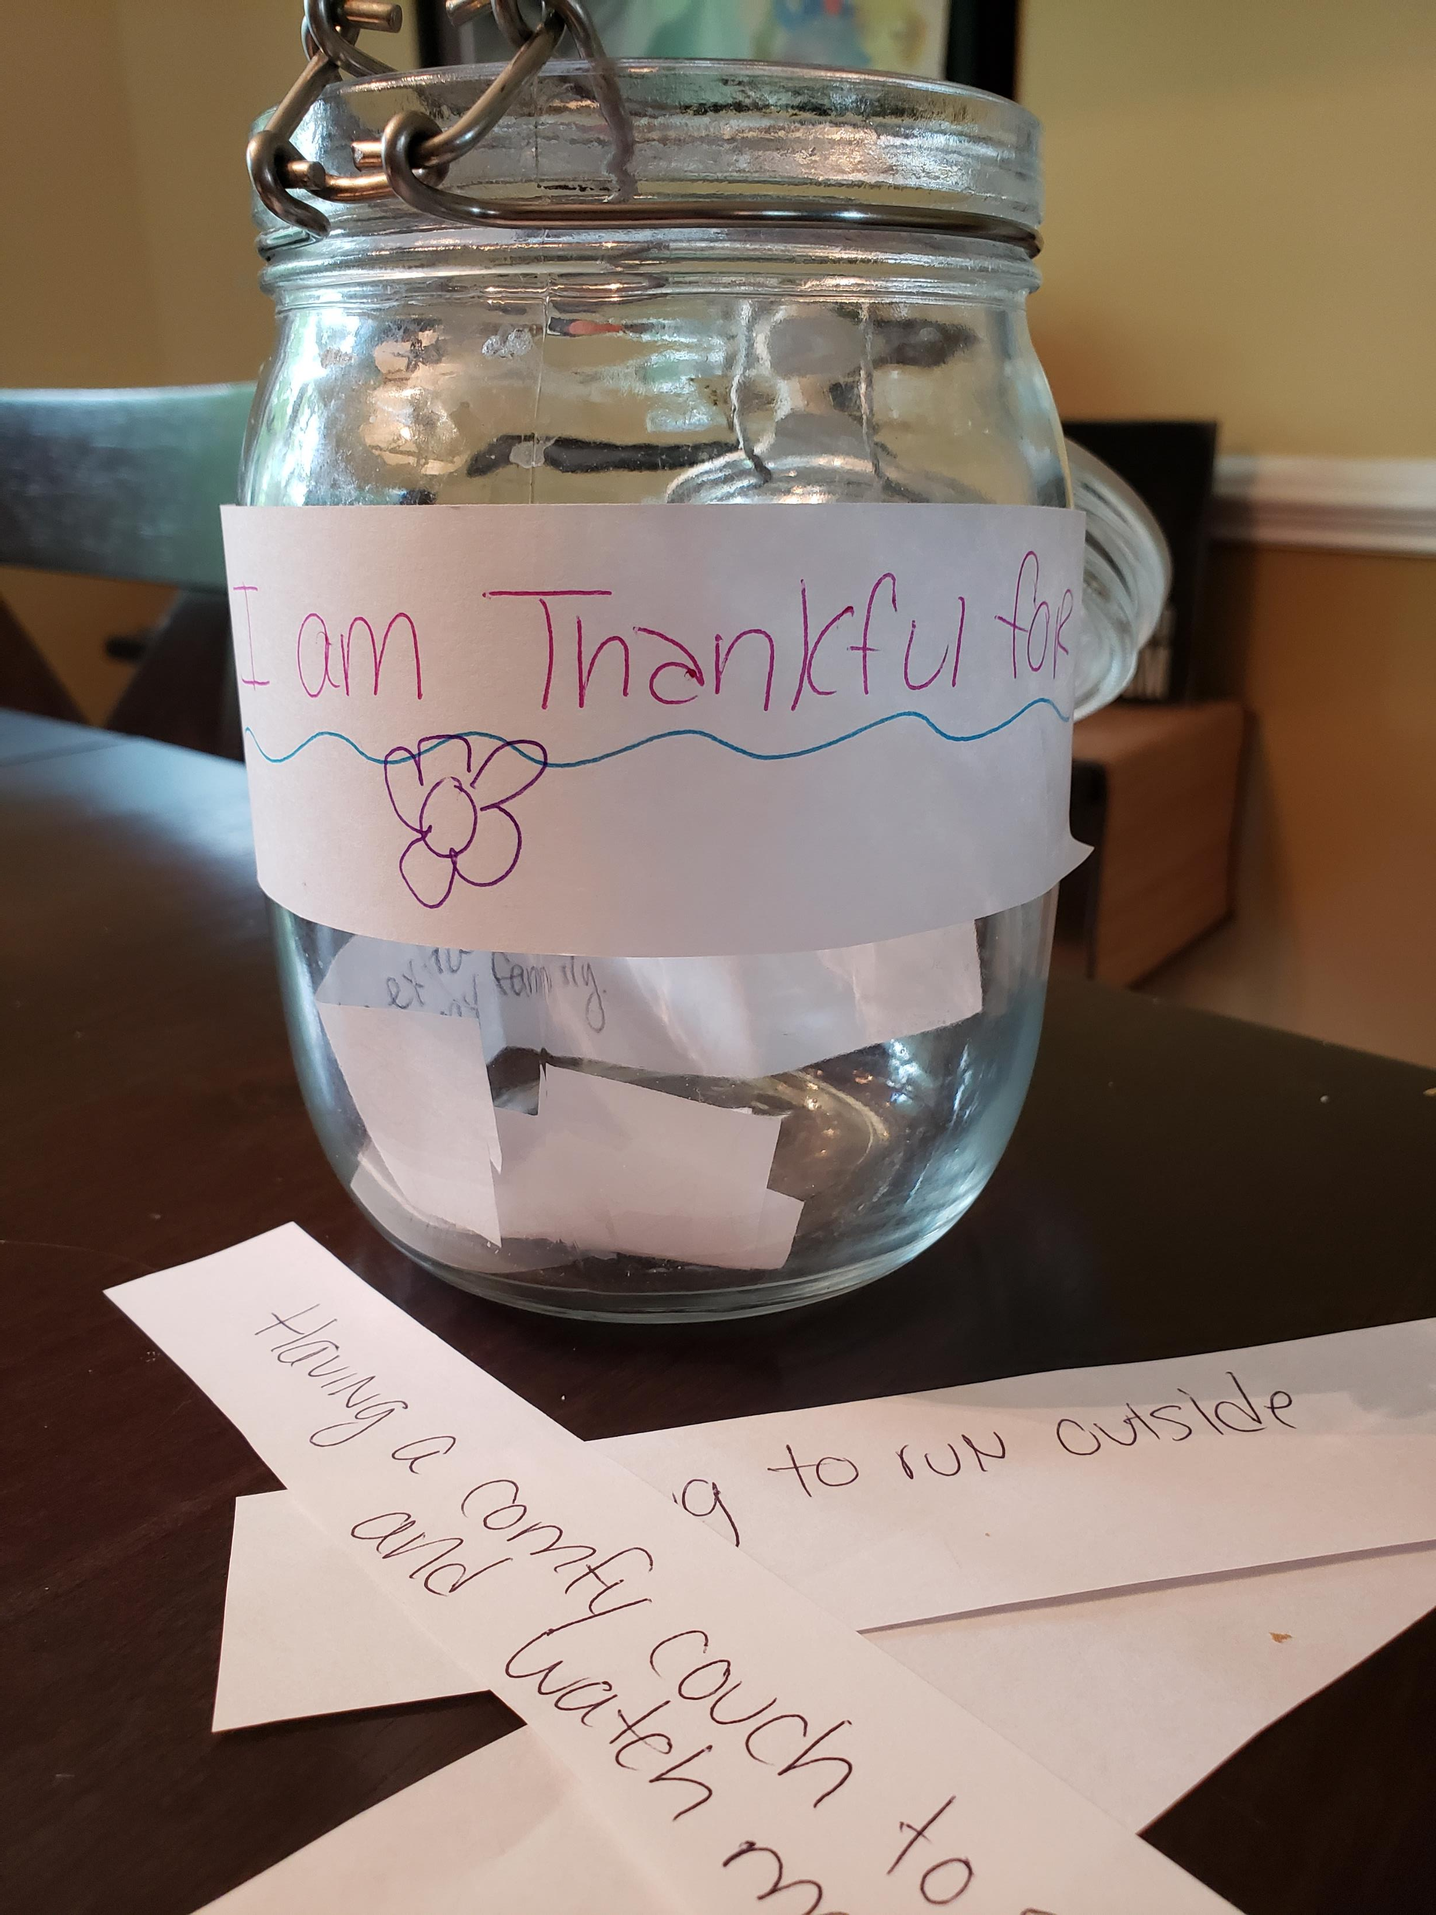
Create your own gratitude Jar!
Click on the video clip below of Mrs. Thompson making a gratitude jar.

Slide 5
Thankful by Juicebox- Music Video
Click here: https://www.youtube.com/watch?v=YeSdQmO51Ps

Slide 6
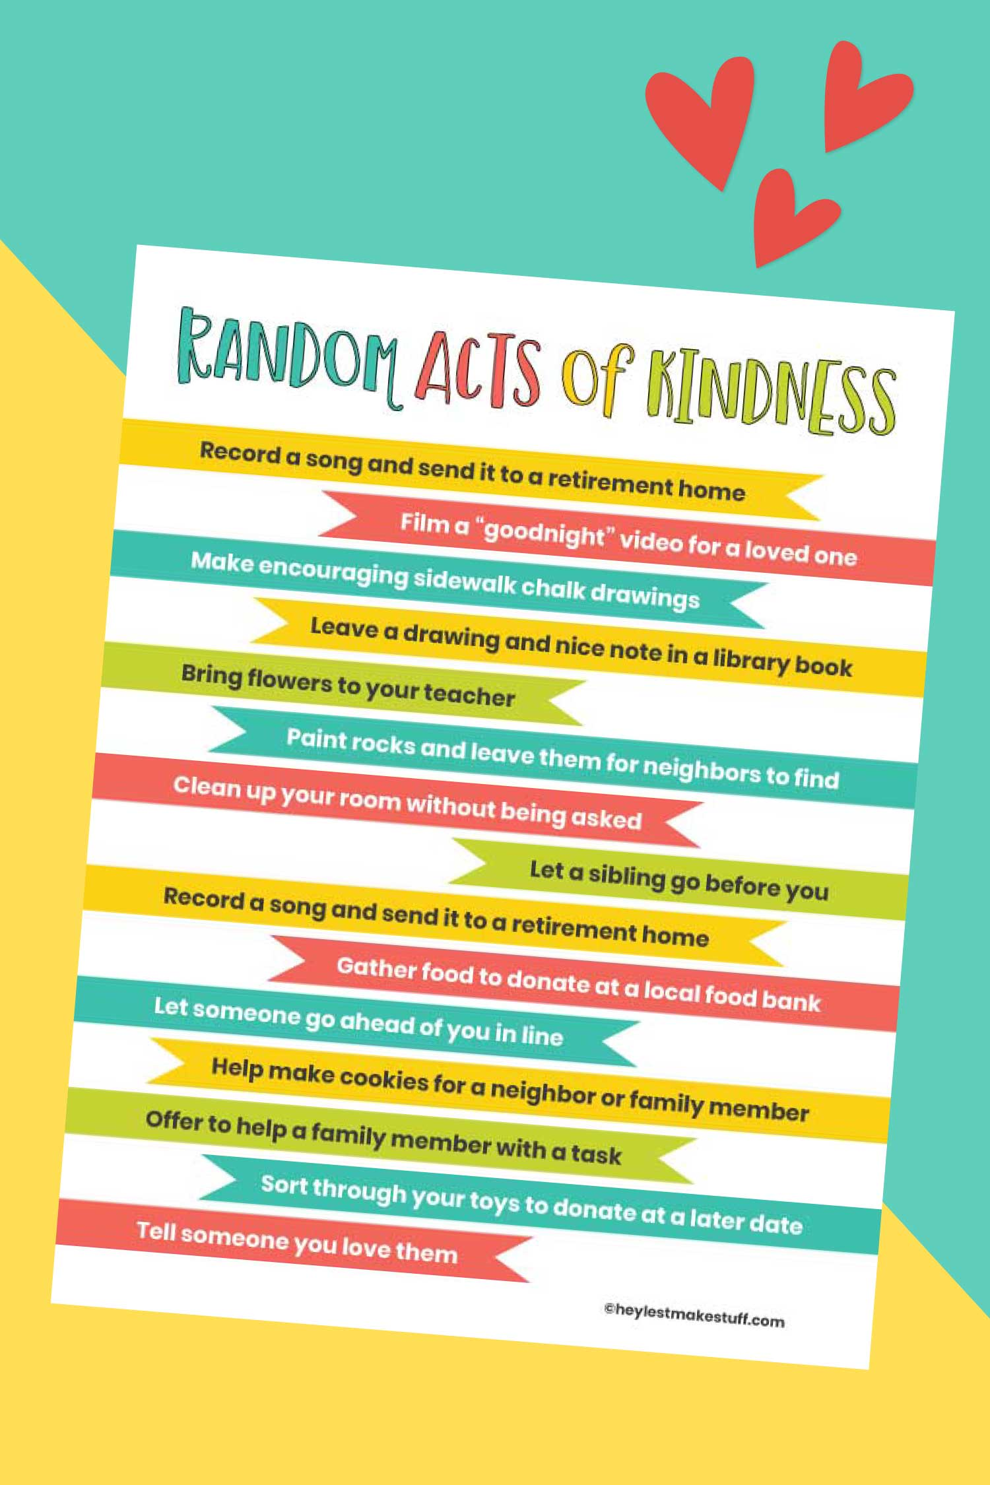
Show Thanks By Being kind

