Slide 1
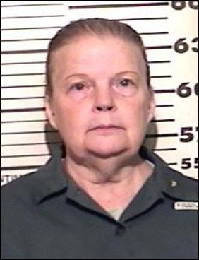
Serial Killer
Marybeth Tinning
Brooke Aughenbaugh and Jordan Hunter

Slide 2

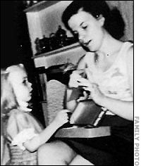

Childhood
Born Marybeth Roe in Duanesburg,New York
Stable family
  Brother and father
  Father was an electrician
Tried to kill herself numerous times
Worked low wage jobs and then became a nurse’s aid.

Slide 3
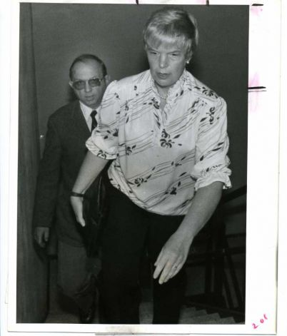
Precursors
Tried to commit suicide as a child
Three of her children died of SIDS

Slide 4
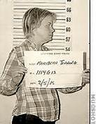
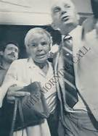
ADUlt life
In 1963, met her husband Joe Tinning on a blind date
  Married in 1965
Graduated high school
Had 9 children, 1 adopted
Not a loner (that was known of)

Slide 5
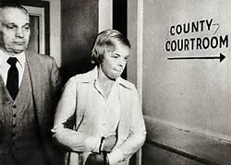
Mental disorder
Never diagnosed with a mental disorder
No treatments given

Slide 6

Nature of crime
Suffocated child with pillow (only conviction)
  Tami Lynne
Confessed to killing two sons
Suspected of killing all children
Span of killing from 1973-1985
2-9 victims

Slide 7
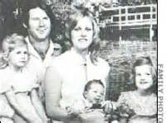
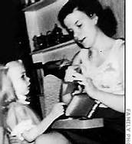
Caught In the act
Marybeth took the arrest
She was arrested after her ninth child Tami Lynne died
Soon confessed to killing Tami Lynne as well as Timothy and Nathan
Admitted she was poisoning husband
  Husband stood by her throughout trial

Slide 8
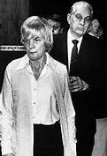
Capable to withstand trial
Withstand trial
  Admitted to murder
  Admitted to attempt at murder
  Claimed to prior child deaths “damaged” her

Slide 9
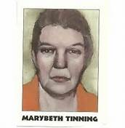
Sentencing
Charged with one murder of child Tami Lynne
Confessed to killing two other children
Sentenced 20 years to life
Did not gain parole

Slide 10

Where is she now?
In jail
  Did a lot of work with AIDS patients
Husband visits once a month
Had a new parole sentence available in January 2013
  Denied four times

Slide 11
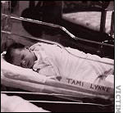
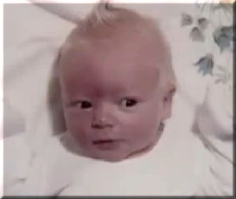
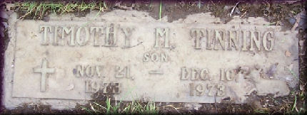
The victims

Slide 12
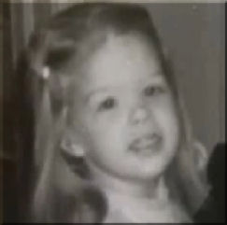
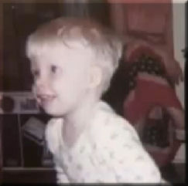
The Children
Barbara Tinning:
May 31, 1967- March 2, 1972
Victim of infanticide
Blamed on SIDS
  Sudden Infant Death Syndrome
    Linked to sleeping environments
Joseph Tinning:
January 10, 1970- January 20, 1972
Viral infection and “seizure disorder”
No autopsy to confirm

Slide 13
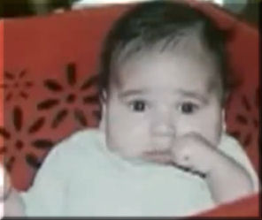
The Children
Nathan Tinning:
March 30, 1975- September 2, 1975
Showed up at hospital with Nathan dead
Said he had suddenly stopped breathing
SIDS
Michael Tinning:
August 3, 1978= March 2, 1981
Adopted child
Couldn’t wake Michael
Possible genetic disorder

Slide 14
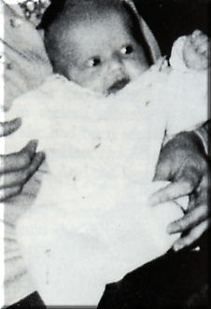
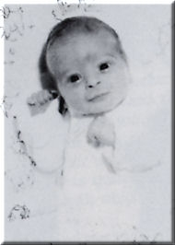
The Children
Mary Frances Tinning:
October 29, 1978- February 22, 1979
Mary Beth said she had a seizure
Then came back saying was brain dead
Death attributed to SIDS
Jonathan Tinning:
November 19, 1979- March 24, 1980
Showed up at hospital with baby unconscious
He was revived
Sent to Boston for tests
No medical reasons
Brain dead a few days later

Slide 15
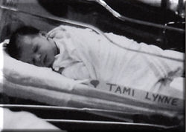
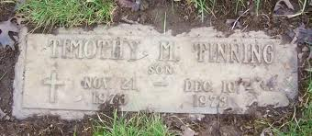
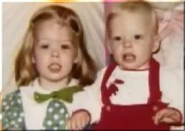
The Children
Tami Lynne Tinning:
August 22, 1985- December 20 1985
Found on changing table with no pulse
Pronounced dead at hospital
Timothy Tinning:
November 21, 1973- December 10, 1973
Tinning said he was found lifeless in crib
Death was attributed to SIDS
Jennifer Tinning:
December 26, 1971- January 3, 1972
Meningitis

Slide 16
Video
http://www.youtube.com/watch?v=jyLSJePGRAc

Slide 17
Works Cited
"Baby Killer." Trutv. N.p., n.d. Web. 1 Nov. 2013. <http://www.trutv.com/library/crime/notorious_murders/wom en/marybeth_tinning/8.html>.
"Child Killer Marybeth Tinning Again Denied Parole." Daily Gazette. N.p., n.d. Web. 1 Nov. 2013. <http://www.dailygazette.com/news/2013/jan/10/0110_tinni ng/>.
"In the Arms of the Angel." Angel Izds Place. N.p., n.d. Web. 1 Nov. 2013. <http://www.angelizdsplace.com/child19.htm>.
"Marybeth Tinning." Murderpedia. N.p., n.d. Web. 1 Nov. 2013. <http://murderpedia.org/female.T/t/tinning-marybeth.htm>.
"Tinning Mary Beth Roe." Crimez Net. N.p., n.d. Web. 1 Nov. 2013. <http://www.crimezzz.net/serialkillers/T/TINNING_mary_beth_ rose.php>.

