Slide 1
Forensic Psychology
The application of psychological findings to legal processes
By: Cole Yazujian and Devon Anderson

Slide 2
The Career of Forensic Psychology
Involves applying psychology to the field of criminal investigation and the law.
The popularity of forensic psychology has grown in recent years due to portrayals of the field in movies and television.
Deals with assessment, evaluation and detection of mental illnesses and human behavioral patterns
It also concerns with the collection, examination and presentation of evidence for legal purposes
This psychological information helps facilitate a legal decision.

Slide 3
Necessary Education
Forensic psychologists need a doctoral degree in psychology
-usually in clinical or counseling psychology
Such a degree typically takes 5 to 7 years of graduate
After the appropriate education, training, and experience, forensic psychologist can apply for board certification.
The American Board of Forensic Psychology offers professionals the opportunity to be certified as a Diplomat of Forensic Psychology.

Slide 4
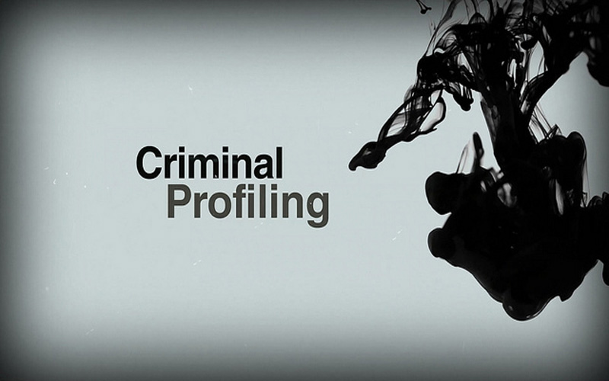
How is this Related to Solving Crime?
Criminal psychologist attempts to answer the question by using research-based techniques to investigate criminal cases.
Works closely with judges, attorneys and other legal professionals to analyze the psychological aspects of crime.
hired to assess the accused person’s motivations, mental status and fitness for trial.
They may be called on to interpret polygraph data, evaluate parental fitness in child custody cases and predict the risk of recidivism when prisoners come up for parole.
Aid in the identification and apprehension of offenders, and predicting the future likelihood of criminal behavior.

Slide 5
Jobs in Forensic Psychology
Forensic psychologists are employed in various domains by government, state, and local authorities.
Some forensic psychologists may also have a private practice
Forensic psychology jobs can include many roles as follows:
Family therapist: One who identifies family patterns to evaluate mental illnesses within the family and helps overcome behavioral disorders through group/individual therapy.
Developmental Psychologist: One who studies the human development through one's lifespan and analyses the social, emotional, intellectual growth of an individual and its effect on the development of personality.
Counseling Psychologist: Assesses and evaluates the personal and interpersonal functioning of an individual by studying various emotional, social and vocational aspects
Criminal Psychologist: One who studies, analyses and evaluates the mindset of a criminal while committing a crime and the reactions there-after.
-Helps a jury understand the psyche of a criminal by being an expert witness in a case.

Slide 6
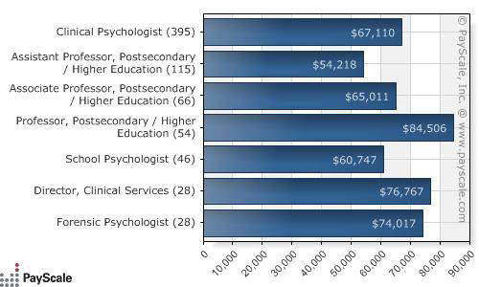
Salary
Can range greatly depending on the sector of employment
Most entry-level positions for those with a doctorate degree start out between $60,000 and $70,000 annually
Individuals with a bachelor's or master's degree generally hold the title of psychological assistant or psychological associate. Starting level salaries for these positions generally start around $35,000 or $40,000
Those in private practice who offer consulting services typically earn more, often in the $85,000 to $95,000 range.
Low of $33,900 to a high of $103,000.

Slide 7
Related Careers
The field is highly related to criminal psychology and in some cases the two terms are used interchangeably.
Related careers:
Counseling Psychologist
Correctional Treatment Specialist
Criminal Investigator
Crisis Counselor
Cognitive Psychologist

Slide 8
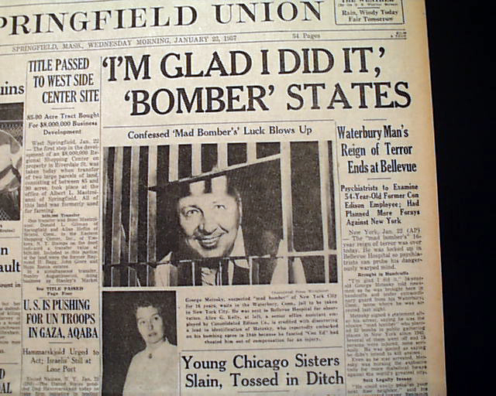
Real life Forensic Psychologist
For 16 years, "mad bomber" George Metesky evaded New York City police.
Metesky planted more than 30 small bombs around the city between 1940 and 1956, hitting movie theaters, phone booths and other public areas.
In 1956, investigators asked psychiatrist James Brussel, New York State's assistant commissioner of mental hygiene, to study crime scene photos and notes from the bomber.
Brussel came up with a detailed description of the suspect: He would be unmarried, foreign, self-educated, in his 50s, living in Connecticut, paranoid and with a vendetta against Con Edison--the first bomb had targeted the power company's 67th street headquarters.
The profile proved dead on: It led police right to Metesky, who was arrested in January 1957 and confessed immediately.

