Slide 1
Modern World History
Unit 2
Enlightenment & Revolution
1700-1850

Slide 2
Enduring Understandings
1. The collision of social unrest and new political ideas can lead to revolution.
2. In times of crisis, people will turn to strong leaders to gain a sense of stability.
3. Nationalism can act as both a unifying and divisive force.
4. New ideas and inventions create progress, but this can be accompanied by problems.
5. Technology and industrial advancement can alter existing social and economic systems.

Slide 3
Essential Questions
1. When is revolution justified?
2. Was the French Revolution a revolution of bread or ideas?
4. How are global revolutions affected by social, economic, and political forces?
7. How should resources and wealth be distributed?
8. Why do political revolutions occur?
Guiding Questions: Did Europe defeat Napoleon or did Napoleon defeat himself?

Slide 4
Enlightenment Spreads
The Paris Salons
Salon- social gatherings where intellectuals met to discuss ideas and artistic performances
Diderot’s Encyclopedia- Denis Diderot developed a large collecting of books with essays from enlightened thinkers
Began publishing in 1751
New ideas Spread
Enlightenment spread through Europe and it’s colonies
Reached middle-class which was growing in size

Slide 5
Enlightenment & Revolution
US CONSTITUTION: AN ENLIGHTENMENT DOCUMENT
ENLIGHTMENT IDEA | U.S. CONSTITUTION
LOCKE A government’s power comes from the consent of the people | “We the People of the United States” Representative government Limits government power
MONTESQUIEU Separation of powers | Federal government Power divided among 3 branches Checks & balances
ROUSSEAU Direct democracy | Public election of president & congress
VOLTAIRE Free Speech, religious tolerance | Bill of Rights gives free speech and religion
BECCARIA Accused have rights, no torture | Bill of Rights protects rights of accused & prohibits cruel & unusual punishment

Slide 6
The French Revolution

Slide 7
The Old Regime
Setting the stage

Slide 8
Calm before the Storm
France was considered the most advanced country in Europe
High prices, high taxes, and questions raising from enlightenment created unrest
Large divide in social classes

Slide 9
What does this image say to you ?

Slide 10
Compare & Contrast
How would you depict the separation
between rich and poor in the US today?

Slide 11
Revolution Threatens
The Old Regime- 3 classes, or estates
1st Estate 1% of population, 10% of land
The church
No taxes
Scorned enlightenment ideas
2nd Estate 2% of population, 20% of land
Rich nobles
Held high govn’t office
Little taxes
Disagreed about enlightenment
3rd Estate 97% of population
Bourgeoisie-middle class, merchants, educated
Urban workers- cooks, servants, low wages
Peasants- farmers, homeless
No influence in gov’t
Forced into military service
Embraced enlightenment

Slide 12
Watch the following….
Mel Brook’s view of the French Revolution and the Third Estate:
The Third Estate
* Complete “Identifying Estates”.

Slide 13
Causes of the French Revolution
Unfair class structure
1st & 2nd class lived extravagant lifestyles
3rd class taxed heavily, not represented, poor
Spread of Enlightenment Ideas
Philosophes challenged authority
why so few had power?
Fairness of aristocracy’s wealth
Divine right of monarchy
Ideas of equality, liberty, democracy
Inspired by American Revolution

Slide 14
Causes of the French Revolution
Economic Crisis & Food Shortage
Failing Economy
Crop failure = grain shortage & higher food prices
Supply/demand?
High unemployment, starvation
Population increase buts further starin on recources
Scarcity?
Government debt due to wars and American support
French government was bankrupt

Slide 15
Causes of the French Revolution
Louis XVI was a weak leader
Made king at 20 years old, was indecisive and put off dealing with issues
Only when facing bankruptcy did he try to tax nobles
Forced to call Estates-General (French Parliament) to get approval for tax reform.
1st time in 175 years

Slide 16
Marie Antoinette
Married to Louis
He was 15 she was 14
Marriage was arranged with long time French enemy Austria
She was not well liked
Spend money on gowns, jewels, and gifts
Known as “Madame Deficit”

Slide 17
Revolution Dawns
1789

Slide 18
5 Stages of the French Revolution
Stage Four
1792-1795
National Convention
Reign of Terror
Committee of Public Safety
Thermodorian Reaction
Stage Five
1795-1799
Directory
Coup d’etat
Stage One
Spring and Summer of 1789
Meeting of the Estates-General
Storming of the Bastille
The Great Fear
Stage Two
1789-1791
National Assembly
Declaration of the Rights of Man
Constitution of 1791
Stage Three
1791-1792
Legislative Assembly
Emergence of 3 political groups
September Massacre

Slide 19
STAGE ONE
Spring and Summer of 1789

Slide 20
May, 1789 Meeting of the Estates-General

Slide 21
1789, Meeting of the Estates-General
1st & 2nd estates wanted to follow the mid-evil rules in which each estate was granted one vote.
Why would the 3rd estate not like this??
3rd estate demanded that each delegate receive a vote
This would give them the advantage b/c it had as many delegates as the other two combined
The decision was up to King Louis, what do you think he did??

Slide 22
Meeting of the Estates-General
Louis sides with the nobles and follows the mid-evil rules
1st & 2nd Estates vote against raising taxes on nobles and clergy
Abbe Sieyes- a sympathetic clergyman who suggests the 3rd estate name themselves the National Assembly
Argues for the rights of the 3rd estate

Slide 23
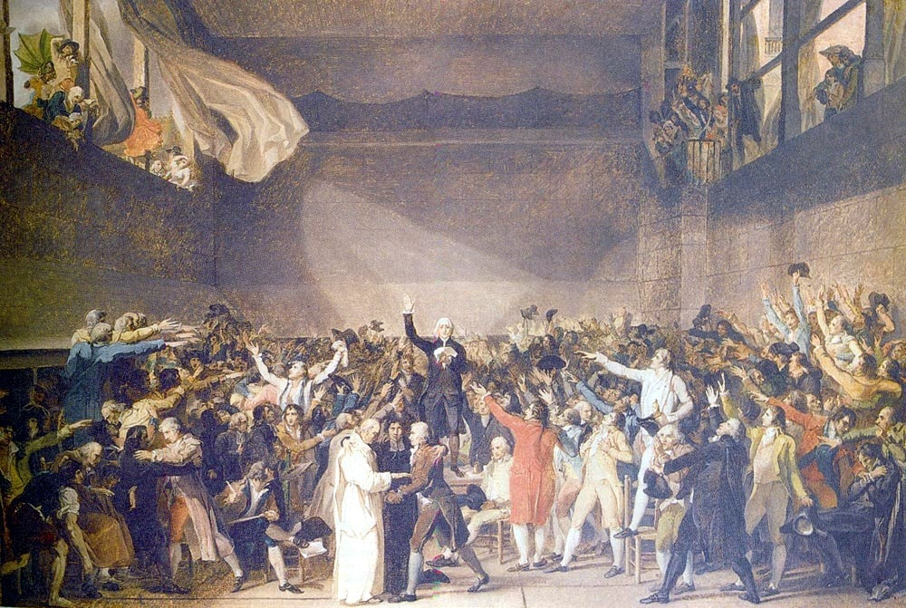
Who are Third Estate Delegates?
Represented the educated
elite. 25% lawyers and 43%
government officials.
Strong sense of common
grievance and purpose.
Considered themselves the
true representatives of the
French people.
* What did the Third Estate want? Read pgs. 184-187 in the “Human Record” and answer the questions on pg. 185.

Slide 24
The National Assembly
June 17, 1789 3rd Estate vote to establish the National Assembly,
proclaiming the end of the absolute monarchy
beginning of a representative government
1st deliberate act of revolution
June 20, 1789 delegates were locked out of their meeting room
Broke in & locked themselves in tennis court until a new constitution was written
THE TENNIS COURT OATH

Slide 25
Storming the Bastille
Storming of the Bastille
July 14, 1789
Parisians storm the largest prison in France in protest to King Louis XVI’s placement of Swiss troops in Paris
Parisians storm the prison’s magazine to gain ammunition and released all prisoners
7 political prisoners
Symbolic event of French independence
Similar to our July 4th

Slide 26
Fear Sweeps France
The Great Fear
Women March on Versailles
Rebellion spread beyond Paris as senseless wave of panic swept countryside.
Peasants feared noble retaliation so they lashed out.
Burned noble’s homes and destroyed financial records.
6000 Parisian women angered by the price of bread marched to Versailles,
violently stormed the palace, and forced Louis XVI and Marie Antoinette to return to Paris.
The king and his family would never return to Versailles.
Complete pkt. Pg. 5 “Revolution Threatens the French King”.

Slide 27
STAGE TWO
1789-1791

Slide 28
National Assembly Reforms France
August 27th Declaration of the Rights of Man is adopted
Reflected Enlightenment ideas & Declaration of Independence
Limited power of monarchy
“Liberty, Equality,, Fraternity” slogan of the Revolution
All men born free, political groups are to preserve the rights of man, free speech, free religion, equal justice
New parliament established and new legislative assembly that could make laws and check power of king to declare war
Did not apply to women
Compare & contrast Declaration of the Rights of Man vs. Declaration of Independence

Slide 29
King Louis tries to escape France
June 1791 King Louis and his family try to leave France for Austria-Netherlands
The king and his family were returned to France by armed guards
His attempt to leave is viewed as an act of treason and he is viewed as a traitor

Slide 30
STAGE THREE
LEGISLATIVE ASSEMBLY
1791-1792

Slide 31
A New Constitution
September 1791- National Assembly creates a new constitution
Legislative Assembly now has power to create laws and approve or prevent any war declared by king
Conflict within the Assembly over how to address poverty, debt, food shortages and equality splits the Assembly into 3 divisions

Slide 32
Division of the Legislative Assembly

Slide 33
Extremes on both sides
Emigres- nobles and others who fled France during the peasant uprising. Wanted to undo the changes of the revolution and restore the Old Regime. Extreme Right winged
Sans-Culottes- “those without knee britches” Parisian wage-earners, shopkeeper who wanted more power in the government. Extreme Left wing

Slide 34
War with Austria/Prussia
Monarchies around Europe feared revolutionary ideas may spread
Austria states support for Louis XVI and threatened to invade
Legislative Assembly declared war on Austria
What is significant about the relationship of Louis XVI and the Austrian Emperor?
France now has domestic and foreign conflicts
What would an Austrian victory have meant for France?
End of revolution and restoration of
Louis XVI to the throne.

Slide 35
Radicals in the Legislative Assembly
Volunteer soldiers worried that royalists in prison might escape and regain control of Paris
September Massacres- Parisians raided the prisons and murdered over 1000 prisoners
Royalists, nobles, and clergy

Slide 36
Radicals take over Assembly
Members of Legislative Assembly give up idea of “limited monarchy” when faced with Radical threats
Set aside Constitution of 1791
Declare King Louis deposed
remove from office suddenly and forcefully

Slide 37
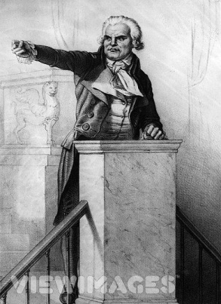
The Jacobin Club
Violent radicals who wanted to remove the king and establish a Republic
Led by:
Jean Paul Marat
Writer, newspaper editor
Friend of the People
Whipped up masses, always calling for more executions
George Danton
Great orator
Rallied people to support radical goals
Supporter of the poor

Slide 38
Maximilien Robespierre
Professional Lawyer
Believed strongly in equality & morality
Called “incorruptible” by his supporters
Wanted a “Republic of Virtue”
Wanted all traces of monarchy & nobility erased

Slide 39
King Louis XVI Executed
National Convention abolishes the monarchy, establishes a Republic
September 21
Adult males have the right to vote
Not women
Reduce King to citizen
Sentenced to death by a small margin vote
Executed by Guillotine
January 21, 1793

Slide 40
Marie Antoinette Executed
Conspiring against
France with her brother
the Emperor of Austria

Slide 41
The Guillotine
Dr. Joseph Guillotin
Efficient, humane, & democratic
Applied equally to all social classes and gave commoners a dignified execution previously reserved for the upper classes.

Slide 42
STAGE FOUR
NATIONAL CONVENTION
&
THE REIGN OF TERROR
1792-1795

Slide 43
Reign of Terror
Robespierre gained control of the revolutionary government & ruled France like a dictator of a year
“Rein of Terror” against suspected” enemies of the revolution”
Approx. 3000 people were executed during the year

Slide 44
Committee of Public Safety
12 man committee under Robespierre’s control
“Enemies of the Republic” were often tried in the A.M. and executed in P.M.
Most were fellow revolutionaries

Slide 45
Jean Paul Marat Murder
Stabbed by a young women, Charlotte Corday, who was a supporter of a rival faction
Corday was convicted by revolutionary court and sent to guillotine
Marat became a martyr

Slide 46
Danton arrested & executed
Danton an early leader of the Revolution and close friend and confidant of Robespierre.
Robespierre turned on fellow revolutionaries who challenged his leadership – including Danton.
Danton led moderate group that wanted to end terror.
Executed by guillotine in spring of 1794.

Slide 47
Robespierre Arrested & Executed July 1794
“Down with the Tyrant”
Why do you think Members of the National Convention turned on their leader?
Executed July 1794 w/ 20 supporters
One of the last vicitims of “Reign of Terror”

Slide 48
STAGE FIVE
THE DIRECTORY
1795-1799

Slide 49
Moderates Gain Control
French public opinion shifted to the right after Robespierre’s execution
Moderate leaders in National Convention create a new plan of government
Beginning the final stage of the French Revolution known as the Directory

Slide 50
The Directory
Legislature of two houses &executive body of five men
Mode up of Moderates, mostly bourgeoisie
Somewhat successful, created sense of order & stability
Found a talented young man to command the army
Napoleon Bonaparte

Slide 51
The Rise of Napoleon
Now begins the rise of France’s greatest military mastermind…
NAPOLEON BONAPARTE
Napoleon will overthrow the Directory in
November 1799.

Slide 52
Are we able to?
1. Explain the causes of the French Revolution.
2. Summarize ideas from the French Revolution about liberty, equality, democracy, popular sovereignty and human rights.
3. Describe how the French Revolution was different from the American Revolution.
4. Explain how the French Revolution led eventually to the rise of Napoleon.

