Slide 1
Unit VI
World War II
Part III
The Allies Are Victorious
1943-1945

Slide 2
The Battle for North Africa
1942-1943

Slide 3
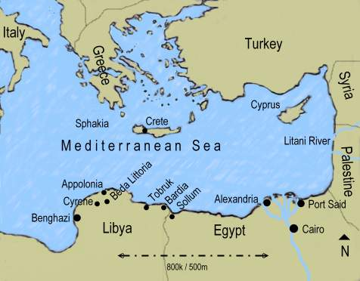
Sept. 1940 The Battle for North Africa
Italian armies in Libya
invaded British controlled
Egypt. Why was Egypt
important?
Suez canal
Access to oil fields of the
Middle East
British counter-offensive
drove Italians 500 miles
back across North Africa.

Slide 4
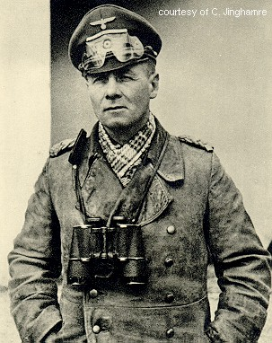
1942 The Battle for North Africa
German forces commanded
by ______________sent
to North Africa.
Rommel’s “Afrika Korps”
took port city of Tobruk
(June, 1942) and advanced
to El Alamein.
Gen. Erwin Rommel
Gen. Erwin Rommel
“The Desert Fox”

Slide 5
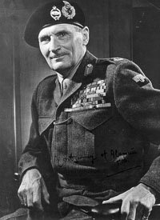
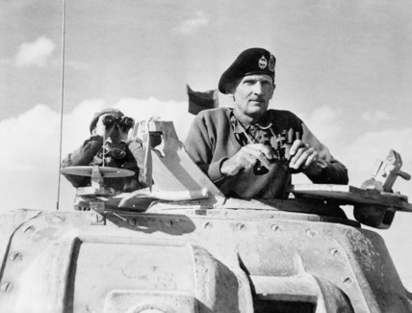
British sent their top general, _______________ _______ to take control of British forces in Egypt.
Bernard Montgomery
(“Monty”)

Slide 6
Oct. 23- Nov. 3, 1942 Battle of Al Alamein
Montgomery launched surprise frontal assault against German forces at al Alamein, in Egypt.
Rommel’s army beaten; forced to retreat west-ward.

Slide 7
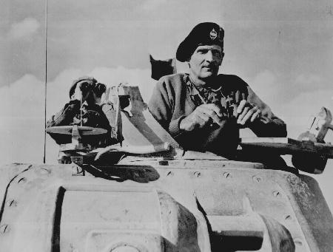
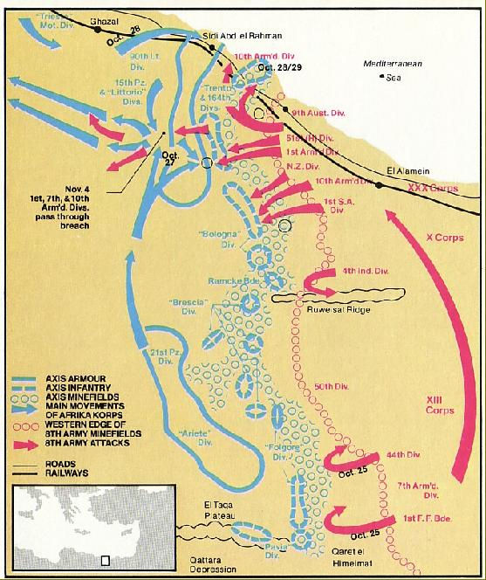
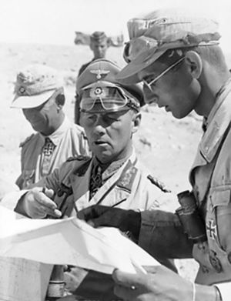
Battle of Al Alamein
Montgomery
Rommel

Slide 8
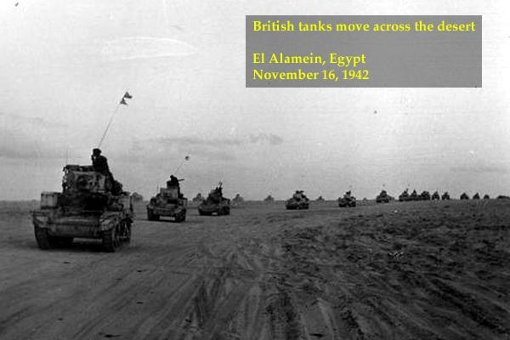

Slide 9
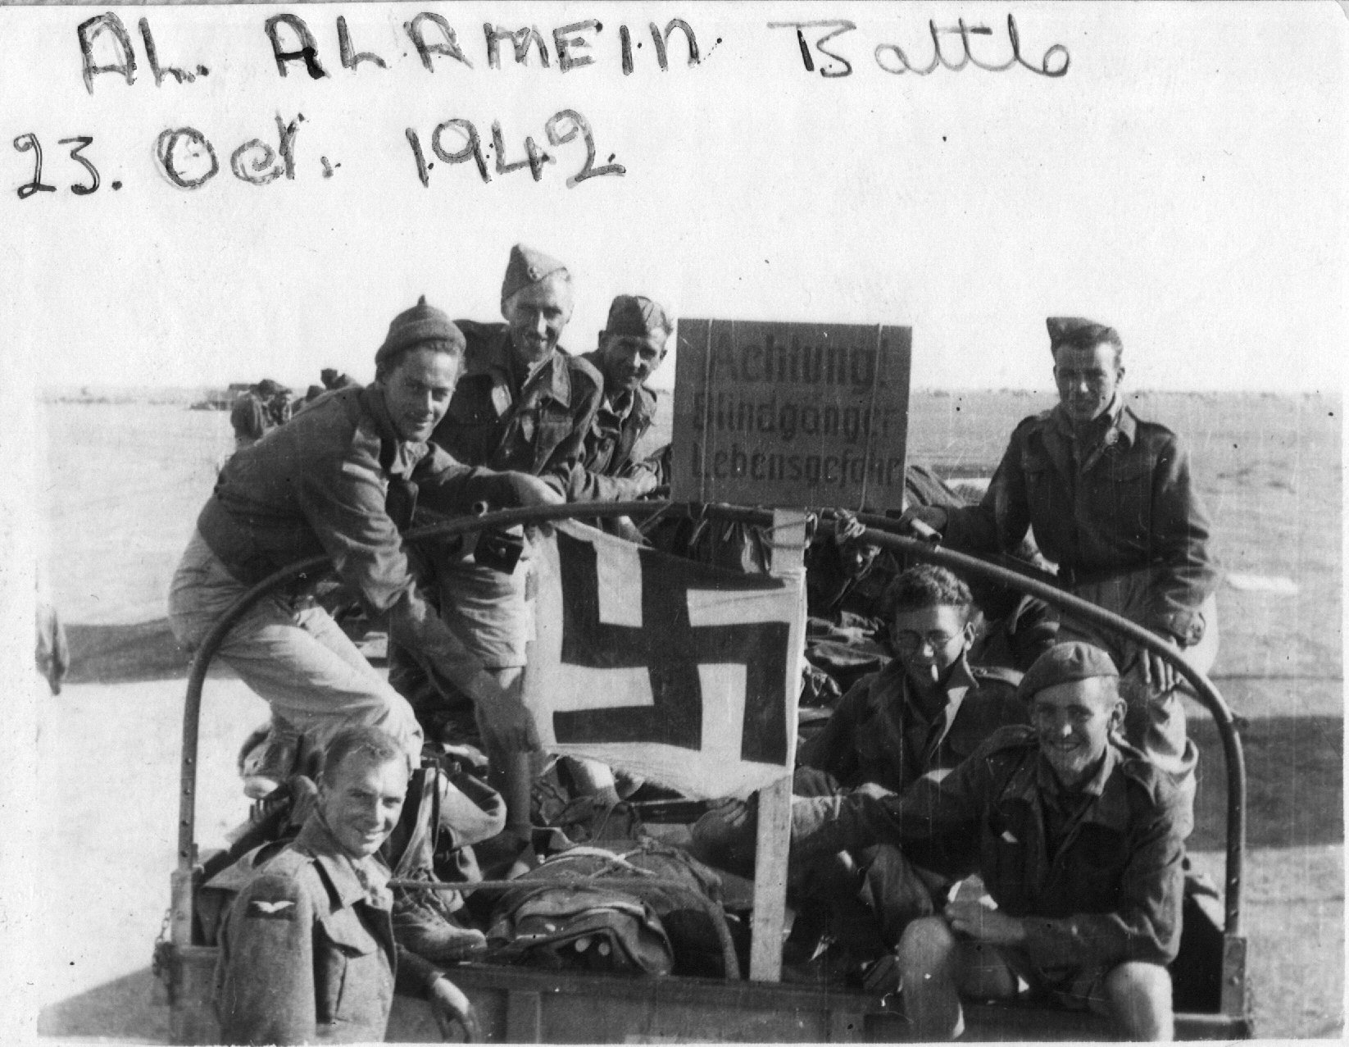

Slide 10
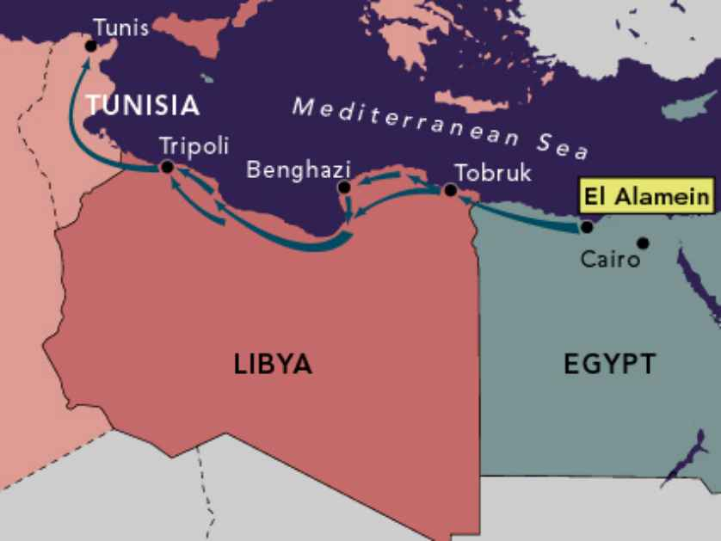
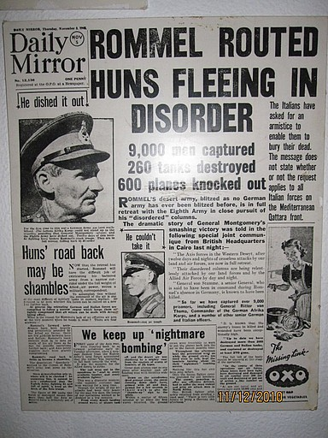
Rommel’s Retreat from El Alamein

Slide 11
Nov. 1942 (“Operation Torch”) Allied Invasion of French North Africa
107,000 Allied troops (mostly American) commanded by General _________________, landed in _________ and
__________ .
Allied forces moved across Africa from the west, trapping Rommel’s army in __________ .
Entire German “Afrika Korps” ____________ in May, 1943.
Dwight D. Eisenhower
Morocco
Algeria
Tunisia
surrendered

Slide 12
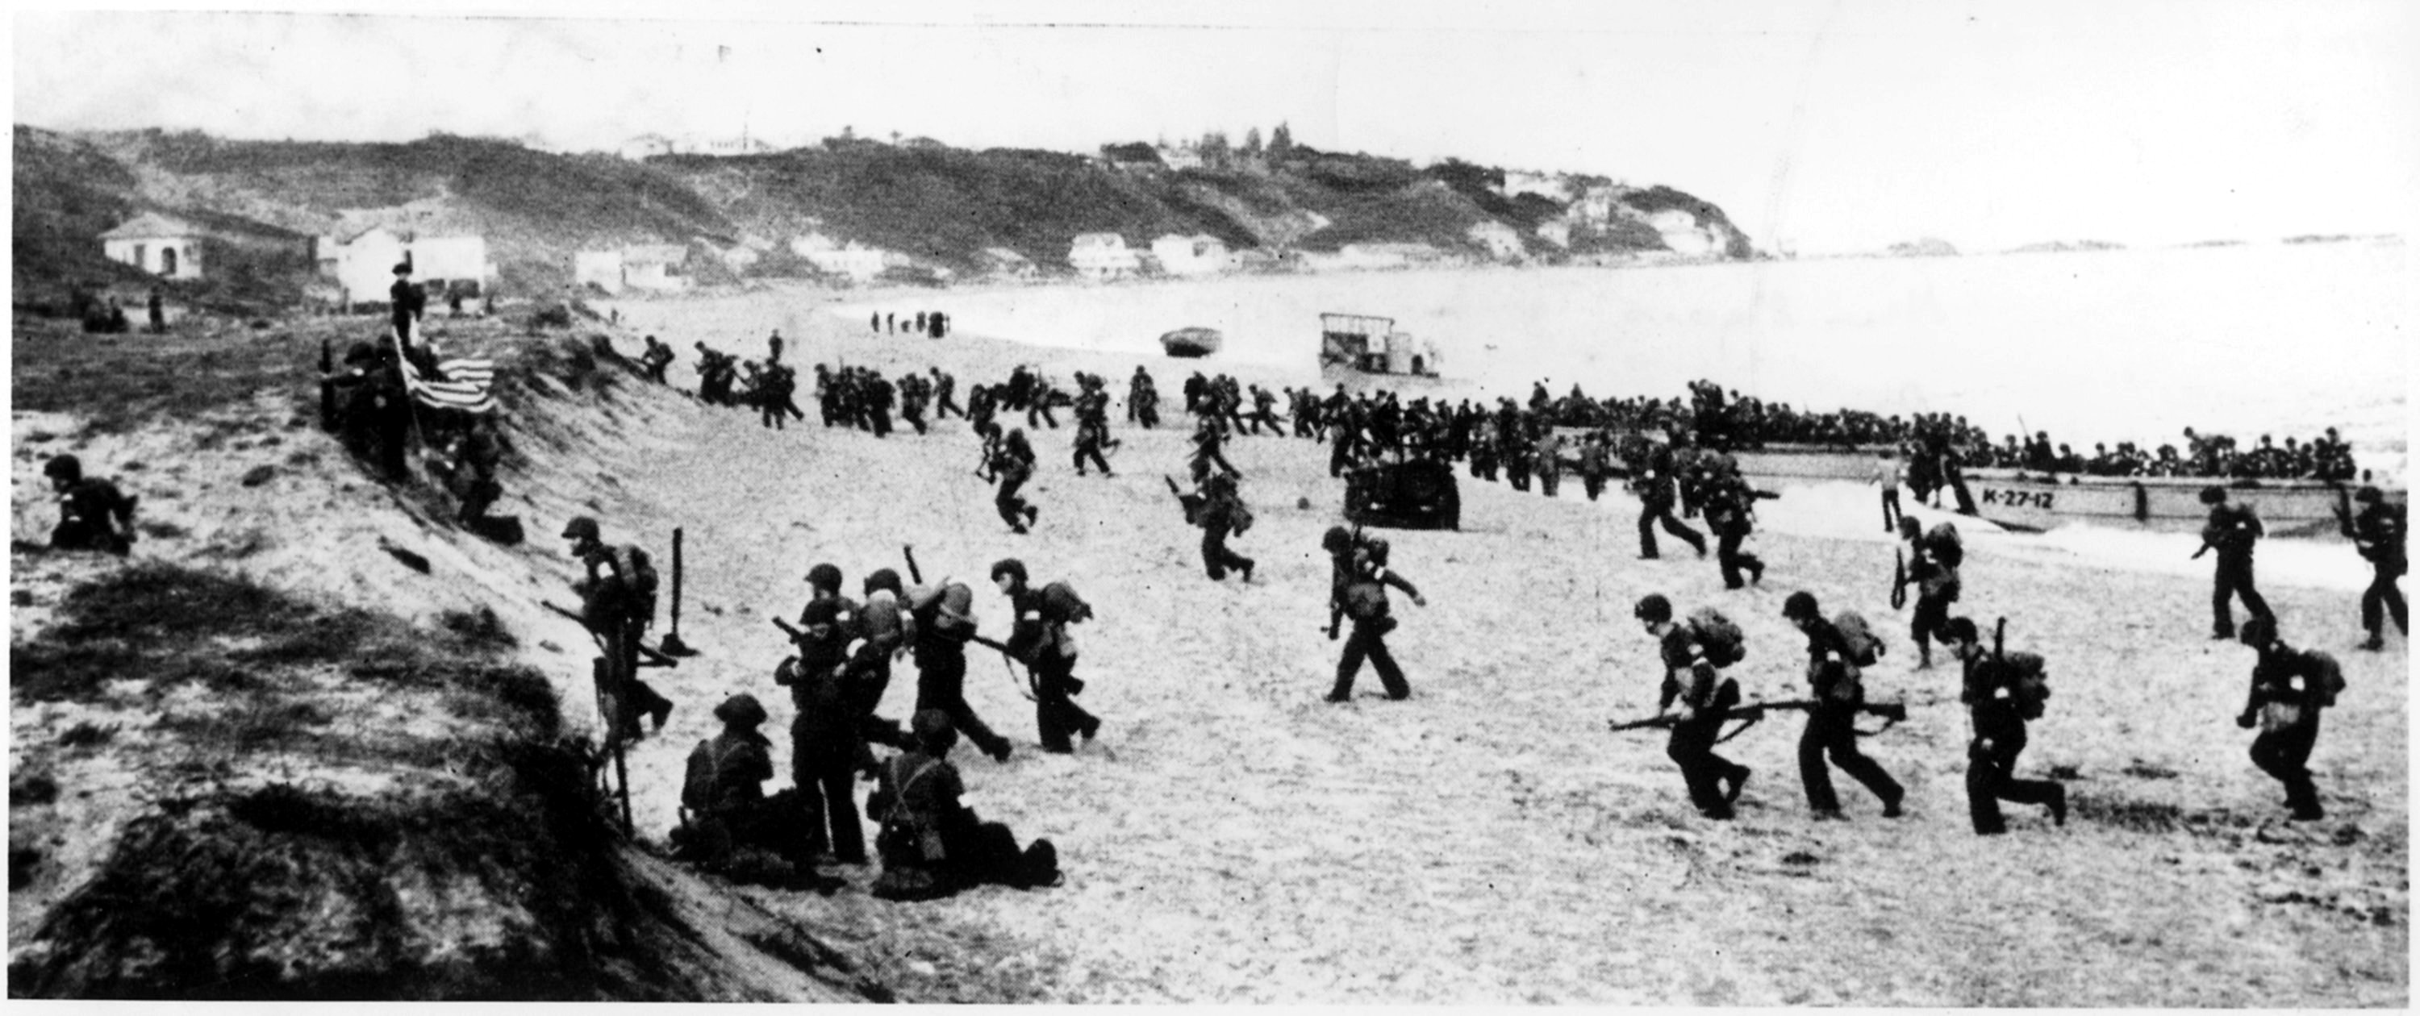
Allied Invasion of North Africa

Slide 13
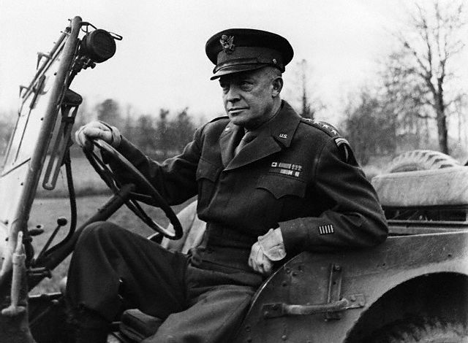
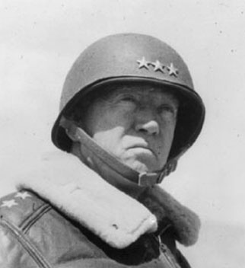
North African Campaign American Generals in North Africa
Gen. Dwight D. Eisenhower
Gen. George Patton

Slide 14
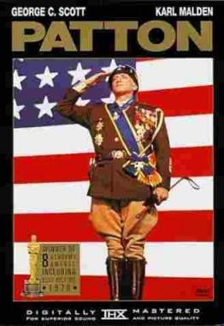
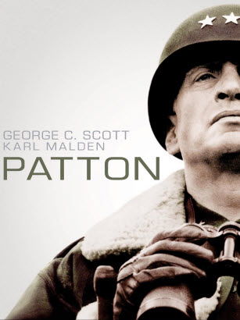
Movie Trailer, Patton

Slide 15
Battle of Stalingrad
1942

Slide 16
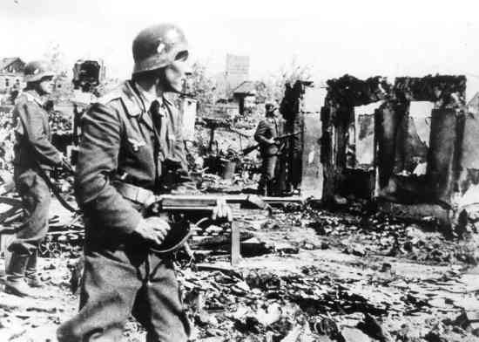
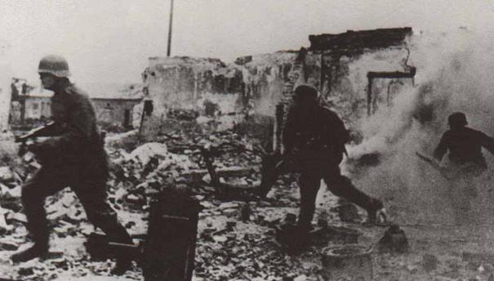
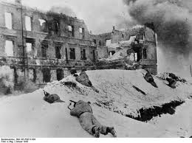
Aug. 1942 – Feb. 1943 Battle of Stalingrad
By early Nov. Stalingrad reduced
to rubble by German bombs and
Germans controlled 90 percent of
ruined city.
As Russian winter set in, Russian
army ___________________
trapping German army inside the
city.
launched counter-offensive

Slide 17
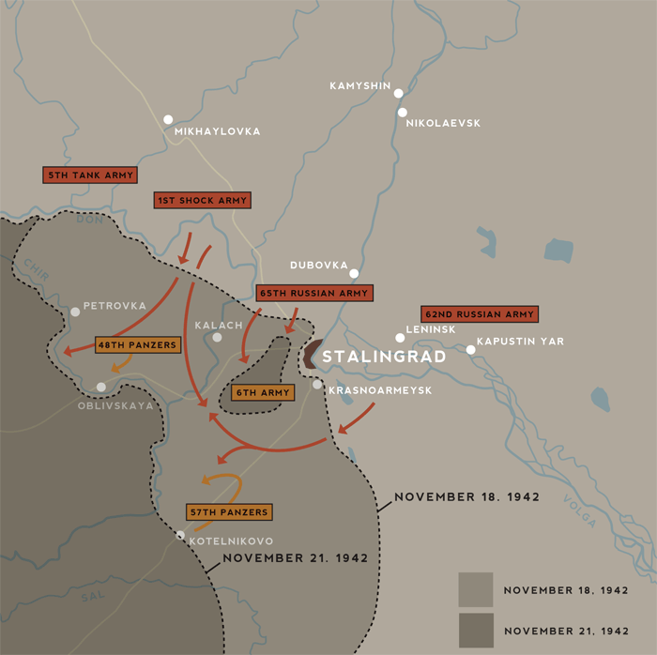
Battle of Stalingrad

Slide 18
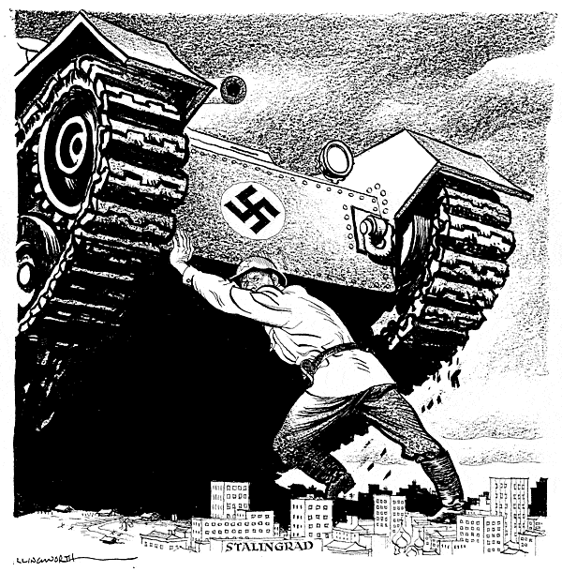
Feb. 1943 Stalingrad: War’s Turning Point
90,000 German troops surrendered
to Soviets. Only survivors from army
of 330,000.*
Over 1 million Soviet soldiers died in
defense of Stalingrad, which was 99%
destroyed.
Decisive battle on the Eastern Front.
German army now on defensive, with
Soviets pushing it back across Eastern
Europe.
*Only 5,000 of these German troops would survive the Soviet prison camps until the end of the war.

Slide 19
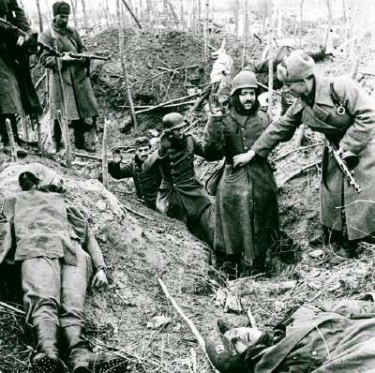

Slide 20
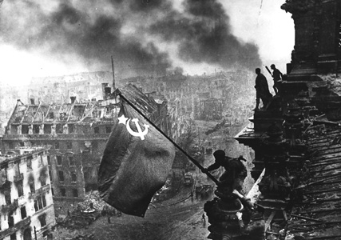
Battle of Stalingrad

Slide 21
The Allied Invasion of Italy
1943

Slide 22
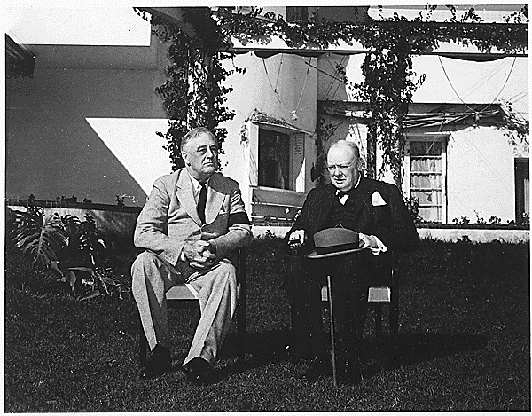
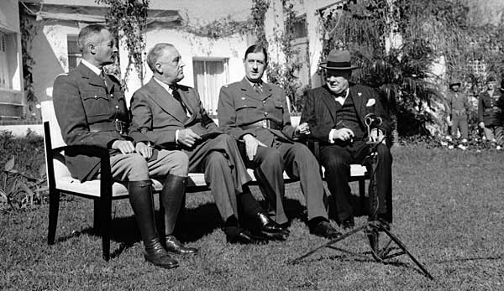
January, 1943 Casablanca Conference
___________begging for Allies to open up second front against Germans in _________.
Roosevelt and Churchill decided to attack ___________ (“the soft underbelly” of Europe”) first.
Also decided on policy of “ _____________________” towards Axis Powers.
Stalin
France
Italy
unconditional surrender

Slide 23
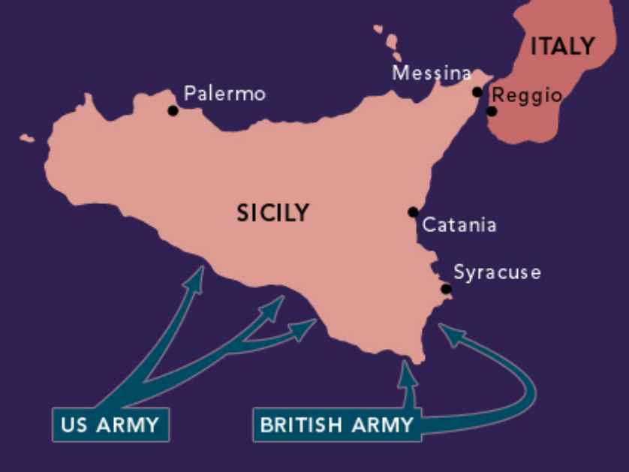
July, 1943 Allied Invasion of Sicily
Allied forces captured
Sicily from German and
Italian forces.
King Emmanuel III
removed __________
from power and had him
__________.
Sicily a stepping stone to
invasion of ________.
Mussolini
arrested
Italy

Slide 24
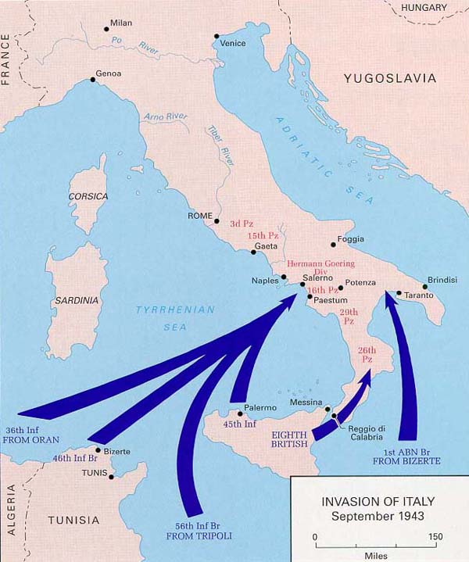
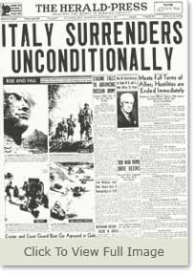
Sept. 1943 Allied Invasion of Italy
Allies invaded Italy on Sept. 1
Italy __________on Sept. 3,
but ________ seized control
of northern Italy.
Germans rescued ________
and set up _____________
in the north under his control.
surrendered
Germans
Mussolini
puppet government

Slide 25
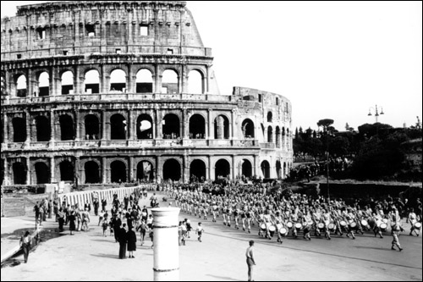
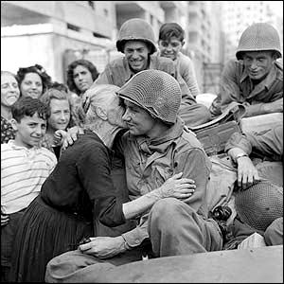
June, 1944 Allies Reach Rome
Victorious Allies entered
Rome in June, 1944.
Fighting in Italy against
__________ continued
until the end of the war.
German forces

Slide 26
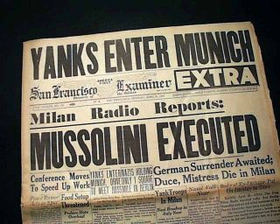
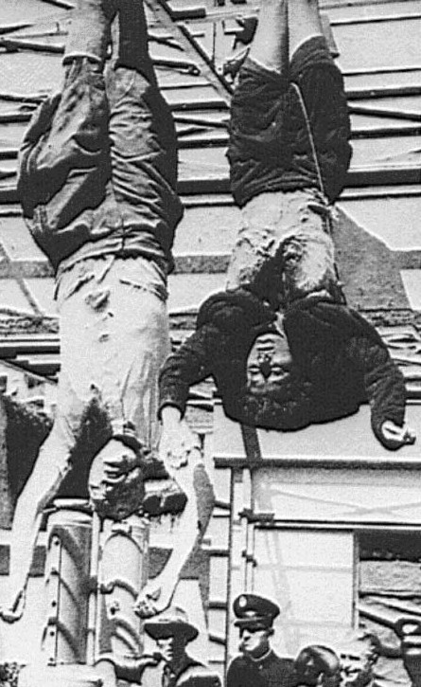
April, 1945 Death of Mussolini
Mussolini captured and shot
by ________________in
April, 1945.
Body was hanged on display
in Milan.
Italian partisans

Slide 27
The D-Day Invasion of France
1944

Slide 28
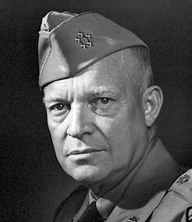
June 6, 1944 D-Day
France
Allied invasion of _____ -- code
named _________________
Invasion force of 5,000 ships
and 11,000 planes transporting
200,000 troops and 50,000
vehicles, crossed the _______
______ and landed on beaches
of ______________, France.
Greatest __________ attack in
history.
“Operation Overlord.”
English
Channel
Normandy
Supreme Allied Commander
Dwight D. Eisenhower
amphibious

Slide 29
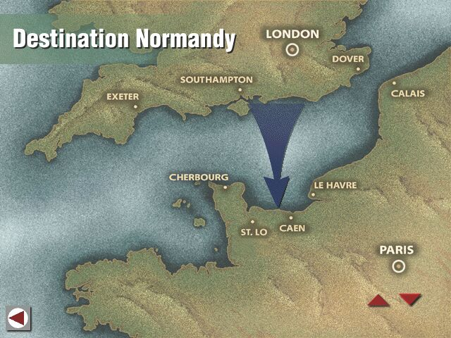

Slide 30
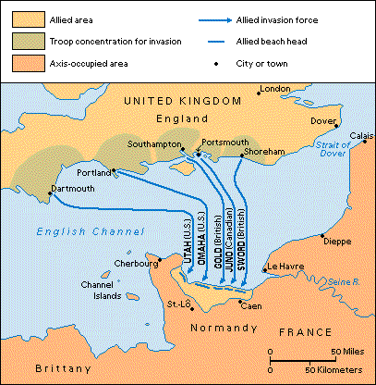

Slide 31
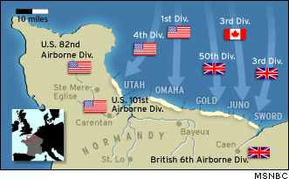

Slide 32
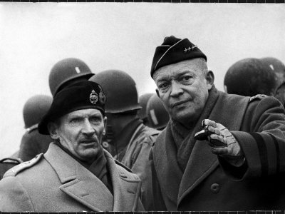

Slide 33
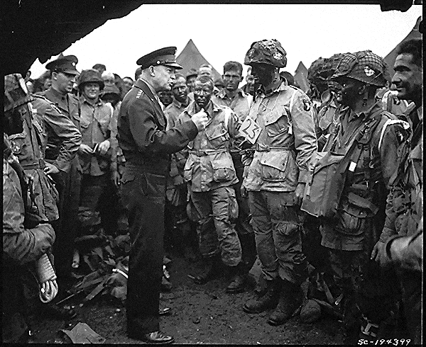

Slide 34
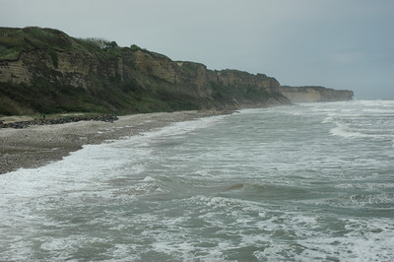
Cliffs at Omaha Beach

Slide 35
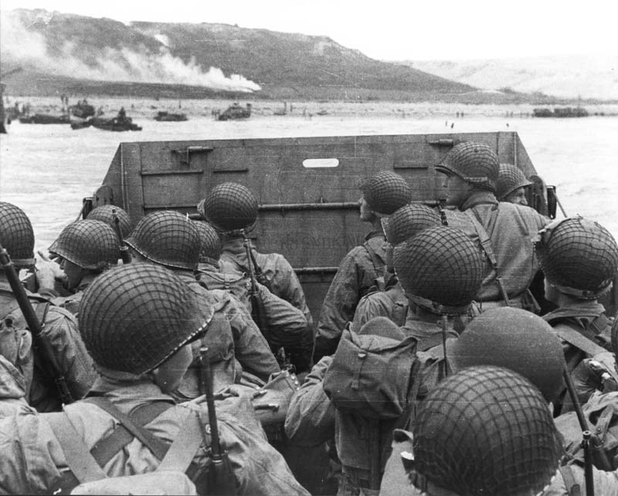
D-Day

Slide 36
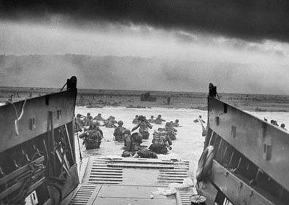
D-Day

Slide 37
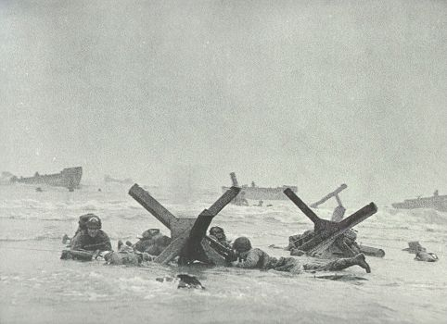
D-Day

Slide 38
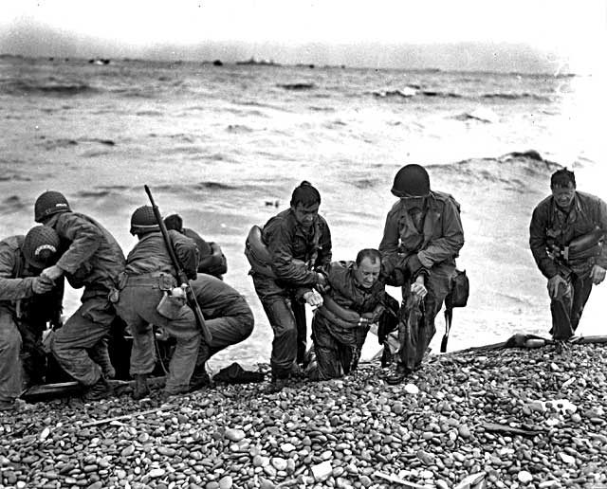
D-Day

Slide 39
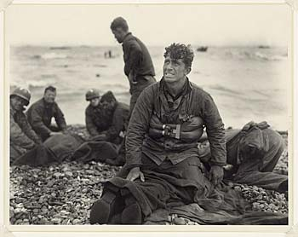
D-Day

Slide 40
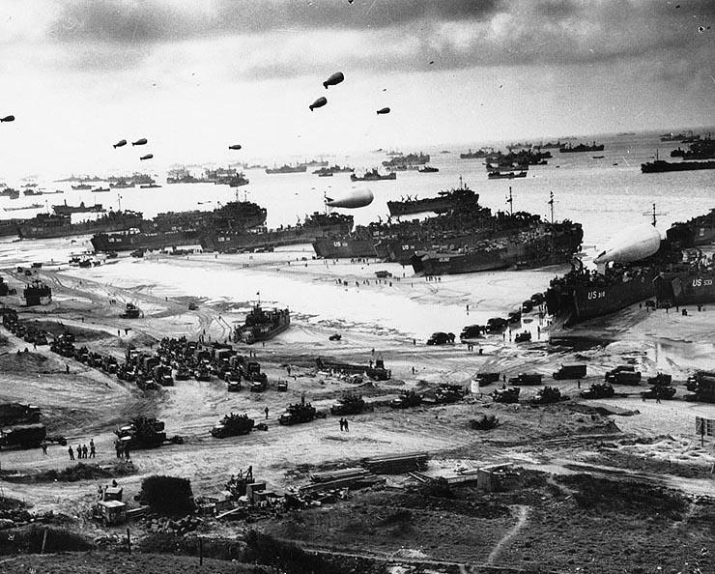
D-Day

Slide 41
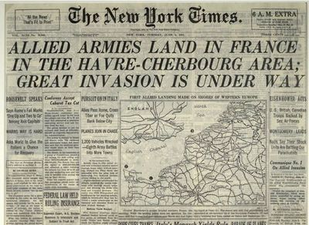

Slide 42
Allied Victory in Europe
1944-1945

Slide 43
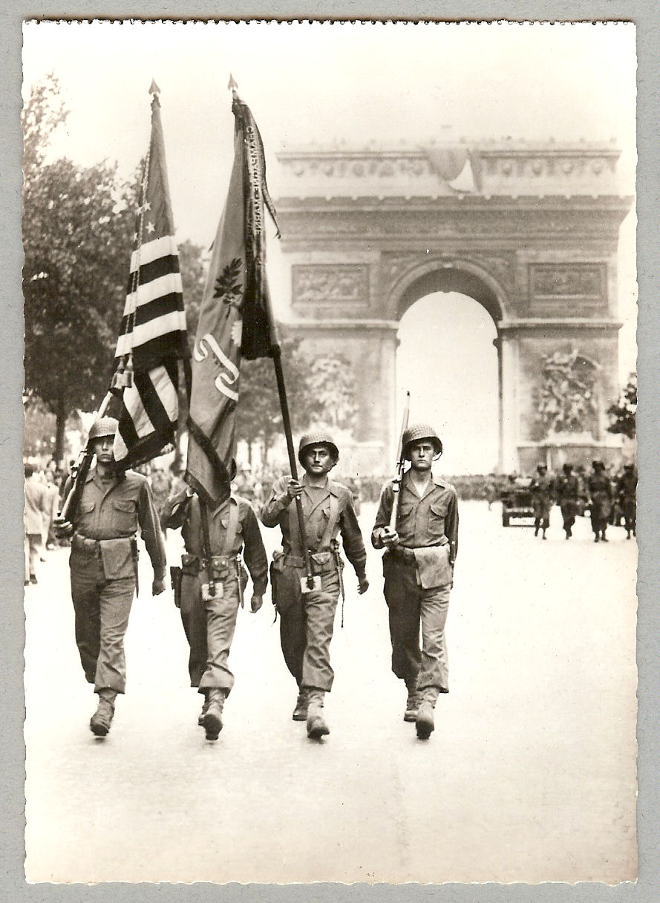
The Liberation of Western Europe
Within a month after D-Day,
Allies had landed 1 million
troops.
Patton’s Third Army first to
___________________
(July 25). German’s soon in
retreat.
_____ liberated on August 25.
Countries of France, Belgium,
Luxembourg, and Netherlands liberated by September.
break through German lines
Paris

Slide 44
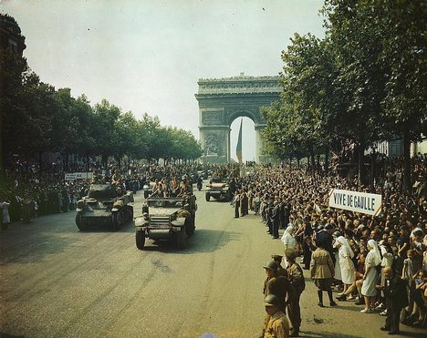
Liberation of Paris

Slide 45
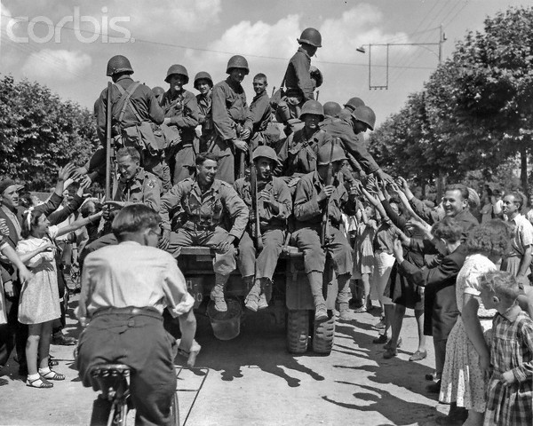

Slide 46
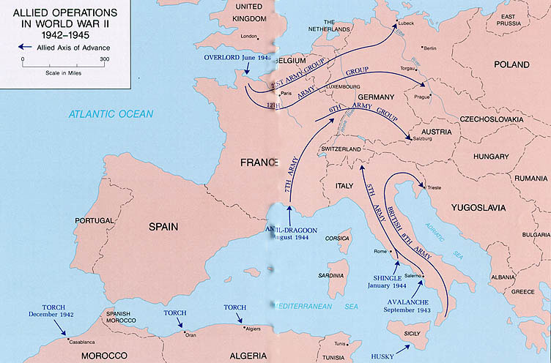

Slide 47
December, 1944 Battle of the Bulge
As Allies closed in on Germany
from the west, Hitler launched
a last counterattack to try and
cut the Allied armies in two.
Pushed American forces back,
creating a “bulge” in their lines,
but Americans eventually
pushed German army back and
won.
Exhausted German forces had
to retreat – lost men could no
longer be replaced.

Slide 50
April 12, 1945 Death of FDR

Slide 51
April 12, 1945 Truman Becomes President
Harry S Truman

Slide 52
May, 1945 The Allies Close In
American and British
______________ forces
entered Germany from the
south and west – crossed the Rhine River in late March.
______ army closed in from
the east.
Surrounded _________by April 25.
Soviet
Berlin

Slide 54
American and Russian
soldiers meeting at the
Elbe River.

Slide 56
April 30, 1945 (Death announced on May 1) Hitler Commits Suicide

Slide 58
May 7, 1945 Germany Surrenders

Slide 60
May 8, 1945 “V-E Day”

Slide 62
Victory in the Pacific
1944-1945

Slide 63
1943-1945 Japan on the Defensive
After the American victory at
Guadalcanal, Allied forces
continued advancing toward
Japan.
U.S. troops landed on island
of Leyte in the Philippines in
Oct. 1944.
Fulfilled MacArthur’s 1941
promise:
“People of the Philippines,
I have returned”

Slide 64
MacArthur’s Return to the Philippines

Slide 65
October 23-26, 1944 Battle of Leyte Gulf
Final and largest naval battle of the war.
Eliminated the Japanese
Imperial navy as a fighting
force in the war.
First use of ___________ by the Japanese.
Kamikaze attacks

Slide 66
Kamikazi Attacks

Slide 68
BATTLE | Dates | U.S. Killed | U.S. Wounded | Square Miles | Japanese Strength | Japanese Dead
Guadalcanal | 7 Aug. 1942-9 Feb. 1943 | 1,600 | 4,400 | 2,510 | 36,000 | 31,000
Tarawa | 20-23 Nov., 1943 | 1,700 | 2,300 | 12 (24 islets) | 4,800 | 4,600+
Bougainville | Nov. 1943-Aug. 1945 | 1,200 |  | 3,598 | 45,000 | 21,500
Kwajalein | 31 Jan., 1943-3 Feb., 1944 | 370 | 1,600 | 6.3 (97 islets) | 8,100 | 7,870
Eniwetok | 17-23 Feb., 1944 | 260 | 760 | 2.44 (40 islets) | 2,741 | 2,677
Saipan | 15 June – 9 July, 1944 | 3,000 | 10,400 | 44.55 | 31,000 | 24,000 (+5,000 suicides)
Peleliu | Sept. 4-Nov. 1944 | 1,800 | 8,000 | 5 | 11,000 | 10,695
Leyte | 17 Oct.-31 Dec. ‘44 | 3,500 | 12,000 | 2,206 | 55,000 | 49,000
Iwo Jima | 19 Feb.-26 March, 1945 | 6,800 | 19,000 | 8 | 22,000 | 21,700
Okinawa | 26 March-21 June, 1945 | 12,500 | 36,500 | 463 | 100,000+ | 94,000-130,000
What trends do you notice in these numbers?

Slide 69
March 1945 Battle of Iwo Jima

Slide 70
March 1945 Battle of Iwo Jima
Heavily fortified island where
Japanese soldiers fought to
the death.
Of 18,000 Japanese soldiers,
only 216 were taken prisoner.
The only Pacific battle where
American casualties exceeded
the Japanese (6,800 dead and
0ver 19,000 wounded).

Slide 72
Iwo Jima

Slide 73
April-June, 1944 Battle of Okinawa

Slide 74
April-June, 1944 Battle of Okinawa
Bloodiest land battle of the
Pacific War.
95,000 Japanese and 12,500
American soldiers died in
battle lasting 82 days.
Victory gave the U.S. a base
only 350 miles from Japan

Slide 75
The Atomic Bomb
1945

Slide 76
The Manhattan Project
Codename for top-secret
project to develop atomic
bomb.
Top American and British
scientists put to work to
develop the atomic bomb
before Hitler could.
Project the result of letter
Albert Einstein wrote to
FDR in 1939.
J. Robert Oppenheimer
Lead scientist on the
Manhattan Project

Slide 77
Einstein’s Letter to FDR
“This new phenomenon would also lead to the construction of bombs, and it is conceivable – though much less certain – that extremely powerful bombs of a new type may thus be constructed. A single bomb of this type, carried by boat and exploded in a port, might very well destroy the whole port together with some of the surrounding territory. However, such bombs might very well prove to be too heavy for transportation by air.” --Albert Einstein, August 2, 1939

Slide 78
FDR’s Response
“…I have convened a Board….to thoroughly investigate the possibilities of your suggestion regarding the element of uranium…”

Slide 79
July 16, 1945 First A-bomb Test
“Trinity Test” in New Mexico desert

Slide 80
August, 1945 Hiroshima and Nagasaki
To avoid having to invade Japan
and to bring about a quick end to
the war, Truman decided to use
the atomic bomb against Japan.
Japan ignored U.S. ________so
first A-bomb was dropped on city
of ___________ 150,000 died.
Three days later, a second bomb
was dropped on ___________.
ultimatum
Hiroshima
Nagasaki

Slide 81
“Little Boy” – bomb dropped on Hiroshima.
15 kiloton bomb (the equivalent of 15,000 tons of TNT).
“Fat Man” – 20 kiloton
bomb used on Nagasaki.

Slide 82
The Enola Gay

Slide 85
Hiroshima

Slide 90
Hiroshima Today

Slide 92
Aug. - Sept. 1945 Japan’s Surrender
Japanese announced
their surrender on
Aug. 14.
Formal surrender of
occurred on deck of
U.S.S. _________ on Sept. 2
Japan’s surrender
was unconditional.
Japan’s surrender
ended World War II.
Missouri

Slide 94
VJ Day

