Slide 1
Unit VI
World War II
Part II

Slide 2
Unit VI
World War II
Part II
The Pacific War Against Japan
1941-1943

Slide 3
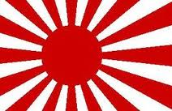
Japan Strikes in the Pacific
1941

Slide 4
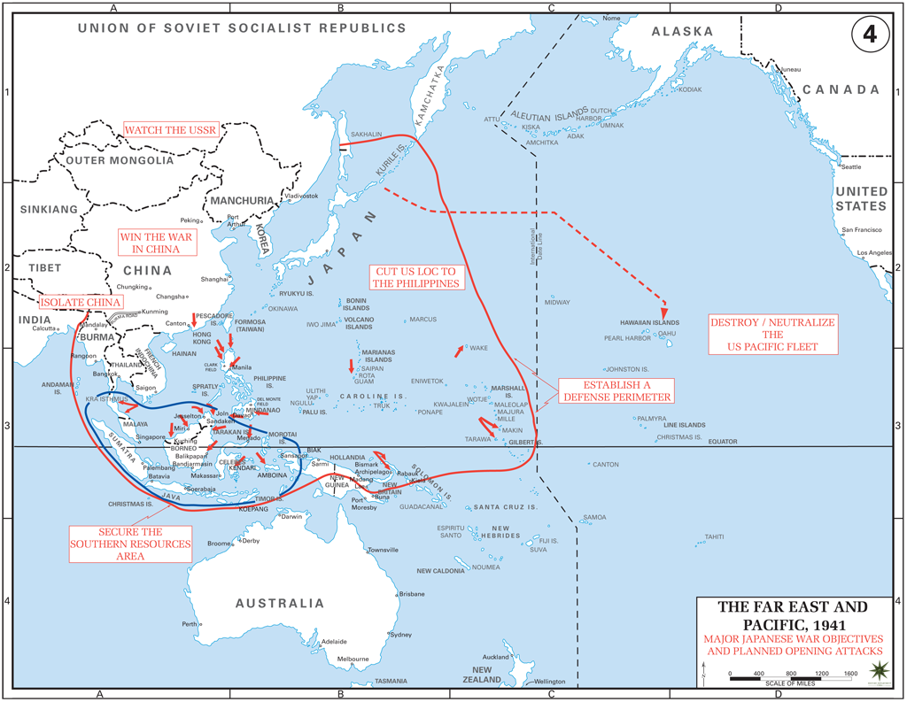

Slide 5
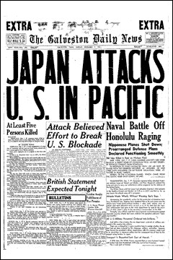
Dec. 7, 1941 Attack on Pearl Harbor
In surprise attack on U.S.
naval base in Hawaii, Japan
destroyed almost the entire
U.S. Pacific fleet.
Pearl Harbor & FDR Speech

Slide 6
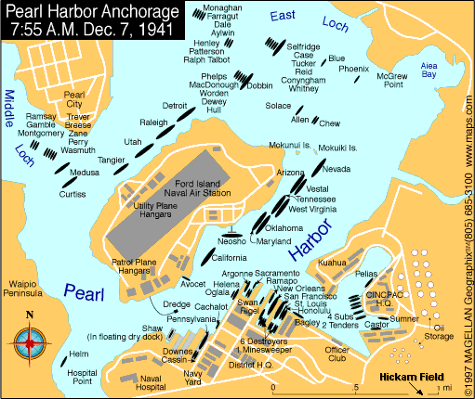

Slide 7
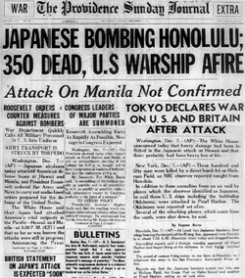
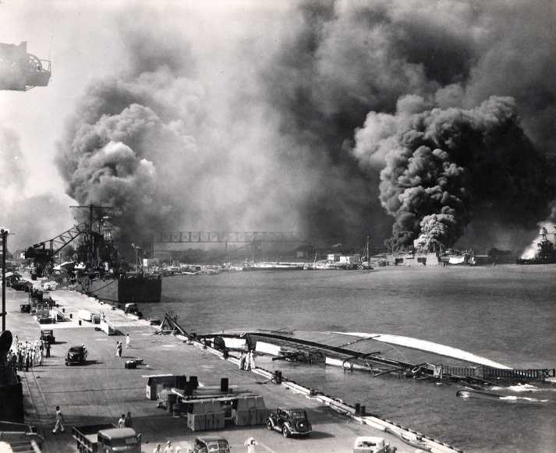

Slide 8
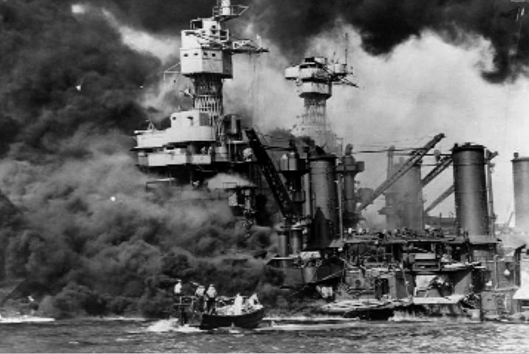

Slide 9
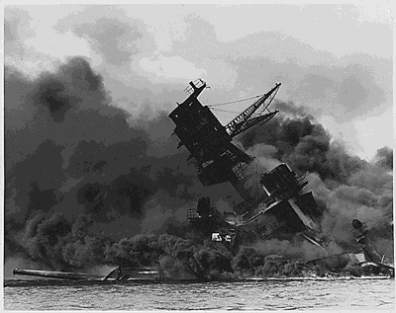
The biggest loss at Pearl Harbor was the USS Arizona, on which 1,177 crewmen were killed.
A 1,760 pound bomb smashed through her decks and ignited her forward ammo magazine causing a terrible explosion.
Fewer than nine minutes later she was underwater.
U.S.S. Arizona

Slide 10
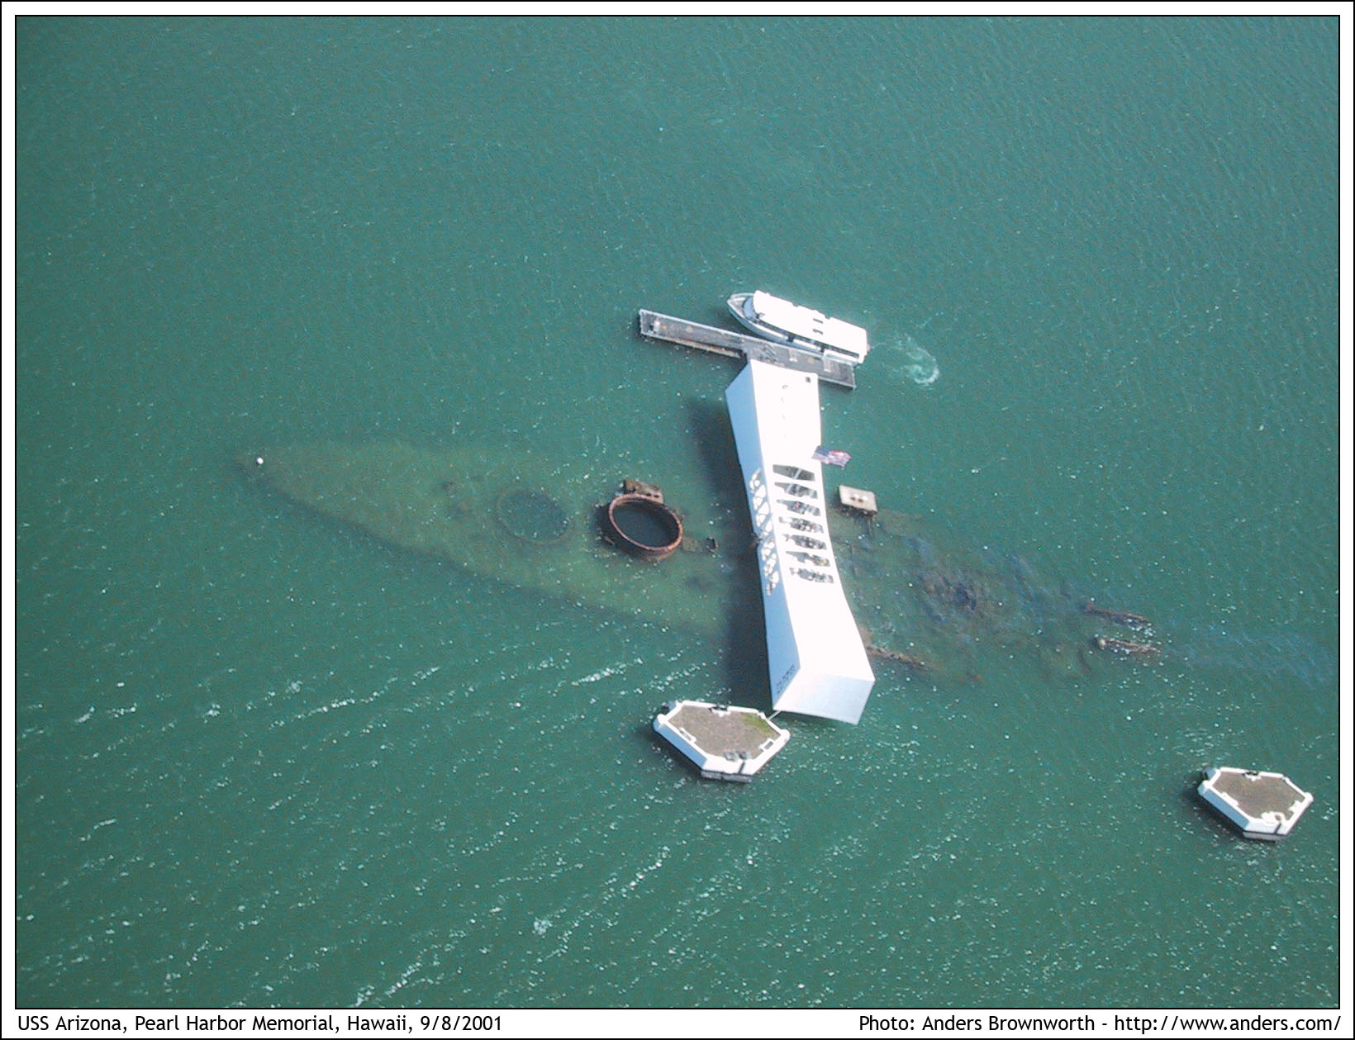

Slide 11
U.S. Losses at Pearl Harbor
LOSSES
2,280 American servicemen and 68 civilians were dead. 1,109 were injured.
Eight battleships were damaged and five sunk.
Three light cruisers, three destroyers, and three smaller boats were lost
188 planes were destroyed.
NOT HIT:
Aircraft carriers (all three were out to sea)
The power station
Shipyard maintenance
Fuel and torpedo storage facilities
Submarine piers

Slide 12
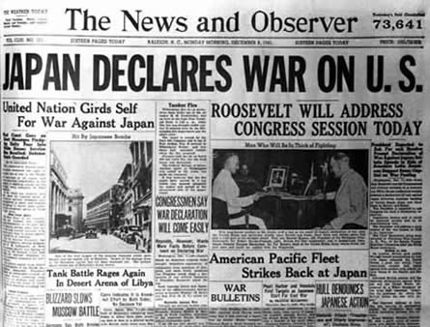

Slide 13
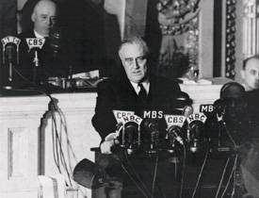
December 8, 1941 The U.S. Declares War on Japan
The following day,
Congress declared
war on Japan.
How did Roosevelt
describe the attack?
“A date which will live in infamy.”
FDR's Speech to Congress
After Pearl Harbor (2:37)

Slide 14
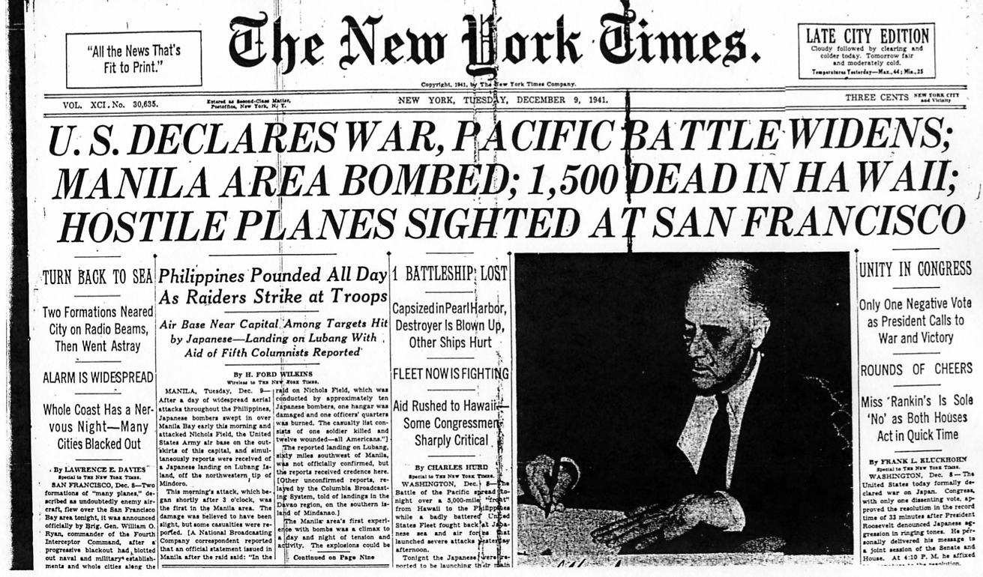

Slide 15
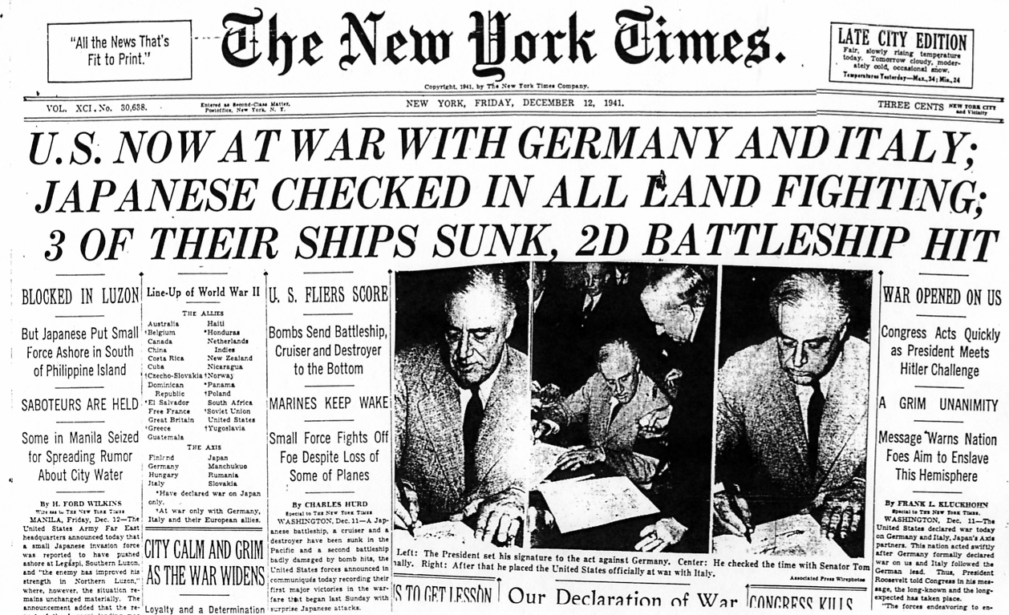

Slide 16
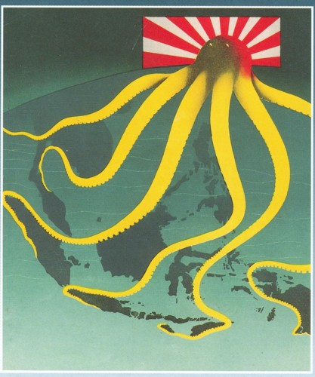
1941-1942 Japanese Conquests in the Pacific
After Pearl Harbor, the
Japanese conquered
these territories:
Guam (U.S.)
Wake (U.S.)
Philippines (U.S.)
Hong Kong (U.K.)
Singapore (U.K.)
Malaysia (U.K.)
Dutch East Indies
Burma (U.K.)
French Indochina
Thailand

Slide 17
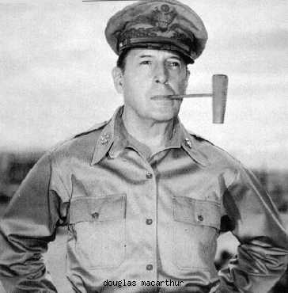
The Philippines Fall to Japan, 1942
Gen. Douglas MacArthur
forced to evacuate the
Philippines, leaving most
of his army behind.
Famous vow made to the
people of the Philippines?
“I Shall Return”
Gen. Douglas MacArthur

Slide 18
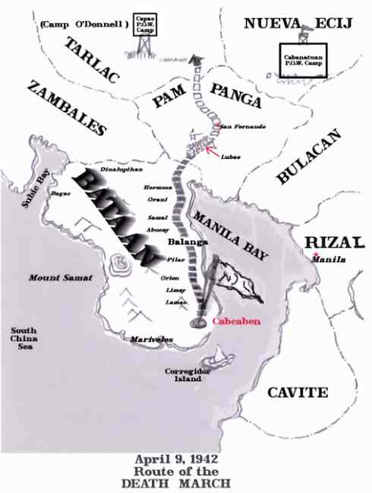
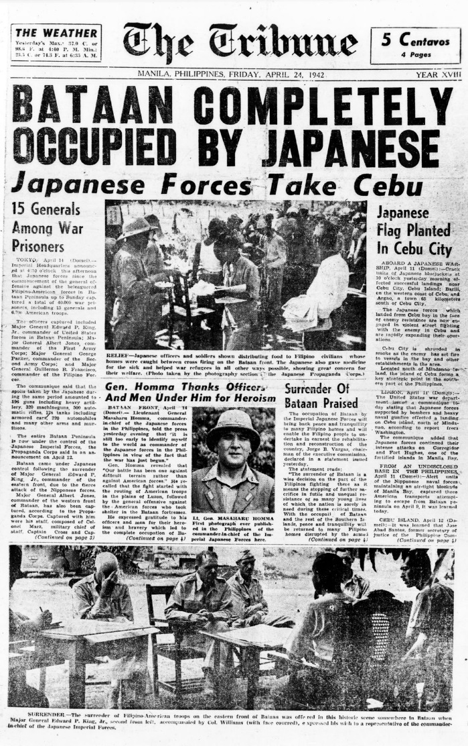
May, 1942 U.S. Forces in the Philippines Surrender

Slide 19
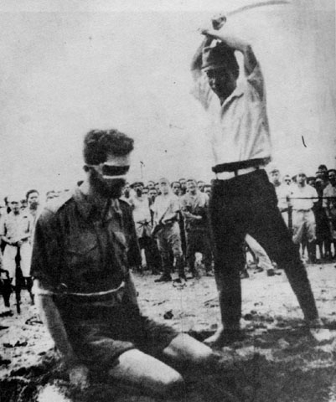
Bataan Death March
Forced 80 mile march of
76,000 American and
Filipino POWs
Not given food, water,
or medical care.
Physical abuse common.
Stragglers killed.
Thousands of POWs
died (650 Americans).

Slide 20
Bataan Death March

Slide 21
Bataan Death March
They were beaten, and they were starved as they marched. Those who fell were bayoneted. Some of those who fell were beheaded by Japanese officers who were practicing with their samurai swords from horseback. The Japanese culture at that time reflected the view that any warrior who surrendered had no honor; thus was not to be treated like a human being. Thus they were not committing crimes against human beings.[...] The Japanese soldiers at that time [...] felt they were dealing with subhumans and animals."^{[8]}

Slide 22
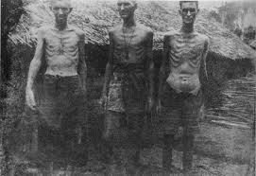
Bataan Death March

Slide 23
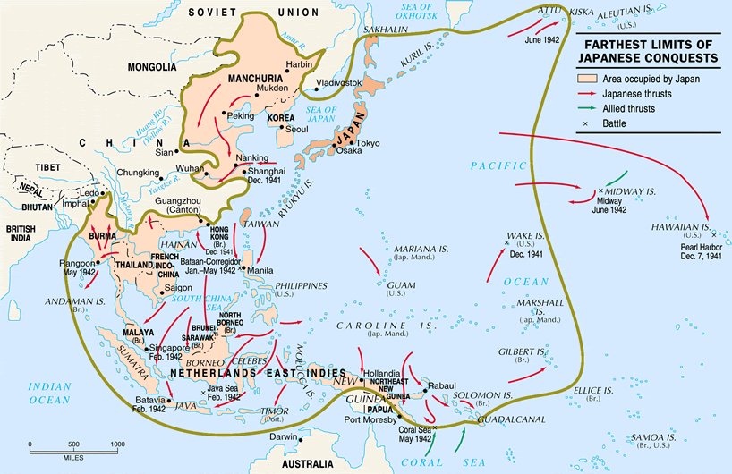
1942 The Japanese Empire at its Peak

Slide 24
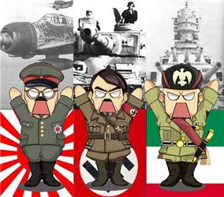
Domination of Axis Powers
1942

Slide 25
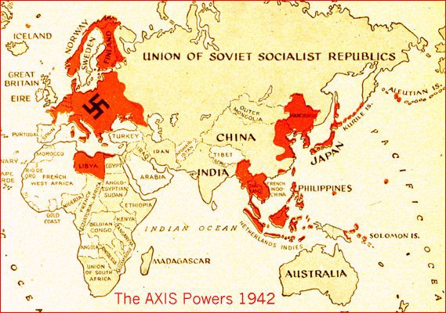

Slide 26
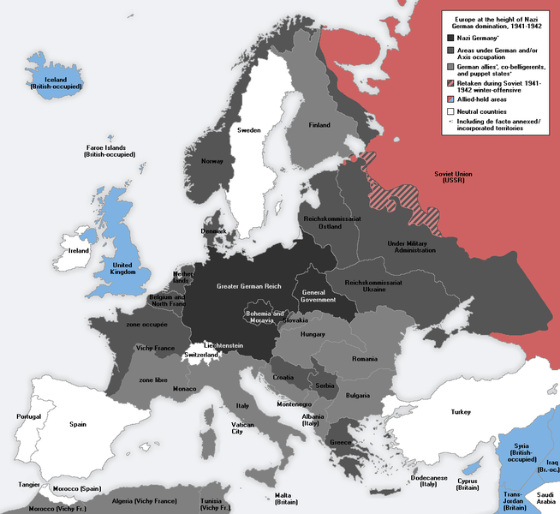
Think
geo-
politically!
What’s your
strategy going
to be
for defeating
Nazi Germany?

Slide 27
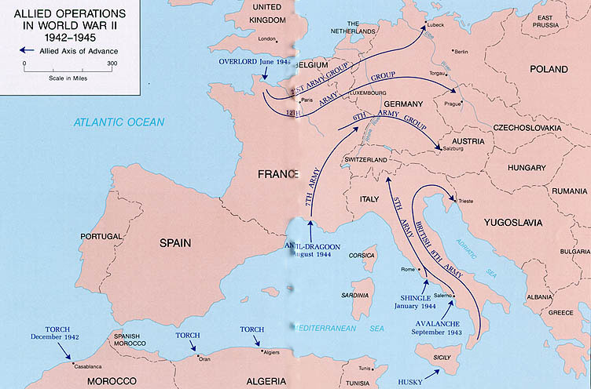

Slide 28
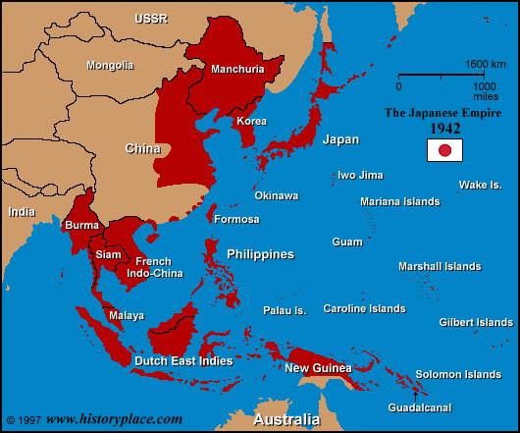
Think
geo-
politically!
What’s
your
strategy
going to
be
for
defeating
Japan?

Slide 29
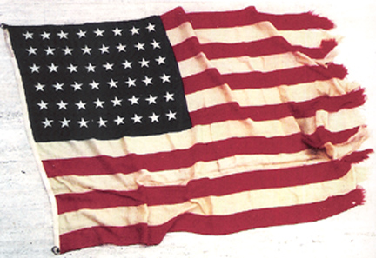
The U.S. Strikes Back in the Pacific
1942

Slide 30
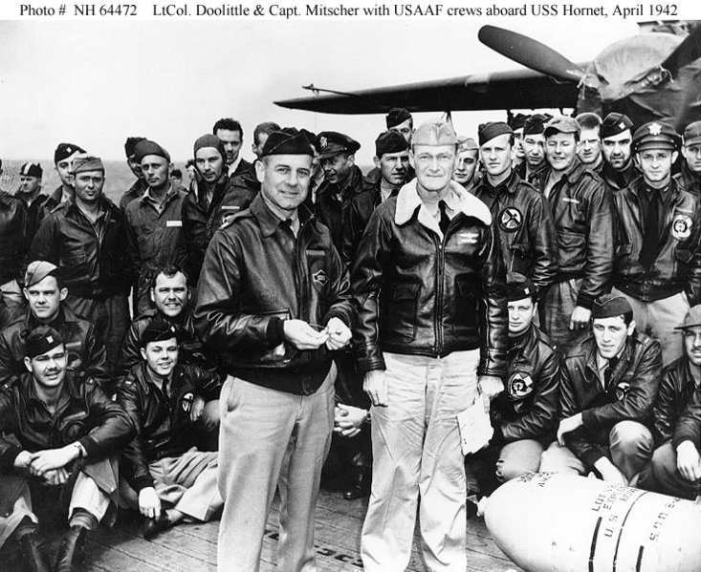
April, 1942 First U.S. Bombing of Tokyo
US bombing of Tokyo and
other Japanese cities
B-25 bombers commanded
by Col. Jimmy Doolittle.
Took off from aircraft carrier
(U.S.S. Hornet)
Did minor damage, but huge
boost for US morale – showed
Japan was vulnerable.
“Doolittle’s Raiders”

Slide 31
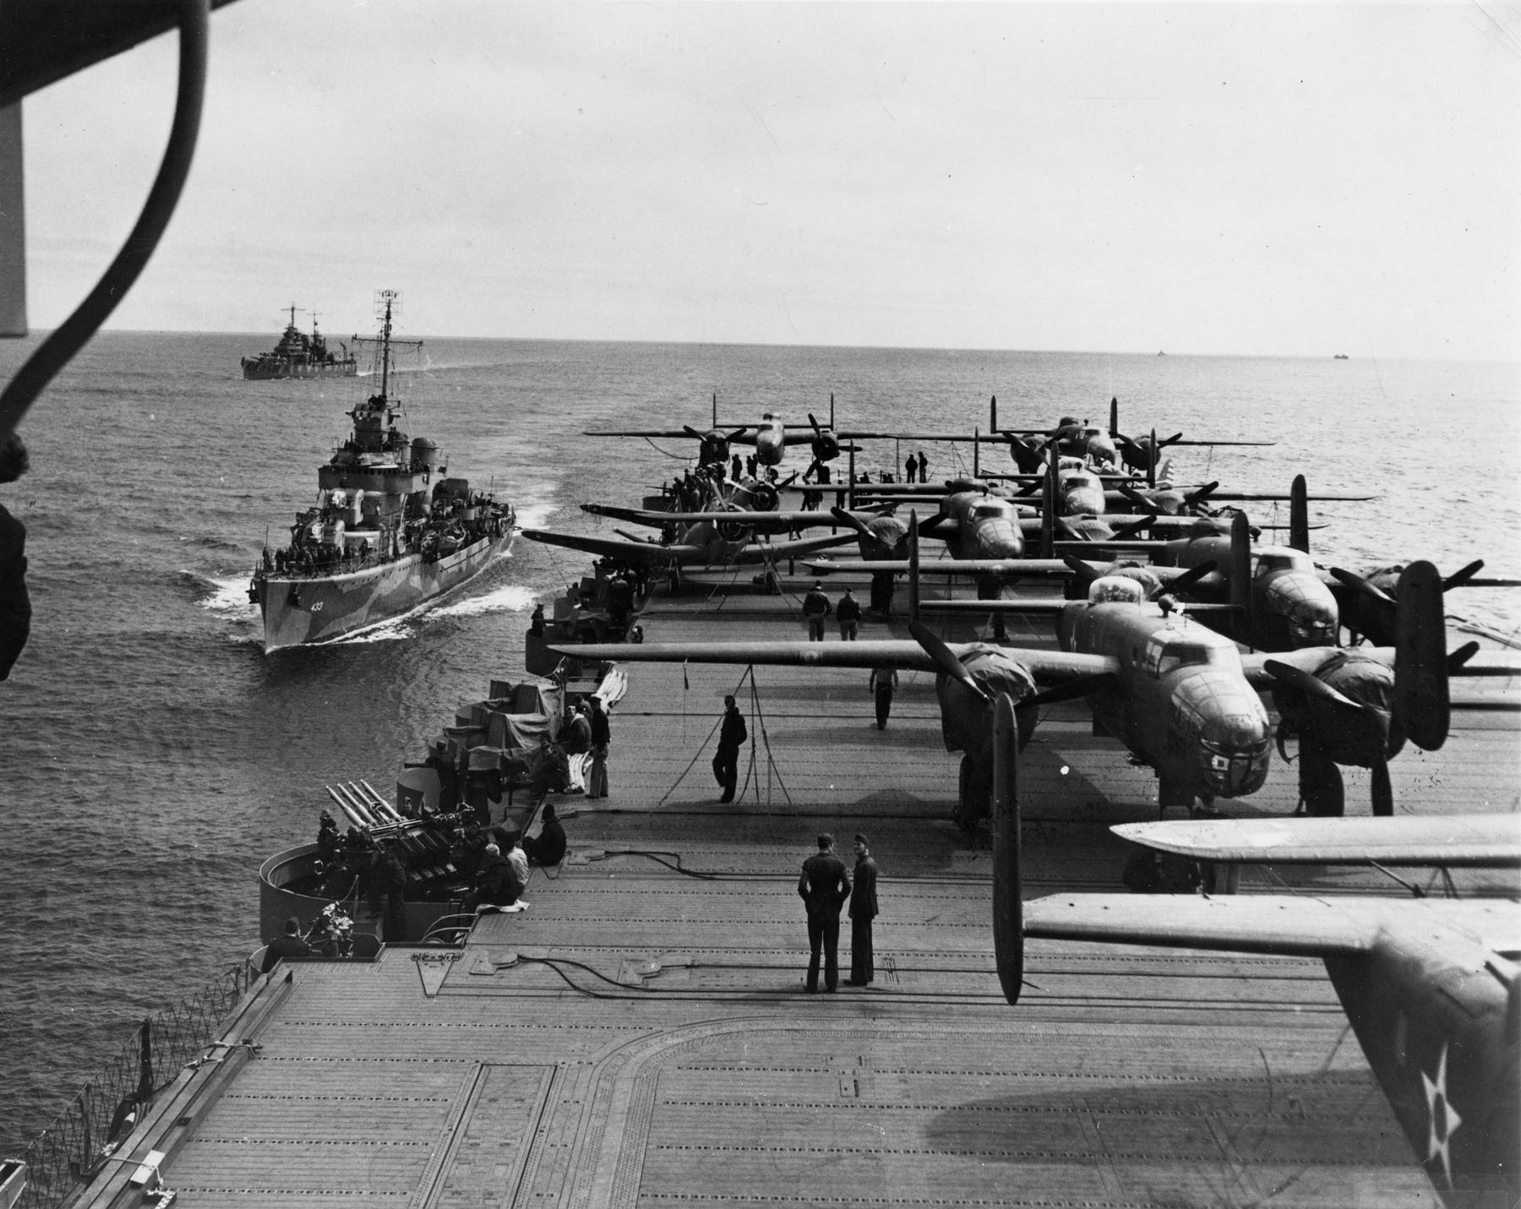

Slide 32
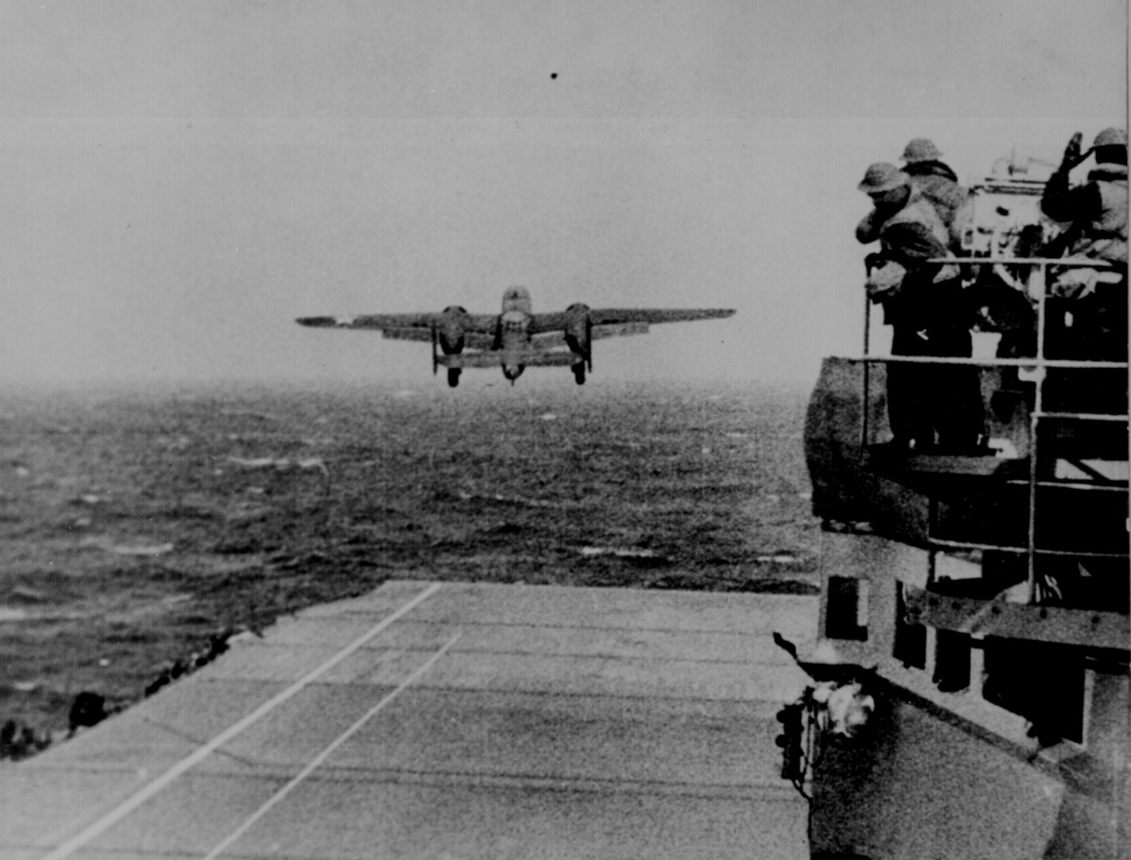

Slide 33
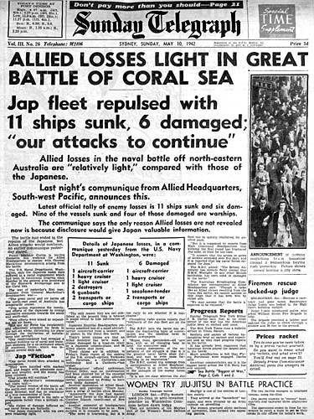
May, 1942 Battle of the Coral Sea
Naval battle fought entirely
with planes from aircraft
carriers.
Battle was a draw (US lost
more ships) but it stopped
Japanese expansion
South towards Australia.

Slide 34
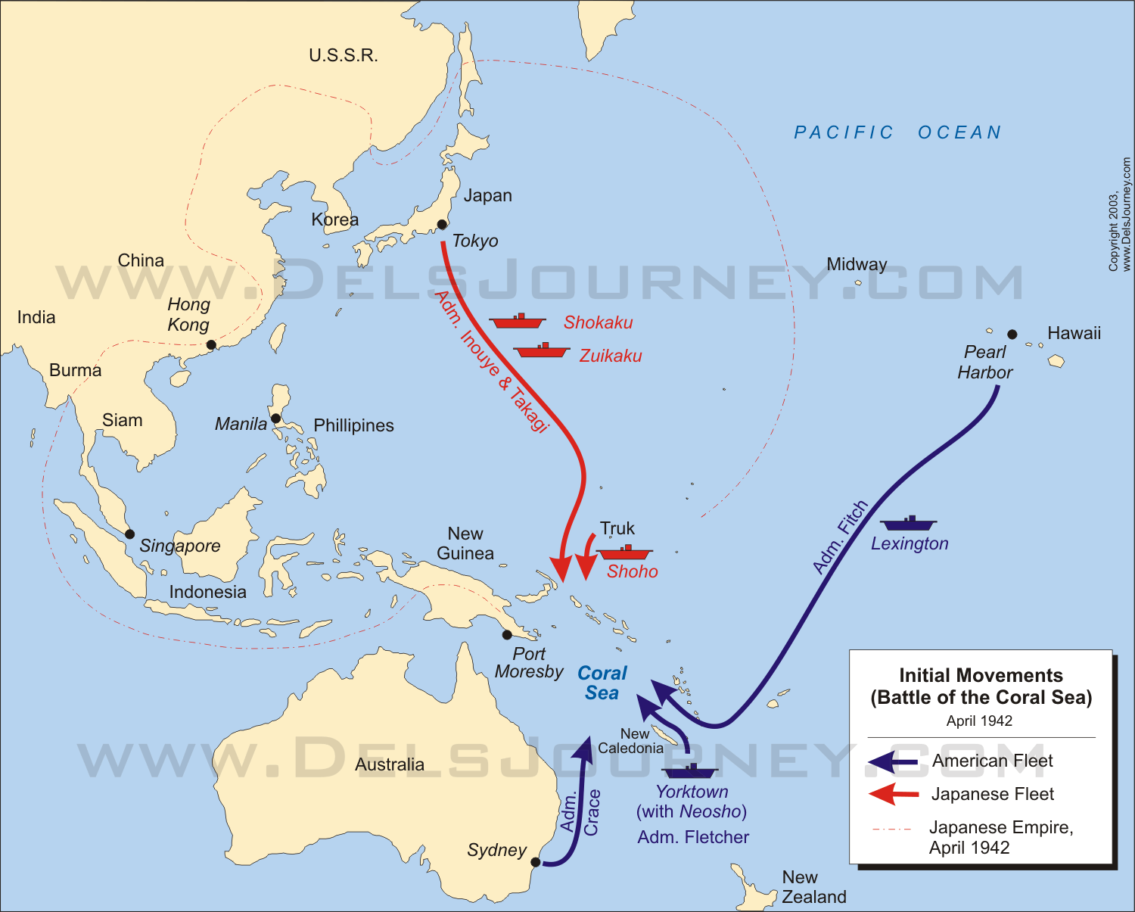

Slide 35
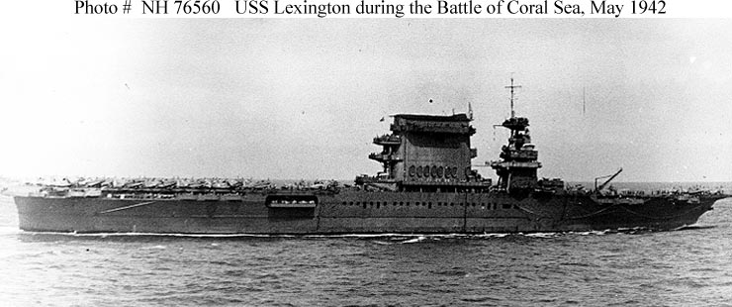

Slide 36
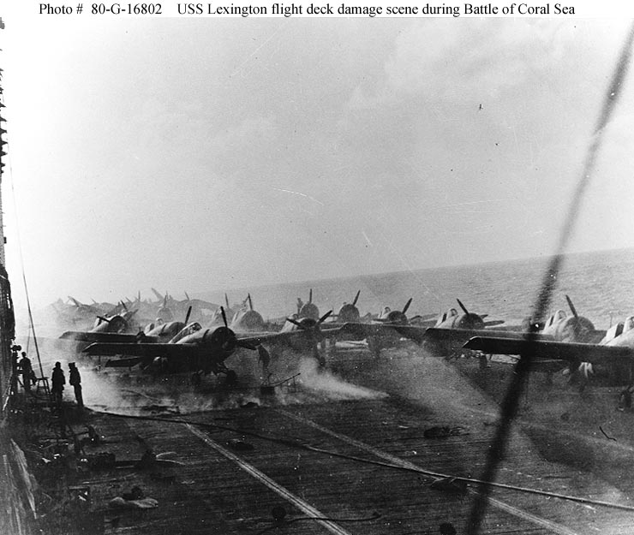

Slide 37
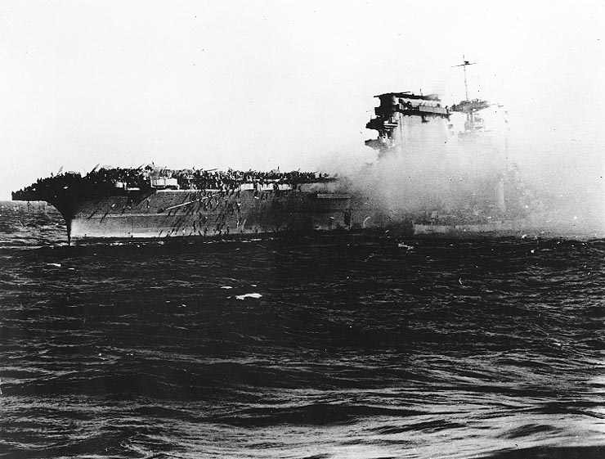
U.S.S. Lexington being abandoned before it sunk

Slide 38
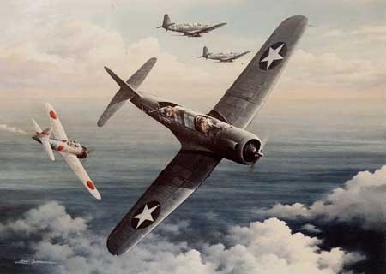
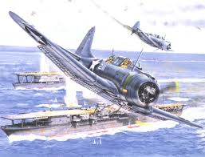
June, 1942 Battle of Midway
Surprise U.S. attack on Japanese
fleet of 200 ships heading to
Midway Island.
Four Japanese aircraft carriers
sunk and 332 planes destroyed.
Why a turning point?
Japanese navy would never
recover from this defeat.

Slide 39
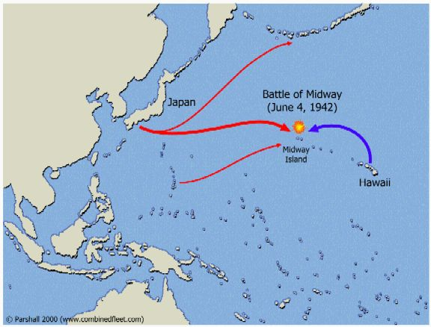

Slide 40
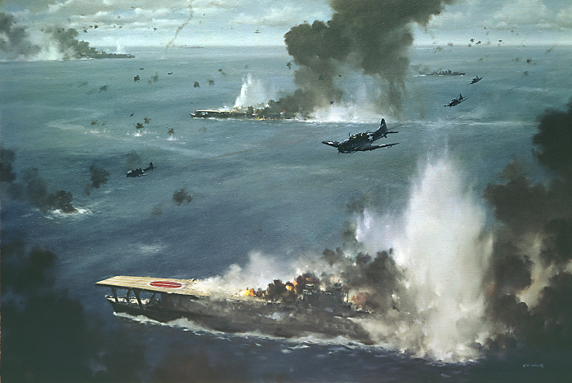

Slide 41
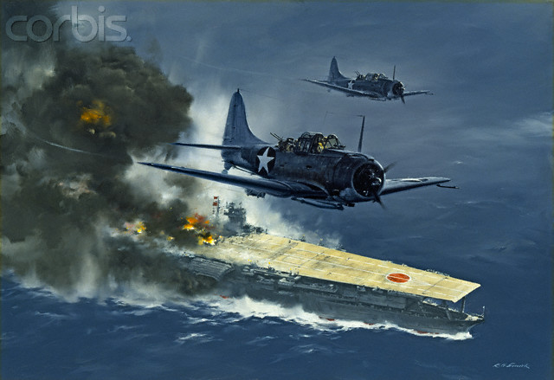

Slide 42
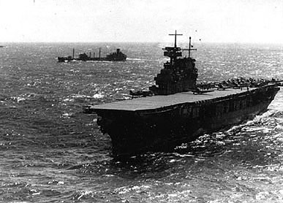
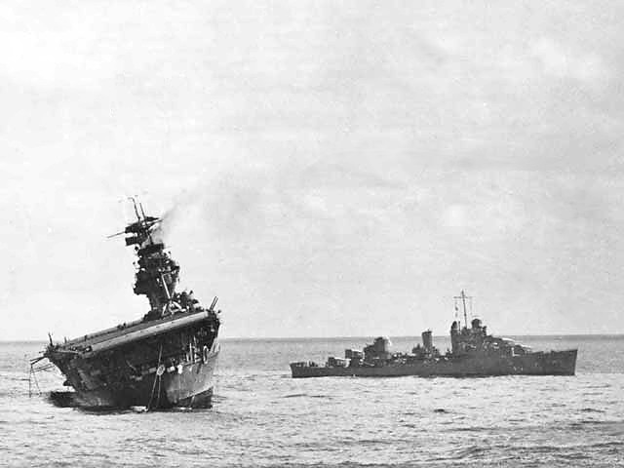
U.S.S. Yorktown
U.S.S. Yorktown sinking at Midway

Slide 43
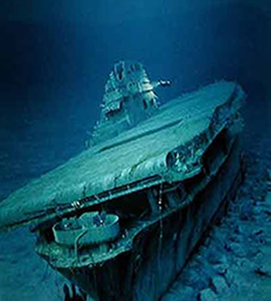
USS Yorktown Discovered After 50 Years
Discovered in
1998 by
underwater
explorer
Robert Ballard,
working with
U.S. Navy.
More than three
miles down.
Japanese carriers
were not found.

Slide 44
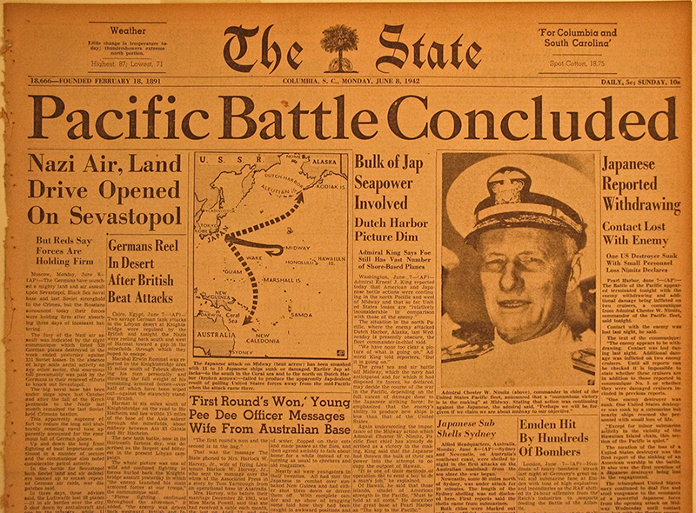

Slide 45
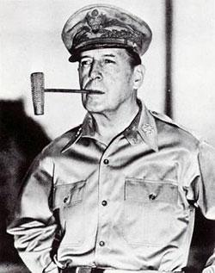
“Island-Hopping” Strategy
After victory at Midway, Allies
went on the offensive against
Japan.
U.S. adopts strategy of “island
hopping” against the Japanese
forces dug in on hundreds of
islands across the Pacific.
Explain this strategy.
Meant jumping over Japanese
strong points and seizing less
fortified islands closer to Japan.
Douglas MacArthur

Slide 46
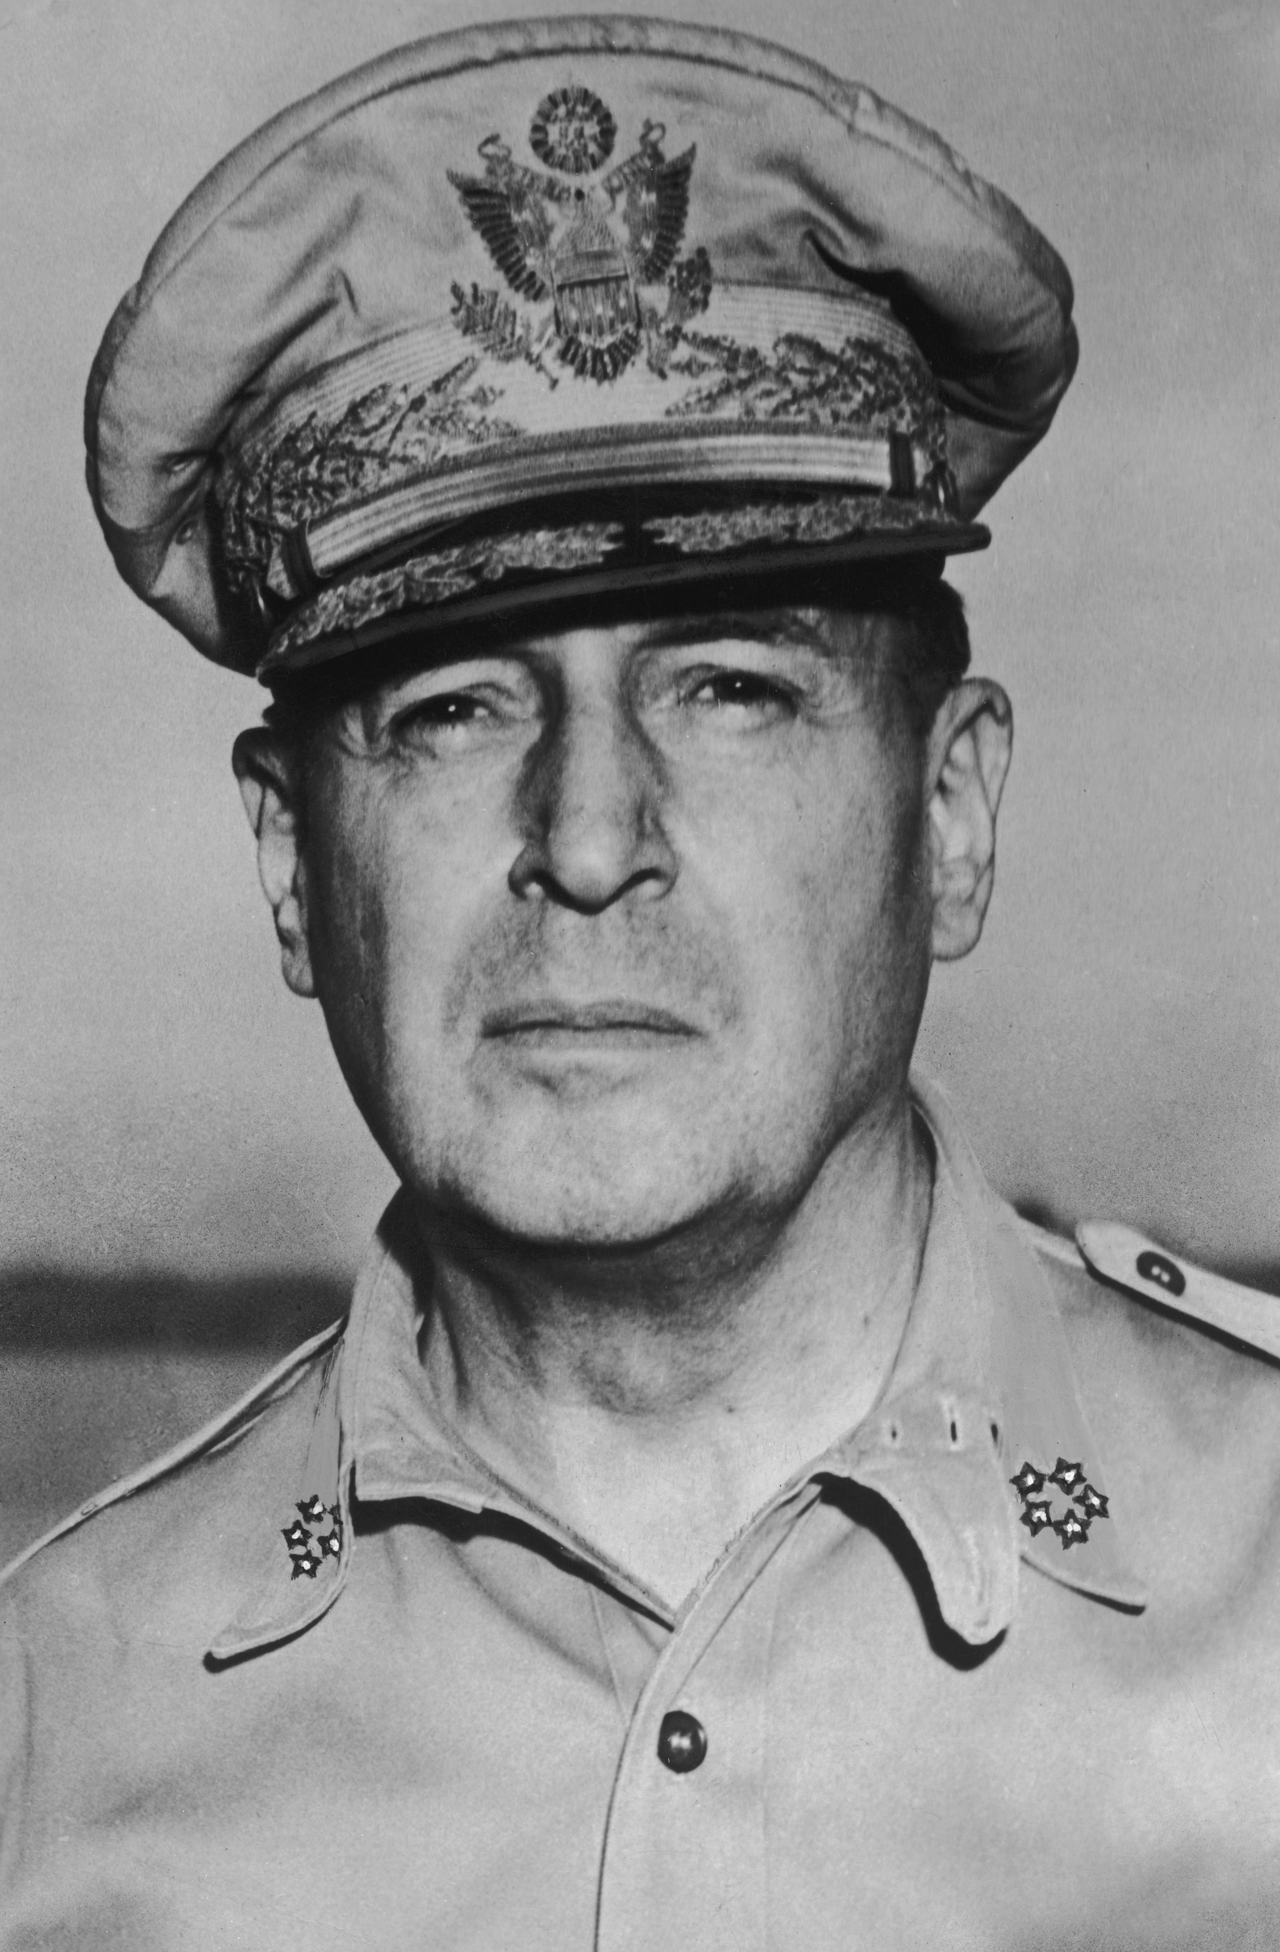
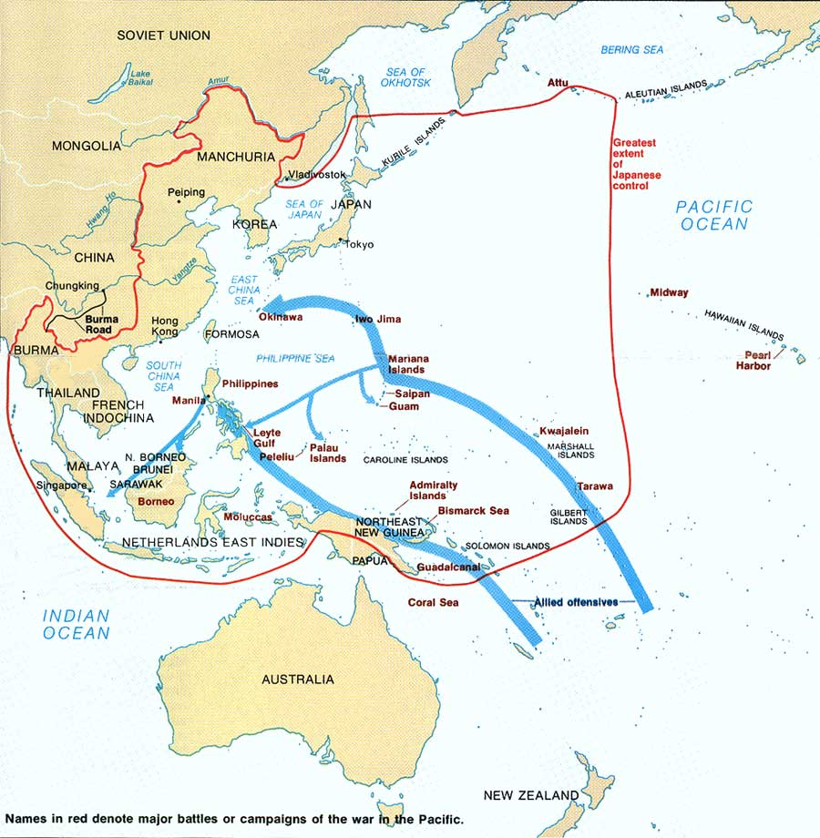
“Island-Hopping”
“Hit ‘em where they ain’t, let ‘em die on the vine”
-Gen. Douglas MacArthur

Slide 47
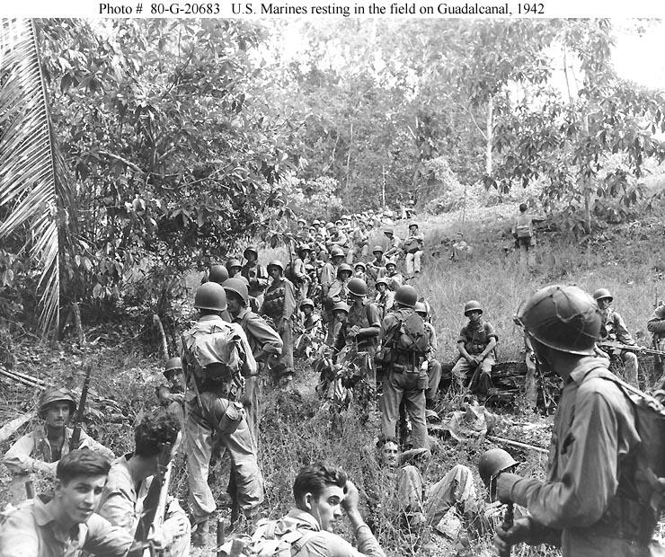
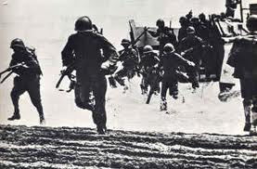
Aug, 1942 – Feb. 1943 Battle of Guadalcanal
U.S. Marines launched surprise
invasion of this island in the
Solomon Islands.
Battle lasted six months.
Japanese lose 23,000 of 36,000
troops before abandoning the
“island of death.”
Why is this battle a milestone?
First time Allied forces took
back territory from Japan.

Slide 48
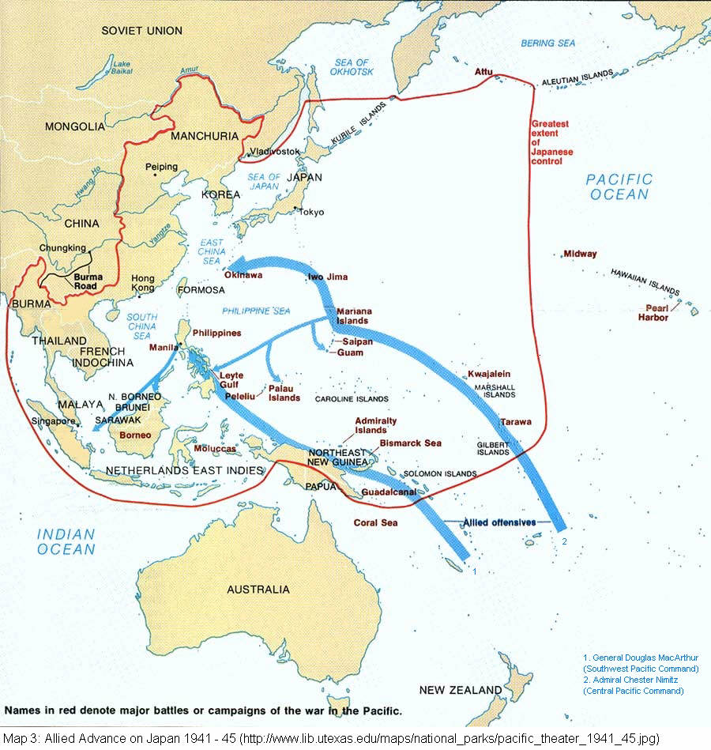

Slide 49
WWII Parts 1 & 2 Group Activity
Assignment 1 (10 pts.)
Using the maps provided show
German Advances in WWII between 1939 - 1941
(p 442)
Japanese & Allies in Asia and Pacific 1941-1945
(p. 448)
Countries, cities, dates, color coded, key
Assignment 2 (10 pts.)
Choose one per group member
West
Dunkirk
Battle of Britain
East
Operation Barbarossa
Leningrad
Pacific
Midway
Guadalcanal
Share with Group

