Slide 1
Unit VI
World War II
Part IV
The Holocaust

Slide 2
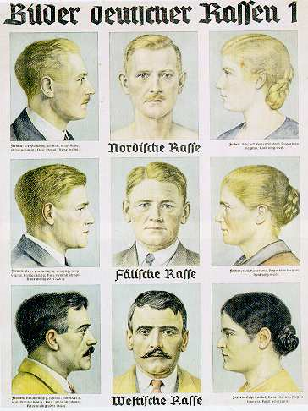
Nazi Anti-Semitism
Nazis believed Germanic
peoples (Aryans) were a
“master race.”
Claimed that non-Aryans,
especially Jews, were
inferior.
Nazis made persecution of
Jews government policy.

Slide 3
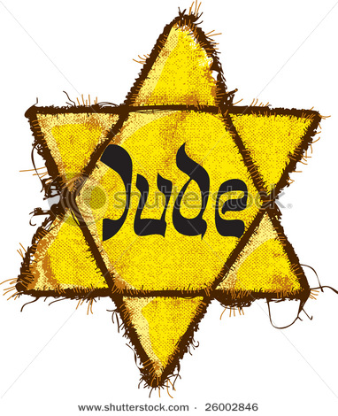
1935 The Nuremberg Laws
Germany’s Jews stripped of
rights and citizenship. Now
only “state subjects.”
Took away rights of Jews to
hold jobs and own property.
Marriages and sexual relations
between Jews and non-Jews
prohibited.
All Jews required to wear a
bright yellow star for easy
identification.

Slide 4
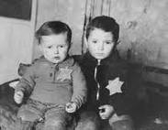
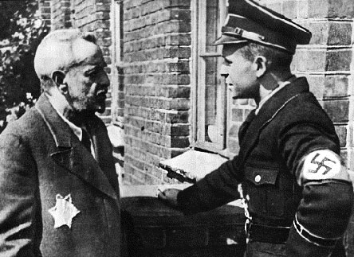
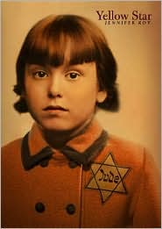
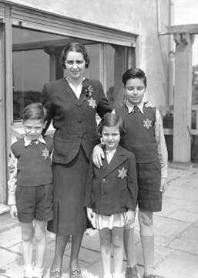
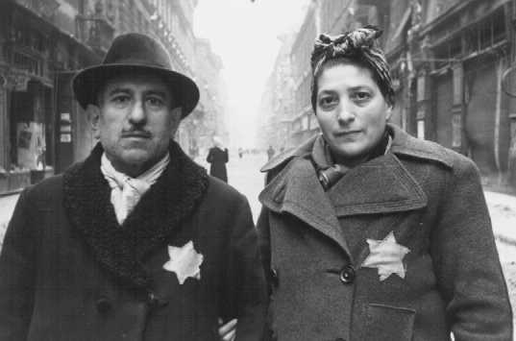

Slide 5
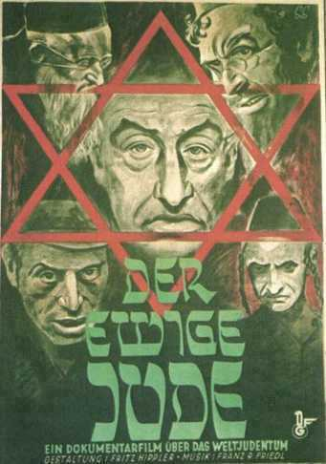
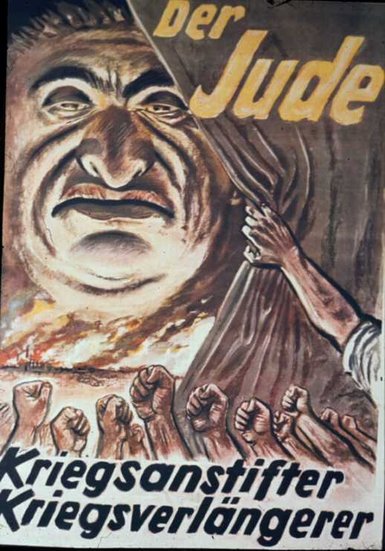
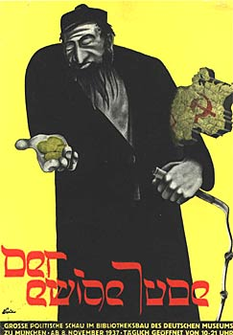
Nazi Anti-Jewish Propaganda

Slide 6
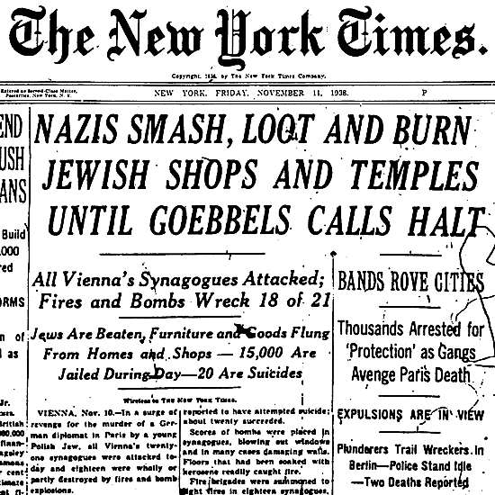
November, 9, 1938 Kristallnacht “Night of the Broken Glass”
The start of an organized
campaign to eliminate
Jews from German life.
Nazi storm troopers
attacked Jewish homes,
businesses, and synagogues
across Germany.
7,000 Jewish businesses
were smashed and 1,300
synagogues were burned.
236 Jews were killed and
30,000 were arrested and
sent to concentration camps.

Slide 7
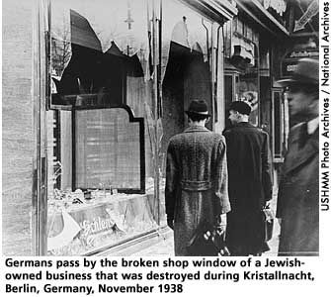
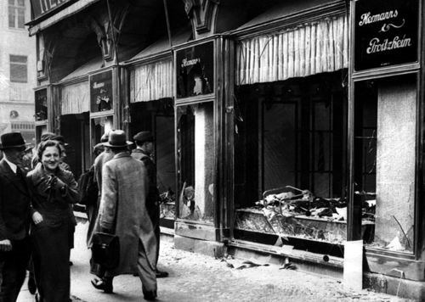
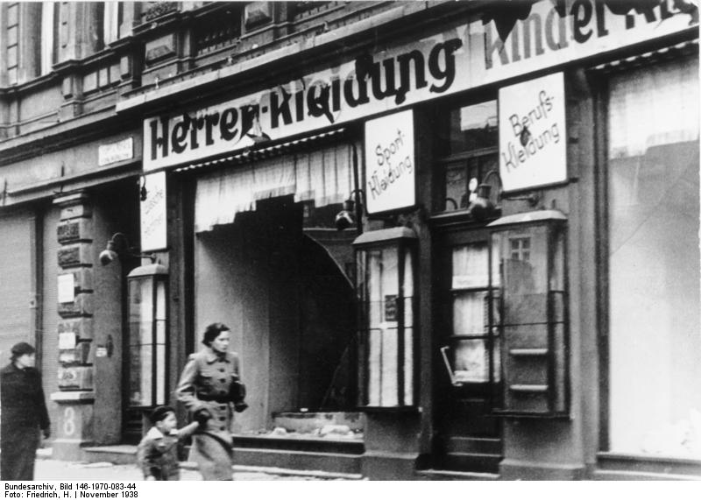
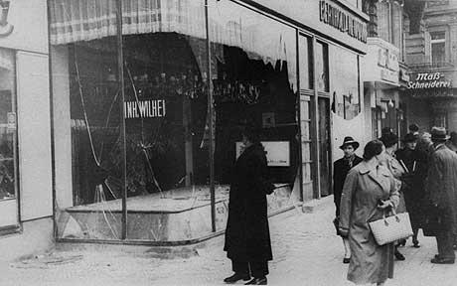

Slide 8
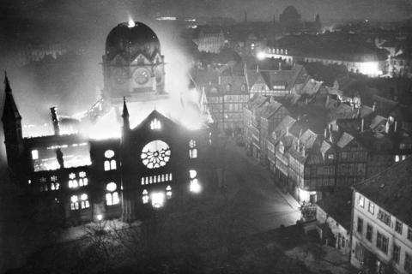

Slide 9
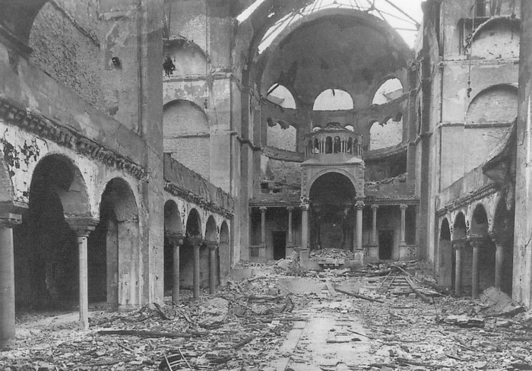

Slide 10
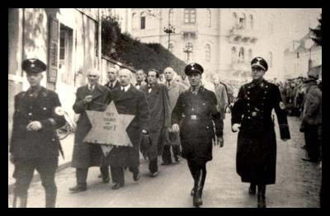

Slide 11
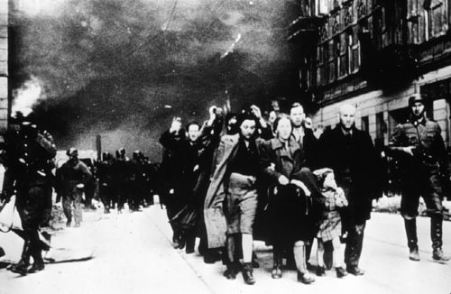

Slide 12
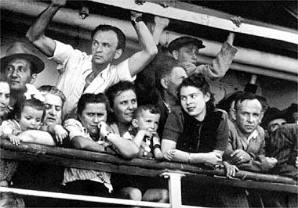
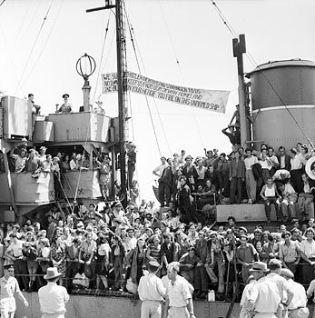
Jewish Emigration
Many Jews fled Germany
to escape violence against
them.
Jews were not welcome in
many places.
U.S. refugee quotas were
rigidly enforced. Only
100,ooo Jews allowed in.
Others turned away.

Slide 13
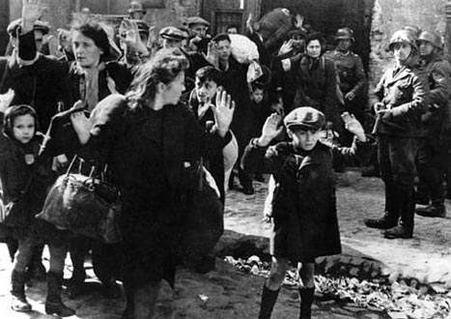
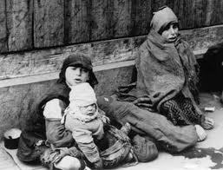
Jewish Ghettos
Nazis rounded up Jews in
areas they controlled and
isolated them in walled off,
sections of Polish cities.
Nazis hoped Jews would
die of disease or starvation.
Jews organized resistance
movements inside ghettos
to smuggle in food and
other needed items.

Slide 14
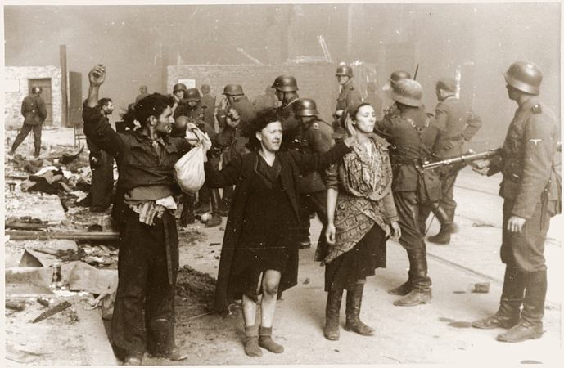
Captured Ghetto Resisters

Slide 15
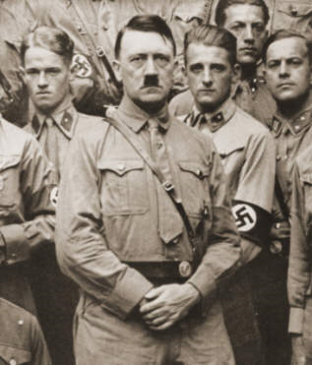
Nazi Program of Genocide Against the Jews
Nazi’s carried out program
of genocide against Europe’s
Jews and other groups they
considered to be inferior and
subhuman.
What is genocide?
The attempt to exterminate a national, racial, ethnic, or
religious group.

Slide 16
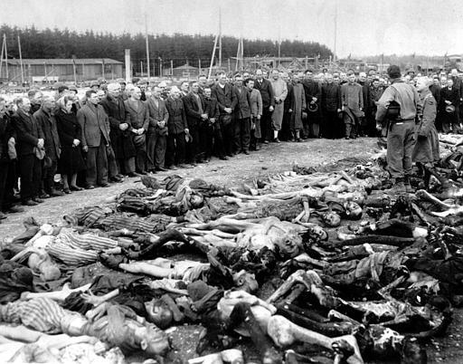
Genocide
“We are in the presence of a crime that has no name”
--Winston Churchill

Slide 17
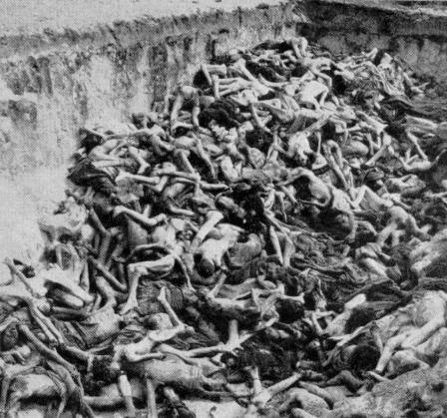
Origins of the Term Genocide
Term “genocide” created
in 1944 in response to the
Holocaust.
The term “mass murder”
didn’t seem adequate to
describe what the Nazis were doing. Why not?
Didn’t account for the intent or motivation behind the crime.
There was no word to describe the organized destruction of an entire group.

Slide 18
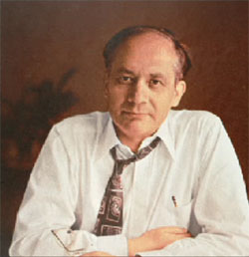
Origins of the Term Genocide
A Jewish legal scholar from
Poland, Raphael Lemkin
coined the term genocide
Combined the Greek word
‘genos’ (race or tribe) with
the Latin suffix ‘cide’ (to
kill).
“To kill a race or tribe.”
Raphael Lemkin

Slide 19
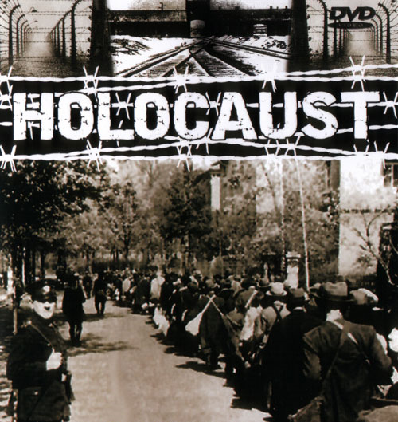
The Holocaust
The “Holocaust” refers to a
specific genocide of the 20th
century.
Specifically, it refers to the
death of six million Jews and
millions of other victims at
the hands of the Nazis before
and during World War II.

Slide 20
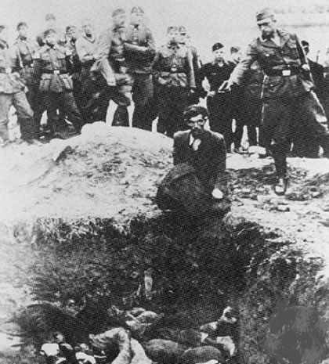
Mass Killings Begin
SS killing squads swept
across Eastern Europe,
hunting down Jews and
executing them.
Additional Jews taken to
concentration camps in
Germany, Poland and
other countries occupied
by the Nazis.

Slide 21
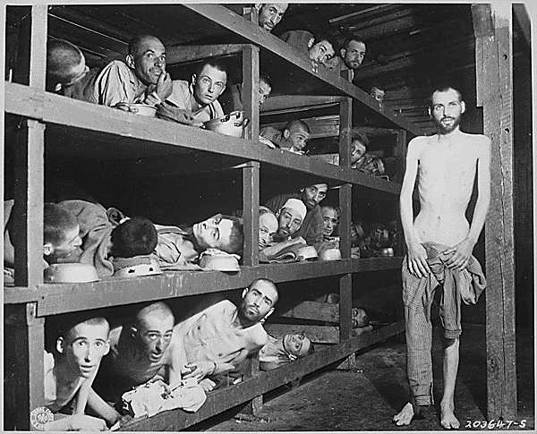
The Concentration Camps
Slave labor camps where
prisoners were worked to
death to support German
businesses.
Prisoners beaten, tortured,
and subjected to cruel
medical experiments by
German doctors.

Slide 22
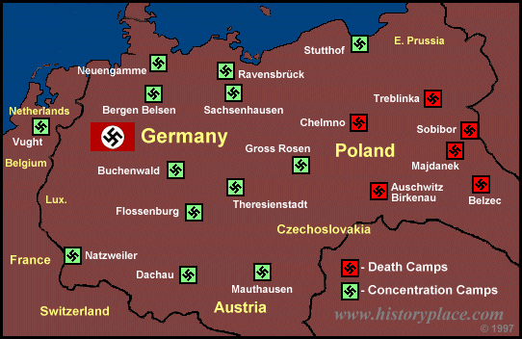

Slide 23
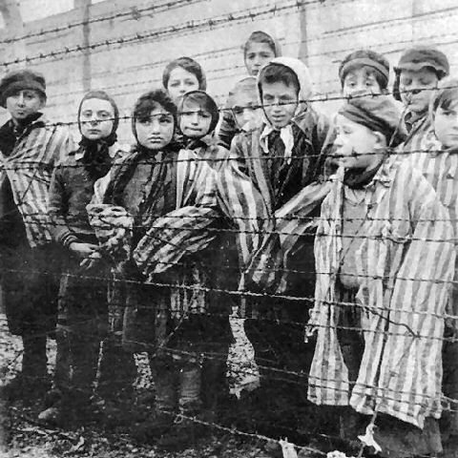
Hitler’s “Final Solution”: The Death Camps
By 1942, Nazis built camps
equipped with gas chambers
for mass murder.
Prisoners poisoned with
cyanide gas. Bodies burned
in large ovens.
Largest and most infamous
of the death camps was
Auschwitz.

Slide 24
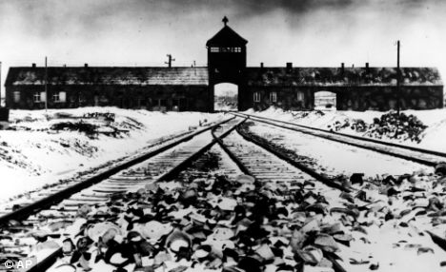
Auschwitz
An estimated 1.3 million victims arrived at Auschwitz between June 1940 and January 1945 and 1.1 million of them died there, including over 900,000 Jews.

Slide 25
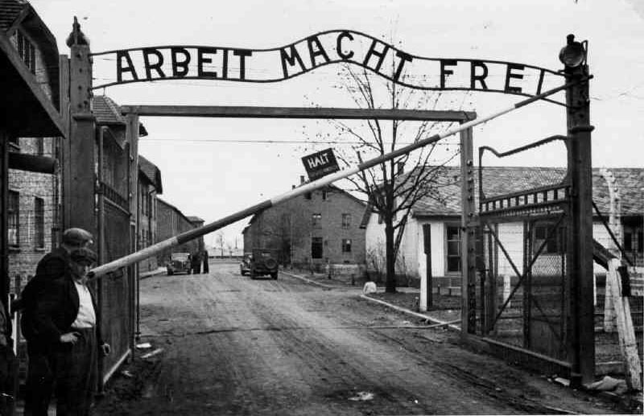
Gateway Sign at Auschwitz:
“Work Sets You Free”

Slide 26
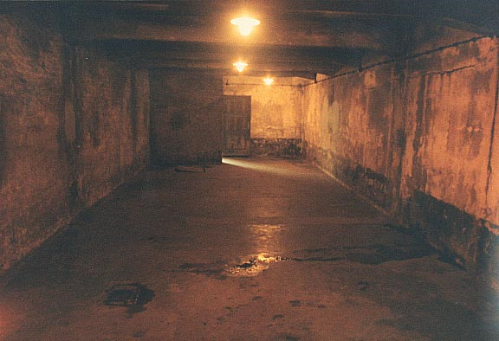
Gas chamber at Auschwitz

Slide 27
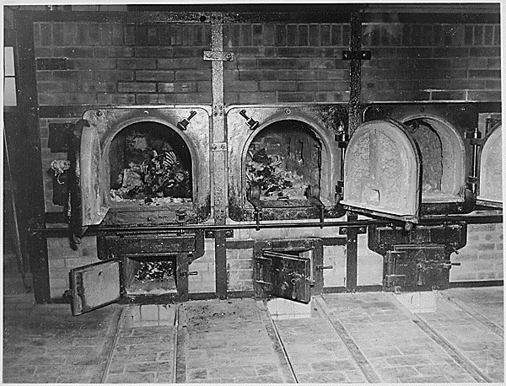
Crematoriums

Slide 29
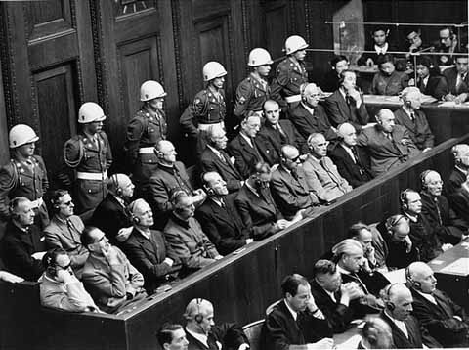
WWII’s Legacy Nuremberg War Crimes Trials (1945-1946)
Allies put surviving Nazi
civilian and military leaders
on trial for waging war
of aggression, violating the
laws of war, and “crimes
against humanity.”
Of 22 defendants, 12 were
sentenced to death.
About 100,000 Germans
and Austrians were tried
and convicted of wartime
crimes.
The defendants at Nuremberg

Slide 30
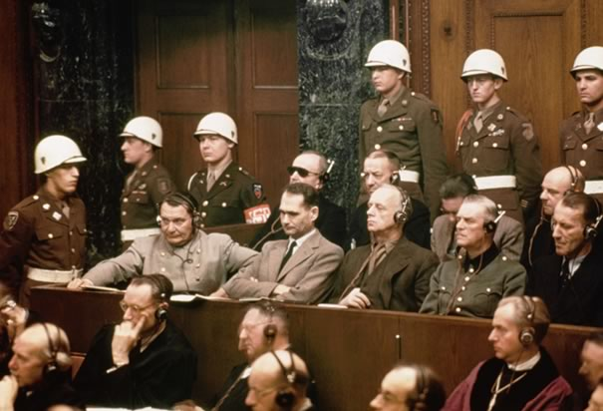

Slide 31
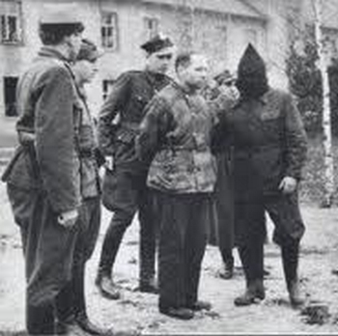
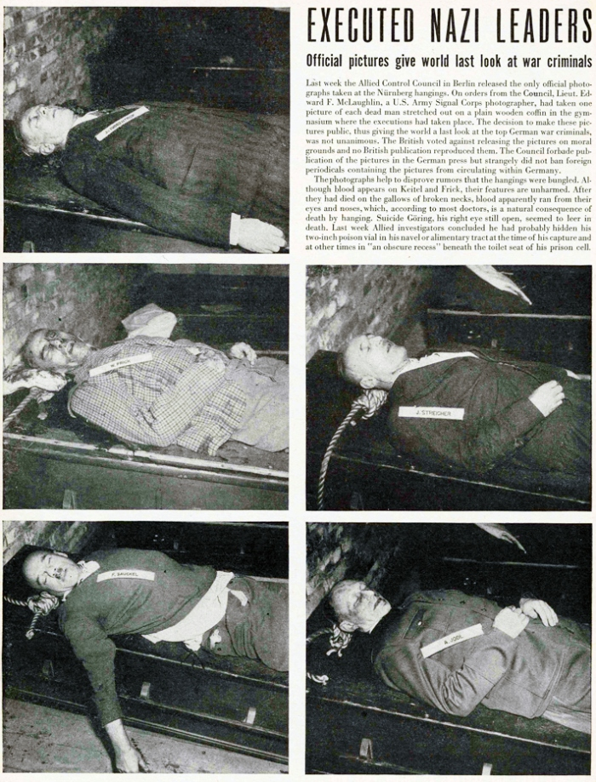

Slide 32
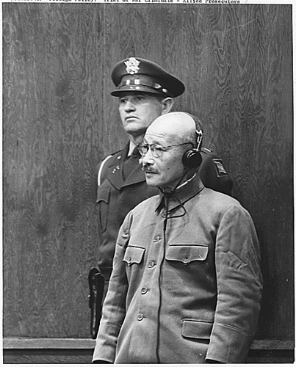
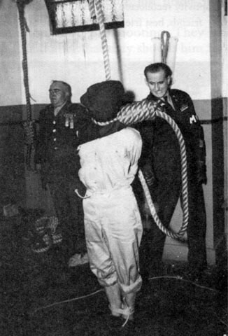

Slide 33
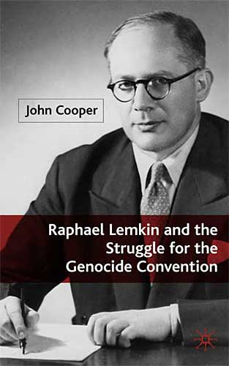
The Genocide Convention
Unanimously passed by UN
General Assembly in 1948.
Made genocide a crime and
obligated nations that signed
it to prevent it and punish
those who commit it.
Implies a promise of “never
again.”

Slide 34
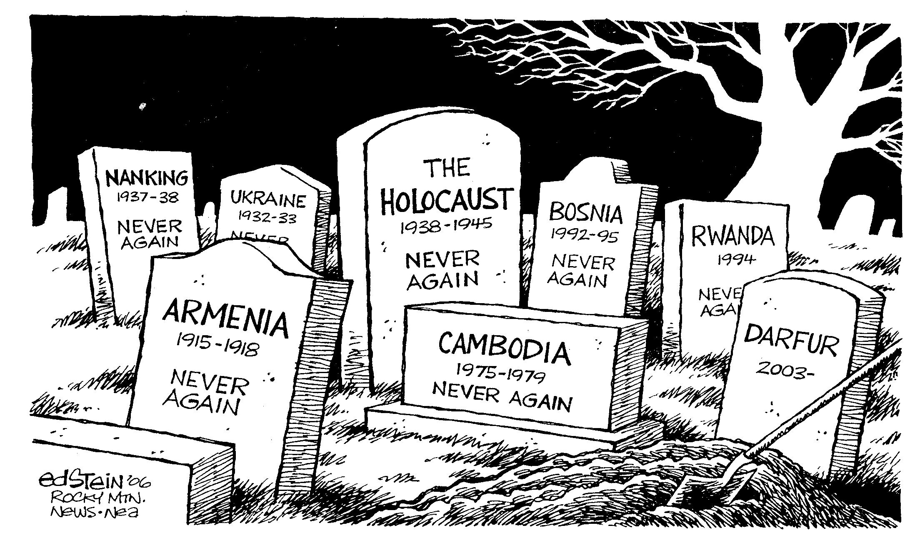

Slide 35
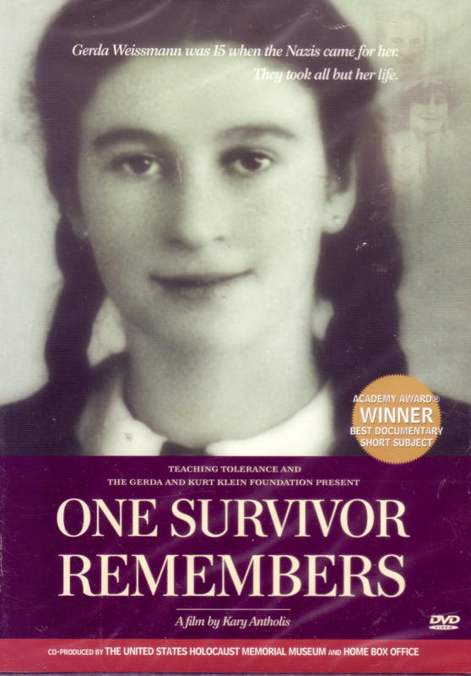
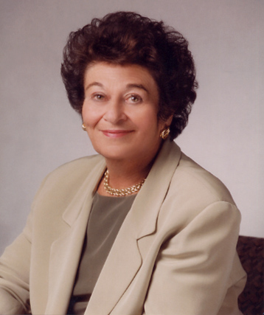
One Survivor Remembers…
Gerda Weissman

Slide 36
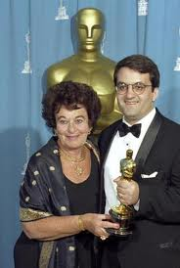

Slide 37
