Slide 1
The Rise & Fall of Napoleon
1799-1815

Slide 2
Napoleon Bonaparte
1769-born in Corsica
Sent to military school in France, at the age of 9
Joins army of the National Assembly
Becomes general of the French Army by Directory in 1796.
“savior of the Republic” after successful cannonade to ward off conservatives

Slide 3
Two important early battles
1796 the Directory sent Napoleon against Austria and the Kingdom of Sardinia
Across the Alps
Won a series of battles, eliminating Austrian Threat
He led army into Egypt
To protect trade interests
Disrupt British/Indian trade
Navel forces defeated by British general
Horatio Nelson
He was able to keep this out of the press in order to protect his image

Slide 4
Coup d'état
Coup d'état- “blow of state”
November 9, 1799 Napoleon put in charge of the military by the Directory
November 10 uses that military to drive out members of one chamber of the national legislature.
Why?
Believed the Directory was corrupt & not interested in promoting the betterment of French welfare
Also lost confidence of the people

Slide 5
Dissolves the Directory
French Consulate
The 2nd Coalition of anti-French Powers
Three Consuls instated
3 leaders called Consuls
1st Consul- Napoleon Bonaparte
2nd Consul- Napoleon’s brother Lucien Bonaparte
3rd Consul-former Director- Sieyes
Napoleon drafts a new constitution
naming him as 1st consul of France
Britain, Austrian & Russian agreement to drive Napoleon from power
Eventually all three sign a peace agreement, with France
Through Diplomacy and War
Europe at peace for the
1st time in 10 years!!
“for life…unbeknownst to the other consuls”

Slide 6
Napoleon’s Rule of France
1800 plebiscite- vote of the people on specific questions
1800- plebiscite votes YES-1st Consul of France
1802-plebiscite votes YES-1st Consul of France for life
1804-plebiscite votes YES- EMPEROR OF FRANCE
Why would the French people vote to give power back to a single ruler?
They were desperate for strong leader who could provide order and stability.

Slide 7
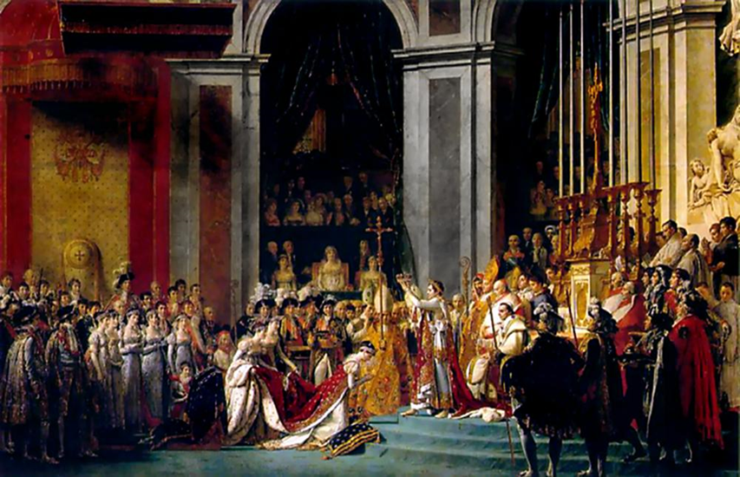
Napoleon's Coronation
December 2, 1804
Napoleon’s Coronation
at
Notre Dame Cathedral
He crowns himself
-big controversy-WHY??

Slide 8
Restoring Order in France
Restores order & stability to France
Although he was Emperor he did not return to the days of King Louis XVI
Kept many of the changes achieved by the revolution
Reforms focused on 4 areas
Economy
Society
Religion
Laws

Slide 9
Economic Changes
1st priority was to get the economy on solid ground
Established a National Bank
Efficient tax collection system
Which assured govn’t a steady income
Balanced budget
Paid off debt
Sold Louisiana Territory
To whom?
What was it called?
Who explored it?
The United States
The Louisiana Purchase, 1803
Lewis & Clarke

Slide 10
Benefits of Selling Louisiana Territory
Earned Napoleon $15 million that he could spending on conquest of Europe.
Increased power of U.S., creating rival for Britain “who sooner or later, will humble her pride.”

Slide 11
Social Changes
Wanted to reduce government corruption & improve services
Welcomed émigrés (nobles) back on good behavior
Promoted officials by merit not nobility
Set up Lycees (public schools)
Both ordinary citizens & nobility

Slide 12
Religious Changes
Signed CONCORDAT (agreement) with Pope Pius VII
New relationship b/w church and state
Separated church from national affairs
Allowed freedom of religion
Promoted Catholicism as “great majority” and “true” religion of France
Eliminated any political control of Pope

Slide 13
Legal Changes
He believed this was his greatest work!!
Established the Napoleonic Code of Laws
Set of 101 new laws establishing strong sense of law and order
Many laws still in use today
Equality under the law
Censured newspapers
Reduced women’s rights
Right to sell property
Restored slavery in French Colonies

Slide 14
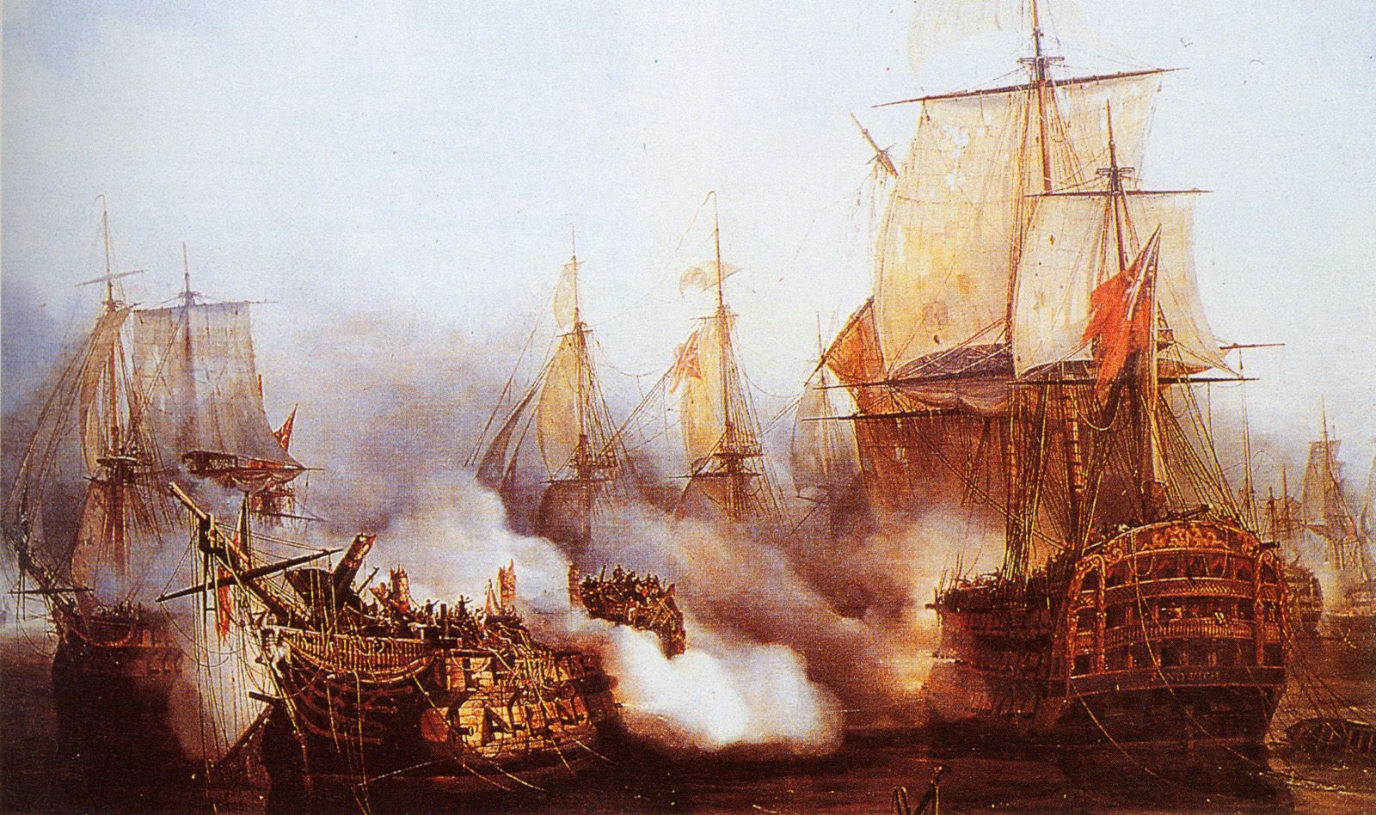
October, 1805 Napoleon’s Only Major Defeat
Battle of Trafalgar

Slide 15
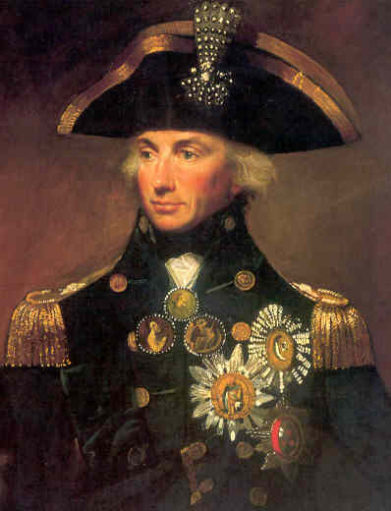
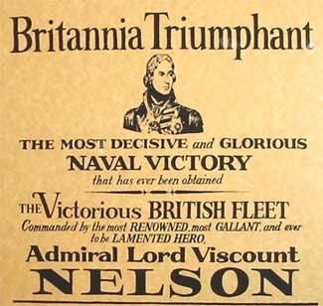
The Battle of Trafalgar
British commander Horatio Nelson defends large Spanish-French fleet
What did this mean for France?
British navy remained Supreme for the next 100 years
Forces Napoleon to give up plans of invading Britain
Complete PKT pg. 35

Slide 16
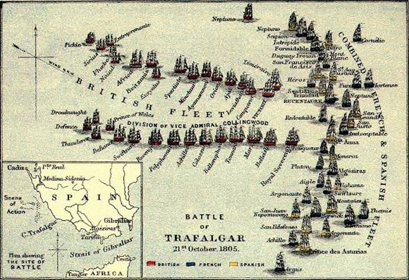

Slide 17
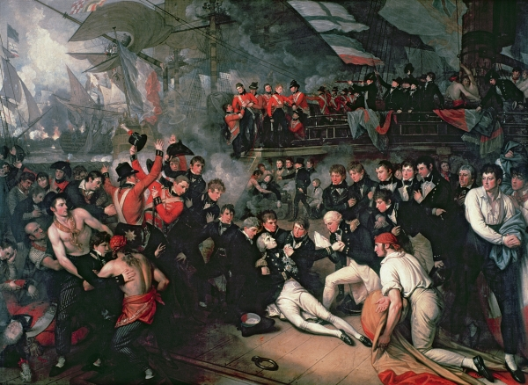
Death of Lord Nelson

Slide 18
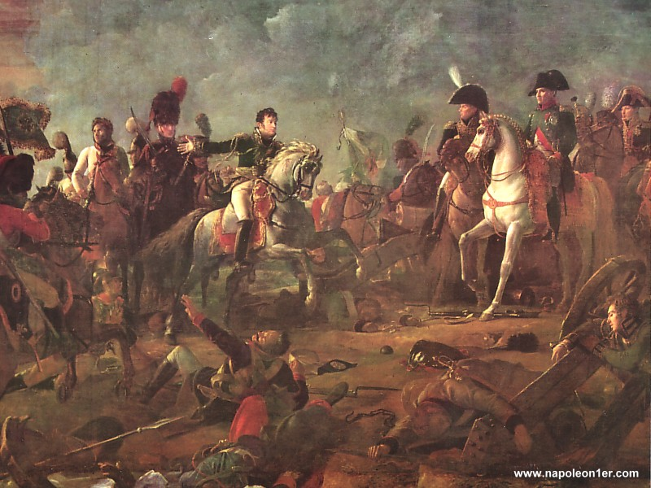
December, 1805 Battle of Austerlitz
One of Napoleon’s greatest victories.
Defeated armies of Russia
and Austria.
Austria made peace with France
and lost territory as a result.
Read and complete pkt. Pg. 38

Slide 19
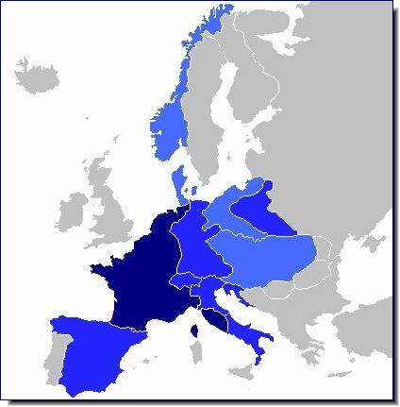
Napoleon’s Empire At Its Peak, 1807-1812
Largest empire in Europe
since the Roman Empire
What were the only major countries not
under Napoleon’s control ?
Britain
Portugal
Sweden
Ottoman Empire
Russia

Slide 20
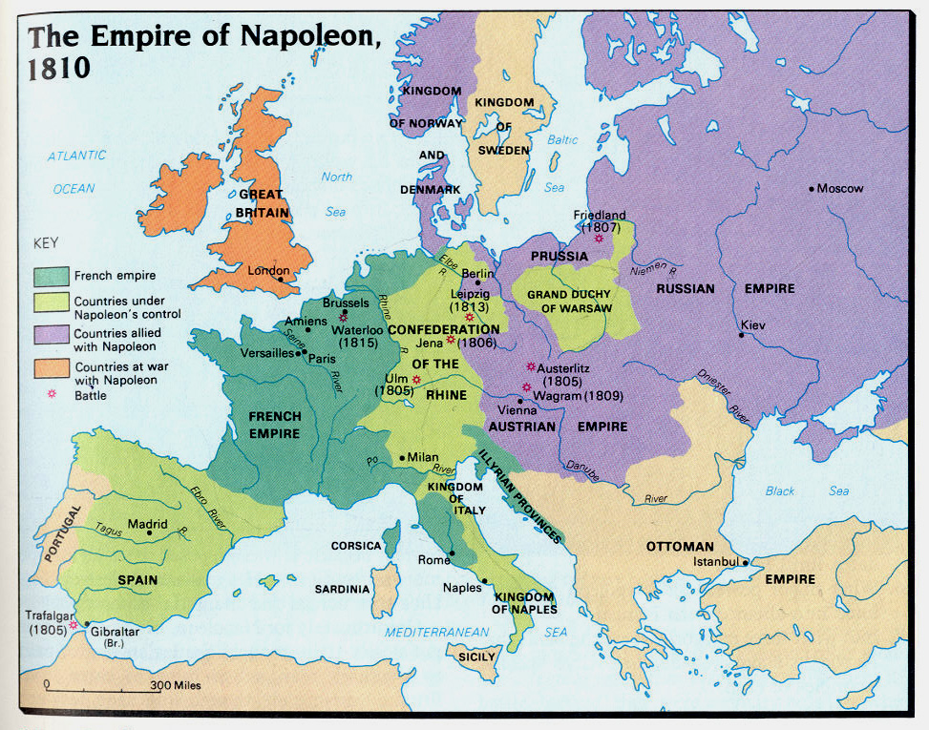

Slide 21
Decline and Fall of Napoleon’s Empire
French empire was huge but unstable.
Short-lived. Only lasted for five years (1807-1812).
Quickly collapsed due to three costly mistakes made by Napoleon.

Slide 22
The Collapses of Napoleon’s Empire
Napoleon’s conquests aroused nationalism in France & across Europe
Empowered France as well as it’s enemies
Napoleon’s love of power was a contributing factor to his ultimate downfall
“I love power, as a musician loves his violin”
Three Costly Mistakes
The Continental System
The Peninsular War
The Invasion of Russia

Slide 23
The Continental System ~ 1806
Unsuccessful attempt to cut off all trade, called a blockade, between Britain & the rest of the European continent.
Intended to destroy Britain’s economy
Why did it fail ?
Smugglers
European countries disregarded it
Britain imposed it’s own blockade, and had a stronger Navy to enforce it
Blockade hurt France more than it helped
War of 1812
Between Britain & U.S. over blockade imposed on France
Ended in draw
Minor inconvenience for Britain

Slide 24
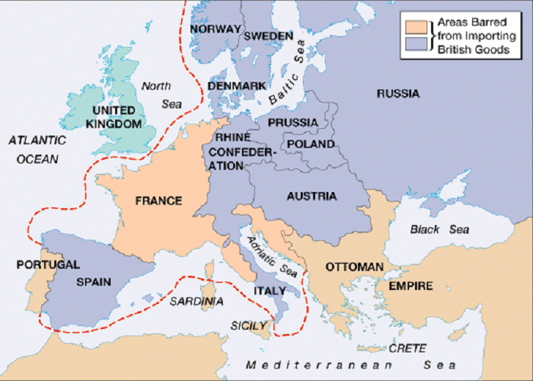

Slide 25
The Peninsula Wars~1808
Napoleon sent his armies through Spain to invade Portugal. Why?
Deposed Spanish king and put brother on the throne, inflaming Nationalist
feelings throughout Spain.
Nationalist feelings were spreading all across Europe
Five year Peninsula War (1808-1813) against Spanish guerrillas and British forces
drove Napoleon’s troops out of Spain.
Napoleon lost 300,000 men, weakening the French empire
.
They were ignoring the Continental System

Slide 26
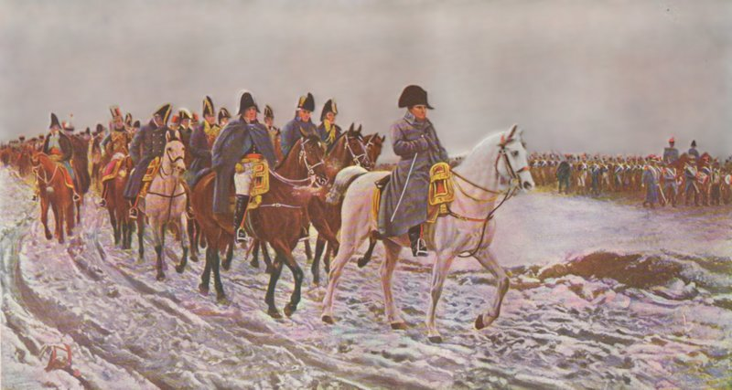
The Invasion of Russia~1812

Slide 27
The Biggest Mistake of All
Napoleon was convinced that Russia Tsar Alexander I was conspiring with Britain against him.
And breaking the Continental System
Invaded Russia June, 1812.
Against the advise of Many
Napoleon’s armies included many non-French draftees with little loyalty to him.

Slide 28
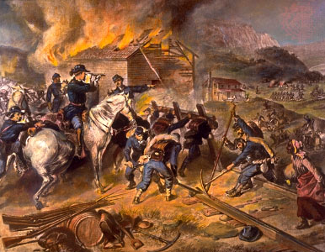
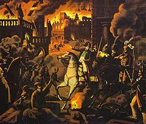
The Biggest Mistake
Russian strategy?
Russian armies retreated
towards Moscow,
practicing “scorched earth”
policy.

Slide 29
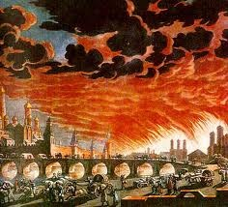
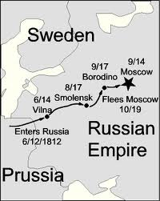
Finally get to Moscow, but…
Napoleon entered Moscow on Sept. 14 to find the city in flames.
Napoleon’s fatal mistake?
Waited fatal five weeks in Moscow for peace offer from Russia czar that never came.
Mid-Oct.: Ordered starving armies to turn back -- but it was too late…

Slide 30
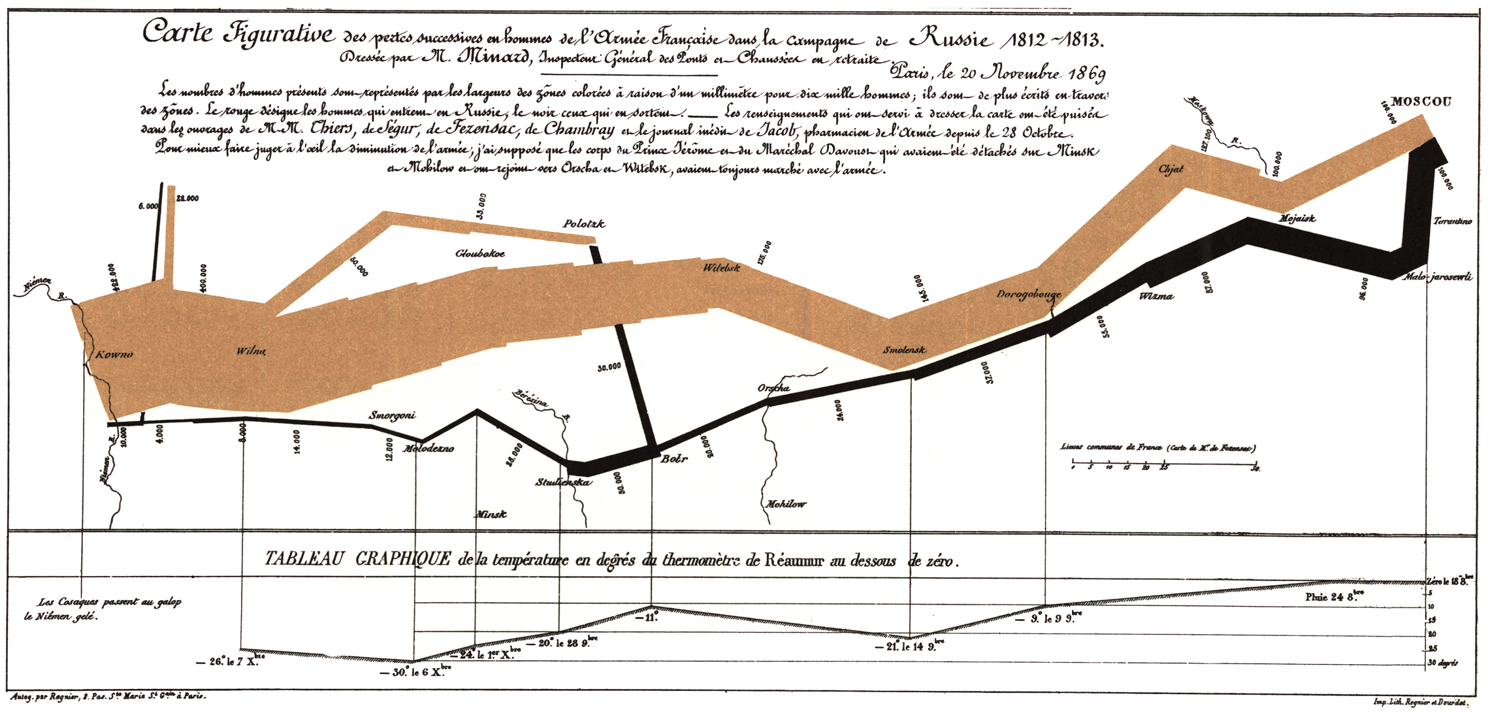
Battle of Borodino
September 7, 1812
30,000 French Deaths
45,000 Russian Deaths
Sept 1812 ??
Importance??
Moscow ~ approx 100,000 troops
Approx 450,000 troops ~ April 1812
Approx 170,000 troops ~ Why, So few?
Moscow burned, resources lost

Slide 31
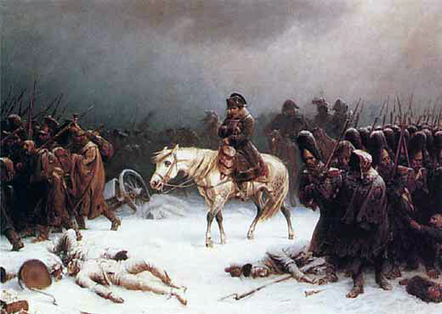
Napoleon's Withdrawal from Russia by Adolph Northen

Slide 32
Oct 1812 no surrender from Russia, Retreats w/ 100,000 troops
Nov. 1812 Smolensk, finds starvation & disease.
Crossing the Berezina River
Dec 6 1812 only 10,000 make it out of Russia
-30°
-20°

Slide 33
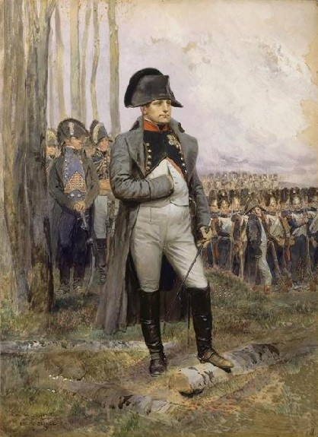
Napoleon’s Defeat, 1813
Napoleon’s enemies now Unite against him.
AGAIN
Britain, Russia, Prussia, join Austria, and Sweden coalition against France
4th Coalition .
In Battle of Leipzig, Germany (Oct.1813) Napoleon’s army is crushed by Allies.
army of inexperienced, unmotivated soldiers

Slide 34
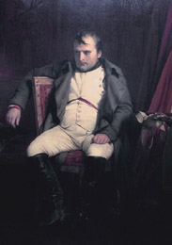
Napoleon’s Defeat
By January 1814 Austrian, Russian & Prussian armies push into Paris
Napoleon wants to fight but generals refuse
April napoleon abdicated throne to Russian Czar Alexander I
Napoleon banished to Elba
Island of the coast of Italy

Slide 35
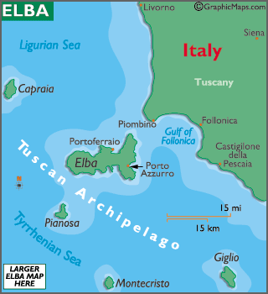
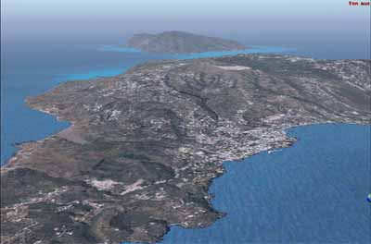
Island of Elba
Not a bad place to be Exiled ??

Slide 36
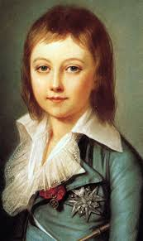
France’s Bourbon king
Louis XVIII (brother to Louis XVI)
Crowned king of France
Very unpopular
Suspected of wanting to undo reforms of the Revolution
All the motivation Napoleon needed to regain his throne
What about Louis XVII??

Slide 37
Napoleon Regains Power, 1815
Escapes Elba with 7 ships and a small army
He rallied the French people and regained control of the army
“you will be liberators of you country”
Reinstated as Emperor
Brother fled
Reigned for 100 Days
Napoleon landing in France

Slide 38
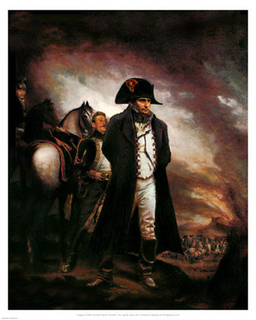
Napoleon at Waterloo
Complete pkt. Pg. 42

Slide 39
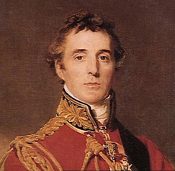
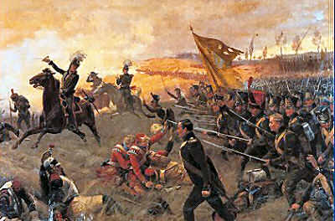
The Battle at Waterloo
Duke of Wellington
European powers quickly gathered their armies against Napoleon.
Duke of Wellington commanded the British Army, joined by Prussian Army defeated Napoleon in the Belgium town of Waterloo
Wellington later became Prime Minister

Slide 40
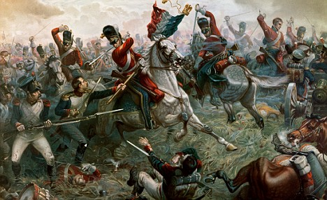
Napoleon’s Final Defeat: The Battle of Waterloo
Battle of Waterloo (5:00)
See PBS segment on Waterloo (12:00)

Slide 41
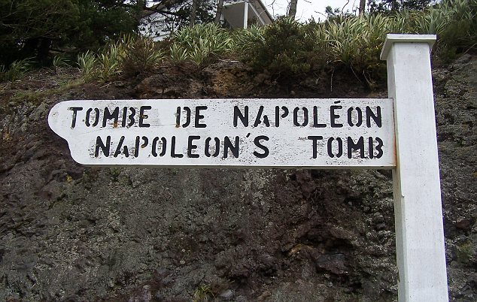
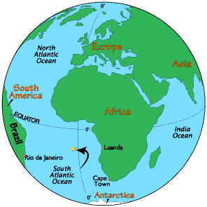
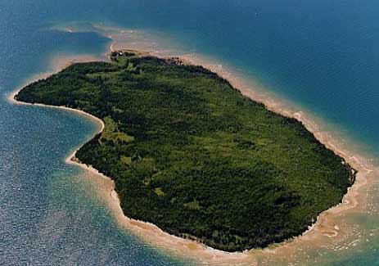
Napoleon Exiled Again, 1825
St. Helen’s in the South Atlantic
Died of a stomach ailment (possibly cancer) six years later

Slide 42
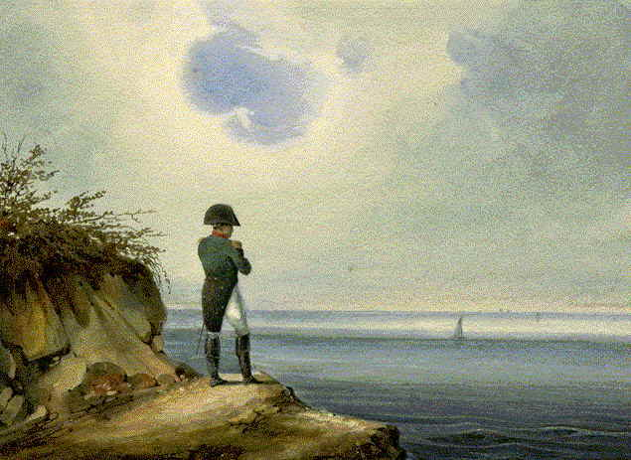
Napoleon on St. Helena, 1815-1821
PBS segment on St. Helena (start at 5:55)

Slide 43
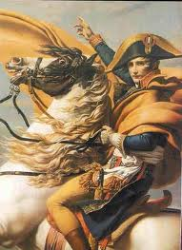
Napoleon’s Legacy
Military genius and brilliant administrator, but…
His military victories must be measured against the millions of lives lost in his wars.
Only real lasting achievements
were non-military:
Napoleonic Code and other government reforms.

Slide 44
“He was as great as a man can be without virtue.”
-Alexis de Tocqueville
French Statesman and writer

Slide 45
Napoleon’s Legacy
Napoleon’s conquests aroused
feelings of Nationalism
across Europe.
His defeat opened the door to the establishment of a new
order in Europe – established at the
Congress of Vienna in 1815-1816.

Slide 46
Views on Napoleon
Complete Packet pages 44-47.
Is he a Hero or a Villain?
What were the lasting effects of Napoleon’s rule?
Napoleon Political Cartoon Assignment

Slide 47
Can we?
Explain how the French Revolution led eventually to the rise of Napoleon.
Explain how Napoleon’s rule led to war in Europe.
Analyze how the French Revolution and Napoleon led to revolutions in Europe and Latin America.

