Slide 1
Unit V: The Interwar Years-Revolution and Nationalism- Part 5 1919-1939
Fascism Rises in Europe

Slide 2
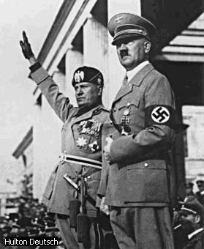
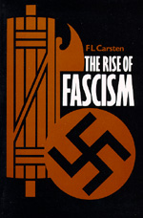
The Rise of Fascism
Video Link: “The Rise of Fascism”
The Rise of Fascism (9:58)

Slide 3
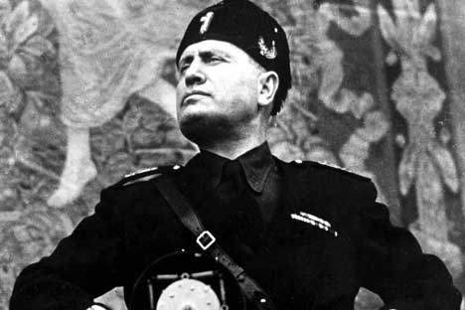
The Rise of Fascism in Italy
Benito Mussolini

Slide 4
Postwar Economic Problems in Europe
After WWI, Europe faced severe economic problems:
Inflation
Worldwide depression
New democracies weak and ineffective in addressing
these problems.
Economic despair caused people to lose faith in democratic government and turn to an extreme system of government called fascism.

Slide 5
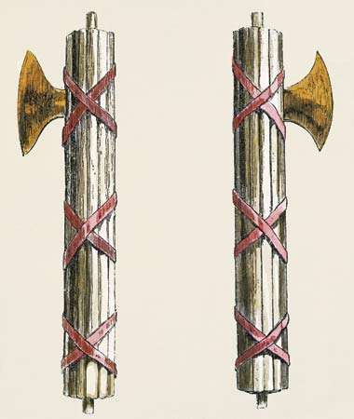
Fascism
Political ideology invented by
Mussolini and introduced in
Italy in the 1920s.
Word derived from the Latin
“Fasces”~ meaning “bundle
of sticks”.
A bundle of sticks wrapped
around an axe became the
symbol of the Fascist party
in Italy.

Slide 6
Characteristics of Fascism
Ultra- conservative (reactionary) nationalism.
Constant use of patriotic mottos, slogans, symbols, songs, etc.
Flags are seen everywhere.
Create a patriotic frenzy over the need to eliminate a common threat or “enemy” Can be racial, ethnic, a religious minority, liberals, communists, etc.
Totalitarianism
Demands absolute obedience to the state and to an authoritarian leader.
Government controls all aspects of society.
One-party dictatorship. People denied individual rights.
Anti-democratic

Slide 7
Characteristics of Fascism (con’t)
Organized violence used to suppress opposition.
Militaristic, expansionist foreign policy.
Preserves capitalism, but with state control of large corporations.
Main supporters: Upper and upper-middle classes and industrialists
Enemies: Labor unions, socialists, and communists .
Where is fascism on the political spectrum?

Slide 8
Support for Fascism in Italy and Germany. WHY?
Fascist leaders in countries like
Germany and Italy promised to
revive the economy, rebuild the
military, and restore national
pride.
People turned to these leaders
out of desperation.
People in both countries were
desperate for strong leaders who
would take action.

Slide 9
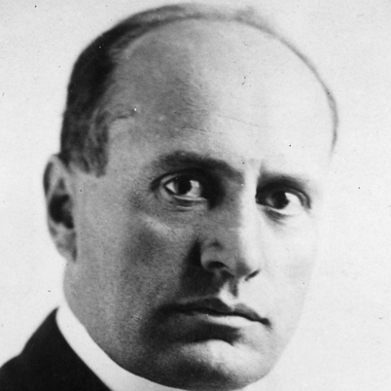
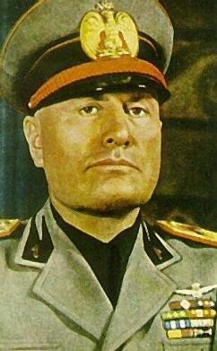
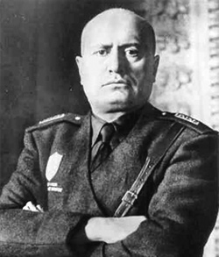
Benito Mussolini Rises to Power in Italy
“My objective is simple. I want to make Italy great,
respected, and feared.”
- Benito Mussolini

Slide 10
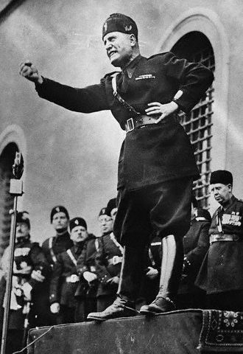
Benito Mussolini’s Appeal?
Great orator who roused audiences
with emotional speeches.
Italy left in financial ruin after WWI.
Mussolini stirred up people against
the countries that had emerged rich
and strong from the war.
Appealed to national pride. Vowed
to restore the glory of the Roman
Empire.
Promised to revive Italy’s economy
and rebuild its armed forces.
Promised to restore ORDER!

Slide 11
Mussolini’s Appeal
"Mussolini is a riddle to me. Many of his reforms attract me. He seems to have done much for the peasant class. I admit an iron hand is there. But as violence is the basis of Western society, Mussolini's reform deserve an impartial study…
What strikes me is that behind Mussolini's implacability is a desire to serve his people. Even behind his emphatic speeches there is a nucleus of sincerity and of passionate love for his people. It seems to me that the majority of the Italian people love the iron government of Mussolini.“
- Mohandas Gandhi

Slide 12
Mussolini’s Appeal
“If I had been Italian, I am sure I would have been with you from the beginning.”
- Winston Churchill (1930s)

Slide 13
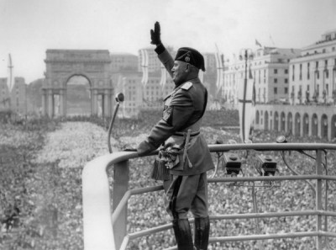

Slide 14
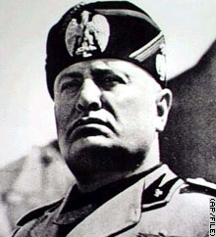
Mussolini Comes to Power in Italy
Founded Fascist Party in 1919
and gained support as Italy’s
economy worsened.
His “Black Shirts” attacked
Communists and Socialists.
Gained the support of what
groups?
Those who feared a worker’s
revolt– the middle classes, the
aristocracy, landowners and
industrial leaders.

Slide 15
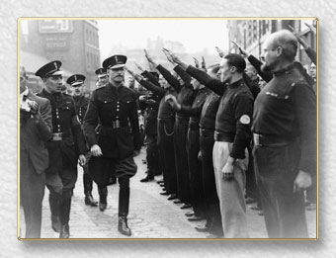
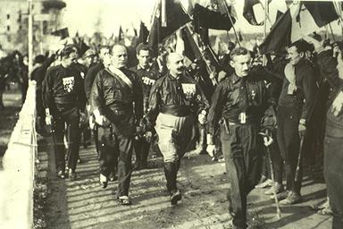
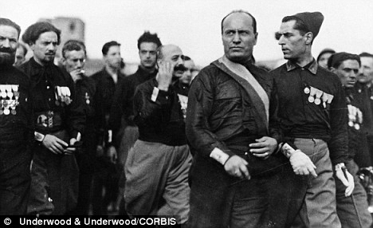
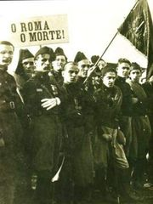
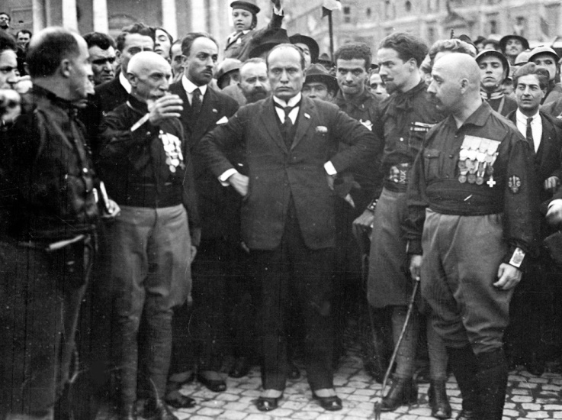
Mussolini’s Private Army - The Black Shirts

Slide 16
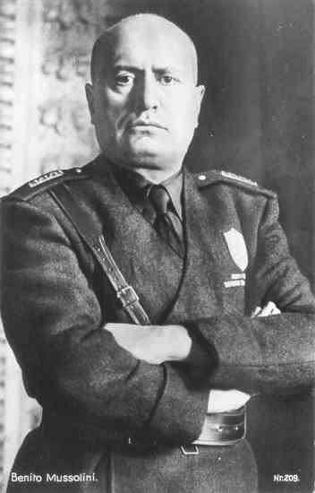
Mussolini Comes to Power
1922 – 30,000 Fascists marched
on Rome. Demanded that King
Emmanuel III put Mussolini in charge of the government.
Threatened with armed uprising.
the king agreed to appoint him
Prime Minister.
Mussolini proclaimed himself to
be Il Duce (ihl DOO-chay)
(“The Leader” or “The Boss’).

Slide 17
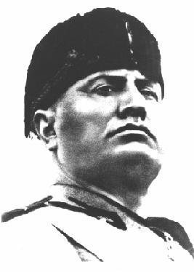
Mussolini in Power
Abolished democracy and outlawed
all political parties except Fascists.
Political opponents imprisoned.
Forced media to broadcast or print
only Fascist doctrine.
Seized control of the economy. Strikes by workers were banned.
Allied with industrialists and large landowners.
Goals: Establish overseas empire in
Africa and militaristic state at
home.

Slide 18
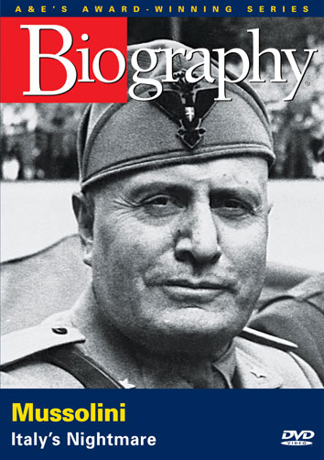
A & E Biography on Mussolini (46 min)

Slide 19
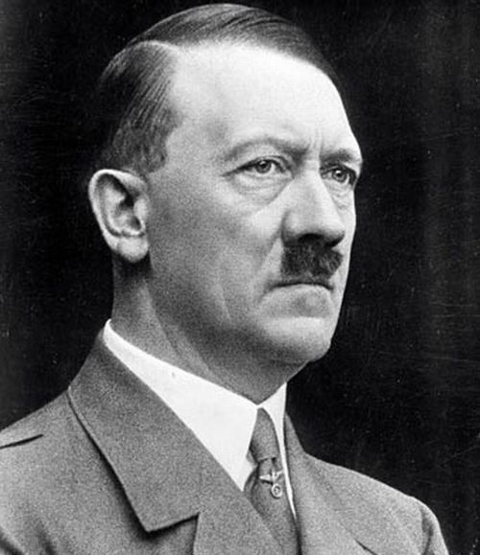
The Rise of Nazism in Germany
Adolf Hitler

Slide 20
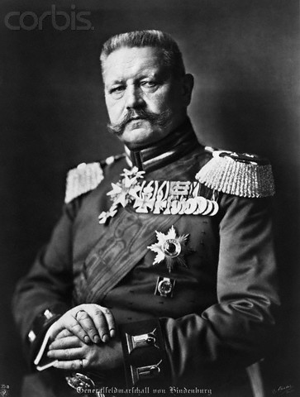
Germany Between the Wars
Germany left greatly weakened
by Treaty of Versailles. Strong
resentment among the German
people over terms of treaty.
Suffered from inflation (1920s)
and depression (1930s).
Weimar Republic (post WWI
democratic government), had
signed Versailles treaty. It was
blamed by Germans for the
nation’s problems.
Paul von Hindenberg
President of Weimar Republic

Slide 21
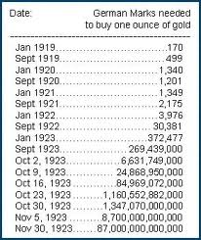

Slide 22
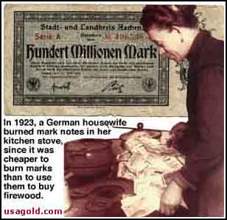
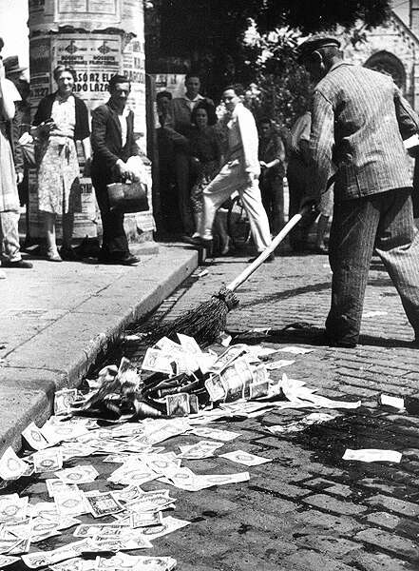

Slide 23
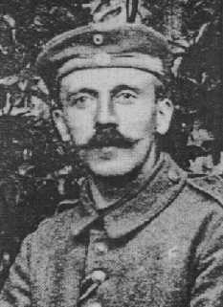
The Rise of Adolf Hitler
1920: Joined small, right-wing
National Socialist German
Workers Party (NAZI Party).
Hitler gained control of the
National Socialist party by
1921.
A young Adolf Hitler

Slide 24
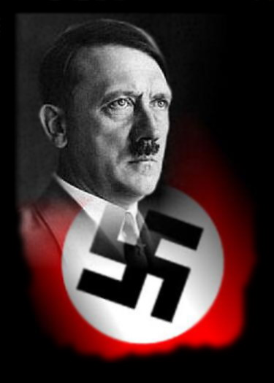
Nazism
German brand of fascism
Core beliefs:
1. Extreme nationalism
2. Racial superiority
A belief that Germans were
a superior people destined to
rule all of Europe.
A belief in the expulsion of
inferior peoples.
Hatred of Jews
Hatred of Slavs
3. Anti-communism

Slide 25
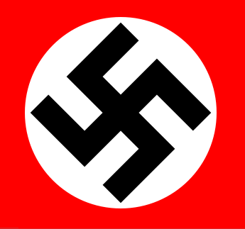
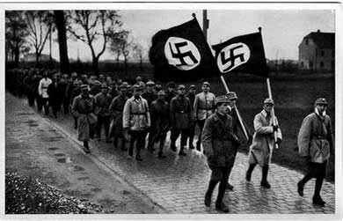
The Nazi Party
Supported by _______
and ______________
classes.
Nazi Party adopted the
_______ as its symbol.
(Aryan Symbol of the
sun)
Organized private militia
of _______________
also known as ________.
middle
lower-middle
swastika
storm troopers (the SA)
Brown Shirts

Slide 26
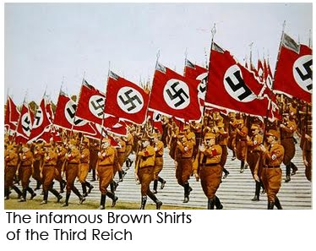

Slide 27
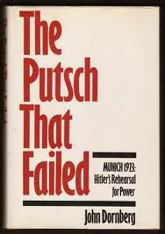
1923 Failed Munich “putsch”
Under Hitler, Nazis plotted
to seize power in Munich in
1923. Attempt to overthrow
government failed.
Hitler arrested; sentenced
to five years in prison for
treason.
Only served nine months.

Slide 28
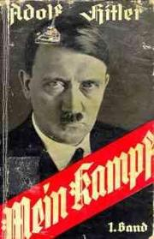
Mein Kampf (“My Struggle”)
Book written by Hitler in prison.
Outlined his goals of territorial
expansion.
Said Germany needed more “living
space” (lebensraum) and outlined
plans to conquer Eastern Europe
and Russia to get it.
Blamed the Jews and Communists
for all of Germany’s problems.

Slide 29
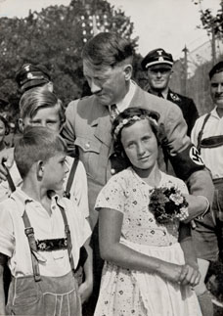
Mein Kampf (con’t)
Asserted the Germans (“Aryans”)
were a “master race”
Non-Aryans (Jews, Slavs, Gypsies)
were inferior or subhuman.
Outlined his plans to create a
racially-pure nation that would
dominate the world.

Slide 31
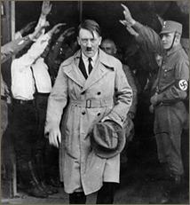
Hitler’s Road to Power
Released from prison in 1924. Built
up Nazi party. 100,000 members by
1928.
1928 election: Nazis only won 2.6
percent of popular vote. Largely
ignored as extremist group -- until
the German economy collapsed.
During Depression, middle / lower
class Germans attracted to Hitler’s
appeals for “national rebirth.”
1932 elections: Nazis won 38% of the
vote and became largest party in the
Reichstag.

Slide 32
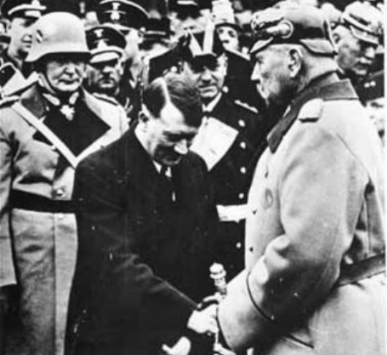
1933 Hitler Appointed Chancellor
President von Hindenberg
pressured to appoint Hitler
chancellor in 1933.
Hitler supported by
conservative politicians and
key leaders in the army and
big business leaders.
These leaders mistakenly
thought they could control
and use Hitler.

Slide 33
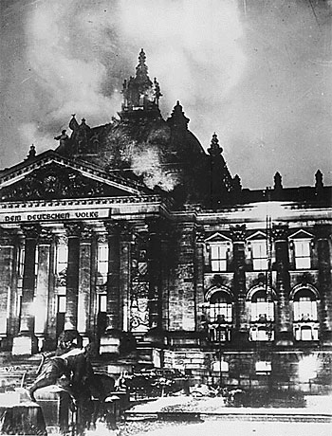
Nazis Elected to Power
Reichstag (Parliament) building
destroyed by fire just before 1933
elections.
Nazis blamed the Communists.
Stirring up fear of communism,
Nazis won enough seats to take
control of the Reichstag.
Nazi controlled Reichstag passed
Enabling Act -- law appointing
Hitler to new post of “Fuhrer” with absolute power.

Slide 34
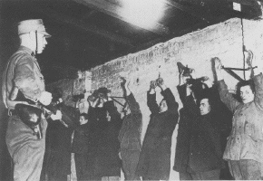
Communists arrested after the Reichstag fire

Slide 35
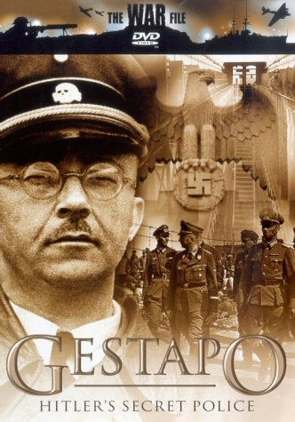
Germany Becomes Totalitarian State
Germany became a one-party
Nazi state.
The SS, loyal only to Hitler,
arrested and murdered
hundreds of Hitler’s political
enemies.
Communists, Social Democrats,
trade-union leaders arrested.
Terror carried out by Gestapo
(Nazi secret police)

Slide 36
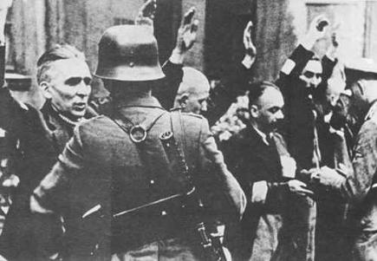

Slide 37
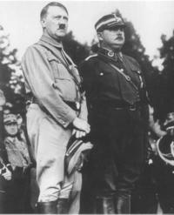
June 30, 1934 “Night of the Long Knives”
Army saw SA radicals as a threat.
To win support of the army, Hitler
purged Nazi Party of SA extremists.
Hundreds of SA leaders who had
helped Hitler come to power were
arrested by the SS and executed
without trial.
German Army now pledged its
supported for Hitler.
Hitler and SA leader
Ernst Rohm, who
Hitler had killed in
1934.

Slide 38
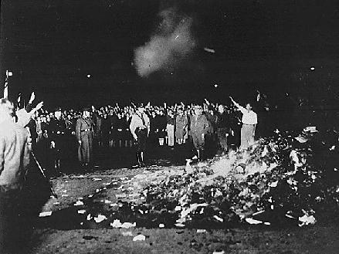
Public opinion shaped by government propaganda and
censorship. Books that didn’t conform to Nazi beliefs were
burned

Slide 39
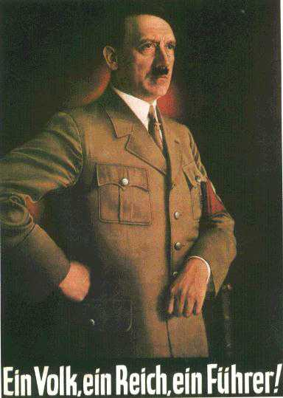
"One People, One Government, One Leader!"

Slide 40
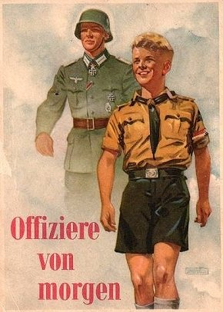
The Hitler Youth
School children were forced to
join the “Hitler Youth”
Was an extension of the Nazi
military structure that sought
to prepare future generations
for responsibility of continuing
its reign.
Indoctrinated German children
so as to perpetuate the beliefs
of the Nazi ideology.

Slide 41
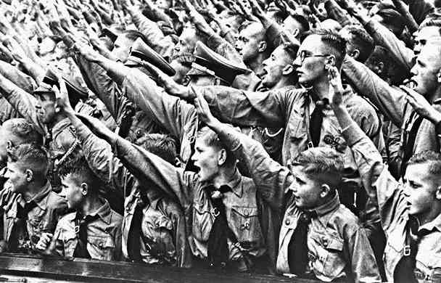
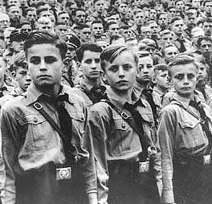
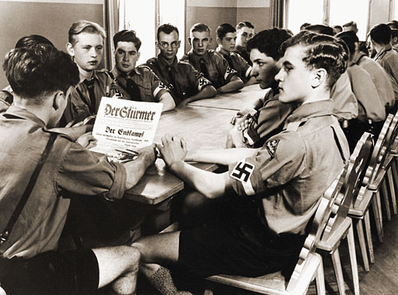
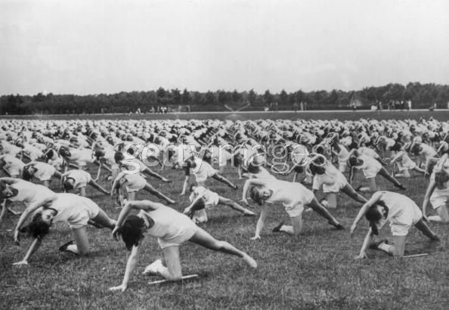

Slide 42
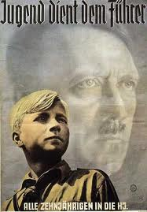
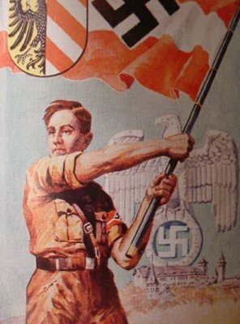
"Youth serves the Fuhrer.
All ten-year-old boys join the Hitler Youth"

Slide 43
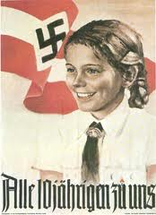
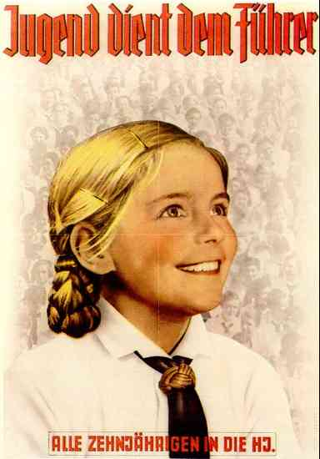
"All Girls Join Us"
German Video on Hitler Youth

Slide 44
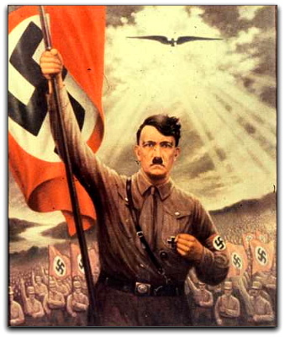

Slide 45
Mass rallies staged to generate enthusiasm for Nazi goals

Slide 46
Nazi Anti-Semitism
Hatred of Jews a key part of Nazi
ideology.
Jews made up less than 1 percent
of Germany’s population, but
were made scapegoats for all of
Germany’s problems.
Nazis passed laws (the Nuremberg Laws) stripping Jews of their rights and eventually,
their German citizenship.

Slide 47
Nazi Anti-Jewish Propaganda

Slide 48
November, 9, 1938 Kristallnacht “Night of the Broken Glass”
The start of an organized
campaign to eliminate
Jews from German life.
Nazi mobs attacked Jews
in their homes and on the
streets.
Ninety Jews were killed.
Thousands arrested.
Thousands of Jewish-owned
buildings, businesses, and
synagogues destroyed by
fire and bombs.

Slide 53
What will become the Holocaust
has begun…

Slide 54
Next ....
Nazi aggression leads to war

