Slide 1
Unit VI
World War II
Part IV
The Legacy of the War

Slide 2
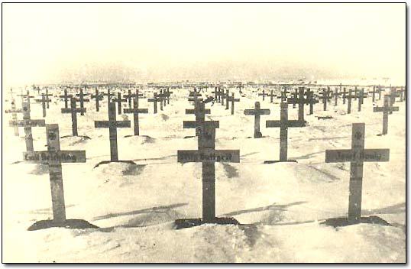
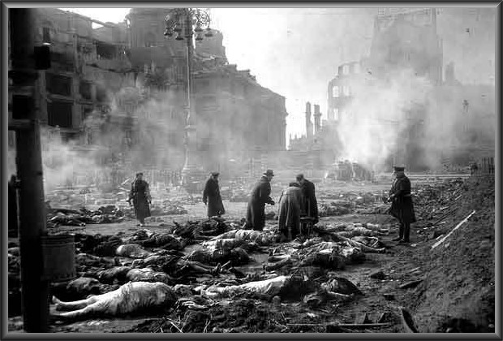
WWII’s Legacy The Human Toll
WWII the most destructive
war in history.
60 million people killed.
50 million more people
became refugees.
Much of Europe in ruins.

Slide 3
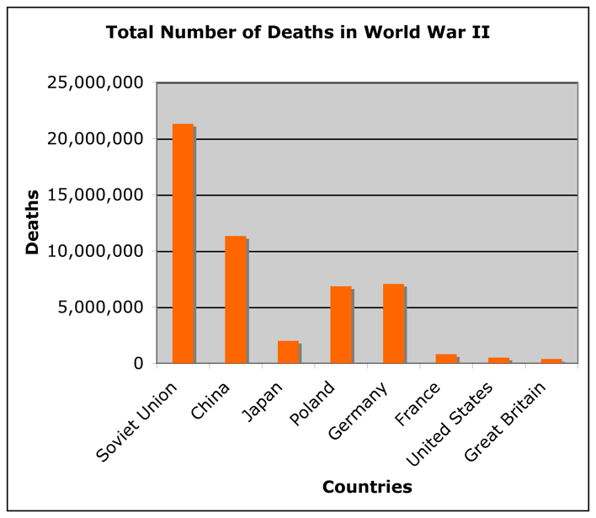
W
Which countries would you expect to have the
greatest and fewest number of deaths?

Slide 4
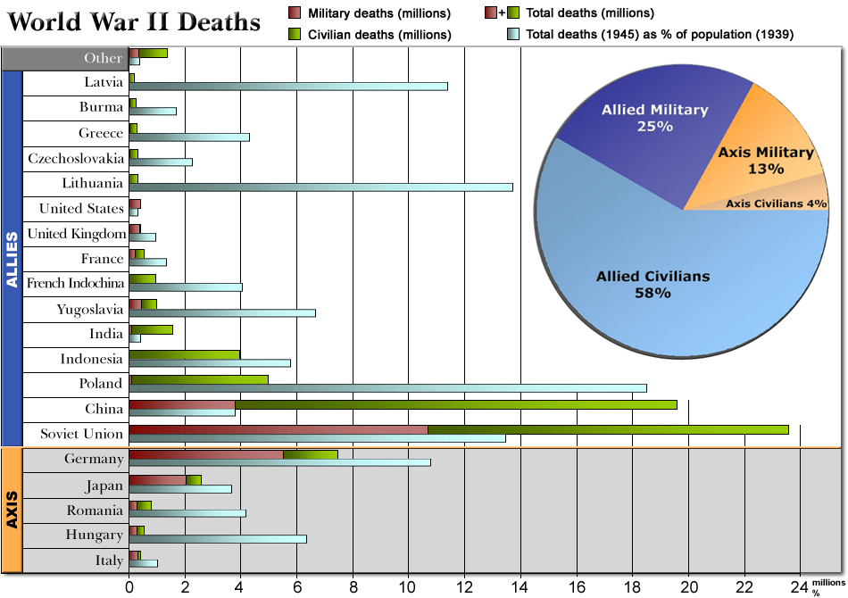

Slide 5
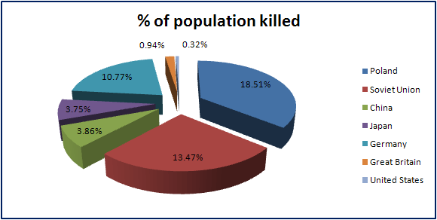

Slide 6
WWII’s Legacy The Map of Europe Changed (Again)

Slide 7
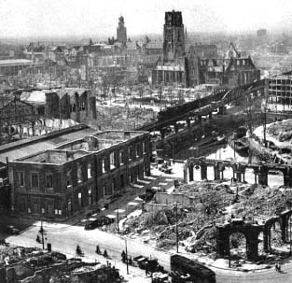
WWII’s Legacy Europe Lay in Ruins
40 million Europeans died
(two-thirds were civilians).
Many major cities reduced
to rubble by German and
Allied bombing.
Buildings, factories, farms,
railways, roads, and bridges
destroyed.
Tens of millions left homeless
and displaced.
Widespread hunger and
disease. Suffering would last
for years.

Slide 8
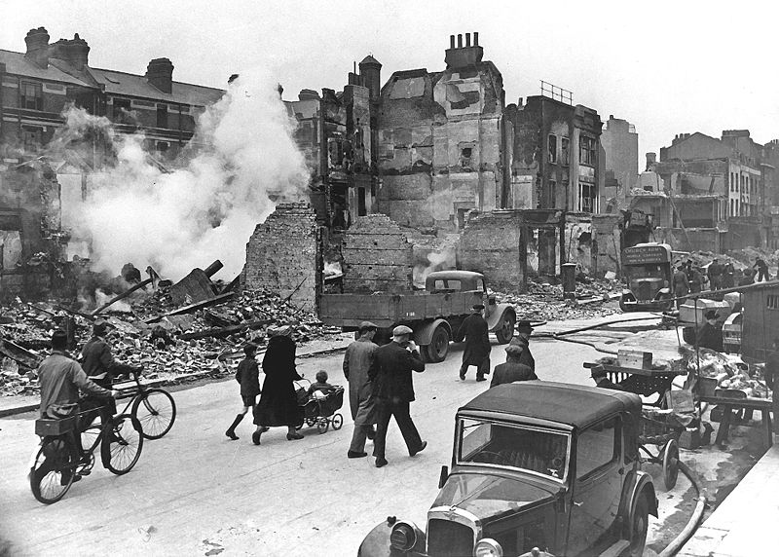
London

Slide 9
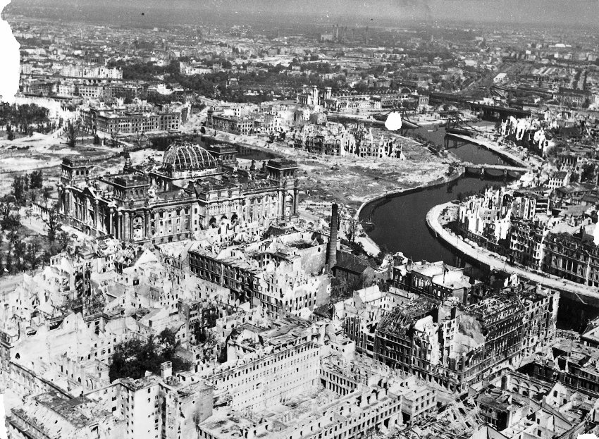
Berlin

Slide 10
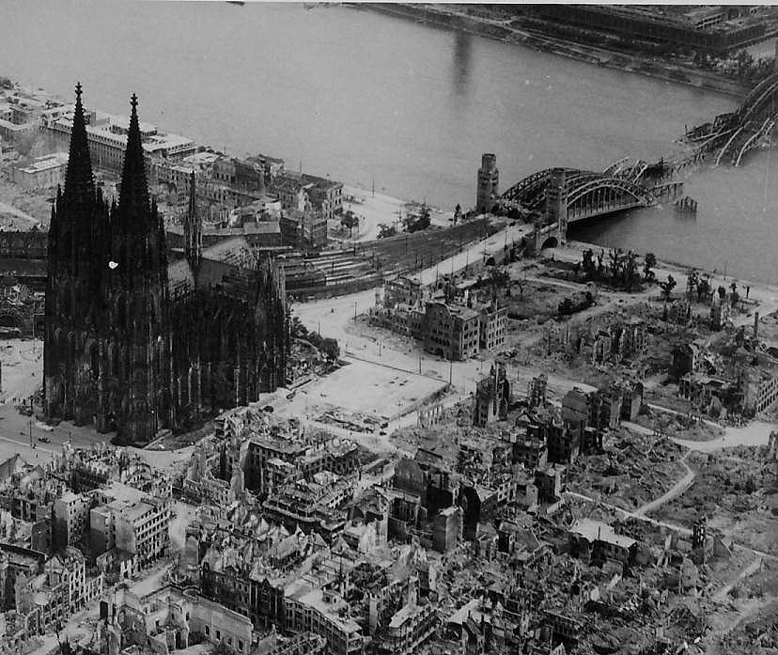
Cologne

Slide 11
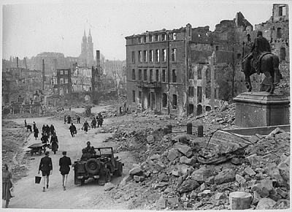
Nuremberg

Slide 12
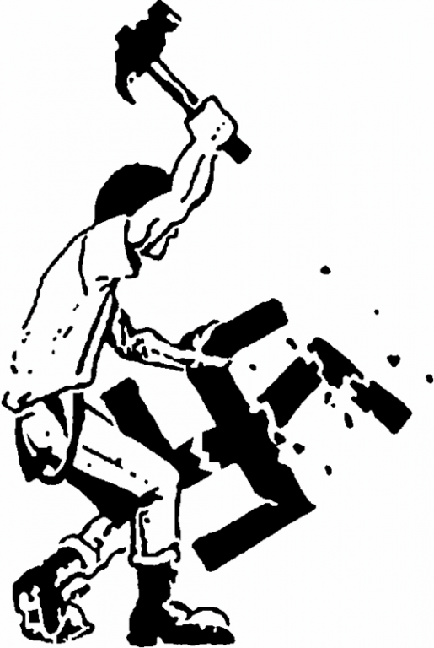
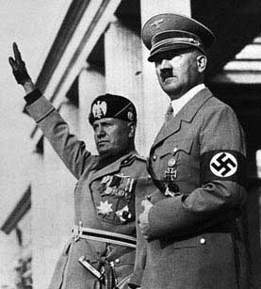
WWII’s Legacy The Demise of Fascism
After Germany and Italy’s
defeat, fascism no longer a
serious threat or a serious
political force in the world.
Discredited as a political
ideology. No longer had
mass appeal.
Relegated to fringe groups
on the far right.

Slide 13
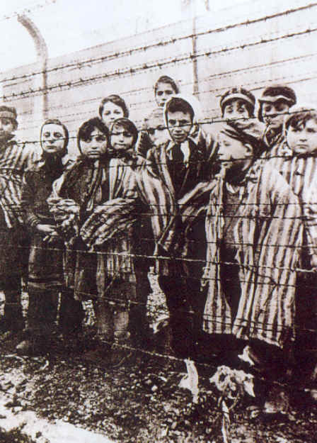
WWII’s Legacy The Holocaust
The Holocaust led to the
creation of a new word –
genocide – to describe
the targeting of an entire
group for extermination.
Genocide Convention
of 1948 made genocide
a crime and committed
nations to preventing
it from ever happening
again.

Slide 15
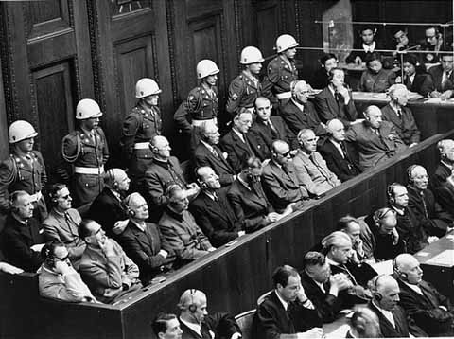
WWII’s Legacy Nuremberg War Crimes Trials (1945-1946)
Allies put surviving Nazi
civilian and military leaders
on trial for waging war
of aggression, violating the
laws of war, and “crimes
against humanity.”
Of 22 defendants, 12 were
sentenced to death.
About 100,000 Germans
and Austrians were tried
and convicted of wartime
crimes.
The defendants at Nuremberg

Slide 16
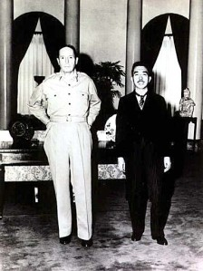
WWII’s Legacy American Occupation of Japan
Japanese cities also left in ruin
and two million Japanese died.
U.S. occupation of Japan under
MacArthur lasted six years.
Japan’s military disbanded and
war criminals put on trial.
Japan democratized under new
U.S. imposed constitution.
Emperor Hirohito left on the
throne, but with greatly reduced
power. No longer considered to
be a god.
MacArthur and Hirohito

Slide 17
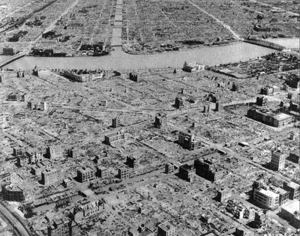
Tokyo in 1945

Slide 18
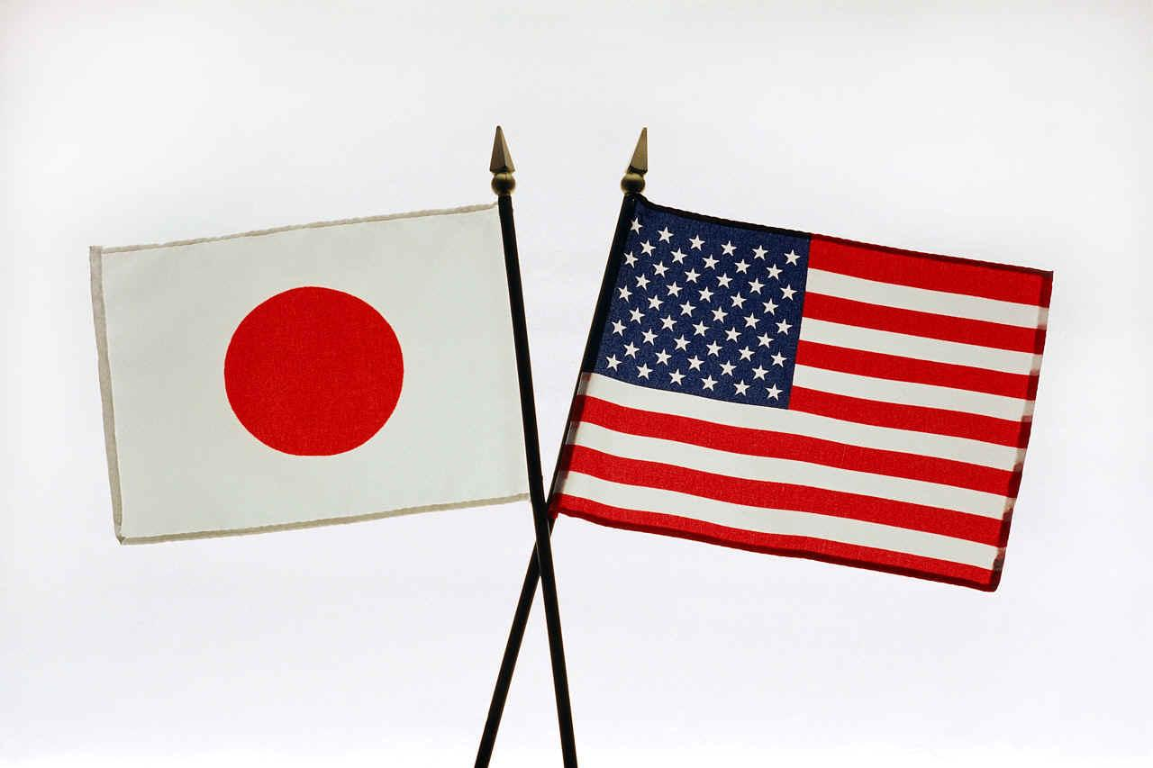
WWII’s Legacy Germany and Japan Transformed
Both Axis Powers occupied
by Allies after the war.
Both were transformed into
peaceful democracies.
Both rebuilt with U.S. dollars
(Germany more than Japan).
Became leading economic
powers.
Both became key U.S. allies
in the postwar era.

Slide 19
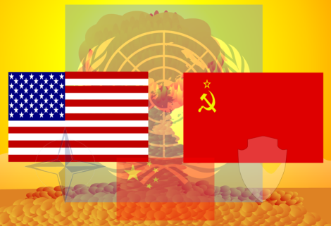
WWII’s Legacy New World Order Emerged
Britain, France, Germany,
and Japan no longer the
world’s dominant powers.
The U.S. and the USSR
emerged as new dominant
powers in bipolar world.

Slide 20
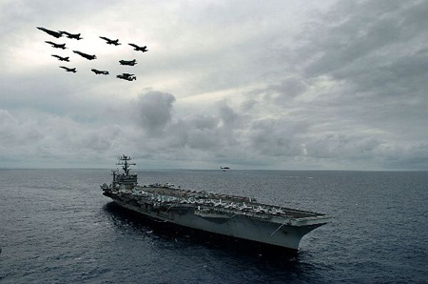
WWII’s Legacy U.S. Became Military Superpower
The only nation with the
atomic bomb.
A global power with
military bases/troops all
over the world.
This new power meant
new responsibilities
and a permanent end
to U.S. isolationism.

Slide 21
WWII’s Legacy U.S. Became Economic Superpower
GNP rose from $91 billion
to $215 billion during the
war (1940-1945).
Post-war prosperity led to
rise in living standards and
large, prosperous middle
class for the first time.
U.S. economy led the world.
U.S. Post World War II Boom (13:00)

Slide 22
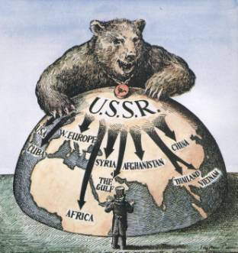
WWII’s Legacy USSR Became Regional Superpower
Soviet Union played major
role in defeat of Germany.
Emerged from war with new
power and prestige.
Not yet a global superpower
comparable to U.S.

Slide 23
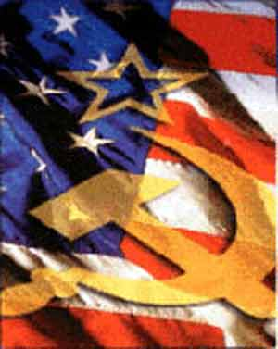
WWII’s Legacy Cold War Began
Wartime alliance between
U.S. and Soviet Union
quickly ended.
Relations became hostile and a cold war emerged.
Began 50 years of conflict
between two competing
ideologies: capitalism and
communism.

Slide 24
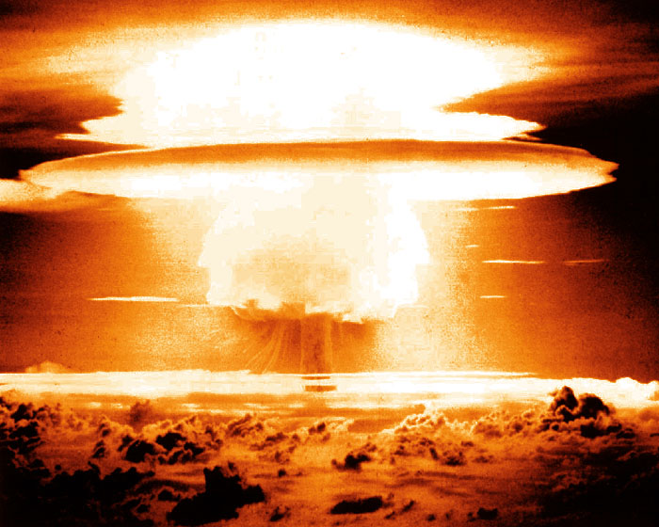
WWII’s Legacy Atomic Age Introduced
Nuclear weapons changed
the world’s concept of war.
Fighting a total war is no
longer possible.
Post World War II wars
have all be limited wars.

Slide 25
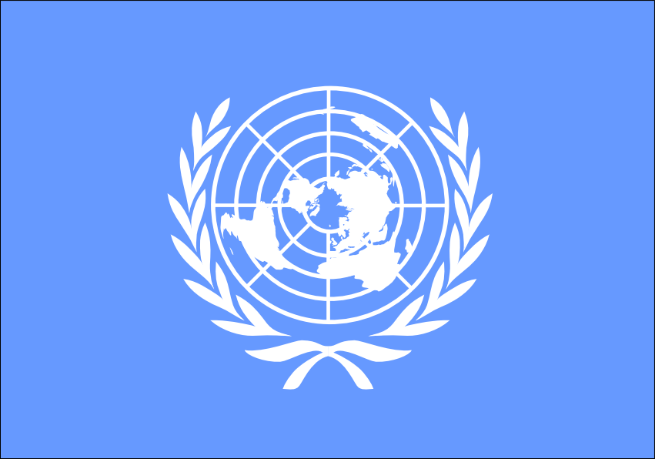
WWII’s Legacy The United Nations
UN founded by the Allies
after the war.
Replaced weak League of
Nations which had failed to prevent WWII.
UN’s purpose is to “save
succeeding generations
from the scourge of war.”

Slide 26
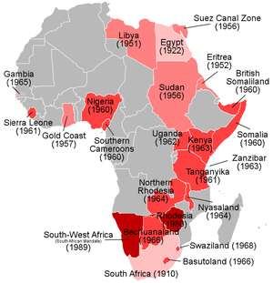
WWII’s Legacy Decolonization
Strong nationalist move-
ments emerged in Africa,
Asia, and the Middle East.
European empires collapsed.
New independent nations in
“Third World” became the
battle-ground of Cold War.
Many struggles between pro-
Western and pro-communist
groups.

Slide 27
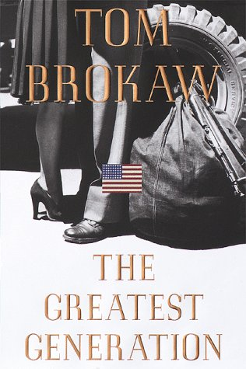
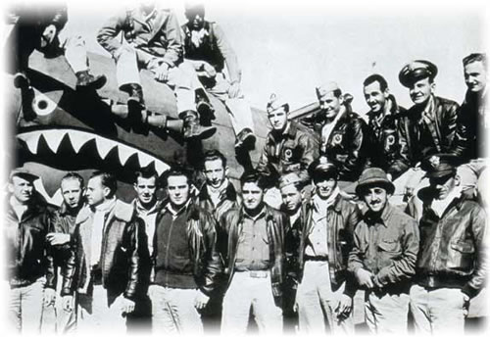
The Greatest Generation
Salute to the Greatest Generation (12:43)

