Slide 1
Unit V - Part 4
The Interwar Years: Revolution & Nationalism
Nationalism in India
&
Southwest Asia
1919-1939

Slide 2
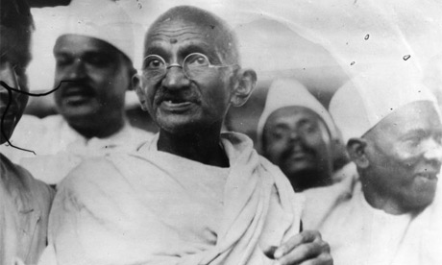
Indian Nationalism and Independence

Slide 3
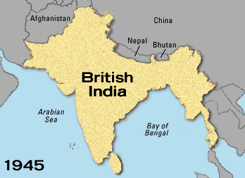
Rise of Indian Nationalism
India under British rule since
1700s.
Indian nationalism growing
since mid-1800s.
Two nationalist groups formed:
Indian National Congress
(Hindu)
Muslim League
Common goal?
Independence. Worked together
to rid India of British rule.

Slide 4
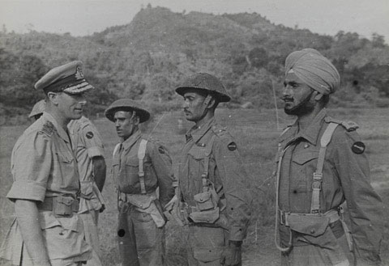
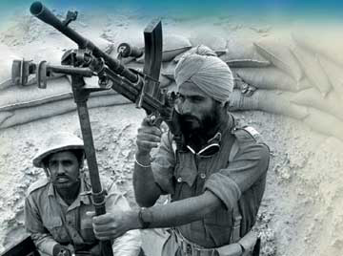
Growing Indian Nationalism Impact of World War I
Britain broke promise of
self rule in exchange
for India’s help in the war.
Radical nationalists
carried out acts of violence
against British rule
.

Slide 5
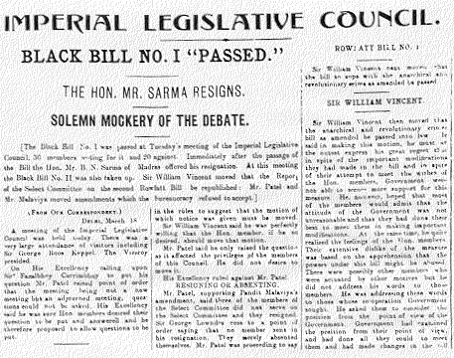
Growing Indian Nationalism Rowlatt Act, 1919
What did this law allow?
The jailing of protestors for
two years without trial.
Indian reaction?
Law sparked violent protests
throughout India.

Slide 6
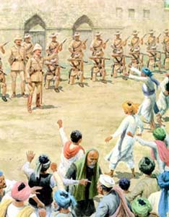
Growing Indian Nationalism Amritsar Massacre, 1919
10,000 Indians held peaceful
protest against Rowlatt Act
British government had banned
such public demonstrations..
Without warning, British troops
did what?
Fired on crowd, killing 400
people and wounding 1,200.

Slide 7
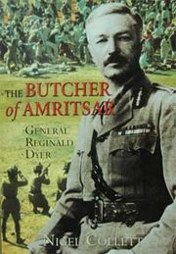
Amritsar Massacre
Gen. Reginald Dyer was British
commander who ordered his
troops to open fire on crowd.
Marks the beginning of the end
of British rule in India. Why?
Turned millions of Indians into
strong nationalists overnight.

Slide 8
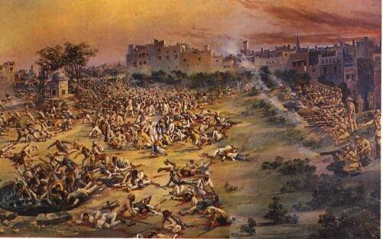
Amritsar Massacre

Slide 9
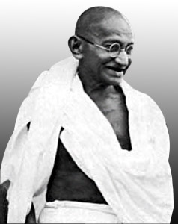
Mohandas Gandhi, 1869-1948
Lawyer who emerged as leader
of India’s independence
movement.
Strategy for fighting injustice
based on ideas from all world’s
major religions.
Attracted millions of followers.
Known as the Mahatma, which means “Great Soul.”
Mohandas Gandhi

Slide 10
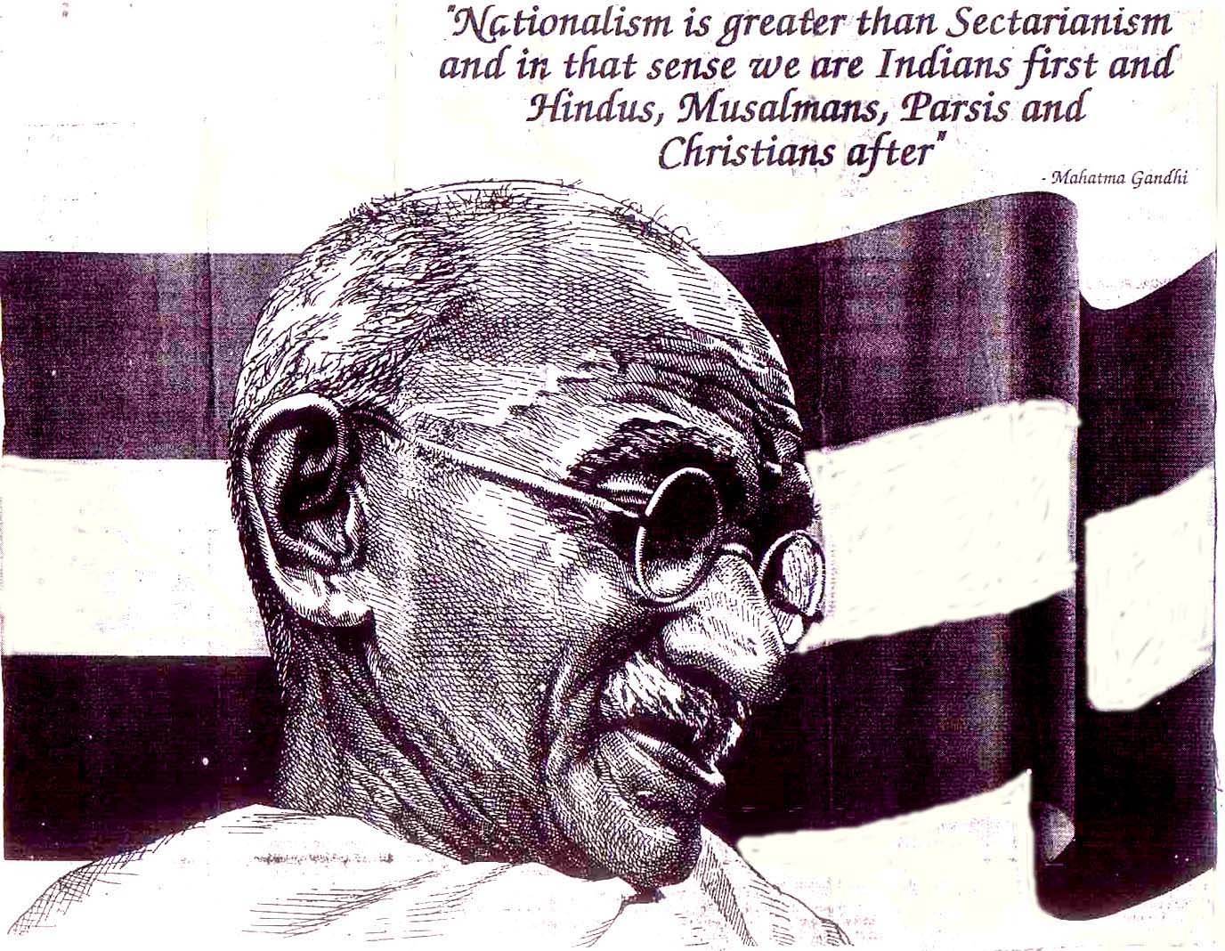

Slide 11
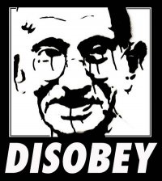
Gandhi’s Principle of Satyagraha
Principle of Satyagraha, or
“truth force.”
In English, idea is known as
civil disobedience. What
does this mean?
The deliberate, public refusal
to obey an unjust law.

Slide 12
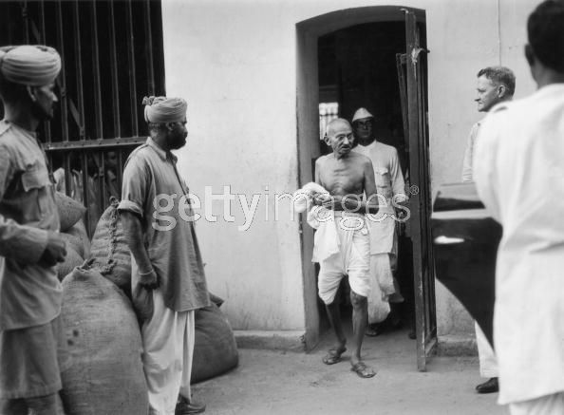
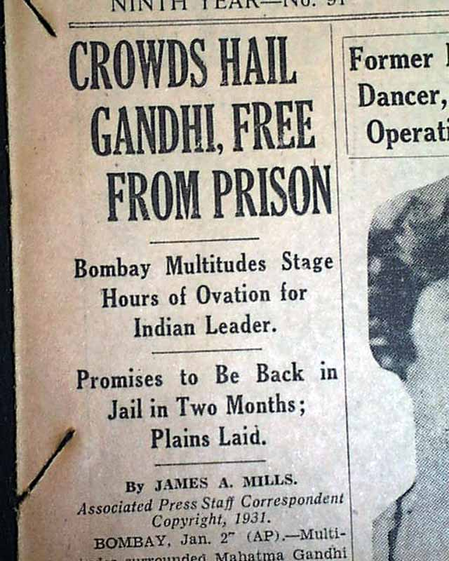
Consequence of Civil Disobedience?

Slide 13
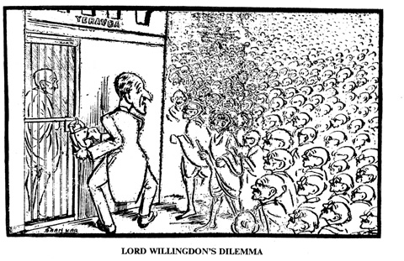

Slide 14
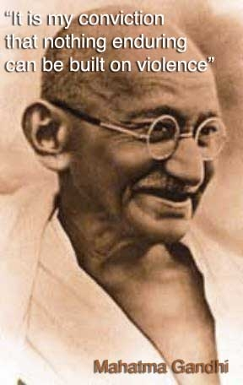
Gandhi’s Principle of Non-Violence
Gandhi also preached philosophy
of non-violence. Meant what?
Peaceful, passive resistance.
In 1920, Congress Party endorsed
Gandhi’s principles of civil
disobedience and non-violence
as means to achieve independence.

Slide 15
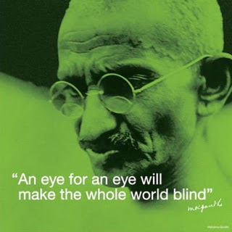

Slide 16
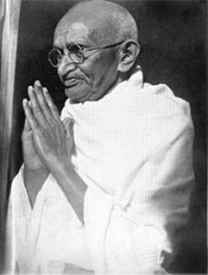
Gandhi’s Campaign of Civil Disobedience
Called on Indians to refuse to
Buy British goods
(especially cloth).
Attend government schools.
Pay British taxes.
Vote in elections.
Was the campaign successful?
Weakened British government’s
authority and economic power.

Slide 17
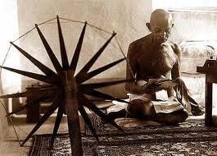

Slide 18
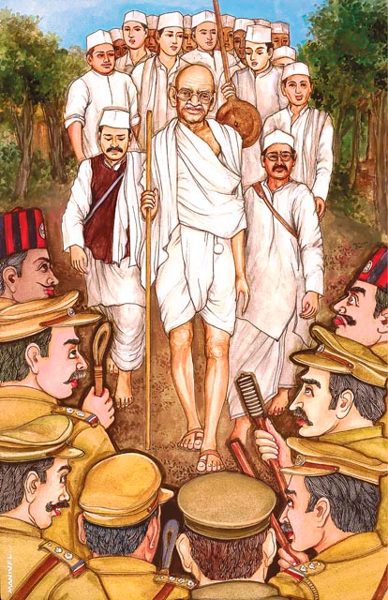
The Salt March, 1930
Act of civil disobedience to defy the hated Salt Acts.
Explain these laws.
Required Indians to purchase their salt from the government and pay a high sales tax.
Gandhi led 240 mile march to the sea to harvest salt.
Demonstrations at British salt works along the march resulted in brutal beatings by police.
Significance?
World was watching & Gandhi gained worldwide support.

Slide 19
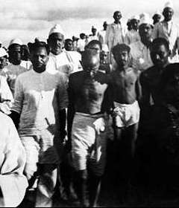
The Route of the Salt March

Slide 20
The Salt March

Slide 21
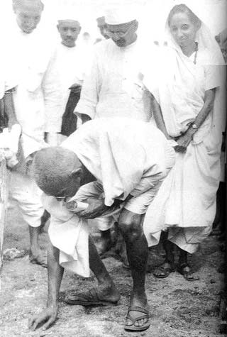
The End of the Salt March

Slide 22
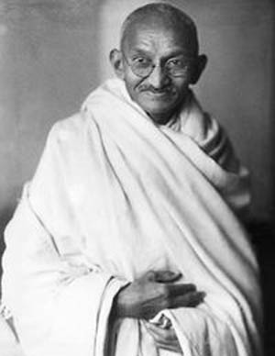
Government of India Act, 1935
What did this law do?
Granted Indians local self-
government and limited
elections.
First step towards what?
Independence from Britain.

Slide 23
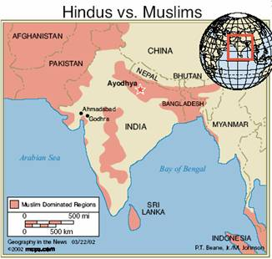
Tensions Between Muslims and Hindus.
Hindus outnumbered
Muslims in India.
100 million Muslims
350 million Hindus
What was the concern of
India’s Muslims?
Feared that Hindus would
control an independent
India.
Muslim solution?
Demanded the partition of
India into two states.

Slide 24
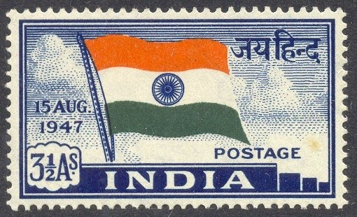
Text Assignment (Pages 505-507)
Read pages 505-507
in the text. Complete
the accompanying GO
to find out how India
finally gains freedom
From British rule.

Slide 25
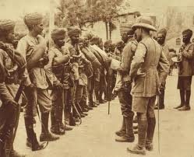
WWII Fueled Indian Nationalism
Why?
Indian nationalists angered by Britain’s commitment of Indian troops to fight without seeking approval of the colony’s elected representatives.
How did war’s high costs affect British attitudes towards India?
Caused British to rethink the expense of imperialism.
Indian Troops in
Mesopotamia

Slide 26
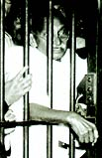
“Quit India” Campaign, 1942
Civil disobedience campaign by
National Congress Party to force
British to leave India.
Gandhi gives speech demanding
India’s immediate independence.
Gandhi and most Congress Party
leaders arrested and jailed
for the duration of World War II.
Gandhi released in 1944 after two
years in prison.

Slide 27
Congress Party vs. Muslim League
Congress Party
Muslim League
Mostly Hindu, but claimed to represent all Indians.
Goal was independent India (where it would control government).
Founded to protect Muslim interests.
Claimed only it could represent Muslims.
Vowed not to accept independent India controlled by Congress Party.
First to propose idea of partition.

Slide 28
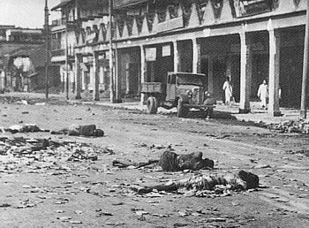
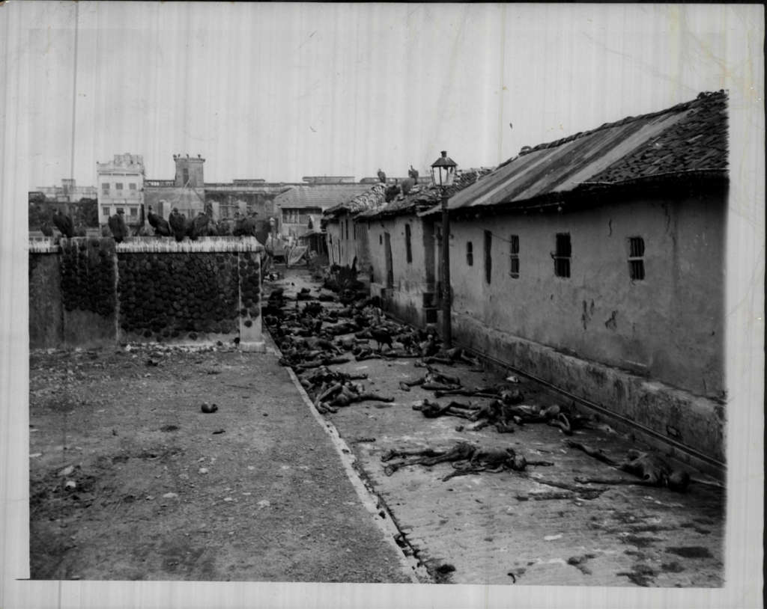
Calcutta Riots, 1946
Rioting between Muslims and Hindus left over 5,000 dead. Why significant?
British fear that Muslims and Hindus will never live together in peace.
British began to accept idea of partition.
Gandhi’s position?
Strongly opposed to partition.
Wanted India to remain intact
as one nation.

Slide 29
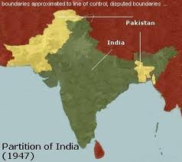
India’s Independence Announced, 1947
July, 1947: British announce
India will be given complete
independence in one month’s
time.
India would be partitioned
into what two nations?
Mostly Hindu India
Mostly Muslim Pakistan
What needed to be decided
within the one month time
limit?

Slide 30
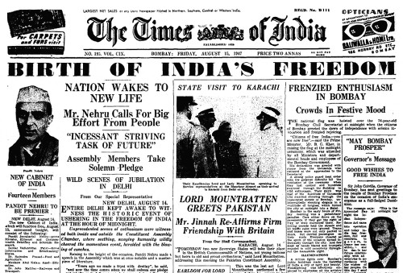

Slide 31
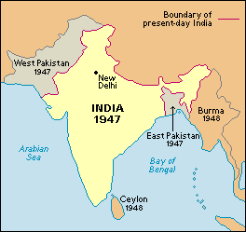
The Partitioning of India, 1947
Before Partition
After Partition

Slide 32
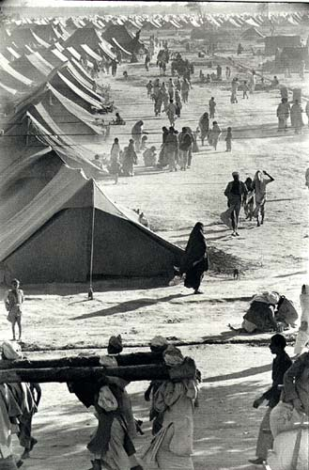
Partition Leads to Bloodshed
Partition resulted in mass flight of 10 million refugees.
Muslims fled from India to Pakistan
Hindus fled from Pakistan to India.
Widespread massacres of refugees by both groups.
An estimated 1 million Indians
died in this violence.
Failure for Gandhi?
Failed to convert his people to the
practice of non-violence.

Slide 33
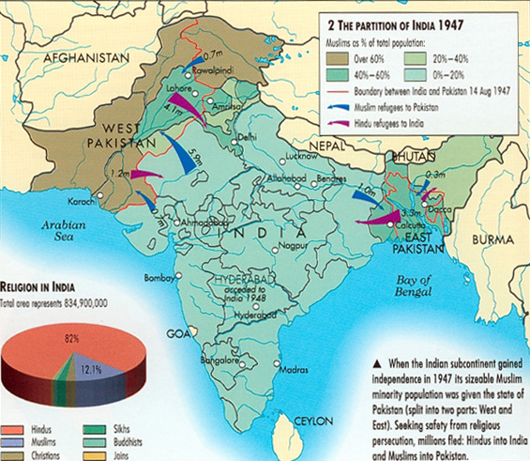

Slide 34
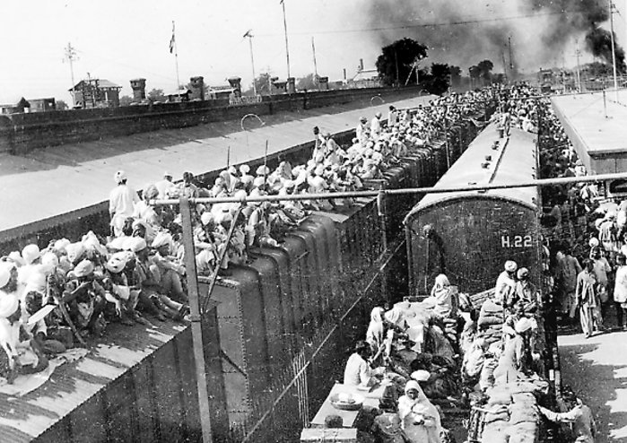

Slide 35
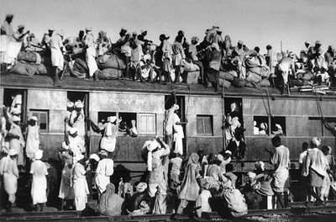

Slide 36
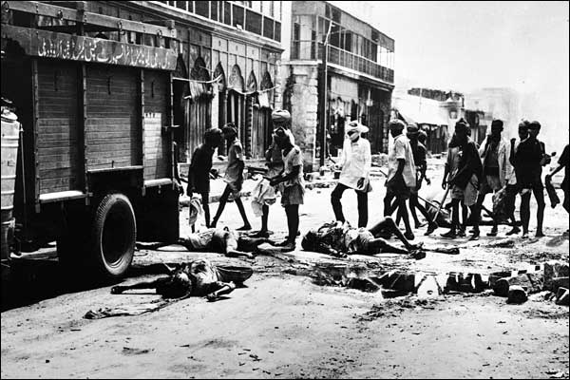

Slide 37
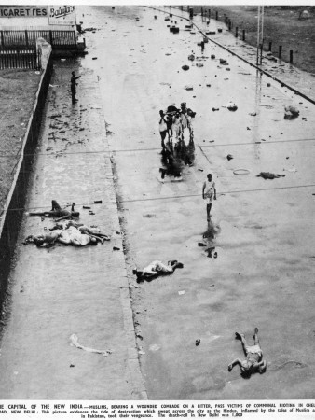

Slide 38
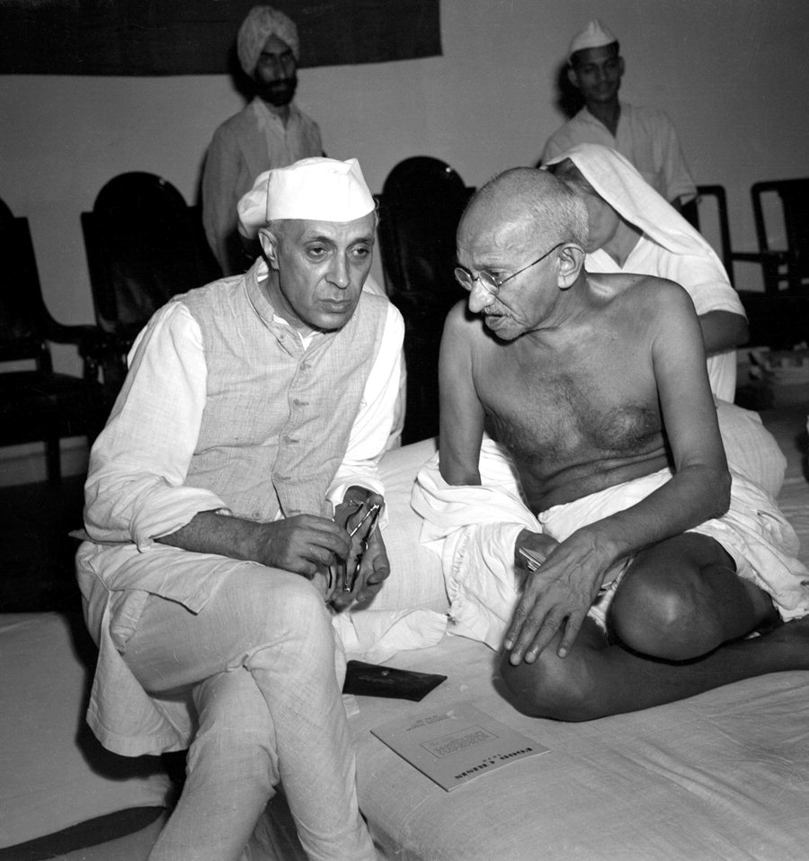
1947 India Gains Independence
India became independent
state and the world’s largest
democracy on Aug. 15,
1947.
Gandhi refused to celebrate:
“What is there to celebrate?
I see nothing but rivers of
blood.”
Jawaharlal Nehru, devoted
follower of Gandhi, became
India’s first prime minister.
Nehru and Gandhi

Slide 39
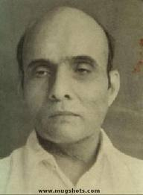
January, 30, 1948 Gandhi Assassinated
Gandhi in New Delhi to try and end
the violence against Muslims.
Went on week-long hunger strike
until violence stopped.
Shot and killed on way to prayer
meeting. By who and why?
Assassin was right-wing Hindu
extremist who thought Gandhi was
too protective of Muslims.
Gandhi’s Assassin
Nathuran Godse

Slide 40
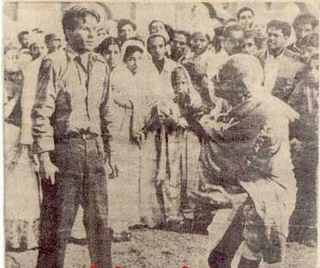
Nathuram Godse and Mahatma Gandhi Rare Real
Unseen Picture before Assassination

Slide 41
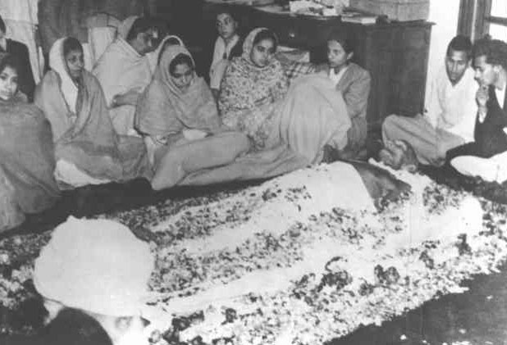

Slide 42
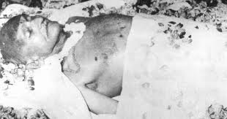

Slide 43
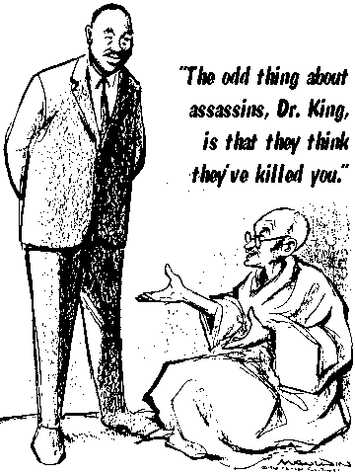
What is the
intended
message of
this cartoon?

Slide 44
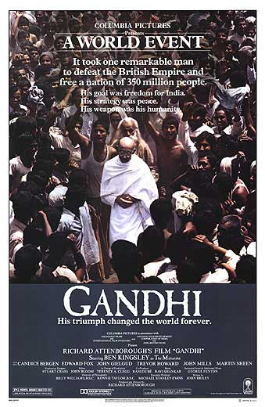
Gandhi: The Movie (1982)
Trailer for Gandhi

