Slide 1
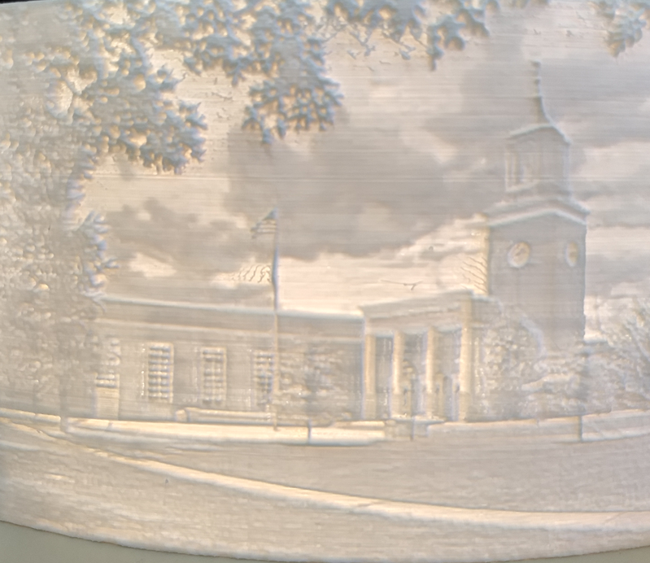
Befriend an Academic 2019 STEMATHON/ TEEAP Conference Lancaster-Lebanon IU13 Conference Center Jon Taylor- Tech. and Eng. Teacher, Central Bucks High School WEST
Lithophane 3D Print of CB West Jason Swope- Class of 2020
Notes:
Good morning. Welcome to TEEAP’s STEMATHON and welcome to this admittadely lengthy but meaningful presentation called “Befriend an Academic”. My name is Jon Taylor and as you can see I teach at CB West High School in Doylestown, part of the third largest school district in PA. I am excited to be a part of this year’s STEMATHON and the reason why this is my favorite conference is because I have been attending it since college and have benefitted so much from attending it each year. Much of what you will see today has its roots from being a former TEEAP Assistant Conference Director as well as scheduling and attending valuable TEEAP presentations over the years.

Slide 2
Agenda
Origins/Ideas of Collaboration
Documentation through Blog
Documentation through Twitter
Future of STEAM Collaboration
Q&A
Notes:
What I plan on presenting today is over decade’s worth of collaboration amongst my colleagues at West and during that time it has grown to involve more schools, teachers, administrators, community members and, most important- more students. What I hope to show you today is how I got started with collaboration through my blog in my earlier years and now through the fast-paced world of twitter- I am a twitter addict!
Through this “show and tell” format, I wish to convey some of the procedural changes I had to make in my own classroom and lab to allow more time for collaboration- more time for student driven ideas- more time freed up for students to pursue creative projects from having conversations with other subject area students, and using my planning time differently as I shifted from meeting my traditional curricular “demands” to focusing on how other subject area’s curriculum could be used in my courses to evolve into what I believe are some solid STEM/STEAM projects.
I will be presenting the content today from an elective teacher’s perspective. You will see collaborations I have done with both academic and elective teachers and classes. The featured activities and projects are, in my opinion, so incredibly important to the STEM/STEAM field because of their academic content that is embedded within all of them. I have titled this presentation “Befriend an Academic” because I believe it is paramount to show students how hardworking and dedicated academic teachers are and I feel it is important to recognize them within the STEM/STEAM field. This morning’s featured projects would not be possible without my colleagues and my tech. and engineering program wouldn’t be as rich in content as it has come to be without their contributions.

Slide 3
Then
Shamelessly and Selfishly Promote My Classes at first
Guidance Counselor Advice- Get to know your students’ workload.
I wanted my classes to be more dynamic in nature to simulate real conversations that might take place outside of school
Notes:
I began collaborating because of selfish reasons but our classes were on the low side and there was a policy of not permitting others to cut through the shop to exit the building. Now, I understood this because it is a shop and there are machines and tools in there, but I remember thinking, wow- this could be a way to show other students that we are here and that we build cool things. So, after my colleague left for South, I let them- teachers and students- cut through the shop and sure enough some would stop and say, Wow, I never knew this was here… Some damned good advertisement there…
Around the same time, I remember taking a Materials class to the computer lab to type a paper about one of their projects and I will never forget one of my students named Jim Pfau respectfully telling me that, “Hey, Mr. T.- we didn’t take this class to come to the computer lab, we just want to build things.” I was like, well, Jim, this makes total sense. Yea, ok- So, I never took them to the computer lab again. But I remember thinking- Geez, my English teacher wife tells me all the time how important it is for my students to learn how to communicate. How can I roll that into my Materials course?
And then a third “incident” if you will took place that I think put me over the edge of needing to talk more with my colleagues and this is a thank you to Stevie B., a retired guidance counselor, who encouraged me to talk to my students to understand their workload better- I mean- like my course isn’t the be all end all?? This conversation took place because I was always telling students (AP and Honors mostly) to put their homework/coursework away during my elective class and I was having trouble being patient with this. I remember thinking after that conversation, How can I roll with this issue and work with them better? So, I set forth to planning with my friends at West.

Slide 4
Math
Greg Wetzel/John Mahoney- Math Teachers- Rockets and Video 10-30-2014, 10-7-2016- Using Physics formulas, Paper and Tape Rockets were made and launched to determine the height of the launched Rocket. (Mahoney)
We created scatterplots in Excel that relate the horizontal distance traveled to mass, height, a ratio of mass to height, nose cone slope, and balancing point. For each of these variables, we were able to track the r-squared value (which is the coefficient of determination).
The r-squared value helps us quantify the legitimacy of the relationship… so an r-squared value of 0.06 means that 6% of the change is the distance traveled can be attributed to a change in the mass (for example). (Wetzel)
Notes:
Lucky for me, West is the smallest high school in the district- I am surrounded by World Language, Art and then right down the hallway- the hallway with the closest bathroom is both Math and English teachers- So- Greg and John is how I remember kicking off this collaborative STEM/STEAM adventure- Greg thought rockets were cool and he just spouted off the information in the hallway one day- Greg is a math teacher, but as you can read, he is also a poet. Such a cool way to incorporate paper and tape rockets that can fly 300 to over 400 feet into something so much better!!
John then quickly joined in on the fun shortly thereafter with his quadratic formulas to mathematically predict the height of the flight of the rocket. They both coach track, so I guess the word spread about the rockets.

Slide 5
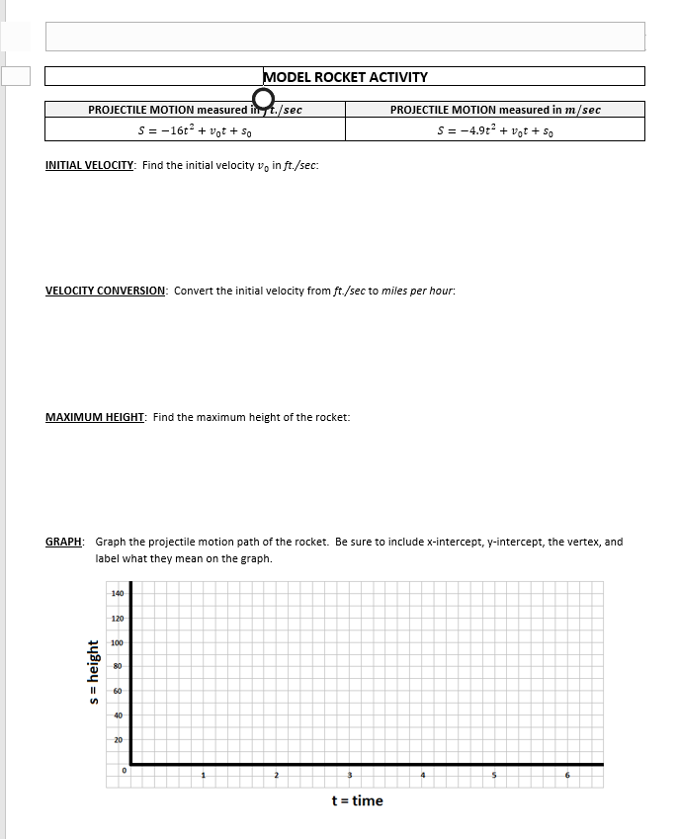
Math
Notes:
John’s worksheet to determine height. John’s classes were separate from mine- so his class was an example of what you would call a partial collaboration- We did this because Greg and I were doing a full class to class collaboration the block before his.

Slide 6
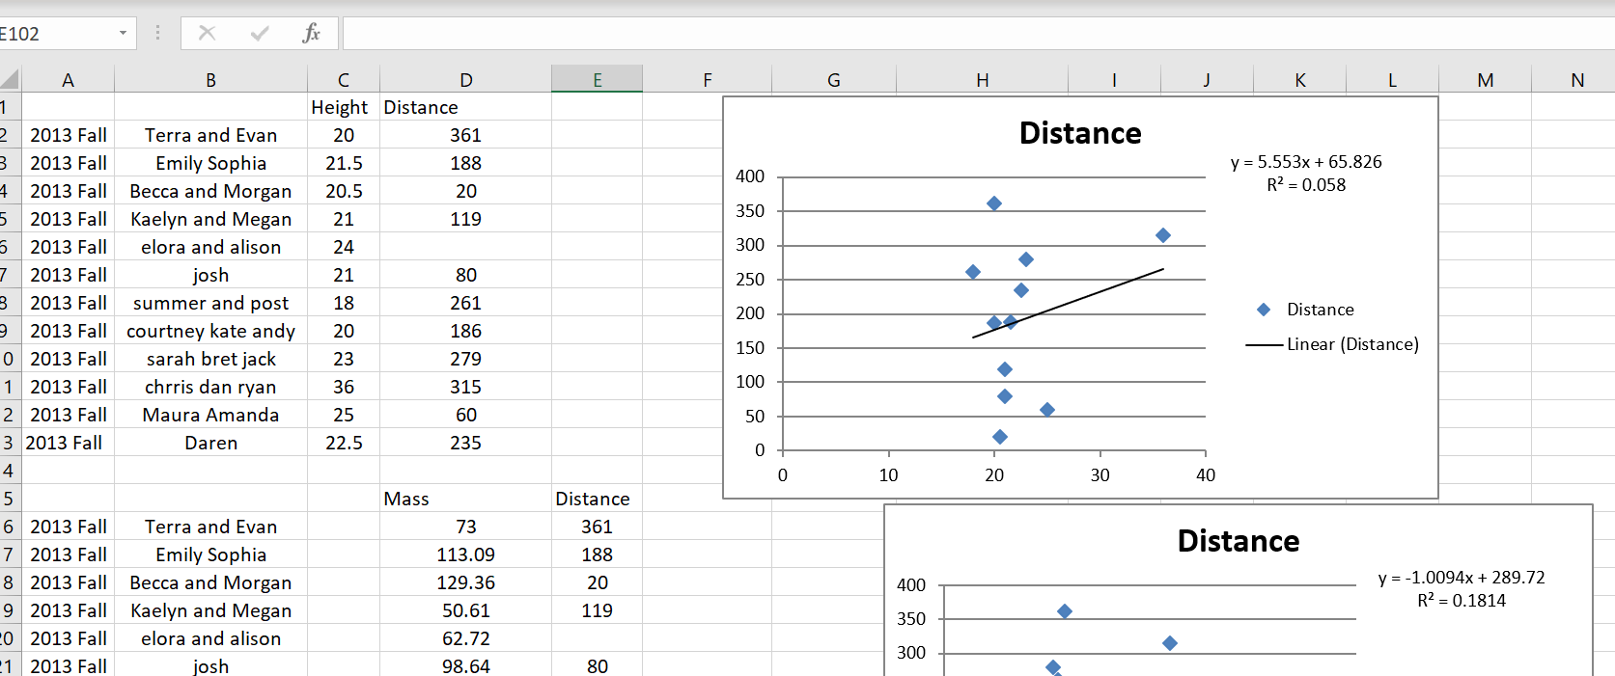
Math
Notes:
Greg and I were full class to class collaboration. Shown are the scatterplots with a trendline and the R squared value.

Slide 7
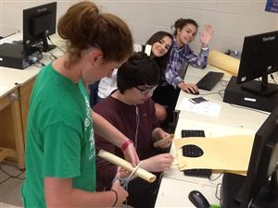
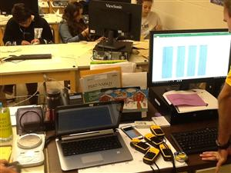
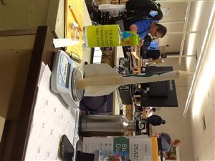
Math
Notes:
Shown are both classes constructing and measuring rockets. After doing this with them, I really wanted to do more collaborating- I always struggled with math, but- man was I hooked on math after doing this with them.

Slide 8
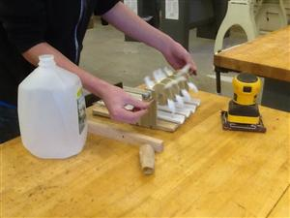
Science
Bill Licopoli- Environmental Science
Alternative Energy Model Creation (10-30-2014)
Notes:
Around the same time I ate lunch with Bill from the Science dept. aside from arguing about sports teams, we both thought it would be cool to do something with our classes. Shown here is a windmill prototype that was a partial collaboration with him sending students down to the shop with a drawing and idea and my students assisting them when needed. It is always great when we have the same students in the same semester in both classes as they really seem eager to use their shop skills and apply it to a project from another class.

Slide 9
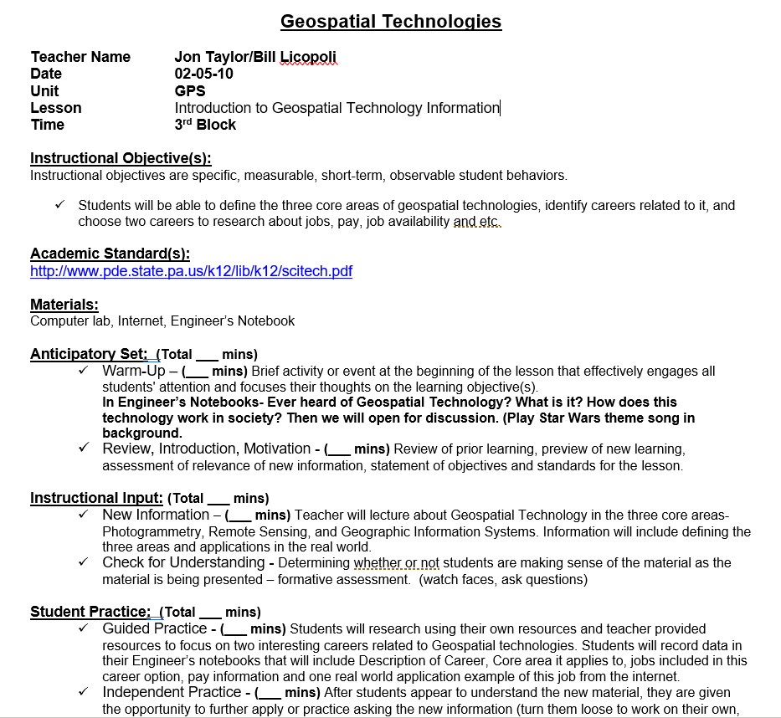
Science
Notes:
Bill and I continue to this day to collaborate depending on the topic of courses that he teaches. Featured above is a lesson plan on Geospatial technologies as we acquired grant money for 2 full class sets of hiking GPS units. He and I both took turns delivering content for three days. It was a lot of planning and a lot of work, but it was really worth it- His delivery of content is smooth and I think I did a bang up job of presenting the technical parts of using the GPS unit. Regardless, I learned a lot from Bill and his research on GPS technology through this collaborative experience.

Slide 10
Science
Energy 3D-
Earthquake Shaketable Structures
Grant- GPS activities
Notes:
Earthquake Shake table was another full class collaboration and we had a ton of fun building the structures together (Architecture and his Science Class) and using the shake table to see how the different earthquake waves affected our model structures. Once again- really rich content provided by Bill that I didn’t know a lot about.

Slide 11
Science
Notes:
Camp. is one of our physics teachers. AP students in small groups to this day stop down every May when AP Physics test is over and they really get into the electric vehicle competition each year. They really gravitate now to the Arduino Uno and use it to their advantage (servo motor control), especially the students who have our classes (Engineering and Architecture) at the same during the same semester. Last spring, 5 or 6 my Engineering and Architecture Level III students took his AP Physics course- We devoted a lot of time to this project.

Slide 12
Music
Dr. Joe Ohrt- (10-22-2014)
Percussion Instrument with PVC pipe
Samson Bamboo Pitches vs. Lengths Excel and Word
Notes:
The Music Department is on the other side of the school, but proximity doesn’t matter. Dr. Ohrt’s collaborations continue through to today and the rhythm of this collaboration found a steady beat with the percussion drum activity. One of our students really took interest in this and just blew me away with his investigation into Pitches vs. Lengths of bamboo. Joe and I both shared Samson for the entire school year.

Slide 13
Music
Notes:
Materials students help set up the chorus students. I remember them being quite shy about it, but by the second or third day, they were all chatting it up.

Slide 14
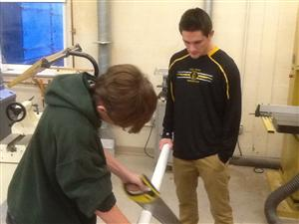
Music
Notes:
More cutting and then gluing later on…

Slide 15
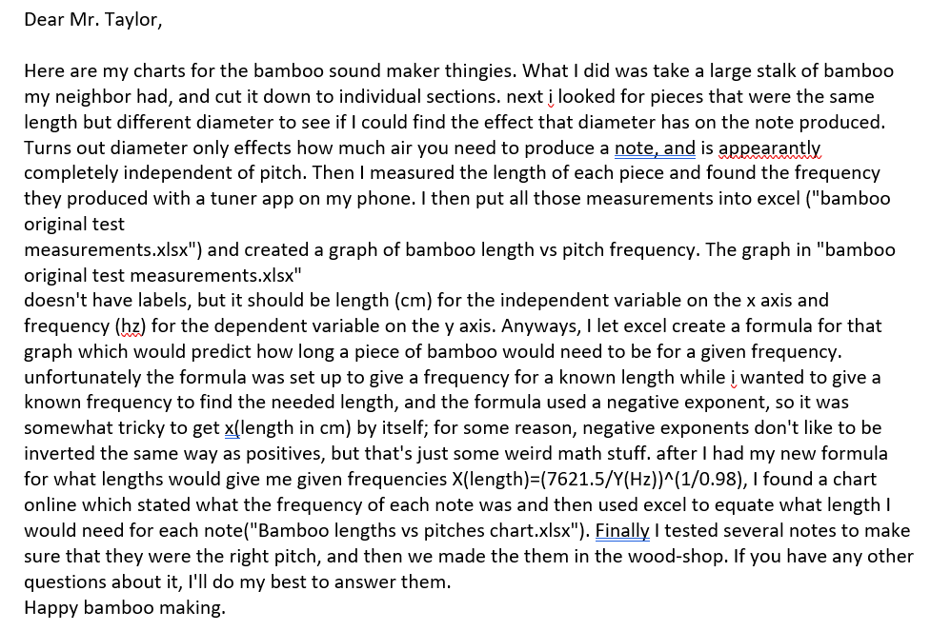
Music
Notes:
Here is Sam’s explanation on the bamboo experiments. This is still one of my favorites. I am glad I made time for him to do this, because I was still pretty structured in my classroom management routine. I think this was 2008 or 2009.

Slide 16
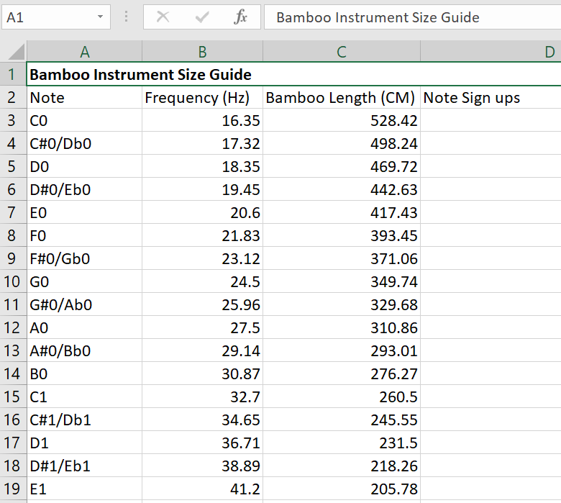
Music
Notes:
Sam’s results- I believe he performed/tested this either at home or in Joe’s Chorus room.

Slide 17
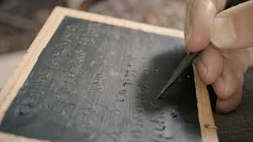
Latin
Sarah Brookshaw- Roman Bathhouses (2010)
Helen Porytko- Wax Tablets
Notes:
Magistra Porytko- just retired in her mid 70’s and we had a blast with CNC carving, and wax pouring Roman tablets. It was a ton of fun. My students assisted with the CNC design and stock processing and melting/pouring of the toilet bowl wax rings. I got the wax idea from participating and competing in Sea Perch.

Slide 18
Latin
Notes:
Sarah had to teach Latin for one year and was nice enough to reach out and we did a full collaboration on this design brief with Sketchup. Arch. Students taught Latin students some CAD skills and we were off and designing in no time.

Slide 19
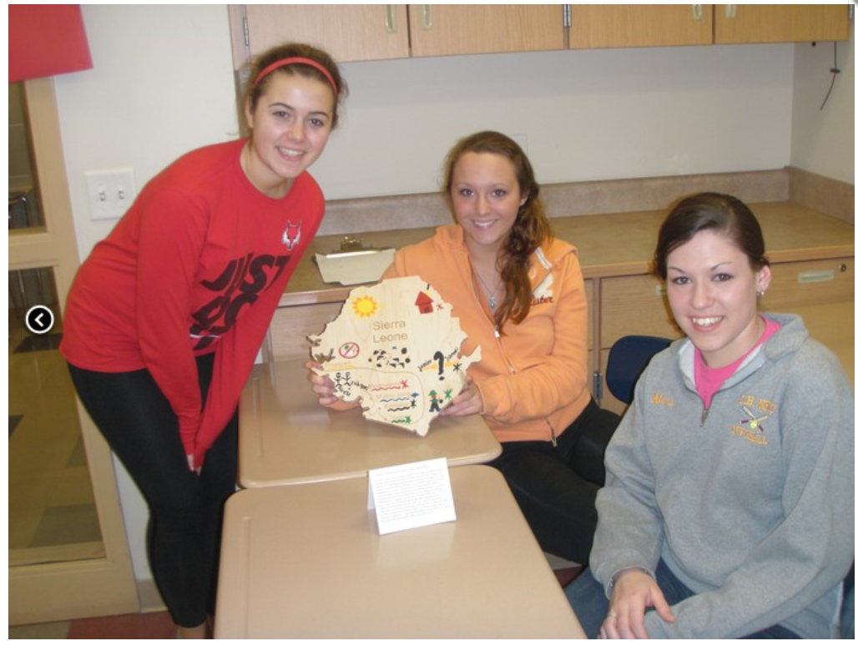
English
Ishmael Beah’s Book “A Long Way Gone” with Dawn Curran and Kerri Donahue- Full Collaboration
Notes:
I personally read Ishmael’s book this one semester- For me, it was good to gain a better appreciation as an adult as to what the students go through during English class- This was a good reminder of a students’ workload in school. My shop students assisted in the process of design and fabrication of the presentation pieces. I wish I had picts. and recordings of the rich conversations that took place during this collaboration.

Slide 20
English
Notes:
Another pict. From Dawn and Kerri’s class.

Slide 21
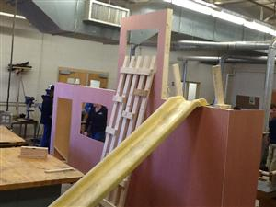
English
Children’s Theater with Jeanine Waldron- Design and Build sets for the 9 week theater class
Notes:
Children’s Theater had its beginnings with Jeanine’s 9 week theater class years ago. This began as a conversation amongst friends that she didn’t have any props to work with and really wanted to do more for her kids- This collaboration continues to this day and is funded by our educational foundation CB Cares- Not only do we have props, but Jeanine has experts give acting lessons and our Attendance Secretary is a talented costume maker.

Slide 22
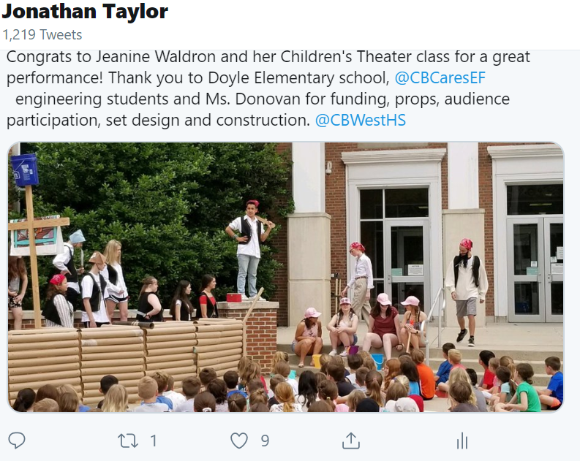
English
Notes:
Linden, Groveland and Doyle come to see our productions each year.

Slide 23
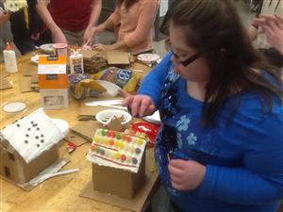
Spec. Ed.
Laser Cut Ginger Bread houses- 12-2014 Mrs. LaBonte
Garden Boxes- Mike Castelli
School Store Table- Mrs. LaBonte- 03-2015
Notes:
Special Education is a great time every time we collaborate. Students really enjoy working with each other to design and build just about anything we can think of. It is a time to slow things down a bit and help each other out to build something really cool. We also got a sugar rush, too.

Slide 24
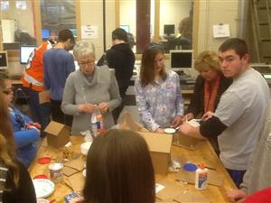
Spec. Ed.
Notes:
Laser Cut Ginger bread houses!

Slide 25
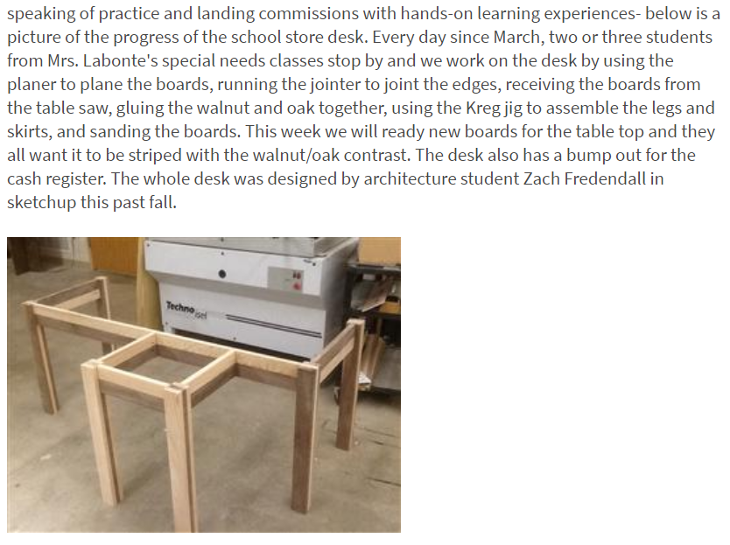
Spec. Ed.
Notes:
The school store table was commissioned by the special education department who used to run our school store- It was such a pleasure gluing up panels and sanding with their students. We used the pocket hole jig system to put the pieces together. A lot of pride went into this project.

Slide 26
Elem.
Doyle Elem. School- Mrs. McPhee Math with Games 11-2014, 12-16-2016
Mrs. Rittenhouse- Simple Machines with K’Nex and RC Car Racetracks
5th Grade Rube Goldberg, 06-2015, Mrs. Denton, Mrs. Dowd and Mr. Merrill
03-2016- Doyle Little Libraries Mrs. Siegle
Warwick’s Garden Club, Lauren Fornwald- 05-2016
Notes:
One of CB’s interests for our students is examining our potential as a district to vertically integrate some of the content of our courses- Here is a small list from having our Tech. and Eng. Students work with the smaller ones over the years.

Slide 27
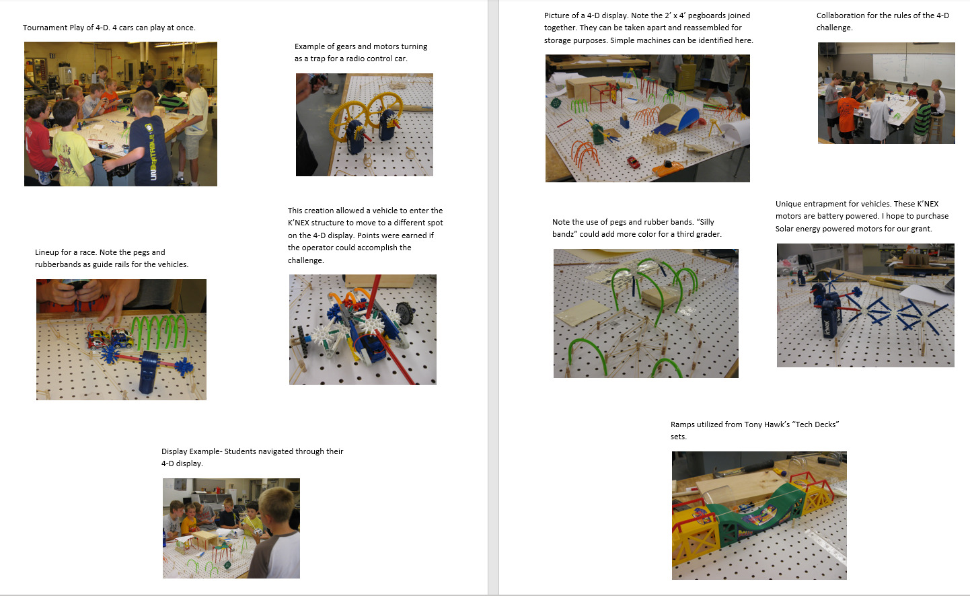
Elem.
Notes:
This was an investigation of Simple Machines through a grant from Westinghouse about ten years ago. Actually, the picts. are from a summer camp I used to offer years ago, but the idea for exploration of simple machines with my classes began and it was great to work with Mrs. Rittenhouse and her 3rd grade students.

Slide 28
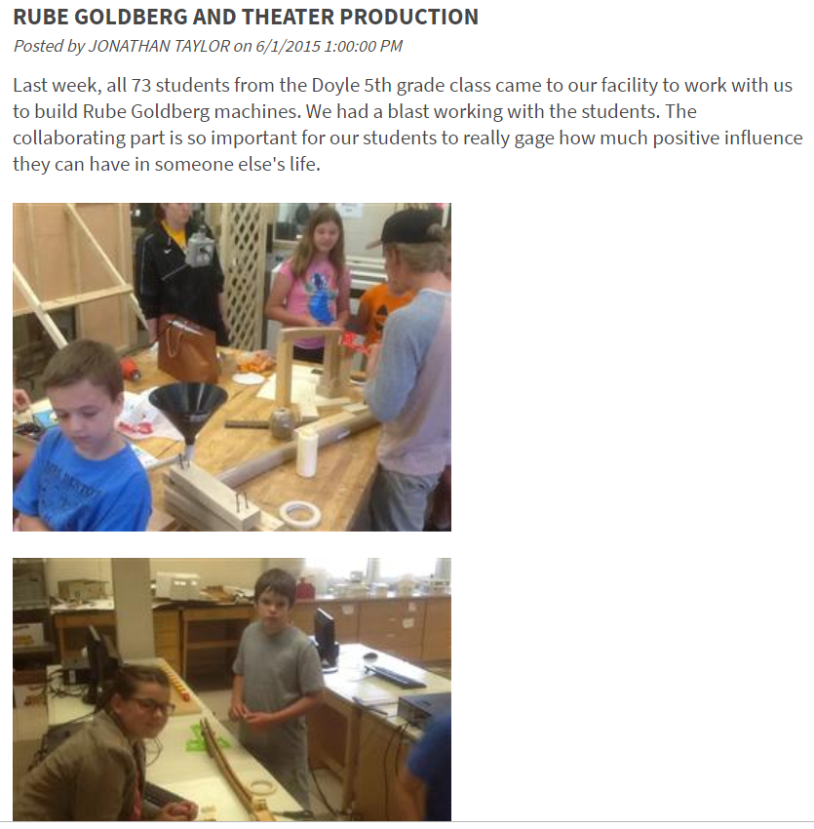
Elem.
Notes:
The entire 5th grade would come to West and we would just have a blast at the end of the year finding out the most unique and creative way to dump Menthos into Diet Coke. Thanks to Lauren, Karen and Brian!

Slide 29
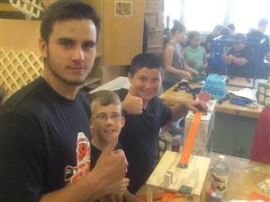
Elem.

Slide 30
Middle
11-11-2014- Start of Girls in Technology Club
West Shop students built Podium out of bleacher board wood for Lenape Middle School
Notes:
Middle school Collaboration- Mira acquired funding through our student organizations to purchase Arduino and Makey Makey kits to have middle school girls explore Electronics and Robotics. Another middle school collaboration was when the Materials Students level III once again met with the Principal of Lenape to determine a design for the podium.

Slide 31
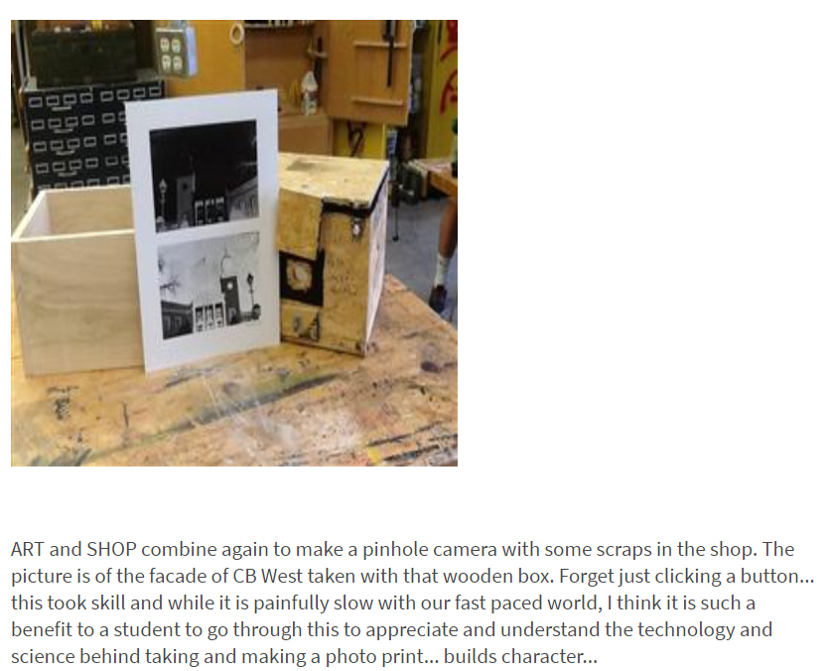
Art
Pinhole Camera- Mrs. Ferraro, March 2016
Notes:
Charlie- Creative kid.

Slide 32
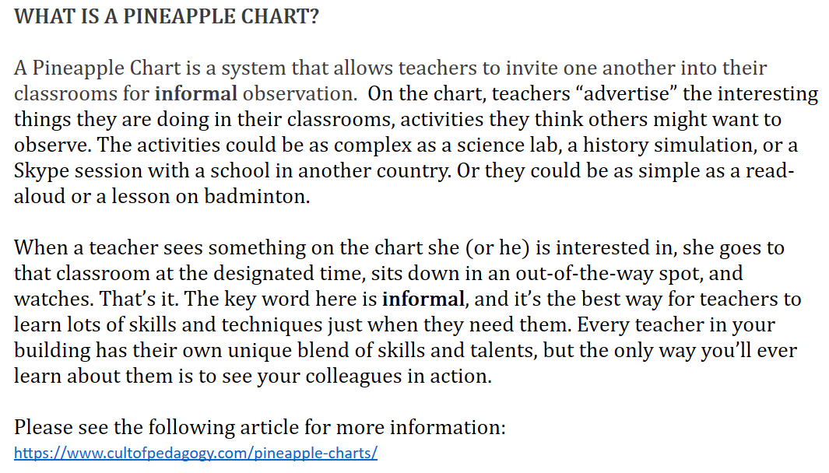
Admin.
Incredibly Supportive
Pineapple Charts
Notes:
Administration across the district is encouraging collaboration through a Pineapple Chart system. Cult of Pedagogy- Jennifer Gonzalez- is an excellent resource for anything educational and I intend to listen more to it in the future. I actually used one of the podcasts to prepare for and organize this presentation for today. Hope it worked…

Slide 33
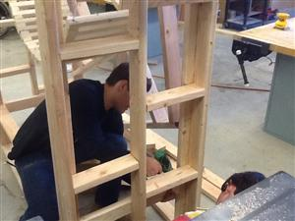
Community
03-2016- Barn Nature Center- Chinchilla Cage
04-2016- CB Cares Gala, Birdhouses, Junior Prom
10-2016- CB West Carnival
Notes:
The CB community has been a larger part of the mantra “It takes a village” for a few years. Warrington’s Barn Nature Center needed a Chinchilla Cage, so we designed one in Sketchup in the Architecture Class and then we built it in the Material’s Class.

Slide 34
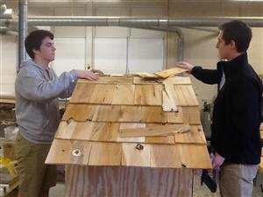
Community
Notes:
Second time putting on the roof.

Slide 35
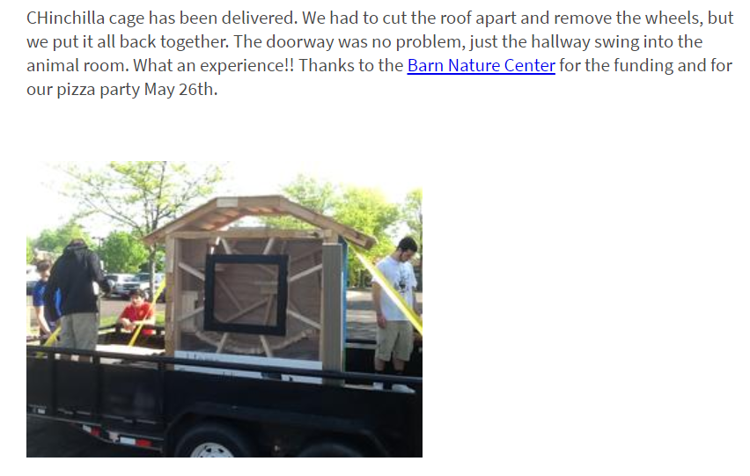
Community
Notes:
Delivery was courtesy of one of our students who had a landscape trailer. You all have heard the saying, those who teach can’t, right? Horrible saying, right?- Well, let me tell you, when we couldn’t get this to turn down the hallway of the Nature Center- (I swear I measured more than twice!) I was really feeling the true human affects of that statement- Fortunately, I have really talented students, and we took apart part of the roof with a Sawzall and then we came back and we put it all back together- What a real life problem-solving activity! The Pizza party was awesome and the students got a free day at the Barn Nature Center including the Rock Climbing Barn! Truly, an unforgettable experience. All part of the community collaboration!

Slide 36
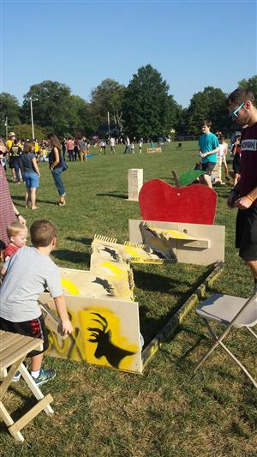
Community
Notes:
Games designed and built from input from our clubs for our Annual CB West Homecoming Carnival.

Slide 37
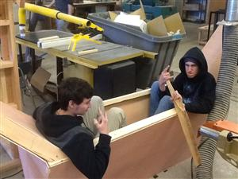
Community
Notes:
Junior Prom Prop.

Slide 38
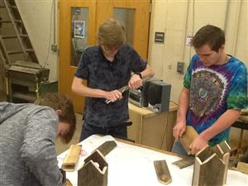
Community
Notes:
CB Cares Foundation Gala Birdhouse Centerpieces.

Slide 39
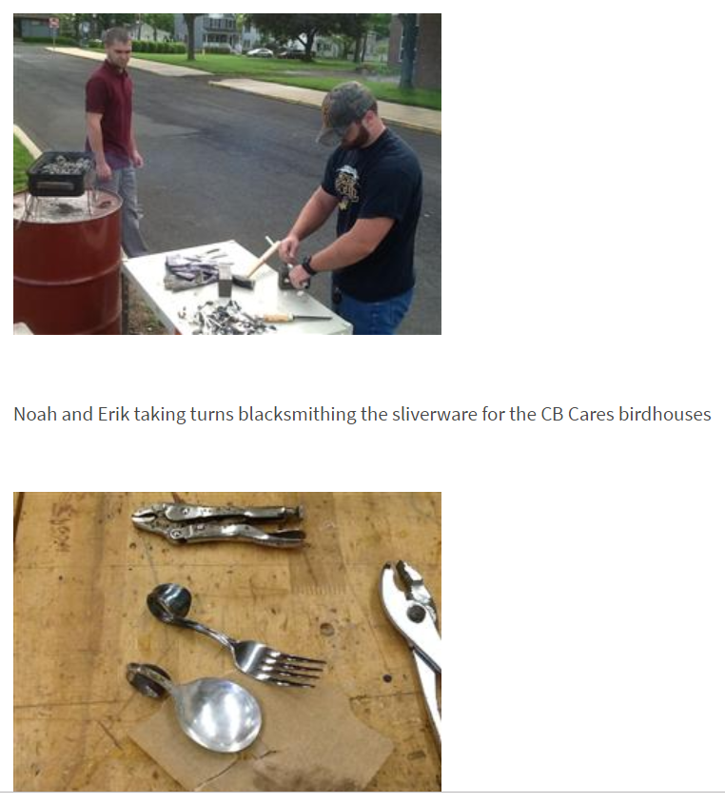
Community
Notes:
“Blacksmithing” for the Birdhouses- The CB Cares Gala is their number one fundraiser for the school year and she sells the centerpieces as part of the fundraising efforts.

Slide 40
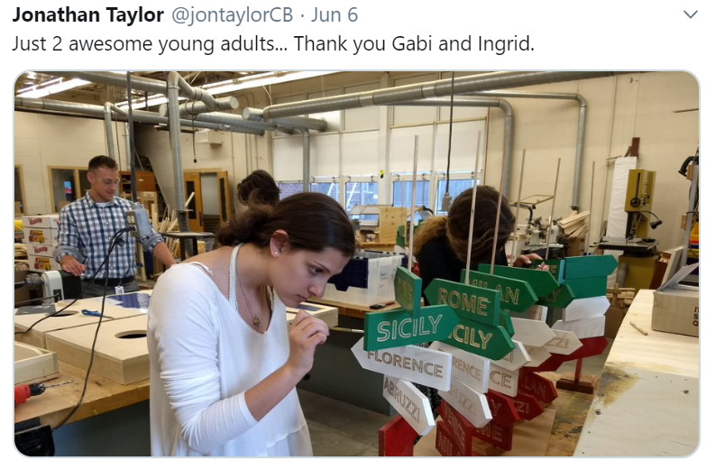
Community
Notes:
Attention to detail was phenomenal last year for the CB Cares Gala- The conversations to get this product from idea to design to final product were so valuable- Comments like, this is crazy, Color change?? we can’t do this, how will this work?

Slide 41
Community
Newsletter Feature
Notes:
Our Bi-Weekly Newsletter that our administration sends out is a great way to get our collaborative efforts out to the community.

Slide 42
Show and Tell
Blog- Make-Mentor-Collaborate
Notes:
I kept a regular blog from 2014 till 2017ish. Most of the projects shown were from the blog.

Slide 43
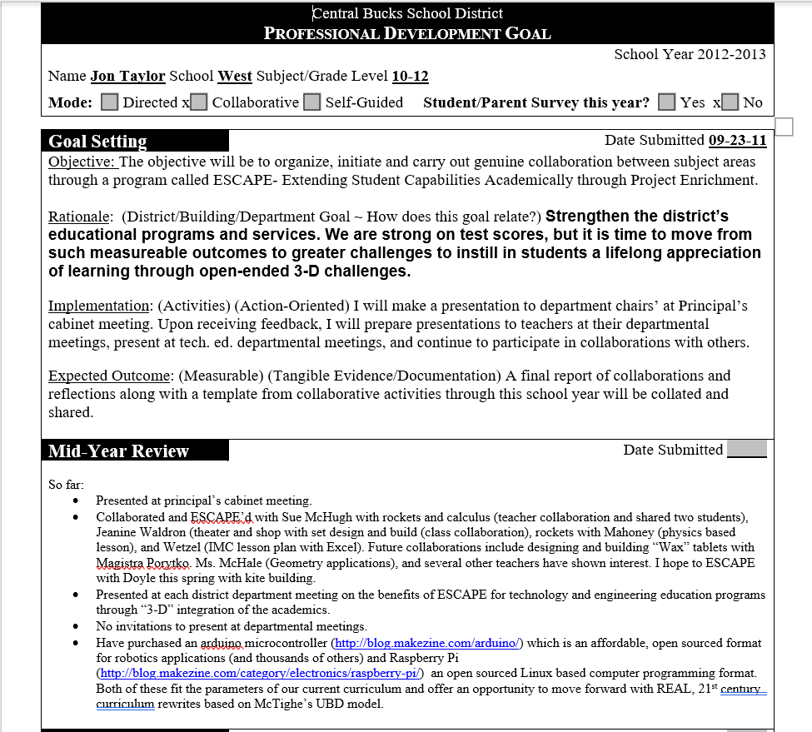
ESCAPE Collaboration
Notes:
As I was digging around, I found my Goal for 2012-13- Here, I was looking for promoting collaboration and did a lot of it that year.

Slide 44
Now
Shamelessly and Selfishly Promote Other classes and STEAM
Tweak students’ workload
Classroom Management changed
Dynamic classes in tech. and eng. because content is included from other classes
Notes:
Now I want to tell you about how collaboration has paid off and how much I have changed as a teacher as a result of it. The collaborative experiences have changed me- I really want to do more to get kids to like their academic classes. I worry much less about numbers for my classes. I do have more of an open, Makerspace like classroom with a mix of focused interactive lessons and choice of projects.

Slide 45
Now
Twitter- @jontaylorCB
Notes:
The last few years I have moved from the blog to twitter- a great promotional tool for education- Staff development sent me to Pete and C conference a few years ago and I was impressed by how twitter was used to promote programs, educational pedagogy and just impressed by some of the cool projects going on out there related to STEM/STEAM.

Slide 46
Recent Events
Comp. Sci., Calculus Collaborations- Anthony Paglione
Many Collaborations still exist today
More classes collaborate- Art and French, Cooking and Spec. Ed., English and Elem. Students and etc.
Presentations Through Central Bucks Staff Development, Technology Showcase
Notes:
I will quickly go through some recent collaborations- ones that have taken place in the last two years.

Slide 47
Recent Events
Science Research Club
STEAM Saturdays
CB QUEST Elem. Program
CB Integrated Tech. Middle School Program
CB Tech. and Eng. Dep’t, STEM Guitar- TEEAP- Pennridge
Young Engineers’ Night
Notes:
There are a lot and it is a ton of work, but it’s like a hobby. I enjoy it.

Slide 48
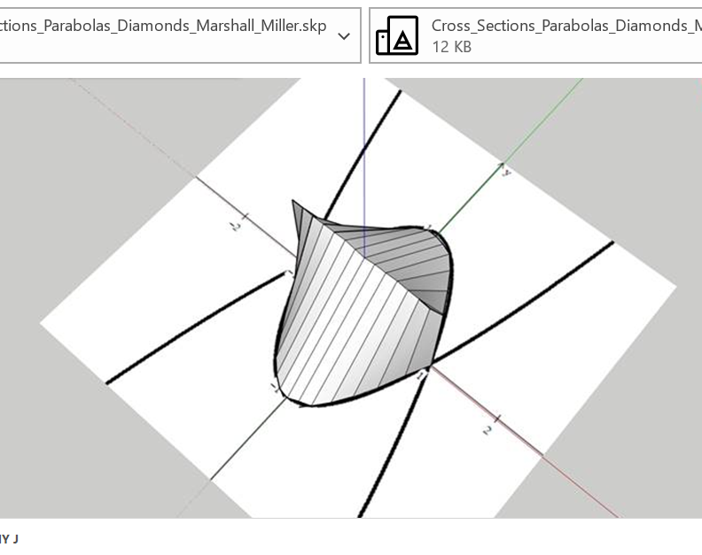
Recent Events
Notes:
Anthony’s classes borrowed the Makerbot to print out their shapes.

Slide 49
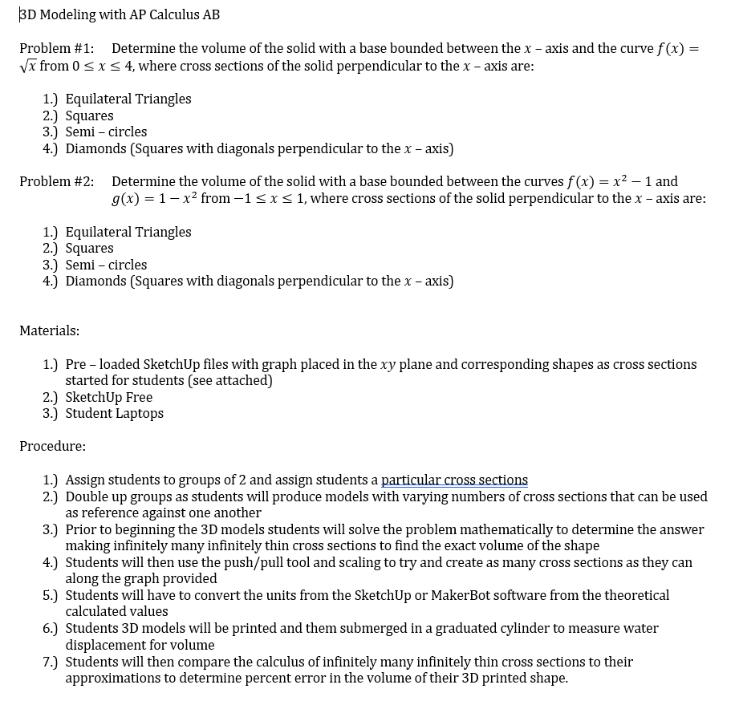
Recent Events
Notes:
Holy cow it’s Calculus. By us planning out this activity together, the Calculus students had a really neat STEAM project by submerging their small object into water and then doing what he describes in the sheet. I am not even going to try to explain this…

Slide 50
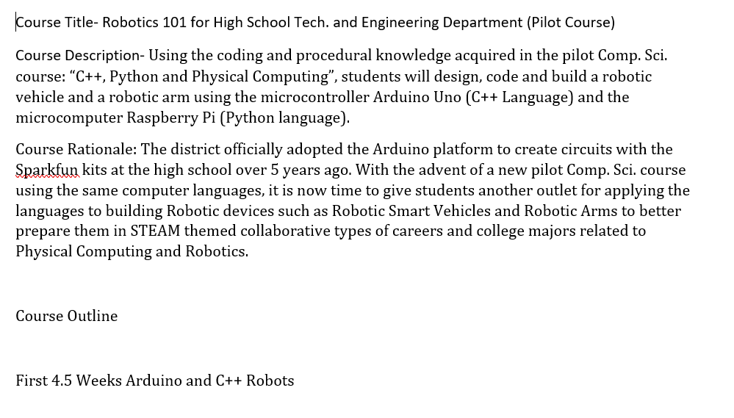
Recent Events
Notes:
Here is my course proposal for a Robotics Course.

Slide 51
Recent Events
Notes:
Here is Anthony’s proposed Comp. Sci. Course- Closely written with mine so we both are teaching the same computer languages and having a really neat output with building a smart car robot. I am really eager to get these two courses going- a great example of collaboration.

Slide 52
Recent Events
Notes:
A shout out to Mark Hayden, our science coordinator and Science Research Club advisor for CB West- I can thank him for the shirt I am wearing today- He does a lot to promote STEM/STEAM in our school. All of us a more than willing to help his students out with their projects.

Slide 53
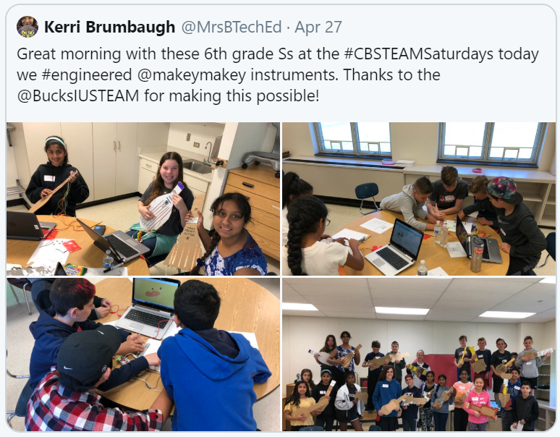
Recent Events
Notes:
Kerri’s a tech. and eng. Teacher at Tamanend Middle School having fun at the Bucks County IU.

Slide 54
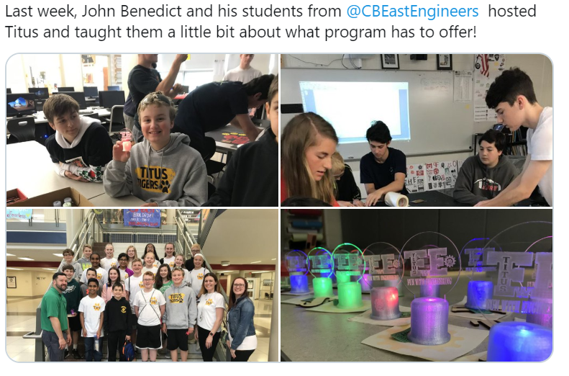
Recent Events
Notes:
CB East hosting Titus for some hands-on fun.

Slide 55
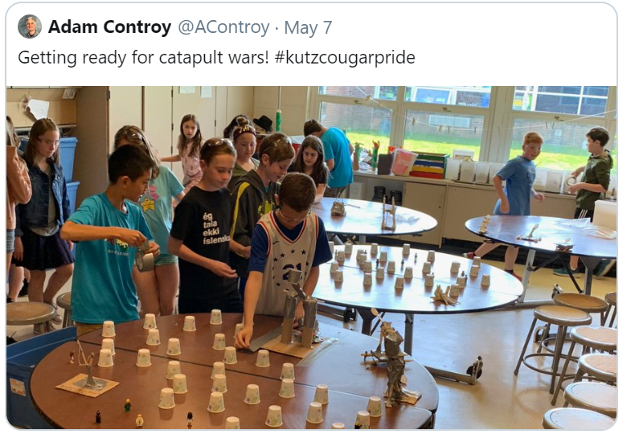
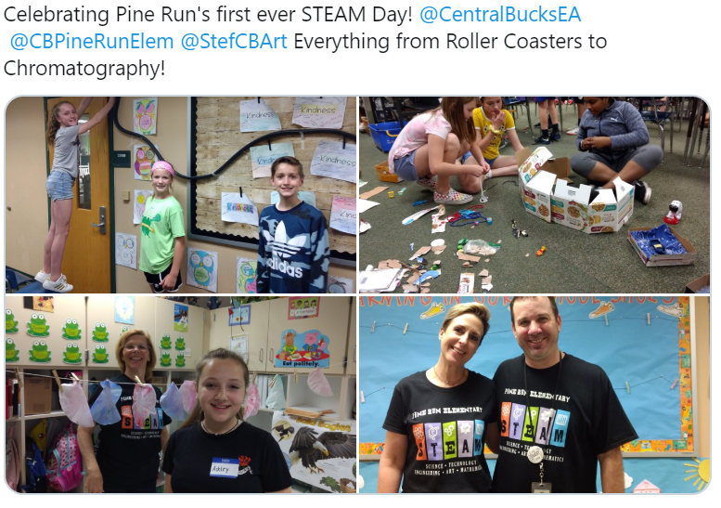
Recent Events
Notes:
The QUEST program at our Elem. Schools-

Slide 56
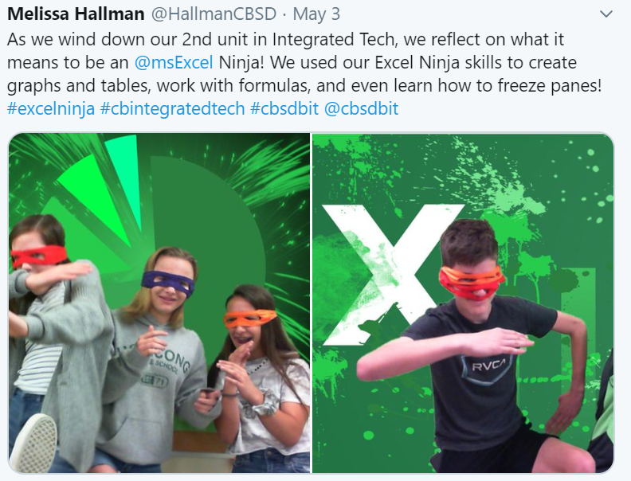
Recent Events
Notes:
Alongside our Tech. and Eng. Programs, we also feature Integrated Technology.

Slide 57
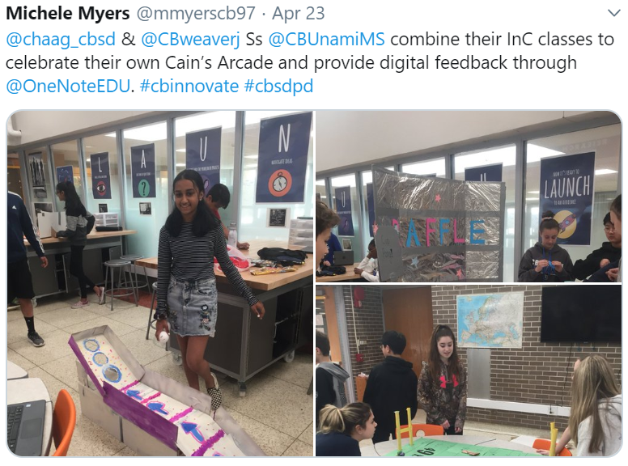
Recent Events
Notes:
Caine’s arcade spread from Tamanend to Unami.

Slide 58
Recent Events
Notes:
Administration got us all together last spring- It was a great conversation and we intend to do more of it this school year.

Slide 59
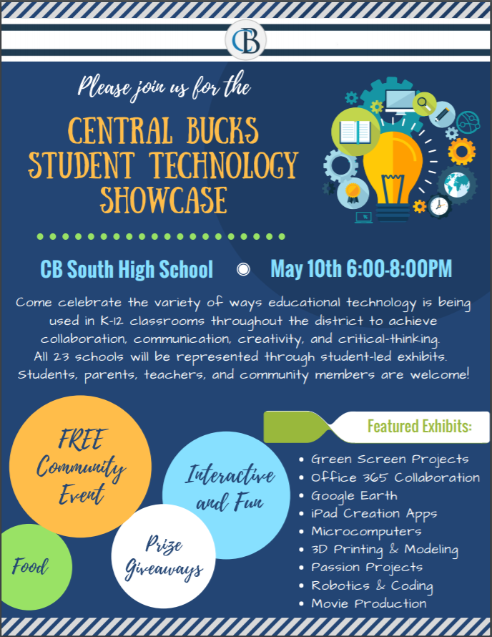
Recent Events
Notes:
Tech. Ed., Integrated Tech., QUEST and other subject areas representing our best activities at our first Tech. Showcase.

Slide 60
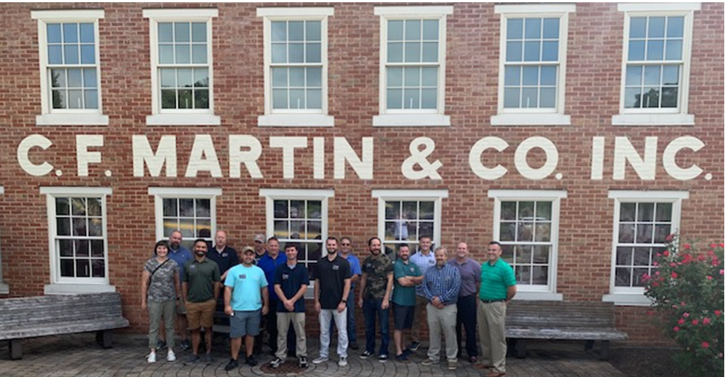
Recent Events
Notes:
TEEAP’s Pennridge STEM guitar has inspired us to pursue guitar building- Admin. Scheduled a tour this fall-

Slide 61
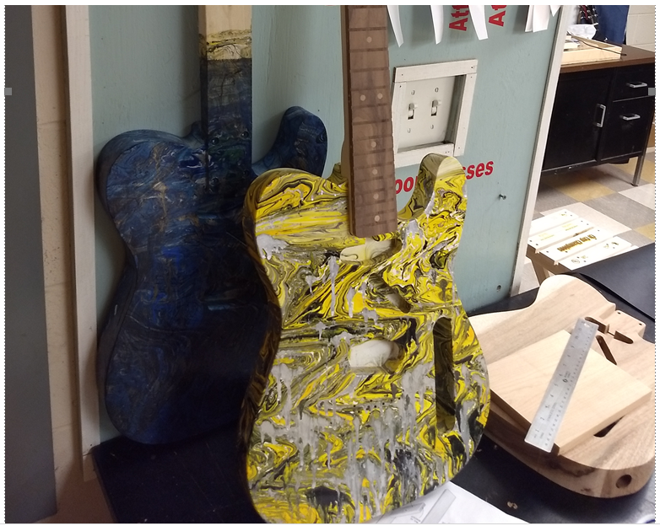
Recent Events

Slide 62
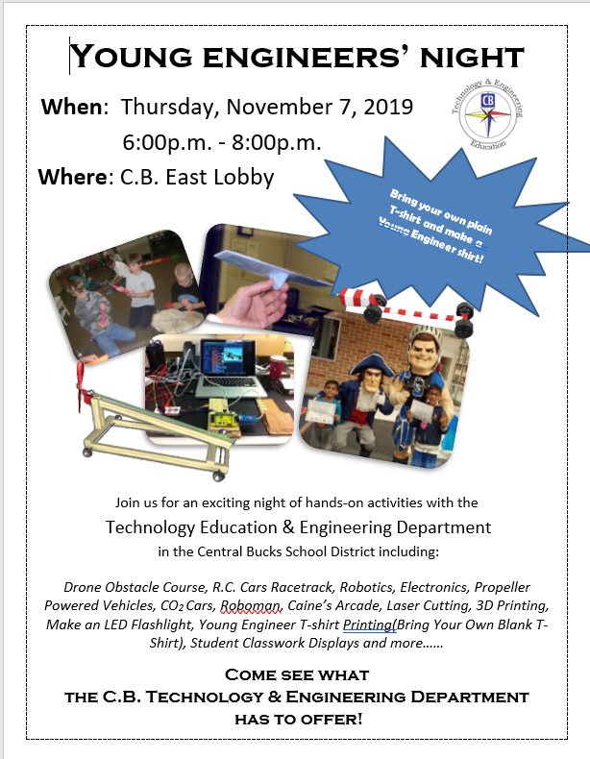
Recent Events
Notes:
I believe our 4th year doing YEN, which is hosted by Tech. and Eng. Teachers-

Slide 63
Future of STEAM Collaboration
More Inter-Departmental Meetings Scheduled
Creation of a District Wide STEAM committee
Continue to partner with other subject areas to try out new STEAM project ideas
Encourage other subject areas to collaborate
Notes:
Ideas to further STEM/STEAM

Slide 64
Future of STEAM Collaboration
Attend each other’s monthly department meetings
Present ideas to department heads at monthly Principal’s Cabinet meetings
Write more Courses of Studies collaboratively with other departments
STEAM involves ALL

Slide 65
Keep learning…
“We want students to be lifelong learners. Well… it starts with us. The adults in the school should set the example of what it means to adapt, change, grow, and continue learning.” –Danny Steele @SteeleThoughts
Notes:
As I wind this down, I found this quote appropriate for this presentation. Why not adapt, change, grow and continue learning from each other, right? Our best sources happen to be our colleagues right next door.

Slide 66
Conclusion
Going through the collaborative process with different subject area teachers to form relationships with them to create these STEM/STEAM projects with the students has been so professionally valuable to me.
Notes:
When you leave here today and take in all that you see and hear, I just ask one thing- Take the time to support and “Befriend an Academic”- start small, share a few students, come up with a fun activity on a Fun Friday, for example. You will learn SO MUCH- It will change you as a teacher and as a human. You will better understand your students’ academic lives and therefore be able to meet their ever changing needs. Academic teachers have intense curriculums, so be patient- It will naturally happen, especially through the STEM/STEAM world-

Slide 67
Links
jtaylor@cbsd.org
Website: https://www.cbsd.org/domain/2108

Slide 68
Grateful…
Thank you to STEMATHON for having me and to CBSD, CB West Teachers, Admin., Staff, Students and CB community for these amazing STEAM Projects.
Notes:
Thanks!!

Slide 69
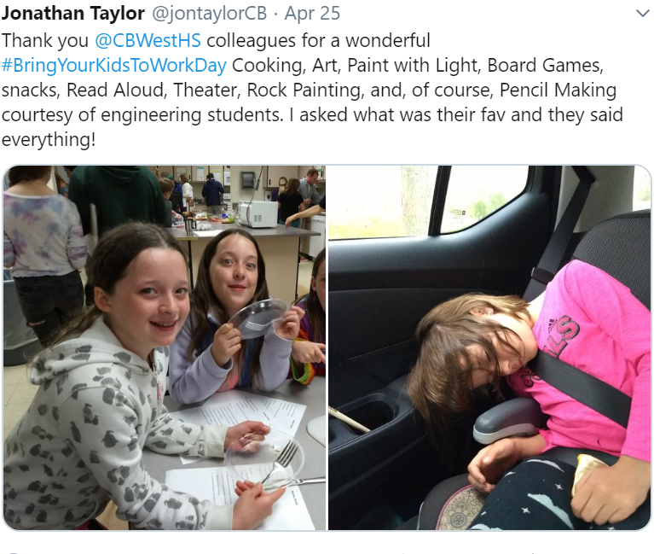
Questions?
.
Notes:
West is a wonderful place- It has a soul- We even collaborate on Bring your Kid to Work day and have been doing so for years- It is tiresome, but so much fun. Questions/Comments?

