Slide 2
"news-jacking" — when brands take advantage of a news event to proactively help their brand and send a message to customers.
"It's a fantastic way to increase [customer] affinity
if you get it right. And it's a fantastic way to lose customers if you get it wrong."

Slide 3
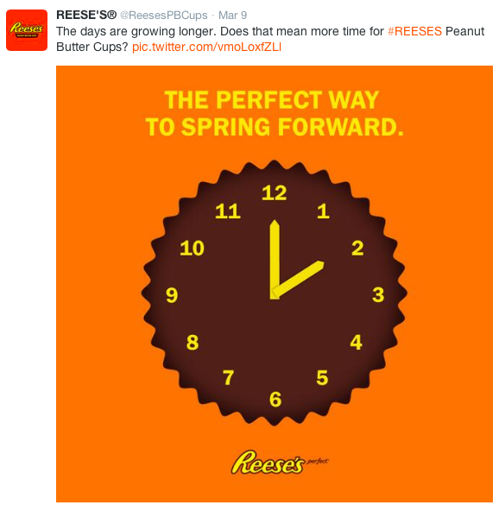

Slide 4
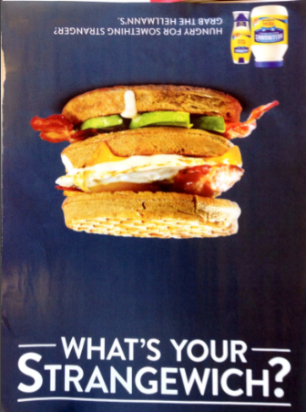
October 2017 in Entertainment Weekly

Slide 5
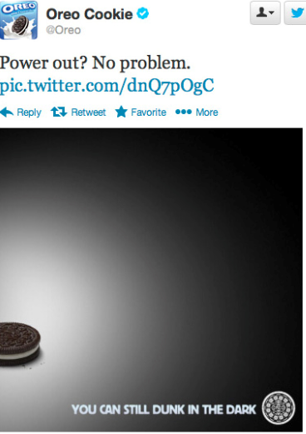
From the 2013 Super Bowl, when a black out plunged the stadium into darkness.

Slide 6
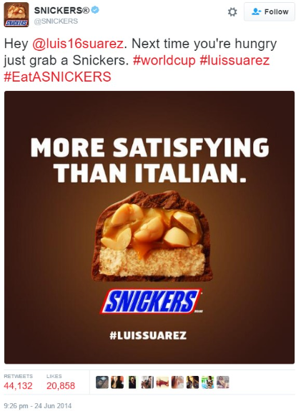
Luis Suarez made headlines in 2014’s Football World Cup when he bit another Italian football player.

Slide 7
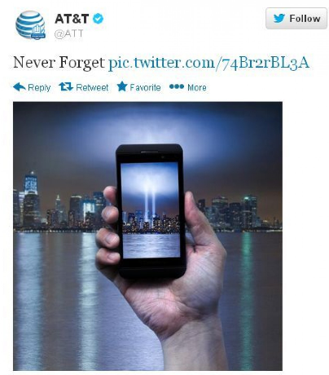
This tweet appeared in early September 2013.

Slide 8
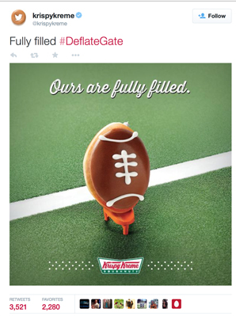
This Krispy Kreme (donut company) tweet came after the Tom Brady/New England Patriots “Deflate Gate” scandal in 2015 when Brady was accused of letting air out of what is supposed to be a standard ball. Supposedly, this helped his grip.

