Slide 1
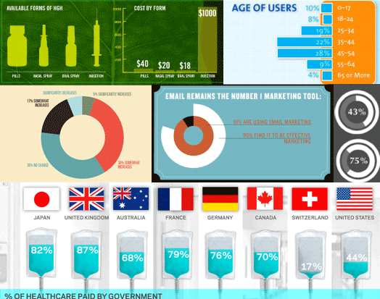
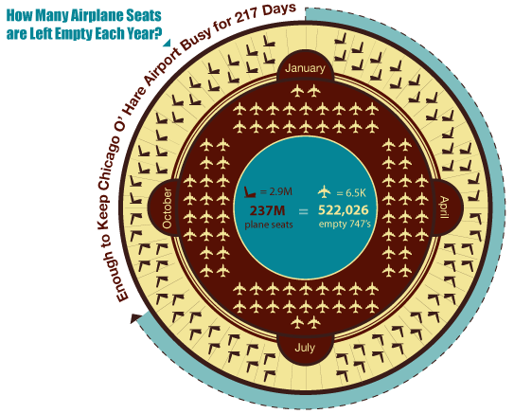
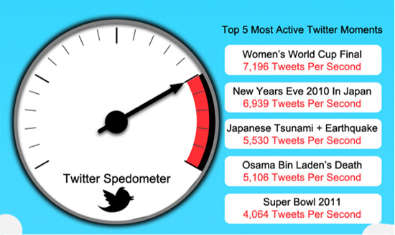
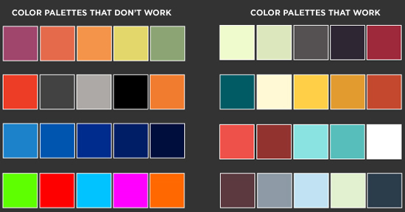
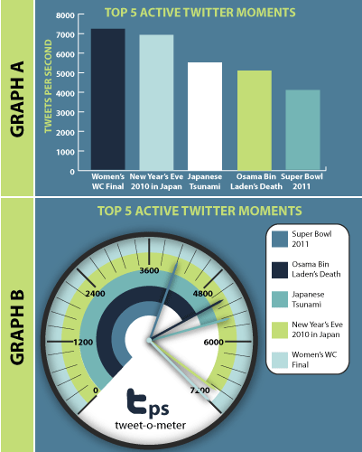
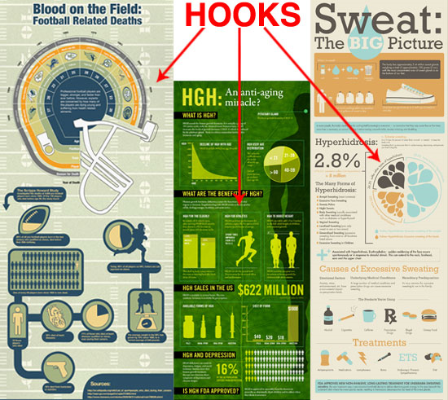
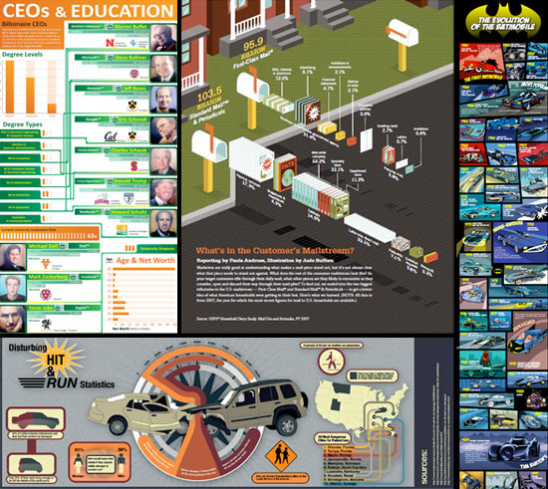
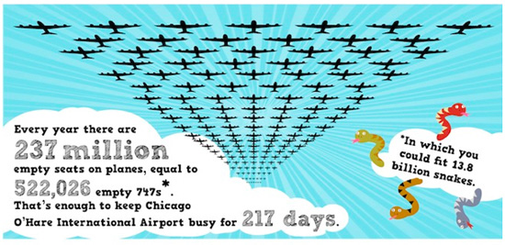
The Do’s and Don’ts of Infographic Design
by Amy Balliett - Smashing Magazine - 10/14/11

Slide 2
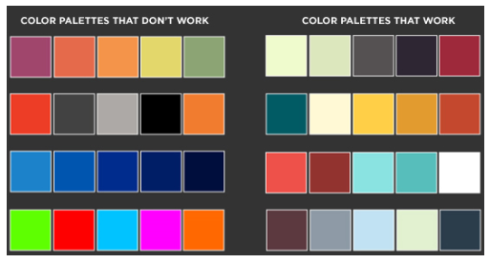
KEY POINTS FROM The Do’s and Don’ts of Infographic Design by Amy Balliett - Smashing Magazine - 10/14/11
The term “data viz” comes from “data visualization,” which implies that sets of data will be displayed in a unique way that can be seen, rather than read.
Today, infographics compile many different data visualizations into one cohesive piece of “eye candy.”
Show, don’t tell – display information visually and dress up conventional graphs and charts whenever possible
Think about interesting organization – will your information flow vertically? horizontally? be divided in sections? tell a story by having a beginning, middle, and end?
Use color – often using three colors that work together is easy for your audience’s eyes
Notice how the info about government healthcare is depicted using an IV bag, which is a medical tool of healthcare. The idea of government is depicted by the national flags.

Slide 3
INFOGRAPHICS
How to
Evaluation
Information
Compare/Contrast
Top Ten
Brief History Of
As you examine main types of infographics, click on the
button to view the entire infographic.

Slide 4
TYPE 1:
“How to”
A pictorial guide to doing something
Notes:
Twitter link: https://coolkidsdesign.files.wordpress.com/2012/02/how-to-twitter-infographic-01.jpg
Resume link: http://www.dailyinfographic.com/spice-up-your-resume-infographic

Slide 5
TYPE 2: Evaluation
The Best…
The Worst…
The Most Unforgettable…
The Scariest…
Notes:
Disney link: http://www.dailyinfographic.com/which-disney-park-is-the-happiest-infographic
Credit card link: http://www.dailyinfographic.com/best-rewards-credit-cards-infographic

Slide 6
Type 3: Information—
Topic
or
Person
What does someone MOST need to know to understand in at least a basic way?
Notes:
Vegan link: http://www.dailyinfographic.com/all-you-need-to-know-about-a-vegan-diet-infographic
Jobs link: http://visual.ly/steve-jobs-an-infographic

Slide 7
TYPE 4: Compare/
Contrast
Look at the differences between two things
Notes:
Netflix link: http://www.dailyinfographic.com/netflix-vs-redbox
Bitcoin link: http://www.dailyinfographic.com/bitcoin-vs-gold-infographic

Slide 8
TYPE 5:
Top 10 (or whatever number) List
Identify key factors related to a topic
Notes:
Movies link: http://www.dailyinfographic.com/9-hacks-for-movie-snacks-infographic
Successful link: http://www.dailyinfographic.com/8-things-successful-people-do-and-why-infographic

Slide 9
Type 6:
The History of…
What key events are crucial in understanding the development or evolution of a topic?
Notes:
Transformers link: http://www.dailyinfographic.com/the-history-of-tranformers-infographic
Super Bowl link: http://www.dailyinfographic.com/the-history-of-the-super-bowl-infographic

Slide 10
Next Steps:
Select a topic that you find interesting and on which you’d like to conduct some brief, basic research.
Fill in the research sheet provided to
you in class.
Create your own infographic according to
one of the main types you just explored
(see left). Review the GAPSTone
considerations on the next slide as well.
INFOGRAPHICS
How to
Evaluation
Information
Compare/Contrast
Top Ten
Brief History Of

Slide 11
As you create your infographic,
be sure to consider the categories of GAPSTone:
You will be filling in a graphic organizer to explain
how these elements are evident in/lend meaning to your infographic.
G = Graphics (font, images, colors, layout, etc.)
A = Audience
P = Purpose
S = Subject
Tone = Your feeling/attitude/opinion toward the content

Slide 12
As you start to design your infographic, give thought to the visual choices:
Background
Chart/pie graph/bar graph format
Images
Font
Color
Lay-out
Be creative and visually engaging!
See samples on the next few slides.

Slide 13
Clever! An infographic on people and their tablets is shaped like an iPad!
Note that the pie chart is placed within the “Uncle Sam” hat to reflect the focus on America’s budget issues.

Slide 14
The bookshelf background is logical and creative in portraying info about writing mistakes; separating info within books is also a relevant way to organize information.

Slide 15
The background design resembles a subway/metro system to hint at the idea of a vast network of companies/ services associated with Amazon.

Slide 16
In this excerpt of an infographic, the Lego background grabs attention, AND it is connected to the topic.

Slide 17
The visual incorporates effective overlays to demonstrate how Godzilla has been sized for films over the years. What would be even more interesting might be notes about how the size reflects social issues/concerns during the year of the movie’s release. For instance, look how big Godzilla is in 2014. Is that because audiences want impressive special effects? Is it because in a post 9-11, terrorized, diseased, financially struggling world people need a mega-hero (remember that in the most recent film, Godzilla saves the day)?

Slide 18
RUBRIC
Clear consideration and explanation of choices for: | + |  | -
Graphics (font, images, colors, layout, etc.)
Audience
Purpose
Subject
Tone

