Slide 1
What is Wellness?
Take a minutes to think about this question, then share your answer with the person next to you.
Notes:
Wellness is the state of being in good health. Often associated with quality of life. How satisfied a person is with her looks, lifestyle, and responses to daily events.

Slide 2
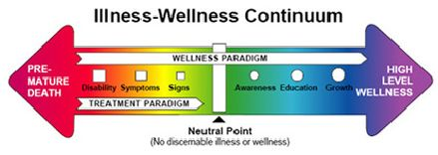
Health and Wellness Continuum
1. Wellness Continuum
Health falls somewhere on a line (continuum) from a high level to a low level.
Choices determine whether YOU have a High or Low level of Health.
2. Low Level of Health
Lack of Energy, inattention, minor aches and pains
Chronic Disorders
Disability
3. High Level of Health
Exhibit a high degree of responsibility, discipline, and positive direction in life.
Accept responsibility for their health.

Slide 3
Aspects of Wellness
Mental has to do with the way you feel about yourself, your life, and the people around you.
Physical refers to the fitness of your body.
Social describes how you get along with others.

Slide 4
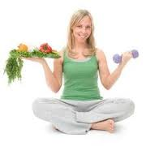
Holistic Approach
Focuses on all aspects of a person – physical, mental and social.

Slide 5
Factors That Affect Wellness
Unhealthful Lifestyle choices
Poor Environmental quality
Inadequate health care
Heredity
Notes:
You make many of your own choices so you have control over your personal wellness.

Slide 6
Health Promoting Choices
Choose a Healthful Lifestyle
Resist Negative Peer Pressure
Improve Your Environment

Slide 7
Assess Your Lifestyle Choices
Do you
Avoid the use of tobacco?
Avoid the use of alcohol and street drugs?
Regularly eat a nutritious diet, including breakfast?
Manage your weight?
Get daily physical activity to maintain fitness?
Manage stress effectively?
Get enough sleep?
Carefully follow the instructions on medicine labels?
Wear protective clothing when participating in sports and fitness activities?
Avoid taking unnecessary risks?
Avoid unsafe sexual practices?
Take appropriate safety precautions when using equipment and machinery?
Enthusiastically participate in school and community activities?

