Slide 1
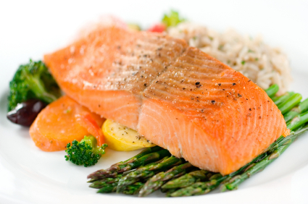
Planning Meals

Slide 2
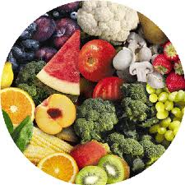
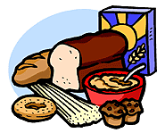
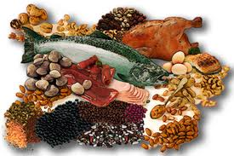
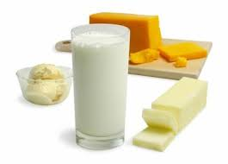
Components of a daily menu!
Five Food Groups
Vegetables/Fruits 4 servings
Bread/Cereal 4 – 8 servings
Milk/Cheese Child: 4 servings/Adult: 2 servings
Meat/Poultry/Fish 2 Servings
Fats/Sweets Eat sparingly

Slide 3
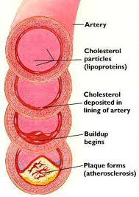
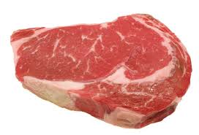
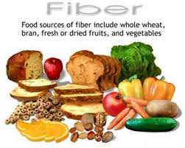
Menu Guidelines For The Average Adult
Calories 1800 – 2000
Fat (less than 30% of calories) Less than 60 grams
Saturated Fat (less than 8% of calories) Less than 16 grams
Cholesterol Less than 300 milligrams
Dietary Fiber 20 - 35 grams
Sodium Less than 2400 milligrams

Slide 4
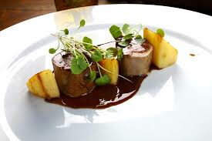
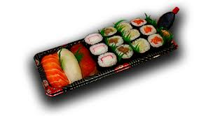
A successful Meal
Should have:
a moderate amount of fat, cholesterol, sugar and salt
be aesthetically pleasing
a variety of colors
a variety of textures
a variety of flavors
a variety of shapes
a variety of temperatures
nutritional varieties
preparation methods

Slide 5
Things to Consider When Planning a Meal
Personal resources
Time
Money
Energy
Skills
Equipment

Slide 6
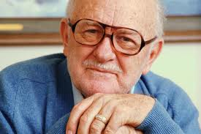
Additional Things to Consider
Health problems
Schedules
Ages of people eating

Slide 7
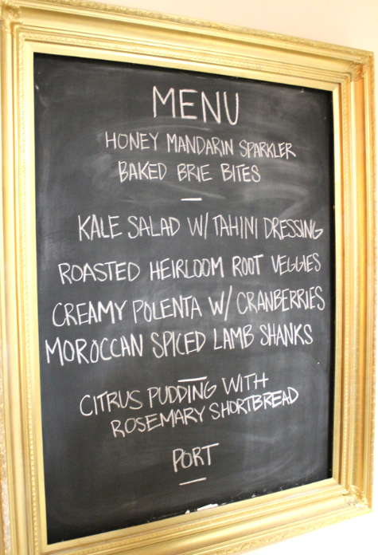
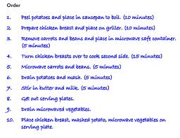
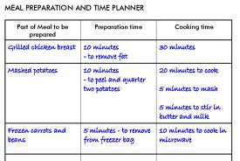
How to Time a Meal
Decide on when the meal will be served
Write out the menu
Make up a time schedule for the meal
Make up a work schedule

Slide 8
Special Diets

Slide 9
Vegetarian diet
Types of vegetarian diets
When people think about a vegetarian diet, they typically think about a diet that doesn't include meat, poultry or fish. But vegetarian diets vary in what foods they include and exclude:
Lacto-vegetarian diets exclude meat, fish, poultry and eggs, as well as foods that contain them. Dairy products, such as milk, cheese, yogurt and butter, are included.
Lacto-ovo vegetarian diets exclude meat, fish and poultry, but allow dairy products and eggs.
Ovo-vegetarian diets exclude meat, poultry, seafood and dairy products, but allow eggs.
Vegan diets exclude meat, poultry, fish, eggs and dairy products — and foods that contain these products.
Some people follow a semivegetarian diet — also called a flexitarian diet — which is primarily a plant-based diet but includes meat, dairy, eggs, poultry and fish on occasion or in small quantities.

Slide 10
Vegetarian diet pyramid

Slide 11
Sample Menu - Vegetarian
Breakfast
German Apple Pancake
Strawberries (1 cup)
Skim Milk
Lunch
Leek, Asparagus & Herb Soup
Orange (1 large)
Snack
Apple
Skim Milk
Dinner
Curried Cashew Burgers

Slide 12
What is Gluten?
Gluten Gives Dough Elasticity, Structure
The gluten in wheat, barley and rye actually consists of two proteins: gliadin and glutenin. When the two combine during the baking process, they form a thick, stretchy, glue-like substance that provides bread and other baked goods with elasticity and appealing texture.
Gluten also helps bread dough rise by trapping (literally gluing) bubbles from fermenting yeast within the dough itself, allowing the dough to rise into a light and airy loaf. Sadly, the gluten proteins in other grains don't provide this same ability, which is why it's so difficult to find decent gluten-free bread.
It's these qualities in baked goods that gave rise to the popularity of modern wheat (and to a lesser extent barley and rye). In fact, modern wheat has been bred to contain far more gluten than older varieties of wheat such as Einkorn wheat and spelt wheat, which makes modern wheat more toxic for those of us who react to it.

Slide 13
Sample Menu - Gluten Free
Breakfasts
Egg, cheese, and vegetable omelet with potatoes and fresh fruit
Lunch
Stir-fried meat and vegetables with rice and wheat-free tamari
Dinner
Corn tortillas with stir-fried meat and vegetables
Snacks
Celery sticks with peanut butter
String cheese

Slide 14
What is a Diabetes Meal Plan?
A diabetes meal plan is a guide that tells you how much and what kinds of food you can choose to eat at meals and snack times. A good meal plan should fit in with your schedule and eating habits. Some meal planning tools include the plate method, carb counting, and glycemic index. The right meal plan will help you improve your blood glucose, blood pressure, and cholesterol numbers and also help keep your weight on track. Whether you need to lose weight or stay where you are, your meal plan can help.

Slide 15
Sample Menu - Diabetic
Breakfast
(360 calories, 52.5 grams carbohydrate)
1 slice toasted whole wheat bread with 1 teaspoon margarine, 1/4 cup egg substitute or cottage cheese 1/2 cup oatmeal, 1/2 cup skim milk and 1/2 small banana
Lunch
(535 calories, 75 grams carbohydrate)
1 cup vegetable soup with 4-6 crackers, 1 turkey sandwich (2 slices whole wheat bread, 1 ounce turkey and 1 ounce low-fat cheese, 1 teaspoon mayonnaise), 1 small apple
Dinner
(635 calories, 65 grams carbohydrate)
4 ounces broiled chicken breast with basil and oregano sprinkled on top, 2/3 cup cooked brown rice, 1/2 cup cooked carrots, 1 small whole grain dinner roll with 1 teaspoon margarine, Tossed salad with 2 tablespoons low-fat salad dressing, 4 unsweetened canned apricot halves or 1 small slice of angel food cake
Snacks
(Each has 60 calories or 15 grams carbohydrate. Pick two per day.)
16 fat-free tortilla chips with salsa, 1/2 cup artificially sweetened chocolate pudding 1 ounce string cheese plus one small piece of fruit 3 cups light popcorn

