Slide 1
PARENTING
Caring for children and helping them develop

Slide 2
A Learning Process
Know when to help and when to back off so that a child can do a task himself or herself
Avoid pushing children to try activities they are not ready for
Adapt parenting skills at each stage of a child’s development

Slide 3
Have Reasonable Expectations
Understanding child development is important
Be sure expectations match their particular child
Respect differences between children

Slide 4
Find a comfortable PARENTING STYLE
Pictionary

Slide 5
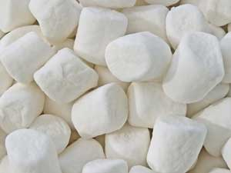
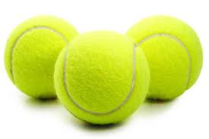
PARENTING STYLES

Slide 6
Authoritarian
* Emphasizes obedience
Set clearly defined standards of behavior and expect their children to follow the rules without question
Provide a structured environment in which children know exactly what they can or cannot do
Children’s opportunities to make decisions on their own are limited

Slide 7
Authoritarian
Example
Tiger Mom: Amy Chua

Slide 8
Authoritarian
“This is a story about a mother, two daughters, and two dogs. This was supposed to be a story of how Chinese parents are better at raising kids than Western ones. But instead, it’s about a bitter clash of cultures, a fleeting taste of glory, and how I was humbled by a thirteen-year-old.”
Example
Tiger Mom: Amy Chua
Chua listed a number of rules that she said she enforced on her two daughters. They were not allowed to:
- Attend a sleepover
- Have a playdate
- Be in a school play
- Complain about not being in a school play
- Watch TV or play computer games
- Choose their own extracurricular activities
- Get any grade less than an A
- Not be the No. 1 student in every subject except gym and drama
- Play any instrument other than the piano or violin
- Not play the piano or violin

Slide 9
Authoritarian
The tiger mother’s cubs are being raised to rule the world, while the offspring of the weak-willed, indulgent Westerners are growing up ill equipped to compete in a fierce global marketplace.
Example
Tiger Mom: Amy Chua
http://www.youtube.com/watch?v=GAel_qRfKx8
HOME

Slide 10
Permissive
* Emphasizes giving children the freedom to make their own choices
Children are encouraged to think for themselves rather than always following rules established by others
Parents make limited demands and are generally accepting of children’s behavior
Children will learn from mistakes

Slide 11
Permissive
Example
Mean Girls
http://www.youtube.com/watch?v=tO07InCjcLs
HOME

Slide 12
Democratic
Set rules for their children- more likely to explain the reasons behind the rules
Offer choices of several alternatives
Take circumstances into consideration if rules are broken
More open to their children’s input when making decisions, but parents have final say

Slide 13
Democratic
Examples
HOME

Slide 14
Parenting Tasks
Meeting Children’s Needs
Basic needs
Food, clothing, and shelter
Safety and health
Teaching them language
Foster intellectual growth
Provide opportunities for them to love and be loved

Slide 15
Parenting Tasks
Nurturing
Giving a child opportunities for encouragement and enrichment
Showing love, support, and concern

