Slide 1
Metabolism Chapter 14

Slide 2
Introductions to Metabolism
Metabolism https://www.youtube.com/watch?v=5qjgEKqVkSo
Do all organisms have the same energy needs?
Chemical reactions are divided into what two categories?
What are two ways organisms can obtain their energy?
Notes:
Do all organisms have the same energy needs? NO
Chemical reactions are divided into what two categories? Catabolism and Anabolism
What are two ways organisms can obtain their energy? Photosyntheses - Conversion of light energy into ATP
Chemolithotrophy – Converting inorganic chemical energy into ATP
Fermentation – Converting organic chemical energy into ATP

Slide 3
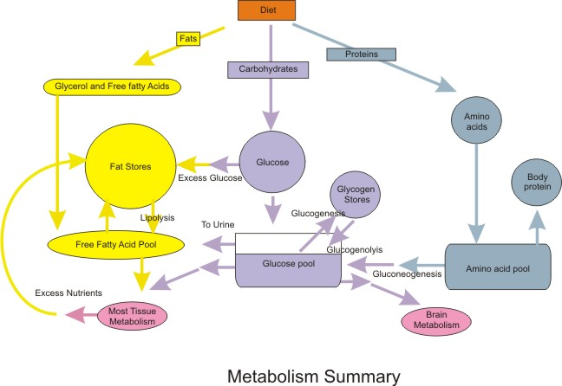
Metabolism
A process where living cells use nutrients in many chemical reactions that provide energy for vital processes and activities.

Slide 4
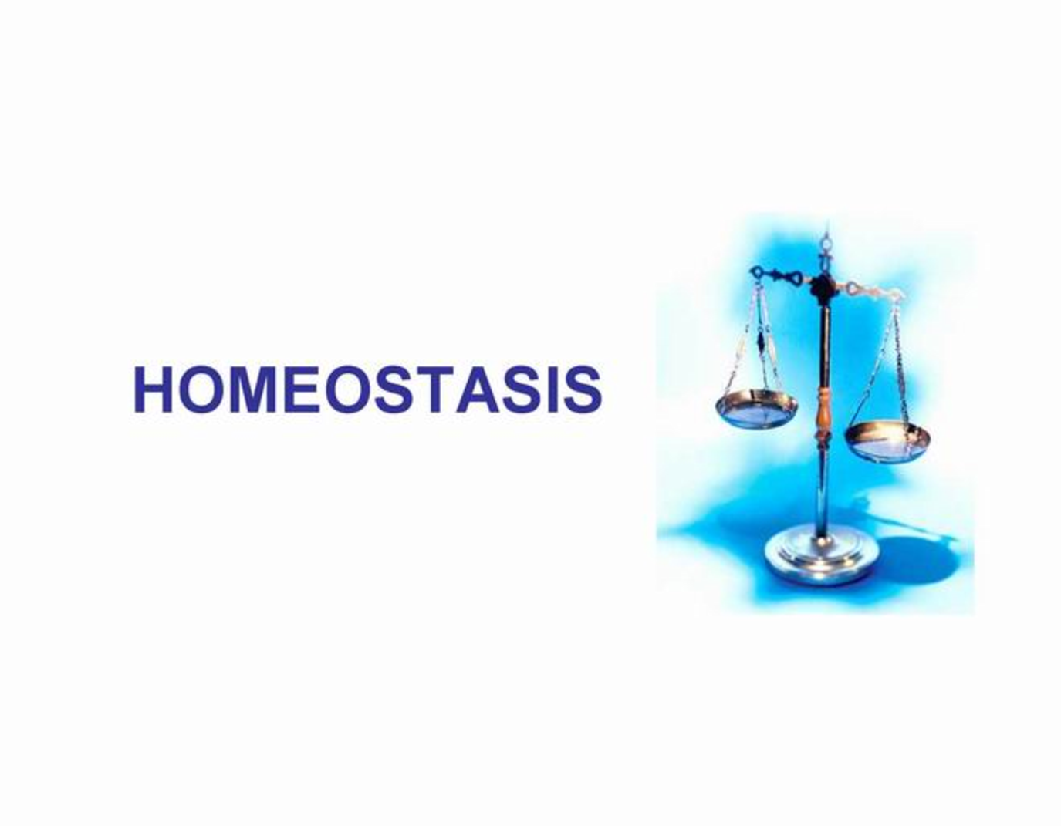
Main Function of Metabolism
To maintain a state of homeostasis, a healthy and relatively constant internal environment. To maintain homeostasis, the body regulates its systems to avoid dangerous lacks or excesses.
Notes:
Example: you breathe to take in oxygen needed and expel unwanted carbon dioxide. If you hold your breath, your brain eventually senses a lack of oxygen. It signals you to breathe deeply and your heart to beat quickly to speed oxygen to the cells.

Slide 5
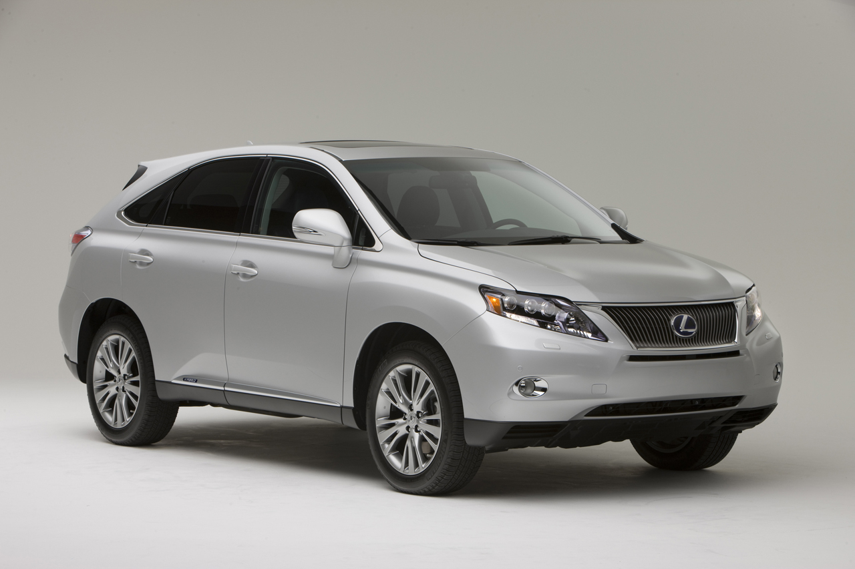
The Metabolic Process
1st Chemical Balance – Body needs the right balance of nutrients and other substances dissolved in the blood and cells.
2nd Oxygen – We breathe to supply cells with oxygen so the the metabolic process can occur.
3rd Temperature – Body temperature needs to be within a certain range for the process to work.
4th Removal of Waste Products – Body disposes of water and carbon dioxide that are carried in the blood to the lungs and then exhaled through the mouth.
Notes:
If body temperature is too hot, kills the enzymes that are needed for the process to take place.

Slide 6
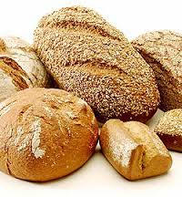
Energy for Metabolism
During metabolism energy is both used and produced.
Energy originates from the sun, when humans eat plants or eat animals that eat plants, they gain the nutrients that provide energy.
Carbohydrates are the bodies preferred form of energy , they are quickly broken down into simple sugars, which are available for immediate use.
Simple sugars are reserved as Glycogen, a form of carbohydrates stored in the muscles. Remaining carbohydrates are converted to fat. They along with fats in the diet, are stored in fat tissue until needed for energy.

Slide 7
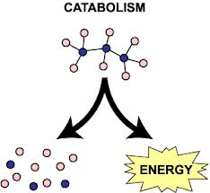
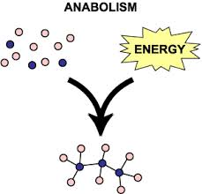
Opposite Processes: Catabolism and Anabolism
Catabolism breaks down complex molecules into simpler ones during chemical reactions, through this process nutrients made available by digestion are broken down into simpler materials that enter cells. Catabolic reactions, which include digestion, release energy.
Anabolism uses some energy from catabolism to combine molecules during chemical processes in order to build the materials of living tissue. Nutrients that were broken down by catabolism are reconstructed into body cells, from the brain to the toenails, this is the anabolic reaction
Cytoplasm is the main component of both animal and plant cells. Catabolism breaks down food to make cytoplasm, which the body uses for maintenance during the anabolic process.
http://www.youtube.com/watch?v=0kZLQGByXN4

Slide 8
Diagram of the the Metabolism Process

Slide 9
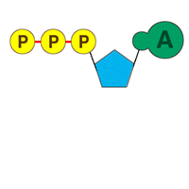
ATP Cycle
Adenosine Triphosphate (ATP) – Energy warehouses that store and transfer energy cells when needed.
ATP molecules combine the compound adenosine with three phosphate groups. These three groups form a chain, they contain one atom of phosphorus and four atoms of oxygen.

Slide 10
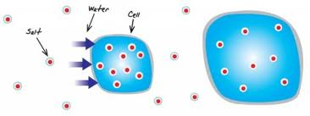
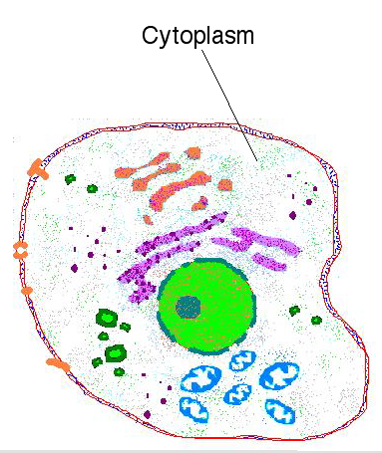
Chemical Balance During Metabolism
Body needs the right amount of chemicals inside and outside the cell.
The cells in the body are mostly cytoplasm walled in by thin layers of tissue called membranes.
These membranes are semipermeable, they allow varying amounts of specific substances to pass through them.
Osmosis, the movement of fluid through a semipermeable cell membrane to create an equal concentration of solute on both sides of the membrane
Notes:
Cytoplasm is a colloidal substance consisting of organic and inorganic substances, including proteins and water found in a living cell. Cytoplasm is the main component of both animal and plant cells.

Slide 11
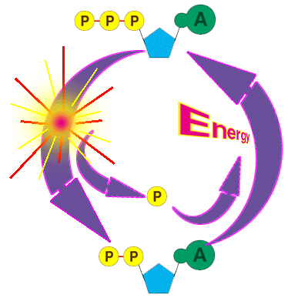
ATP Cycle continues
When a cell needs energy the bond between two phosphate groups are broken and the third group transfers to another molecule.
With only two phosphate groups remaining attached, ATP becomes adenosine diphosphate (ADP).
Storing Energy = ATP
Using Energy = ADP

Slide 12
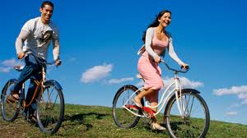
Influences on Metabolism Metabolic Rate - how fast the chemical processes of metabolism take place.
Body Temperature – humans have mechanisms to keep body temperature fairly stable
Body Size – Body weight is the result of a combination of genetic, metabolic, behavioral, environmental, cultural, and socioeconomic influences.
Physical Development and Age – Scientists believe that cells function rapidly in young individuals in order to build the new material needed for development
Body Composition –lean tissue (muscle) takes more kcalories to maintain than other types
Energy Supply – When energy supply (food) is low, the body will automatically slow down the metabolism therefore burning calories at a slower rate.

Slide 13
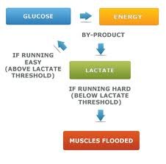
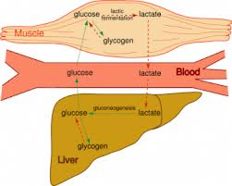
Metabolism and Weight Management
Basal Metabolism is energy used by a body at rest to maintain automatic, life-supporting processes
Basal Metabolic Rate (BMR) is a measure of heat given off per time unit, calories per hour.
Voluntary Activities are conscious and deliberate actions
Weight-Loss Diets – Don’t work, the fewer calories you consume the fewer the body tries to get by on.
Physical Exercise – Increases your metabolism by using energy supplied by catabolizing simple sugar in the blood, then dip into their glycogen stores.
Lactic Acid – a waste product formed when carbohydrates are not completely metabolized.

Slide 14
VIDEO REVIEW
Rapid Learning: Metabolism – What is Metabolism? (7:37)
https://www.youtube.com/watch?v=5qjgEKqVkSo
What is Metabolism? (9:19)
https://www.youtube.com/watch?v=MrOK_zWUzpM
Glucose Metabolism (4:41)
https://www.youtube.com/watch?v=1KgDXDLZNJI&list=TLfbzP3l4IPyg

