Slide 1
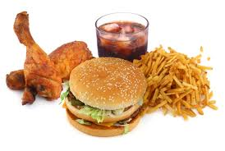
FAST FOOD

Slide 2
Fast Food
People eat out today more than ever before.
It has become an American passion.
Ordering nutritious foods can be challenging.
Often meals in fast food restaurants are high in calories, fat and sodium and low in some essential nutrients.

Slide 3
Eating Out Considerations
Choose restaurants that provide foods from your daily food guide.
Choose foods that are not cooked in lots of fat. (Ex. When the menu says…fried or sautéed)
Limit large portions of meat.
Share an entrée with someone.
Limit high calorie drinks.
Ask for condiments on the side so you can control how much you use.
Make eating well your priority.

