Slide 1
Digestion Chapter 13
The chemical and mechanical process of breaking down food to release nutrients in a form your body can absorb for use.
The Digestive System (3:38)
http://www.youtube.com/watch?v=P5lyQUtq1KQ

Slide 2
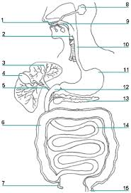
Absorption
Food is broken down in the digestive tract or ALIMENTARY CANAL.
Nutrients get from the digestive tract into the transportation system that carries them to cells throughout the body

Slide 3
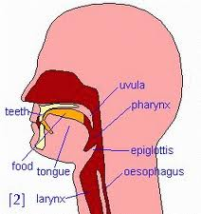
Digestion in the Mouth
Mastication – the process of chewing the food
Saliva - mixture of water, mucus, salts and digestive enzyme amylase
Epiglottis - located at the back of the tongue
- prevents food from entering the windpipe
Notes:
Mastication, chewing, creates more food surface area for the chemical reactions that are already starting to take place. As you chew liquids are release by the mucous membranes and glands under the tongue to soften the food.
Epiglottis is located at the back of the tongue, its job is to shield the windpipe when you swallow and prevents food and water from entering.
Saliva is a mixture of water, mucus, salts and digestive enzyme amylase. The saliva starts the chemical processes that aids in digestion.

Slide 4
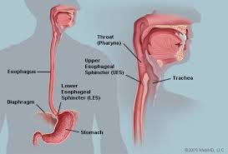
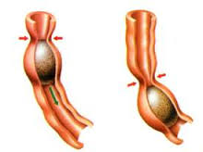
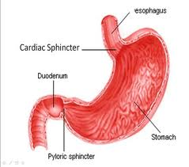
Food in the Esophagus
Esophagus - tube-like object connecting the mouth to the stomach.
Peristalsis – muscular contractions that breaks food down into finer
Cardiac sphincter -ring like muscular valve that is at the end of the esophagus.

Slide 5
Digestion in the Stomach
Hydrochloric acid – breakdown proteins
Enzymes – breakdown protein
Gastrin – a protein that controls acid secretion
Mucus –bicarbonate-rich mucus protects the stomach
Chyme – a thick fluid that was once your meal
Pyloric sphincter – controls the foods rate of movement from the stomach to the small intestine
Notes:
Hydrochloric acid – breakdown proteins
Enzymes – breakdown protein
Gastrin – this a protein made by the body to control acid secretion
Mucus – a lining that protects the stomach by releasing a bicarbonate-rich mucus
Chyme – a thick fluid that was once your meal
Pyloric sphincter – controls the foods rate of movement from the stomach to the small intestine

Slide 6
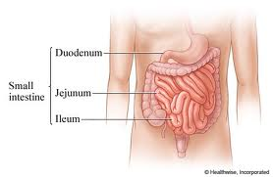
Digestion in the Small Intestine
Small intestine - longest section of the alimentary canal
Assisting organs - liver, gall bladder and pancreas
Liver - produces bile
Gall bladder – stores the bile
Pancreas - secretes pancreatic juice, an enzyme-rich fluid that continues to reduce food to smaller molecules.
Notes:
Small intestine - longest section of the alimentary canal
Assisting organs - liver, gall bladder and pancreas
Liver produces bile, a greenish liquid that helps fat mix with the water in the intestine. By creating this water-fat emulsion, bile helps the body digest and absorb fat. Bile is stored in the gall bladder until needed.
Pancreas secretes pancreatic juice, an enzyme-rich fluid that continues to reduce food to smaller molecules.

Slide 7
Small Intestine Absorption
Nutrients are now tiny molecules that can pass through the thin walls of the small intestine
Greatest possible surface area for nutrient absorption
Villi and Microvilli aid the absorption of one particular nutrient
Foods are absorbed in a set order, the same order they are broken down. (simple sugars, proteins, fats)
Notes:
Nutrients are now tiny molecules that can pass through the thin walls of the small intestine
Greatest possible surface area for nutrient absorption
Villi and Microvilli are finger like projections specifically designed to aid the absorption of one particular nutrient. A microvilli designated as absorbers for a certain sugar will not absorb a protein or even another sugar.
Foods are absorbed in a set order, the same order they are broken down. (simple sugars, proteins, fats)

Slide 8
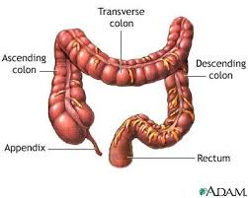
Absorption in the Large Intestines
Large Intestine - colon and rectum
Bacterial action –
breaks down any remaining carbohydrates
breaks down indigestible fiber into simpler compounds.
Vitamin K and certain B vitamins are created from other existing chemicals.
Water Recovery –
water is reabsorbed by the body
sodium and potassium are also reabsorbed
Collection of waste – foods the cannot be used or digested are stored until elimination from the body
Notes:
Large Intestine includes two parts the colon and the rectum, these segments make up the final of the digestive tract. They perform the following three functions:
Bacterial action – breaks down any carbohydrates that were not digested earlier by enzymes. Also breaks down indigestible fiber into simpler compounds. They synthesize vitamin K and certain B vitamins, creating those nutrients from other, existing chemicals.
Water Recovery – Water is reabsorbed by the body, along with such mineral salts as sodium and potassium
Collection of waste – Some parts of foods the cannot be used or digested are stored until elimination from the body

Slide 9
All about poop!
What Your Poop Is Telling You (stop at 10:00)
https://www.youtube.com/watch?v=LUHa13nx-uc
Bowel Health (stop at 11:00)
https://www.youtube.com/watch?v=dxek0D9mH6o

