Slide 1
Pregnancy
The period from conception to childbirth

Slide 2
Pregnancy
The common length of pregnancy is about 40 weeks, or 240 days

Slide 3
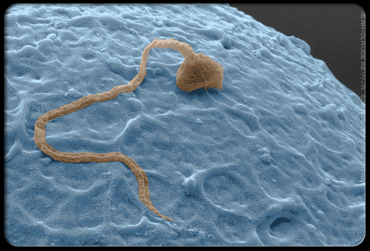
Conception
From Egg to Embryo

Slide 4
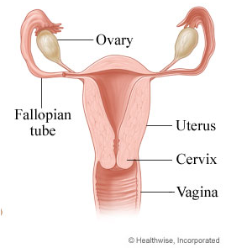
Ovulation
OVUM female reproductive cell, or egg
Each month, a mature egg (OVUM) is released from one of the women's two ovaries -- this is called OVULATION
Notes:
Ovulation takes place about two weeks after the first day of the last menstrual period

Slide 5
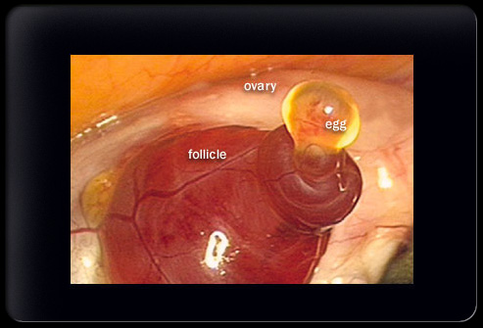
Ovulation
Notes:
The rare picture shown here is the clearest ever taken of human ovulation
Observing ovulation in humans is extremely rare, and previous images have been fuzzy

Slide 6
Ovum
Once the egg is released from the ovary, it travels into the fallopian tube where it remains until a single sperm penetrates it during fertilization

Slide 7
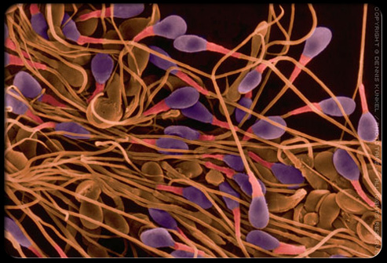
Sperm
SPERM male reproductive cell
An average ejaculate discharges 40-150 million sperm
Swim upstream toward the fallopian tubes on their mission to fertilize an egg
Fast-swimming sperm can reach the egg in a half an hour, while other may take days
The sperm can live up to 48-72 hours
Only a few hundred will even come close to the egg, due to the many natural barriers and hurdles that exist in the female reproductive tract
Notes:
An average ejaculate discharges 40-150 million sperm which eagerly swim upstream toward the fallopian tubes on their mission to fertilize an egg
Fast-swimming sperm can reach the egg in a half an hour, while other may take days
The sperm can live up to 48-72 hours
Only a few hundred will even come close to the egg, due to the many natural barriers and hurdles that exist in the female reproductive tract

Slide 8
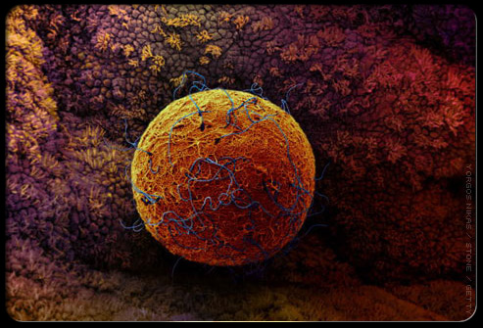
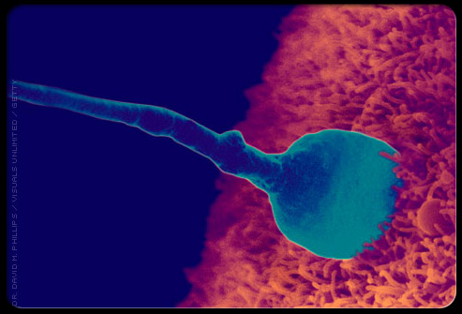
Conception
If a sperm cell meets and penetrates an egg, it will fertilize the egg
The fertilization process takes about 24 hours
Notes:
If a sperm cell meets and penetrates an egg, it will fertilize the egg. The fertilization process takes about 24 hours. When fertilization happens, changes occur on the surface of the egg to prevent other sperm from penetrating it. At the moment of fertilization, the genetic makeup is complete, including the sex of the infant.

Slide 9
Three Stages of Prenatal Development
The baby’s development during pregnancy is called prenatal development
Grouped into three stages:
The Germinal Stage
The Embryonic Stage
The Fetal Stage

Slide 10
The Germinal Stage
Formation of ZYGOTE (fertilized egg)
1st 2 weeks of pregnancy
Major Steps:
Cell division
Implantation

Slide 11
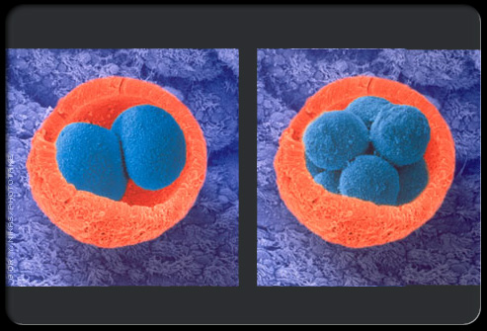
Zygote and Cell Division
The fertilized egg begins dividing rapidly, growing into many cells
It leaves the fallopian tube and enters the uterus three to four days after fertilization
Notes:
Rarely, the fertilized egg does not leave the fallopian tube; this is called a tubal pregnancy or ectopic pregnancy and is a danger to the mother.

Slide 12
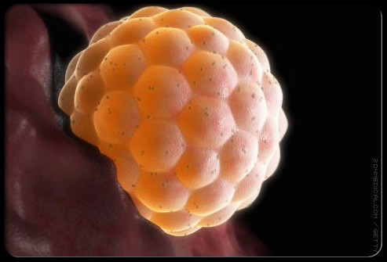
Implantation
After entering the uterus, the fertilized egg attaches to the uterine lining
This process is called implantation
The cells continue to divide.

Slide 13
Cell Division
After implantation, some cells become the placenta while others become the embryo
EMBRYO

Slide 14
The Embryonic Stage
3rd-8th week of pregnancy
Importance changes occur:
Organs and Body Systems
Amniotic Sac
Placenta and Umbilical Cord

Slide 15
Developing Embryo
The baby's brain, spinal cord, heart, lungs, and muscles
The heart begins beating during week five
They are not ready to function yet
Continue to develop throughout pregnancy

Slide 16
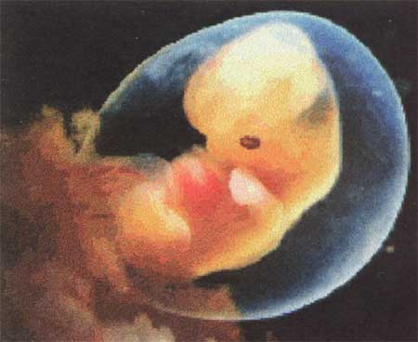
Amniotic Sac
A sac filled with fluid forms around the embryo
AMNIOTIC FLUID
Protects the developing baby
Cushions the embryo
Maintains body temperature
Collects waste
Helps the developing muscles and bones

Slide 17
Placenta
A tissue called the PLACENTA develops
Rich in blood vessels and attached to the wall of the uterus
Mother’s bloodstream carries food and oxygen to the placenta
Placenta absorbs oxygen and nourishment from the mother’s blood to be transmitted to the baby

Slide 18
Umbilical Cord
During week seven, the umbilical cord appears
Connects the baby to the placenta
Brings oxygen and nourishment to the baby
Takes carbon dioxide and other waste products away from the baby to the placenta
Notes:
Stiff and firm like a garden hose filled with water

Slide 19
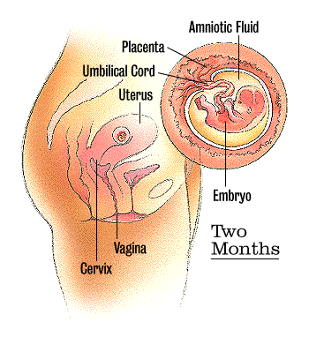
Placenta and Umbilical Cord
Notes:
The placenta and umbilical cord provide everything a baby needs until birth

Slide 20
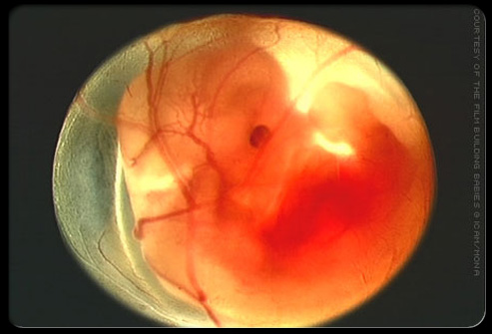
The Fetal Stage
At the eighth week the developing baby, now called a FETUS, is well over 1/2 of an inch long -- and growing
This stage lasts until birth
Fetus at 8 weeks

Slide 21
Fetus
Making movements
Around the fourth and fifth month, the kicks and other movements of the fetus touch the wall of the uterus
Gradually, these sensations become stronger and more frequent
Staying active
Suck its thumb, cough, sneeze, yawn, kick, cry, and hiccup
Can change positions

Slide 22
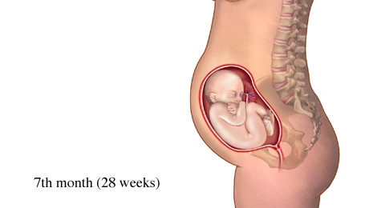
Fetus
Completing development
Preparing the fetus to live outside the womb
Major organs become ready to function
Gains weight rapidly
Fat deposits are formed under skin
Skin becomes smoother and rounder
Stores nutrients and builds immunity to diseases and infections
Notes:
By the 7th month, the baby is capable of living outside of the uterus, but not without a great deal of medical help

Slide 23
Life’s Greatest Miracle
http://safari.cbsd.org/SAFARI/montage/play.php?keyindex=688

