Slide 1
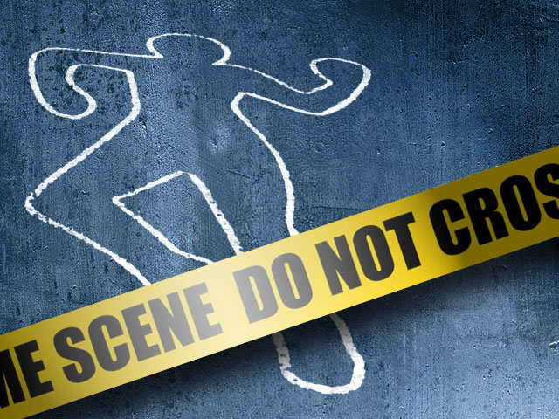
Homicide

Slide 2
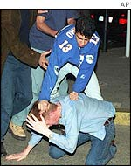
Considered a “Crime Against the Person”
CAP include the following:
1. homicide
2. rape
3. assault/battery
CAPs have degrees of severity (depending on the circumstances of the action)

Slide 3
Criminal Homicide
First Degree Murder must be:
1. premeditated (planned out ahead of time)
2. done with malice (have intent to kill)
On November 12, 2004, Scott Petersen (above) was found guilty of first-degree murder of his wife Laci. He was sentenced to death a month later.

Slide 4
Criminal Homicide (cont’d)
Second Degree Murder is:
1. done with malice (intent is to kill)
2. no premeditation (intent to kill did not exist until the moment of murder)
Legendary music producer Phil Spector was found guilty of second-degree murder on April 13, 2009
http://www.history.com/this-day-in-history/music-producer-phil-spector-indicted-for-murder-of-actress

Slide 5
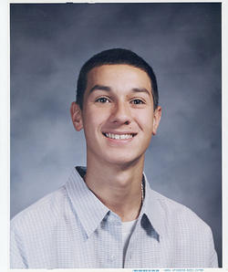
Criminal Homicide (cont’d)
Manslaughter
1. voluntary - no prior intent to kill or seriously harm exists BEFORE the murder
2. something happens that makes the killer lose reasonable control of self; killing must occur soon after provocation
In June 2010, Esteban Nunez (L) pled guilty to the voluntary manslaughter charge of stabbing fellow San Diego State student Luis Santos (R) in 2008. Nunez and his friends were denied entrance to a fraternity party and in a fit of anger stabbed Santos while walking back to campus. Nunez’s 16-year maximum sentence was commuted to 5 years by Gov. Schwarzenegger in Jan. 2011.

Slide 6
Criminal Homicide (cont’d)
3) Involuntary Manslaughter – no intent to kill; no intent to injure; death results from extremely reckless conduct on behalf to the defendant.
Many times vehicular manslaughter is tied to this.
Baltimore Ravens WR Donte Stallworth was charged with 2nd Degree Inv. Manslaughter and DUI for hitting and killing a pedestrian with his car on March 14, 2009. He pled guilty and received a 30-day jail sentence, 1,000 hours of community service, and 8 years probation

Slide 7
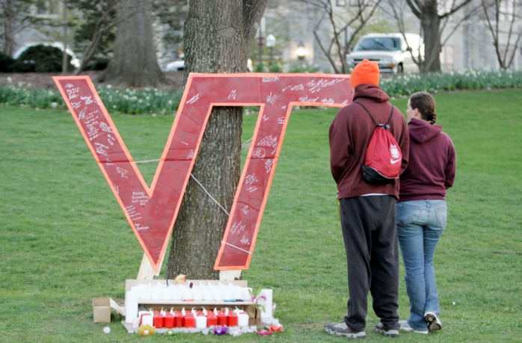
Criminal Homicide (cont’d)
Negligent Homicide
1) cause of death is through failing to be careful where extreme care should have been taken
2) most often applied to work-related death
In March of 2012, two of victim’s families from the 2007 shooting were awarded $4 million each in wrongful death case. The school was found guilty of negligence as it was determined they did not do enough to warn faculty and students after the first shooting.
In January 2006, the deaths of 13 miners at the Sago Coal Mine in West Virginia was ruled as negligent homicide

Slide 8
Non-Criminal Homicide
Killing that is deemed justifiable and is not considered to be a crime
Examples include:
1. self-defense
2. combat associated with war
3. protecting the safety of the public
If Det. Benson was to kill a suspect in self-defense or because he/she was posing a credible threat to public safety, she would not be charged with criminal homicide

