Slide 1
GANGS
Look at the following 3 trailers and fill out the quick chart below
Trailer | When | Where | What did they want?

Slide 2
The Untouchables
Boyz n the Hood
Gangs of New York

Slide 3
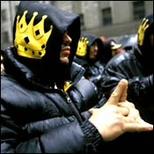
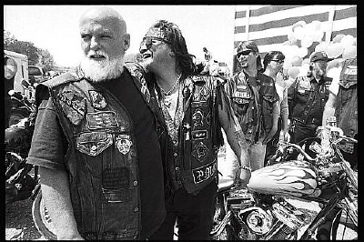
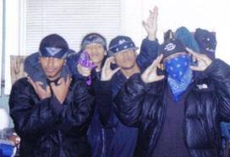
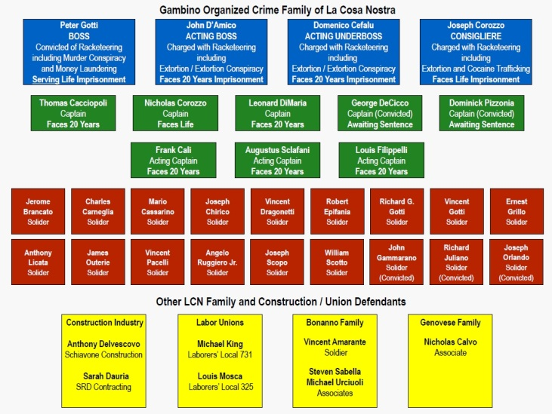
Latin Kings – NYC and beyond
Warlocks (Philly and beyond)
Even the Poconos
Bloods (Red) – LA and beyond
Crips (Blue) – LA and beyond
Italian Mafia (Gambino crime family….one of the 5 majors in NYC)
Hells Angels (CA)

Slide 4
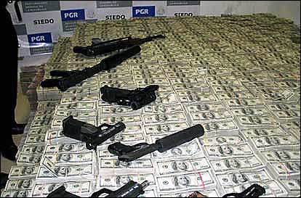
GANGS
People who form groups closed to the general public to participate, typically, in criminal activity
Examples of such activity: drug trafficking, gun dealing, burglary, extortion (more refined version of robbery), auto theft, prostitution, and other organized crime
How are they identified? Symbols, emblems, tags/graffiti, colors, tatoos
Concerns? Status, territory, $
How do you get in to a gang? Typically you have to go through a ritual which could include a fight, committing a crime, drive-by, or be assaulted by current members to prove their toughness
Misconception: that it is a given you will prosper
financially from it membership in it
GO TO p. 84 and answer how the gang problem
can be solved

