Slide 1
absolutism
1600-1700’s
“When the power of love overcomes the love of power, the world will know peace.”
– Jimi Hendrix
Power can corrupt, but absolute power can corrupt absolutely!

Slide 2
ABSOLUTISM VIDEO CLIP! (3:22)
http://www.youtube.com/watch?v=n3ru_S_5k2c

Slide 3
Absolutism
Basic Principle:
Ruler has absolute power/control over all aspects of an individual citizen’s life
Receives power from the belief in
“DIVINE RIGHT”
Ruler’s power is granted by the grace of God
Reasons why it emerged:
Rise of cities, strengthening of kingdoms, weakening of church are among some of the primary reasons why it emerged.

Slide 4
Absolutism’s challenges
People began to resent total control and question DIVINE RIGHT
Renaissance ideals bred discussions of DEMOCRACY
Success of England’s Parliament intrigued many in surrounding nations
Emerging studies in Social Sciences such as psychology and political science generated discussion of how to better rule people

Slide 5
Louis XIV of France
“The Sun King”
“L’etat c’est moi”
“I am the State”
Almost single-handedly decided all fates of France during his reign
Heavily taxed his people to build his Palace of Versailles and instigate costly wars
France became center of culture in Europe
Drastically declining economy due to high expenses
Limited power of nobility by promoting positions of Upper Middle Class

Slide 6
Palace of Versailles
37,000 acres were cleared. 1,400 fountains were placed on the grounds. 36,000 workers. Could hold 5,000 people, including servants. It now sits on 2,000 acres with 12 miles of roads.

Slide 7
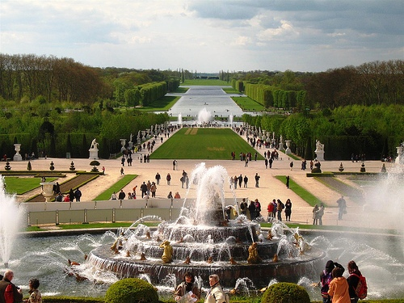
Palace of Versailles

Slide 8
Palace of Versailles

Slide 9
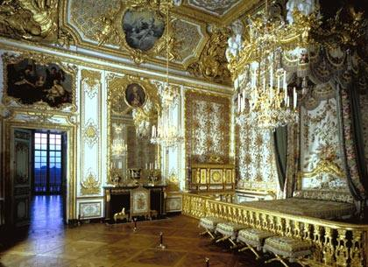
Palace of Versailles

Slide 10
Peter The Great of Russia
ROMANOV family in power for over 300 years
Peter’s goal was to “WESTERNIZE” Russia
Merciless
Willing to do anything to promote advancements of Russia
Successfully accomplishes his goals

Slide 11
“westernization”
Modernize it; bring it up to speed with Western Europe
Take a peasant nation and educate and modernize it BUT not free it
Creates a Navy
Built new capital of St. Petersburg
“Window to the Sea” (all granite to be sent here to build statues and fountains)
Implements technical schools
Newspapers
Promotes women’s presence in society
Become PATRIARCH of Russian Orthodox Church

Slide 12
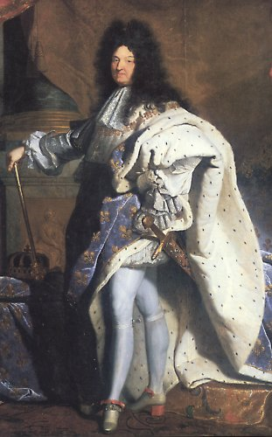
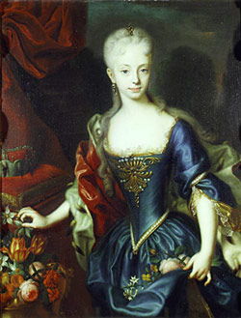
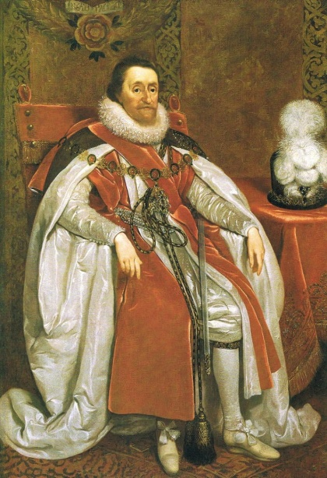
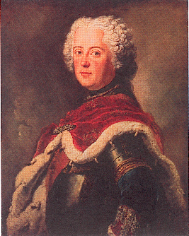
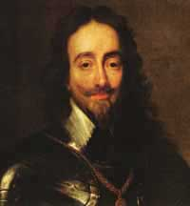
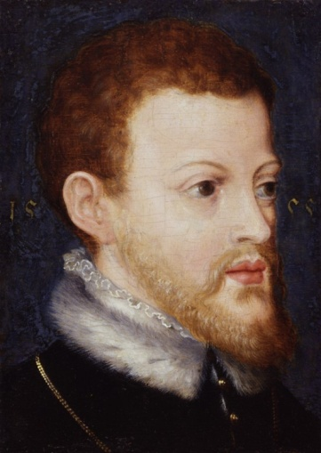
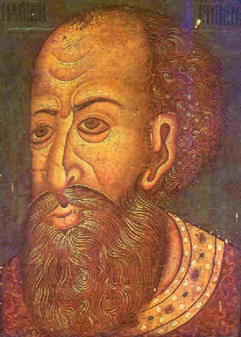
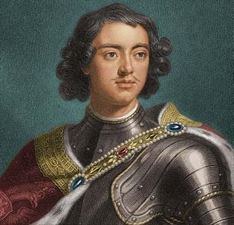
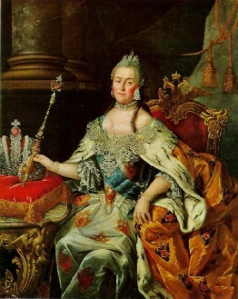
Louis XIV- France
Maria Theresa – Austria
Fredrick the Great- Prussia
James I- England
Charles I - England
Phillip II- Spain
Ivan the Terrible- Russia
Peter the Great- Russia
Catherine the Great- Russia

Slide 13
Absolute Monarchs – Baseball Card Activity
With a partner of your choice, you will create a baseball card that depicts one of the Absolute Monarchs that ruled after the Black Death. You will use your text and the internet to gather info for the baseball card. You will create your card on 2 slides in Power Point.
Front of the Card
Picture of the leader
Name of the leader
Name of the country
Flag of the country
Back of the Card
List date of birth/death and years of rule
Organize the bullets below into 3 clean categories
Have at least three (3) bullets in each category
List some bio info (interesting facts, family life, growing up, etc…)
List examples of Absolutism and Divine Right (How did it impact the people?)
List other positive Accomplishments

Slide 14
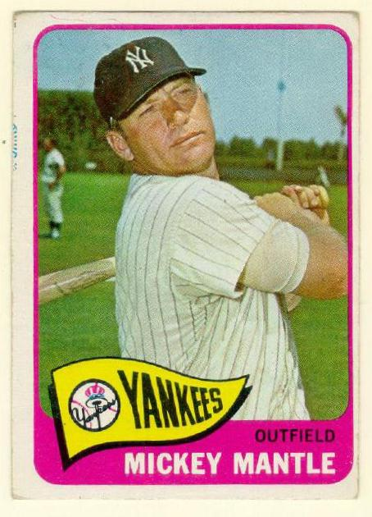

Slide 15
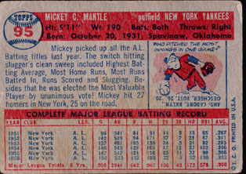

Slide 16
Prussia
Monarch
Fredrick the Great

Slide 17
Name of Monarch Nation years ruled
Birth date Death date
Short Bio:
List of Accomplishments:
Absolutism examples:
Divine right Examples:

