Slide 1
Geography in the Classroom
Wednesday, February 03, 2016
Amanda Dicks and Chris Johnson
C.B. East

Slide 2
Where in the world are we?

Slide 4
Where is South Africa? Where is Iraq?

Slide 5
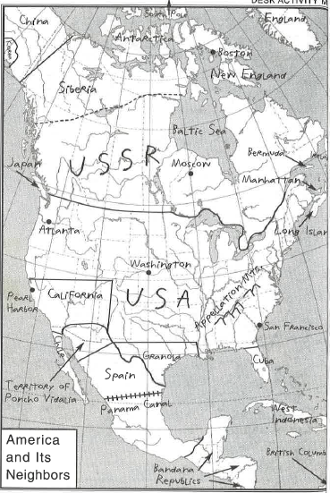

Slide 6
What is it? Google Earth is an interactive mapping application that allows users to navigate the entire globe, scanning satellite imagery with overlays of roads, buildings, geographic features, and numerous other location-specific data points. Students can: add their own points of interest, chart routes, plot areas, calculate distances, and overlay separate images onto the application.
Notes:
Introduce what GE is … GE can be used throughout disciplines. Some examples of how students are seen on the next slide.
Since this is such a short webinar, this is just to give you ideas of how you can use GE in your class. You can download your handout to help you navigate with more specifics . If you are interested in learning the specific how to you could take an online course with Jason.

Slide 7
Why use Google Earth?
Embed Media
Student Projects
Build Lesson Background
Visit Settings of Novels
Evaluate Historic Decisions
Visit Current Event Locations
Notes:
Google earth
3d, updated, street view,,,etc
Scenerio Lewis and Clark
PowerPoint giving ideas
Show examples teaching from class.
Model street view of Pearl Harbor with an image Model urbanitstiib with time line.

Slide 8
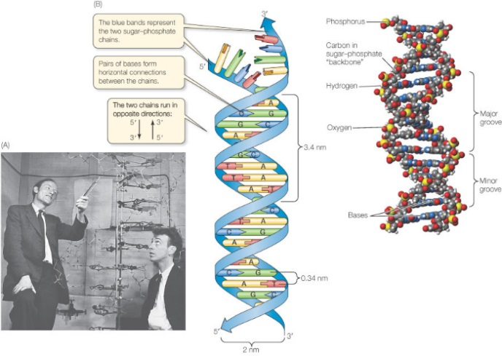
To Build Background (DNA Structure)
Biology Lesson
Notes:
Highschool Biology example where DNA structure discovered.

Slide 9
Settings of Novels
The Diary of Anne Frank
Notes:
This example is a middle school english class.
(wake up kid and look up their address to show where we are starting from)
Lenape – to Amsterdam
Overlay an image
(street view)

Slide 10
Current Events
Urbanization
Notes:
This example is focusing on current issues.
The focus on this is the historical imagery tool.
So looking at the Sochi Olympics, you can the urbanization and transformation of the town by using the historical imagery tool. (circle w/ clock)
Roads, villages, all in an 8 year span when you are building this village.

Slide 11
Real World Application
Notes:
Any newscast on any chanel uses google earth to show the audience where Sochi is.
Just like your teaching, you can show the students what you are talking about.
You would be the guy in the field like the news.

Slide 12
Walking Tours of Famous Cities
Virtual Trip
Notes:
Walking tours of cities. This is Paris and the blue line models the
You are showing students how much tourism there is with all of thesse buses and you can visualize being there. The height.
When you exit street view, you can give the students a 3d image when they enter.

Slide 13
Student Projects
Student Projects
Notes:
This is an example of how students used it in AP EURO

Slide 14
Time to Check out Google Earth
Use the worksheet and follow step by step to create your own tour!

Slide 15
Mix
Microsoft Mix is an add-on to Powerpoint that enhances the multimedia nature of that program
Screencasting
Screenshots
Video use

Slide 16
Mix Screen Recording: Freedom Riders’ Journey

Slide 17
Other Geography Resources
Bureau of the Census
CIA World Factbook
Gapminder
National Geographic Xpeditions
Tellmaps and Show World
USGS: national map viewer and historical maps

Slide 18
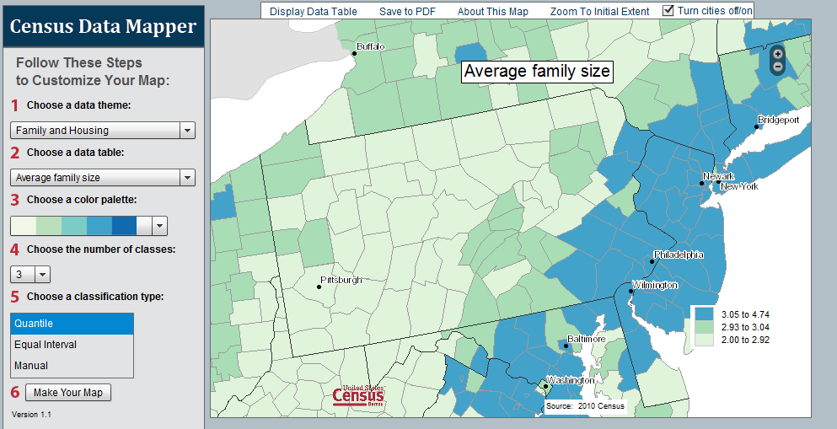
Bureau of the Census

Slide 19
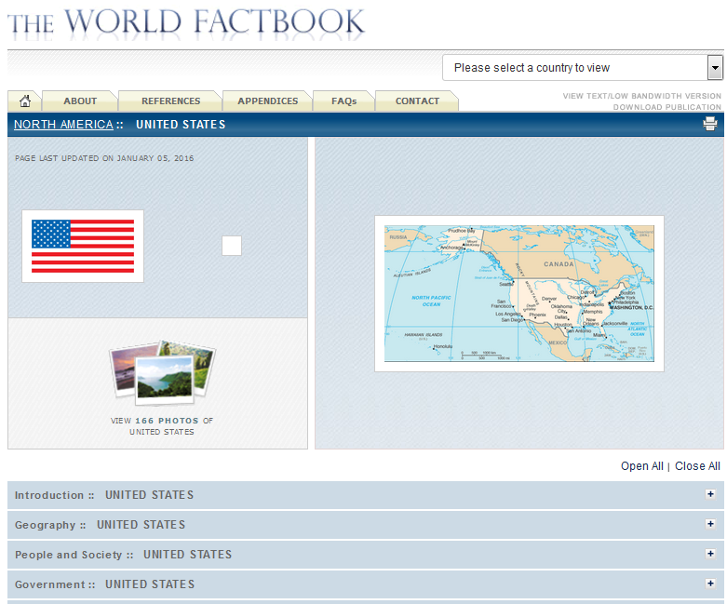
CIA World Factbook

Slide 20
Gapminder

Slide 21
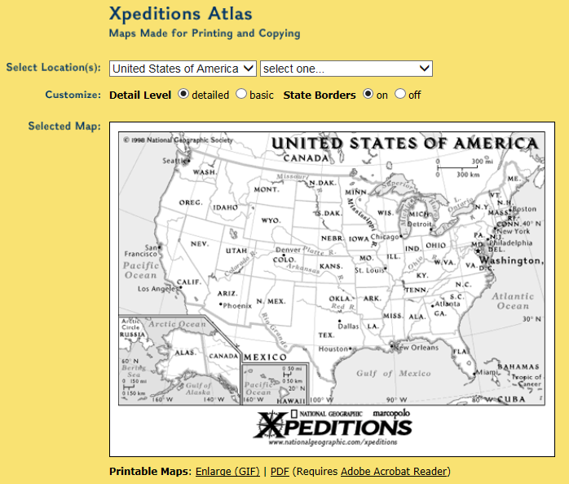
Xpeditions from National Geographic

Slide 22
Tellmaps and Show World

Slide 23
USGS

Slide 24
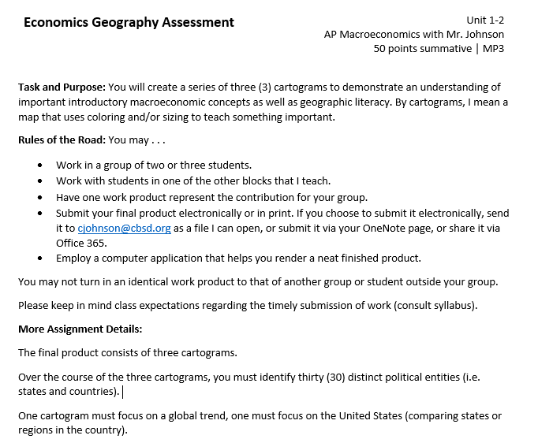
An example of a student activity

Slide 25
How can our teachers use geography to engage students in learning?
Reflection
Notes:
So I just showed you a couple of examples.
I have Tina sitting with me to answer questions, I will do my best to answer anything.

