Slide 1
Reflection

Slide 2
The Law of Reflection….

Slide 3
The Law of Reflection:
θ_{i} = θ_{r}
The incident angle is equal to the reflected angle.
(Remember: Each of these angles is measured between a normal line-line perpendicular to the mirror - and the appropriate ray.)

Slide 4
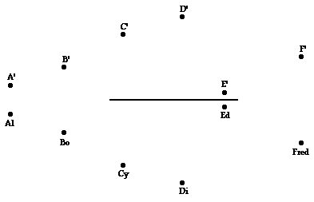
The Law of Reflection….

