Slide 1
Microscopes

Slide 2
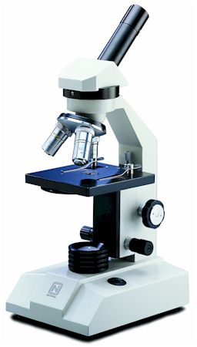
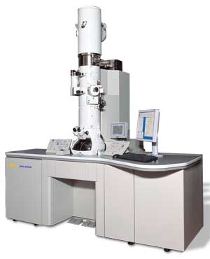
One of most important tools of Biology = Microscope
Two main types of microscopes for biology . . .
1. Compound light microscope
2. Electron microscope
Images from: http://www.microscope-microscope.org/basic/microscope-types.htm, http://www.jeol.com/Default.aspx?TabId=124

Slide 3
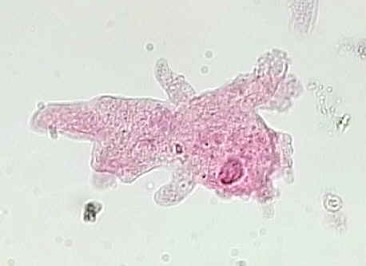
1. Compound light microscope
Amoeba, magnified 400x
Most commonly used microscope
Allow light to pass through a specimen
Lenses used to magnify clearly up to 1000 x
Produce 2-D images
Specimens may be living
Less expensive
Amoeba magnified 100 x
Images from: http://www.microscope-microscope.org/basic/microscope-types.htm, http://microbewiki.kenyon.edu/index.php/Amoeba_proteus

Slide 4
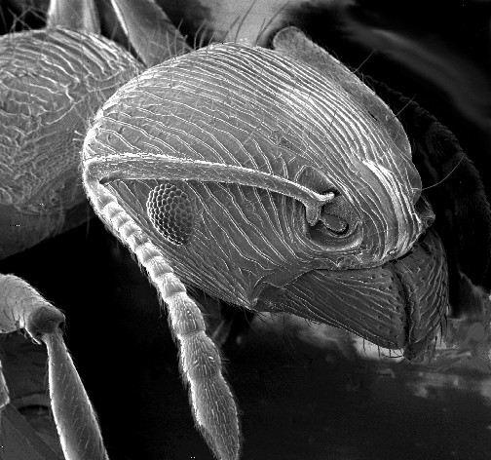
2. Electron Microscope (SEM and TEM)
Beams of electrons bounce off surface of specimen to produce image
Can magnify much more (~100,000x)
Produce 3-D images
Specimens must be dead
More expensive
Try it!

Slide 5
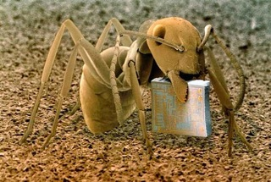
Gallery of SEM photos
All these pictures are from the book ' Microcosmos,' created by Brandon Brill from London.
An ant, Formica fusca, holding a microchip

Slide 6
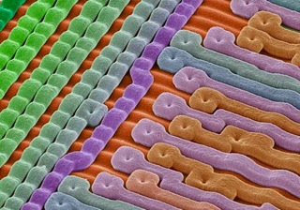
Gallery of SEM photos
Surface of an Erasable Programmable Read-Only Memory silicon microchip
Picture from the book ' Microcosmos,' created by Brandon Brill from London.

Slide 7
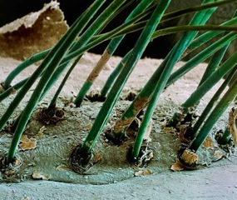
Gallery of SEM photos
Eyelash hairs growing from the surface of human skin
Picture from the book ' Microcosmos,' created by Brandon Brill from London.

Slide 8
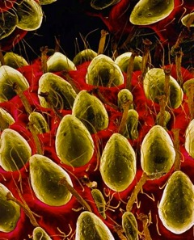
Gallery of SEM photos
The surface of a strawberry
Picture from the book ' Microcosmos,' created by Brandon Brill from London.

Slide 9
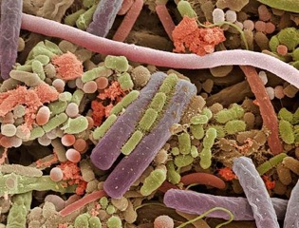
Gallery of SEM photos
Bacteria on the surface of a human tongue
Picture from the book ' Microcosmos,' created by Brandon Brill from London.

Slide 10
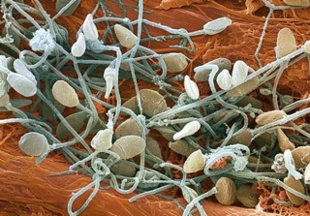
Gallery of SEM photos
Human sperm (spermatozoa)
Picture from the book ' Microcosmos,' created by Brandon Brill from London.

Slide 11
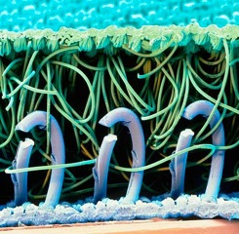
Gallery of SEM photos
Nylon hooks and loops of Velcro
Picture from the book ' Microcosmos,' created by Brandon Brill from London.

Slide 12
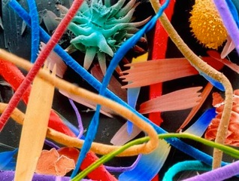
Gallery of SEM photos
Household dust: includes long hairs of cat fur, twisted synthetic and woollen fibers, serrated insect scales, a pollen grain, and plant and insect remains
Picture from the book ' Microcosmos,' created by Brandon Brill from London.

Slide 13
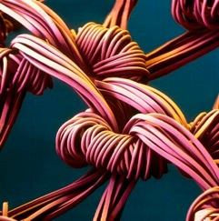
Gallery of SEM photos
The weave of nylon stocking fibers
Picture from the book ' Microcosmos,' created by Brandon Brill from London.

Slide 14
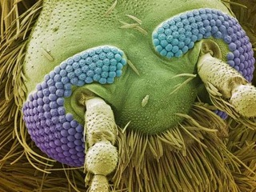
Gallery of SEM photos
The head of a mosquito
Picture from the book ' Microcosmos,' created by Brandon Brill from London.

Slide 15
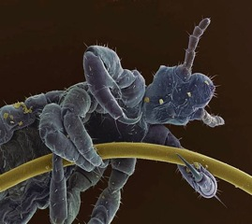
Gallery of SEM photos
Head louse clinging to a human hair
Picture from the book ' Microcosmos,' created by Brandon Brill from London.

Slide 16
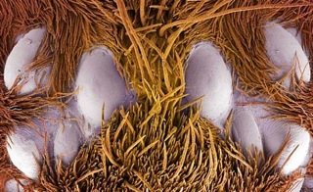
Gallery of SEM photos
Eight eyes (two groups of four) on the head of a tarantula
Picture from the book ' Microcosmos,' created by Brandon Brill from London.

Slide 17
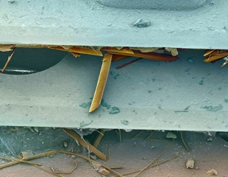
Gallery of SEM photos
Cut human hairs and shaving foam between two razor blades
Picture from the book ' Microcosmos,' created by Brandon Brill from London.

Slide 18
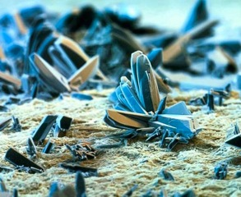
Gallery of SEM photos
Cigarette paper the tobacco is rolled in
Picture from the book ' Microcosmos,' created by Brandon Brill from London.

Slide 19
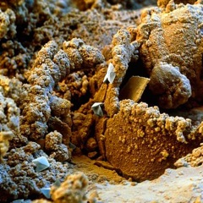
Gallery of SEM photos
Corroded surface of a rusty nail
Picture from the book ' Microcosmos,' created by Brandon Brill from London.

Slide 20
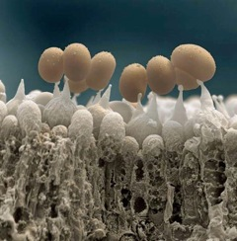
Gallery of SEM photos
Mushrooms spores
Picture from the book ' Microcosmos,' created by Brandon Brill from London.

Slide 21
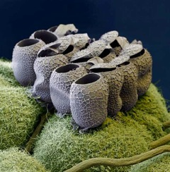
Gallery of SEM photos
Clutch of butterfly eggs on a raspberry plant
Picture from the book ' Microcosmos,' created by Brandon Brill from London.

Slide 22
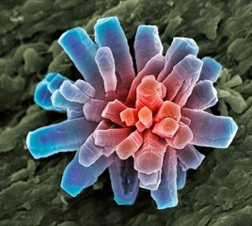
Gallery of SEM photos
Calcium phosphate crystal
Picture from the book ' Microcosmos,' created by Brandon Brill from London.

Slide 23
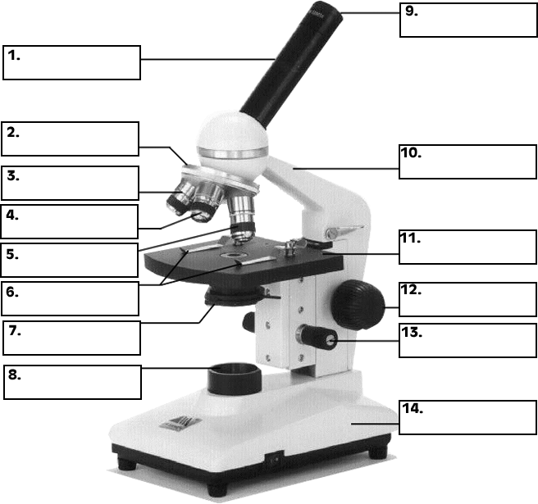
Parts of a compound light microscope:
Activity: Label Microscope Parts
To label microscope, click here→ http://www.biologycorner.com/microquiz/

