Slide 1
Glass Evidence
Trace Evidence Continued . . .

Slide 2
I. Glass Introduction
= a common type of trace evidence
Characteristics of glass
Common material in our environment
Found in many shapes, sizes, colors, and types
Composed of fused inorganic material
Mixture of:
Sand
Soda
Lime
Other trace elements
Variation in elemental formulas can alter significantly its characteristic uses
Components of glass content from: www.kaukauna.k12.wi.us/teachers/mader/glass.ppt

Slide 3
5. Additives’ responsibilities
Alumina (Al₂O₃)
Aluminum oxide
Improves chemical durability and viscosity
Boron Oxide (B₂O₃)
Addition used in borosilicate & aluminoborosilicate glasses.
Very heat resistant
Slide from: www.kaukauna.k12.wi.us/teachers/mader/glass.ppt

Slide 4
5. Additives’ responsibilities (cont.)
Lime (CaCO₃)
Added to improve hardness & chemical durability
Lead oxide (PbO)
High lead content lowers melting pt.= decreased hardness, but increases refractive index
Slide from: www.kaukauna.k12.wi.us/teachers/mader/glass.ppt

Slide 5
II. Types of glass
Aluminosilicate & borosilicate
Can withstand high temps.
Laminated glass
Glass w/ plastic layer - used in car windshields
Lead glass
Fine crystal
Soda lime glass
Plate & window glass, glass containers, electric light bulbs, art objects
Tempered (stressed) glass
Side & back windows of cars; breaks into tiny pieces
Slide from: www.kaukauna.k12.wi.us/teachers/mader/glass.ppt

Slide 6
III. Glass as Evidence
Physical—Fracture
Can be used to place people at a crime scene and reconstruct sequence of events
Does this make glass
CLASS or INDIVIDUAL evidence???
Can be used to reconstruct events
Fingerprints
Blood
Density determination
Refractive index (R.I.) determination
Chemical testing
Last 3 bullet points content from: www.kaukauna.k12.wi.us/teachers/mader/glass.ppt

Slide 7
A. Physical—Fracture
Glass is slightly flexible
When it reaches its elastic limit = break
this leads to blowback
2 Distinct types of fractures
1. Radial
2. Concentric

Slide 8
Fractures
A. Physical—Fracture (cont.)
Concentric
Radial
bsapp.com
Slide from: http://www.bsapp.com/forensics_illustrated/pppresentations.htm

Slide 9
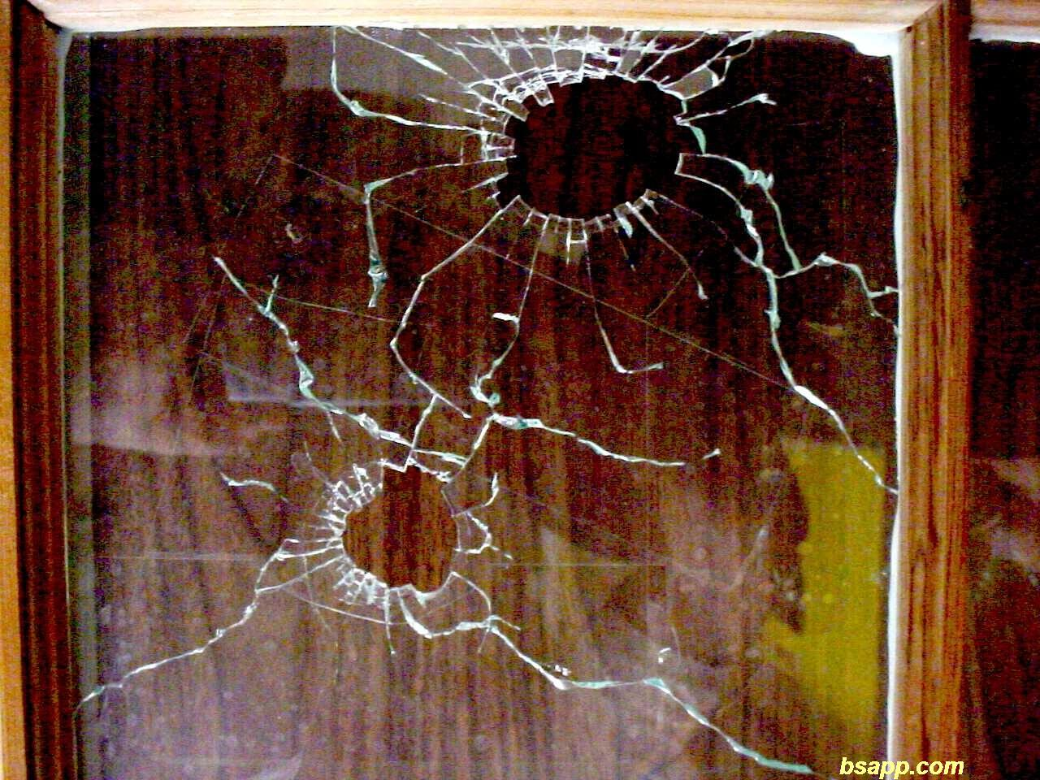
Key = Newer cracks will terminate when they hit existing cracks. This info can help determine sequence of events.
A. Physical—Fracture (cont.)
A.
B.
The radial crack from impact point B stops when it hits the radial crack from point A. Thus A must have occurred first.
Image from: http://www.bsapp.com/forensics_illustrated/pppresentations.htm

Slide 10
Direction of Penetration
A. Physical—Fracture (cont.)
Radial
Concentric
bsapp.com
Slide from: http://www.bsapp.com/forensics_illustrated/pppresentations.htm

Slide 11
Direction of Impact
A. Physical—Fracture (cont.)
Found from stress marks on the edges of broken glass.
At the point of impact, glass will break with a conchoidal pattern (shell-like)
Image from: http://www.hsa.gov.sg/publish/etc/medialib/hsa_library/applied_sciences/forensic_science_files/images_-_criminalistic_2.Par.28737.Image.gif
Direction of force
High velocity projectiles always leave a hole wider at the exit surface.

Slide 12
Direction of Penetration
A. Physical—Fracture (cont.)
A projectile hole is inevitably wider at the exit side
bsapp.com
Slide from: http://www.bsapp.com/forensics_illustrated/pppresentations.htm

Slide 13
B. Density Determination = m V (water displacement)
Common Glass Densities
Glass Type | Density (g/cm³)
Blue ornamental | 2.4880
Double glazing | 2.5125
Lead crystal | 2.9614
Pyrex | 2.2300
Quartz | 2.2106
Red ornamental | 2.5539
Soda | 2.4862
Window glass | 2.5092
Zinc titania | 2.5310
Content of slide from: www.kaukauna.k12.wi.us/teachers/mader/glass.ppt

Slide 14
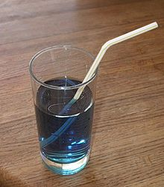
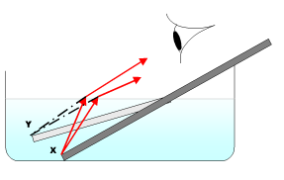
1. Background:
C. Refractive Index
Refraction = the bending of a light wave as it passes from one medium to another
Images from: http://en.wikipedia.org/wiki/Refraction

Slide 15
1. Background:
C. Refractive Index
Refraction = the bending of a light wave as it passes from one medium to another
Refractive Index (RI)= a comparison of the speed of light in a vacuum to the speed of light in another substance
Sample calculation: speed of light in vacuum is 3.00 x 10¹⁰ and the speed of light in water is 2.25 x 10¹⁰
Thus RI of water
3.00 x 10¹⁰
⁼ ^{________________ =} 1.33
2.25 x 10¹⁰

Slide 16
2. Determining the RI from samples in an investigation:
C. RI (continued)
Different types of glass will have different RI
To analyze this property→
Glass fragments can be immersed in a liquid with a known refractive index to help approximate the RI of the evidence

Slide 17
i. Analysis method 1
C. RI (continued)
If the liquid has the same RI as the glass sample, the glass will disappear under a microscope.
If the liquid has a higher or lower RI, the glass is visible and a “halo” appears around perimeter (we call this halo the “Becke Line.”)
. . . when RIs are the same, the Becke line disappears
. . . if Becke line appears on the outside perimeter = Glass has lower refractive index
. . . if Becke line appears on inside perimeter = Glass has higher refractive index

Slide 18
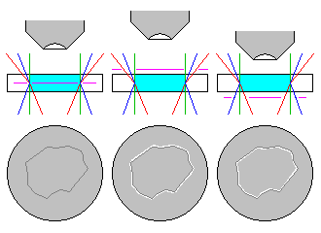
Becke Line
C. RI (continued)
Disappears
Outside
Inside
**GOAL**

Slide 19
Becke line-- outside
C. RI (continued)
Glass has lower refractive index
Content of slide from: www.kaukauna.k12.wi.us/teachers/mader/glass.ppt

Slide 20
Becke line-- inside
C. RI (continued)
Glass has higher refractive index
Content of slide from: www.kaukauna.k12.wi.us/teachers/mader/glass.ppt

Slide 21
Common liquid refractive indices
C. RI (continued)
Liquid | Refractive index
Ethyl acetate | 1.373
n-butyl alcohol | 1.402
Olive oil | 1.467
Corn oil | 1.473
Castor oil | 1.482
Methyl salicylate | 1.522
Clove oil | 1.543
Canola oil | 1.465-1.467

Slide 22
ii. Analysis method 2
C. RI (continued)
RI is dependant on:
The wavelength of light
The temperature of the medium
When the temp. of a liquid is changed, the RI changes rapidly, but the RI of an immersed solid will not
Content of slide from: www.kaukauna.k12.wi.us/teachers/mader/glass.ppt

Slide 23
C. RI (continued)
ii. Analysis method 2
Silicon oil usually used
Oil is calibrated so RI can be determined from its temp.
Sample glass is immersed in oil
Oil is heated/cooled to determine match temp.
Glass “disappears”
Oil RI = Glass RI
Content of slide from: www.kaukauna.k12.wi.us/teachers/mader/glass.ppt

Slide 24
Chemical testing
Destructive
Test for silicates, metal oxides, trace evidence
Content of slide from: www.kaukauna.k12.wi.us/teachers/mader/glass.ppt

