Slide 2
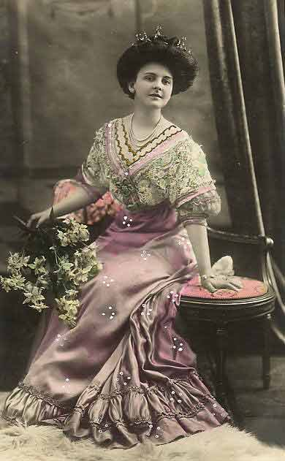
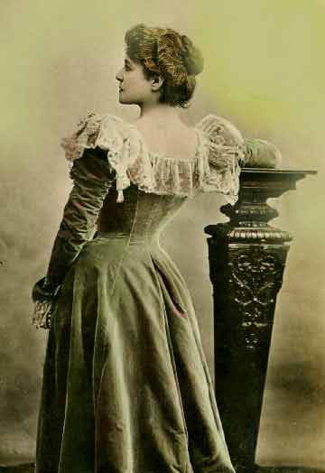
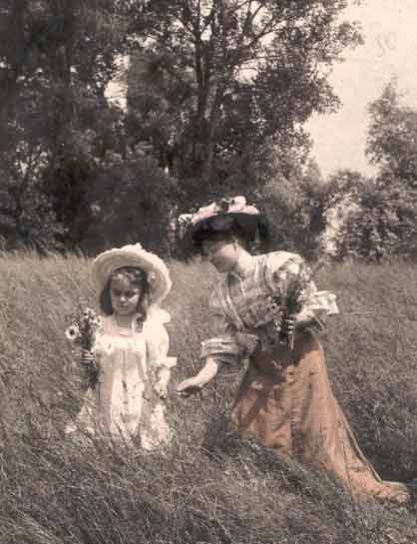
Victorian Ideal
1890-1918

Slide 4
The “Old” and “New” Woman
= OLD WAYS
Dependent
Independent
Conventional
Wild
Unmotivated
Ambitious
Simple
Adventurous
Serious
Fun-loving
Ignorant
Intelligent
Restricted
Free
Submissive
Assertive
Plain
“Made up”
= New Ways

Slide 5
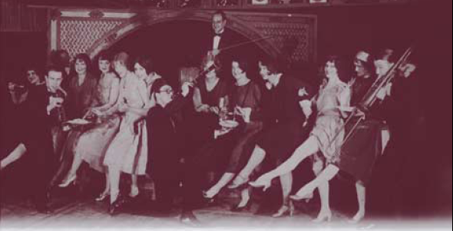
The New 1920s Woman

Slide 6
KIDS THESE DAYS!
What complaints do the “OLDER GENERATIONS” have about TEENAGERS?
What complaints do TEENAGERS have about the “OLDER GENERATIONS?”

