Slide 3
The Scopes Monkey Trial

Slide 4
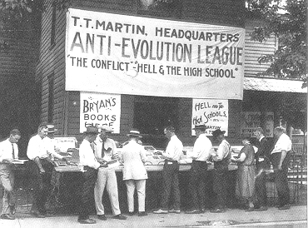
Background Information
Following WW1 many rural communities saw a surge in fundamentalism
This was an example of the urban/rural clash of cultures
Fundamentalists launched a campaign throughout the country to ban the teaching of Darwin’s theory of evolution
Tennessee’s anti-evolution law was called the Butler Law (1925)

Slide 5
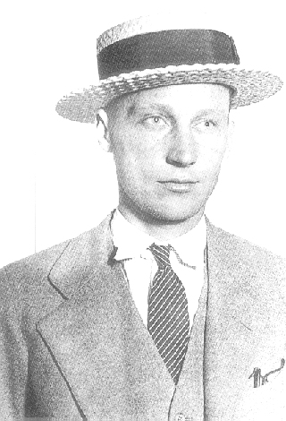
Background Information
A high school teacher, John Scopes, taught his students about Darwin’s theory of evolution
The state of Tennessee brought a suit against John Scopes for violation of the Butler Law
VS

Slide 6
Trial of the Century
William Jennings Bryan – attorney for the prosecution
Clarence Darrow – attorney for the defense
VS

Slide 7
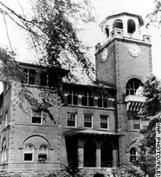
Dayton, TN Courthouse
Courthouse
Dayton, TN

Slide 8
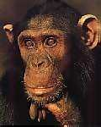
Outcome
Scopes was found guilty and fined $100
The verdict upheld the Butler Law and was a victory for the conservative fundamentalists
The verdict was seen as a victory for morality and a reaction against the “immoral” urban lifestyle
Darrow appealed to the TN Supreme Court – verdict was overturned, but the Butler Law existed until 1967

Slide 9
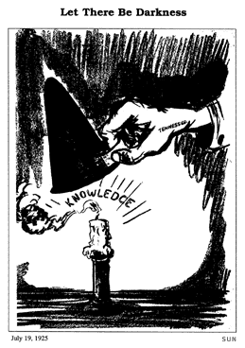
Why is the hand labeled “Tennessee”?
In the opinion of the cartoonist, what is the verdict in Tennessee going to do to education?

