Slide 1
Peopling
Katie Pappler, Tori Hastings, Austin Kramer, Selina Nguyen, Nick Ambolino, Alyssa Yates

Slide 2
Theme
As new cultures started to integrate into American society from 1980 to 2010, the more diverse population contributed a more progressive society towards accepting “minorities,” yet created a harsher ideology towards foreign cultures.

Slide 3
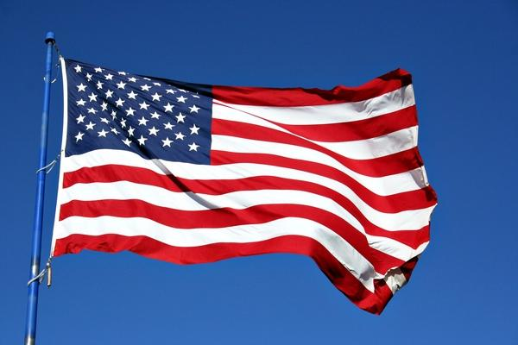
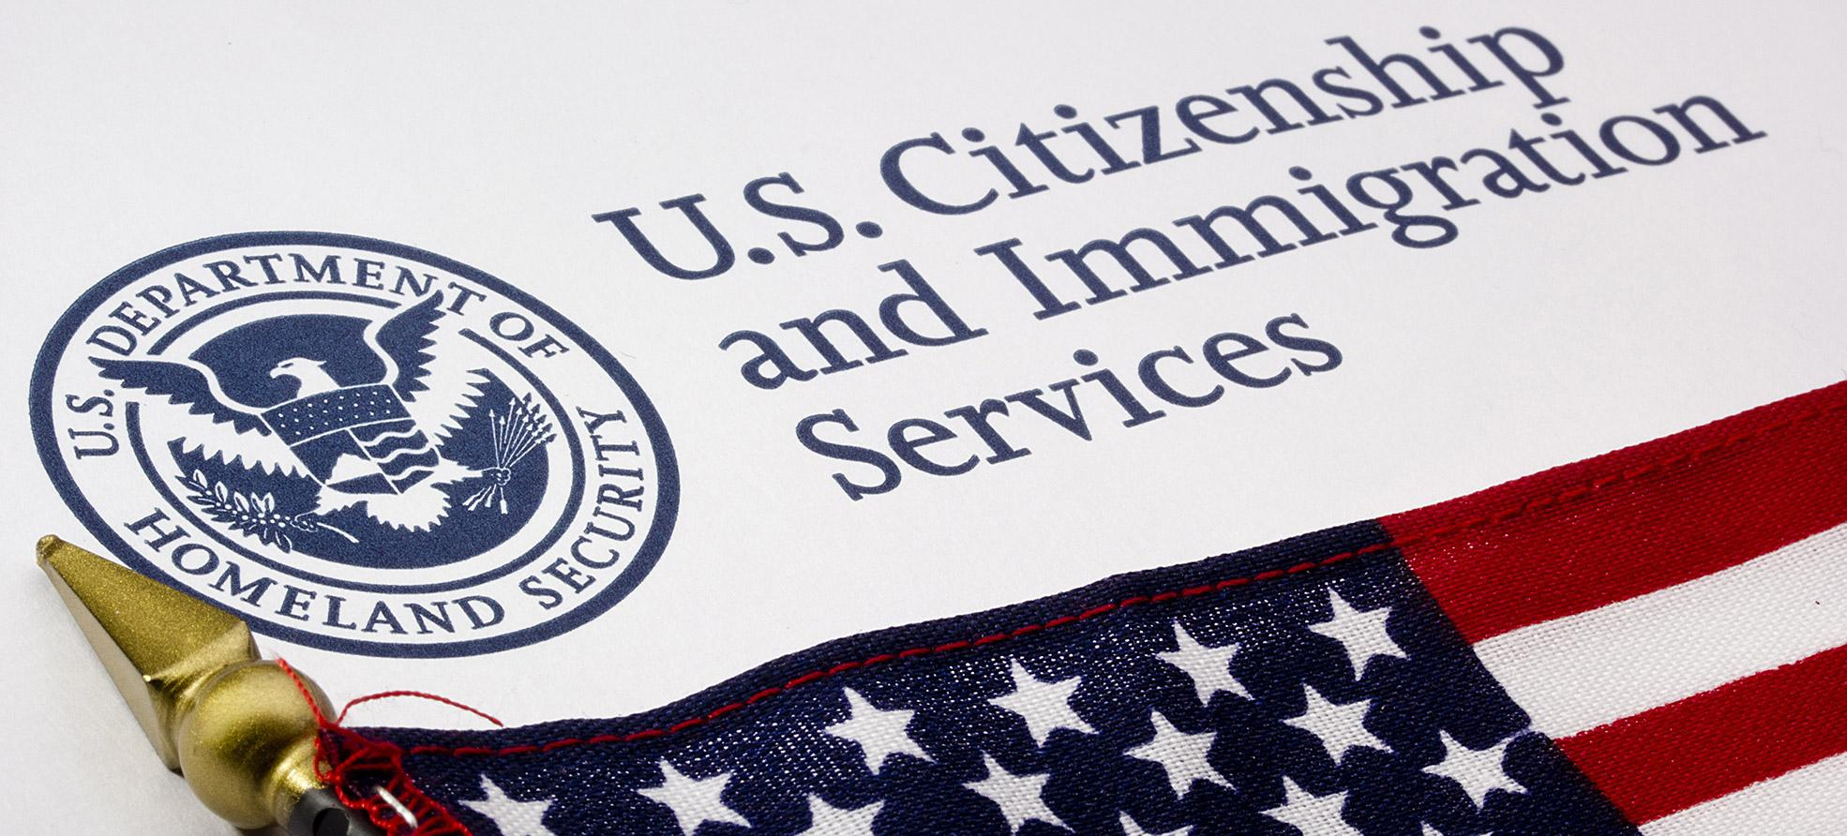
Trends
Immigration Influx
Multiculturalism
Protecting American Culture

Slide 4
Immigration Influx
Latinos consisted of 6 million in 1960
3.24 percent of the U.S. population
50 million (or 16 percent of the nation's population) by 1980
1980 - 1988 - 70% Asain increase
3.8 - 6.5 million people (Asian)
Asian immigrants Countries: Philippines, China, South Korea, Vietnam, Japan

Slide 5
Protecting American Culture
Latinos consisted of 6 million in 1960
3.24 percent of the U.S. population
50 million (or 16 percent of the nation's population) by 1980
Latino role involves
1980-1988 - 70% Asain increase
3.8-6.5 million people (Asian)
Asian immigrants Countries: Philippines, China, South Korea, Vietnam, Japan
Proposition 63
Used to deal with immigrant influx
English becomes official language (California)
Over 50% of Hispanics were fluent
Protect America’s language (fear)
Border Patrolling

Slide 6
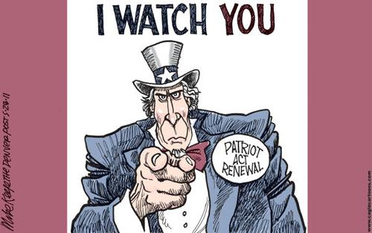
Immigration/ Protecting American Culture
9/11 justified anti-immigration feelings
Increased security at airports allowed invasion of privacy
Patriot Act after 9/11
Allows law enforcement to use surveillance against more crimes of terror
Computer -hacking and other personal ID information of citizens
Increased penalties for terrorist crimes
“Protecting” Americans, but racially profiling people on appearance

Slide 7
Multiculturalism
1990
Predominantly Liberal Individualism perspectives
Liberal Feminist Critique
Undermined National Unity
Diminished universalist values
Attacked identification of the United States

Slide 8
Multiculturalism/Protecting American Culture
Proposition 63
Immigration and Nationality Act of 1965
Immigration Reform and Control Act
Proposition 187
Proposition 209
Ron Unz and Proposition 227

Slide 9
Multiculturalism
Voter Demographic during Obama’s election in 2008- 53% of Voters
95% of African American voters
67% of Latino voters
62% of Asian American voters
43% of White voters
Voter Demographic during Obama’s election in 2012- 51% of Voters
93% of African American voters
71% of Latino voters
73% of Asian American voters
49% of White voters

Slide 10
Multiculturalism
Texas
“Majority Minority” is where the majority of a state’s
population is composed of minorities
Hawaii
California
New Mexico

Slide 11
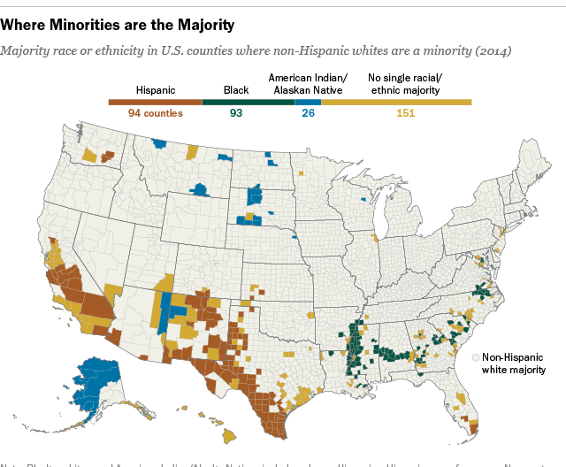
Multiculturalism

Slide 12
https://drive.google.com/file/d/0BwmSkMsou9G1ejZLbm1vSEFQMmZJaDlMRUJzdE1PYWQxdkR3/view

