Slide 1
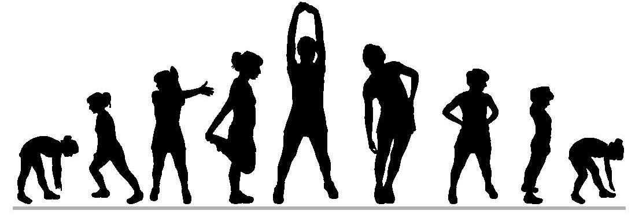
Exercise Video Library #1

Slide 2
Table of Contents
3. Butt Kicks
4. Calf Raises
5. Crunches
6. Forward Arm Claps
7. High Knee March
8. Inch Worm
9. Jumping Jacks
10. Knee Hugs
11. Leg Pulls
12. Leg Raises
13. Leg Sweeps
14. Overhead Arm Clap
15. Planks
16. Push-ups
17. Reverse Lunge Twist
18. Russian Twist
19. Side Lunges
20. Skipping
21. Squats
22. Standing Quad Stretch
23. Supermans
24. Wall Push-ups

Slide 3
Butt Kicks

Slide 4
Calf Raises

Slide 5
Crunches

Slide 6
Forward Arm Claps

Slide 7
High Knee March

Slide 8
Inch Worm

Slide 9
Jumping Jacks

Slide 10
Knee Hugs

Slide 11
Leg Pulls

Slide 12
Leg Raises

Slide 13
Leg Sweeps

Slide 14
Overhead Arm Clap

Slide 15
Planks

Slide 16
Push-ups

Slide 17
Reverse Lunge Twist

Slide 18
Russian Twist

Slide 19
Side Lunges

Slide 20
Skipping

Slide 21
squats

Slide 22
Standing Quad Stretch

Slide 23
Superman

Slide 24
Wall Pushups

