Slide 1
I. Constitutional Convention (1787):
Closed (not open to public) meeting between the delegates (representatives) from the 13 states.
Meeting took place in Philadelphia, Pennsylvania between May 25th and September 17th, 1787.
Delegates planned to amend (change) The Articles of Confederation.

Slide 2
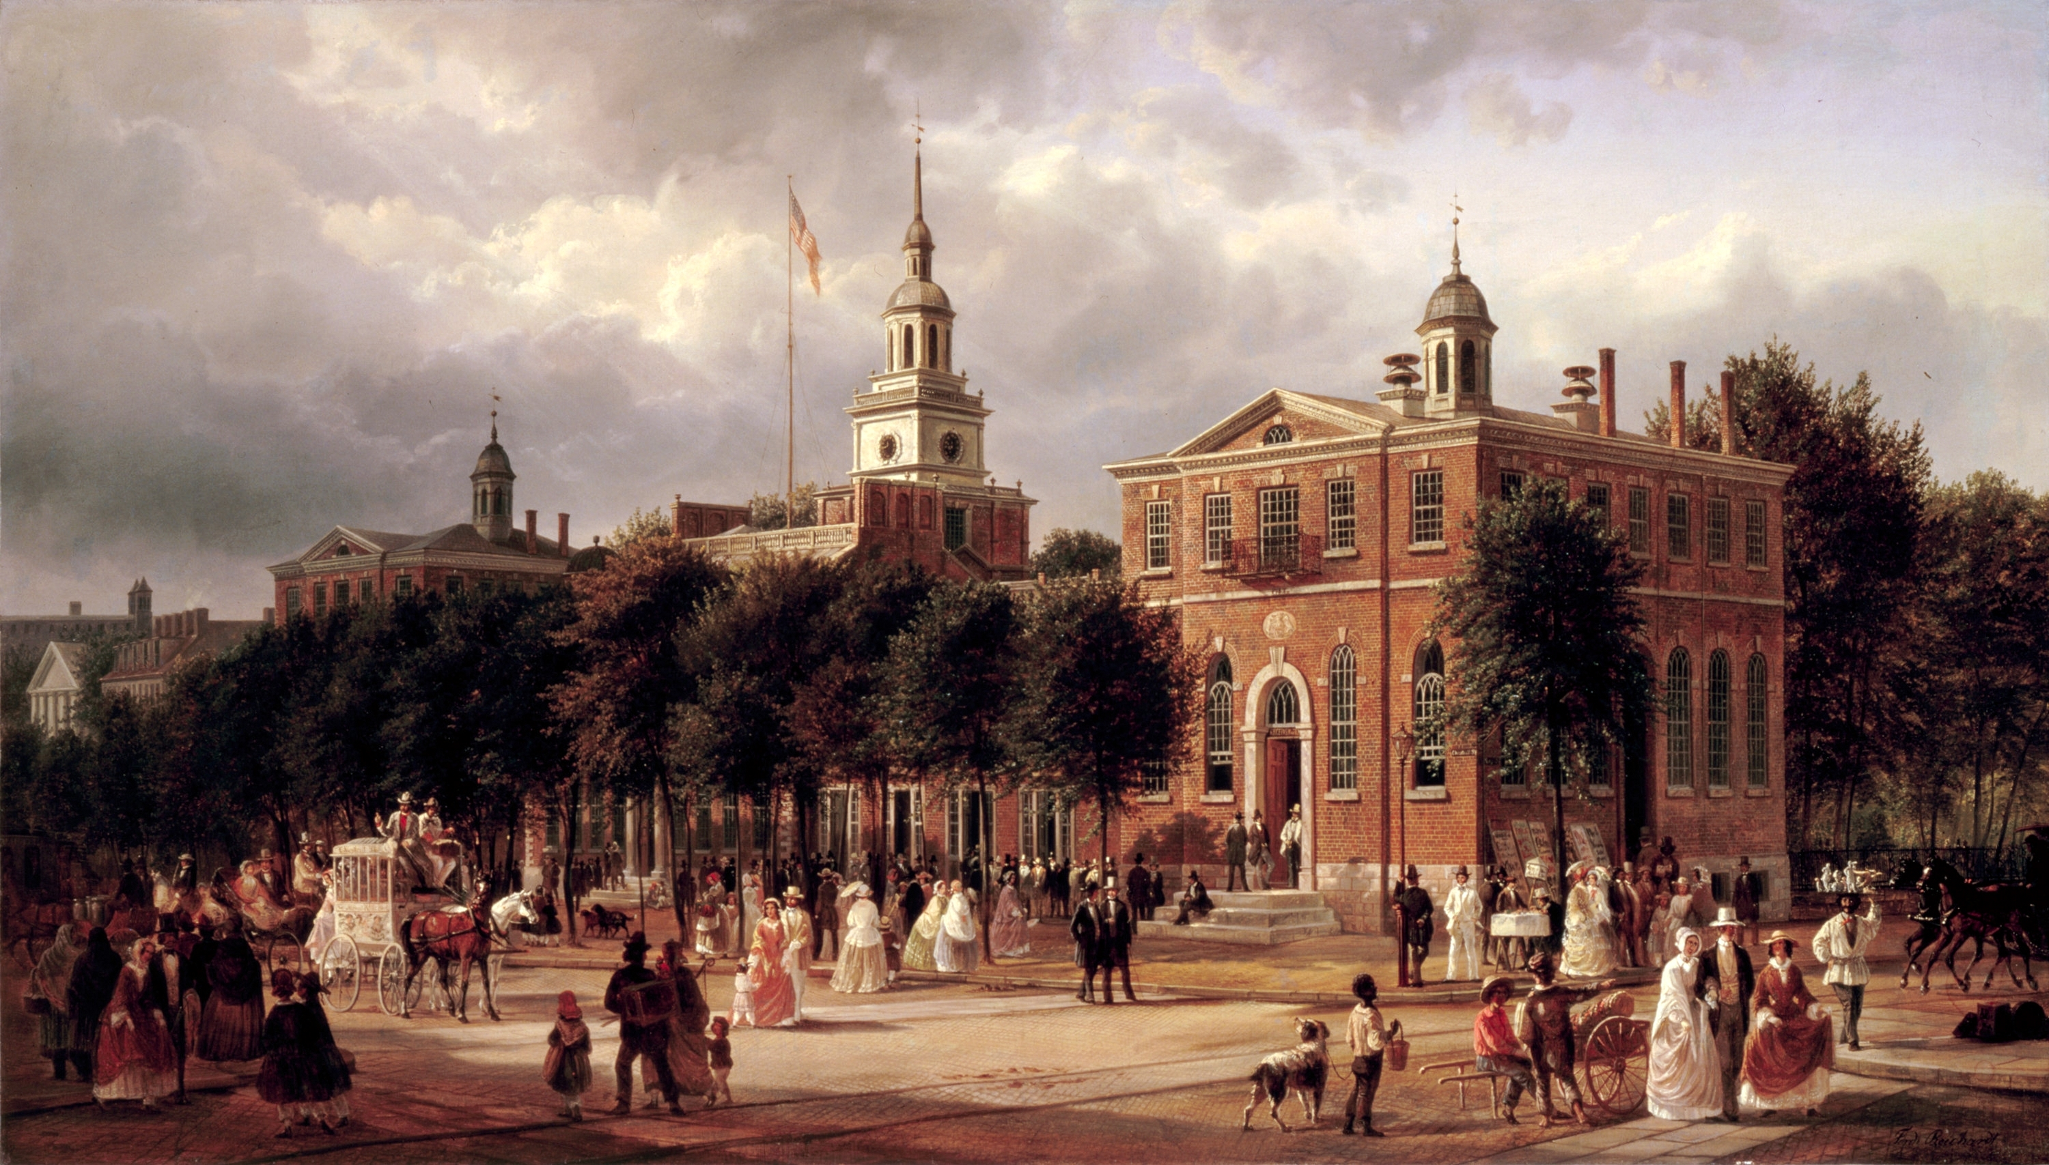

Slide 3
Results:
Delegates decided to scrap The Articles of Confederation and develop a new form of government.
It was a very long process which required a lot of compromise between states.
*George Washington was nominated to be president of the Convention.
**James Madison took very careful notes of the debates and discussions during the Convention.

Slide 4
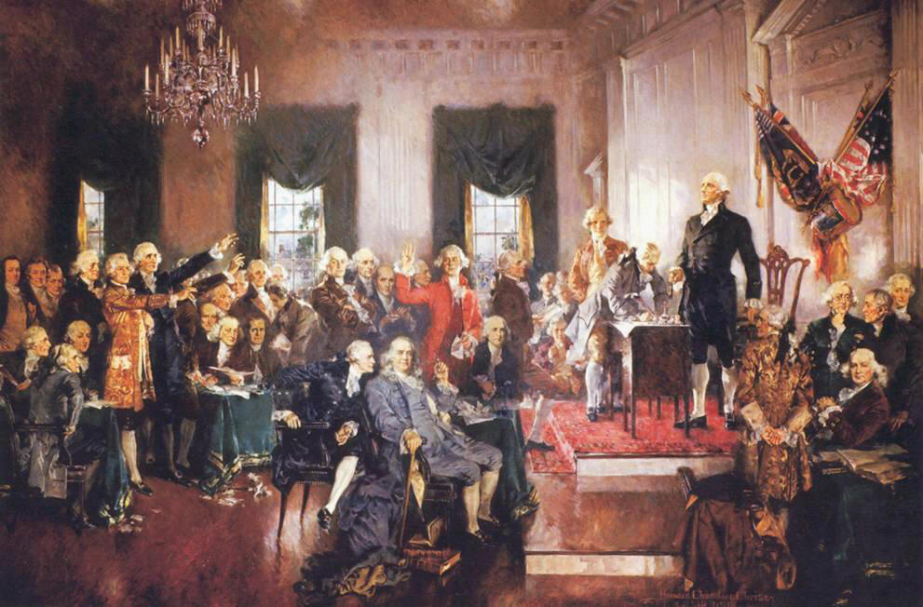
II. Major Arguments During The Constitutional Convention:

Slide 5
1. Representation of Large & Small States:
Large & small states argued over how their state would be represented.
Large (population) states felt they should have more say (power).
Small (population) states felt they should have equal say (power).
Results:
Two plans were proposed.
The debates over the issue of representation got so heated, the Convention almost ended.

Slide 6
a. Virginia Plan:
Favored the large states.
Each state would be given a number of votes / delegates based on their states’ population.
Proposed by James Madison of Virginia.

Slide 7
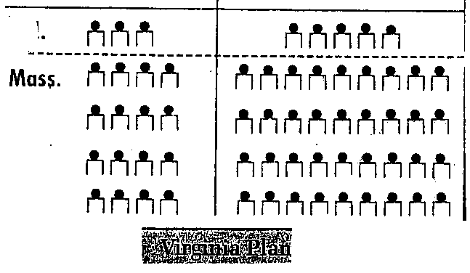

Slide 8
b. New Jersey Plan:
Favored the small states.
Each state would be given the same number of votes / delegates regardless of their states’ population.
Proposed by William Paterson of New Jersey.

Slide 9
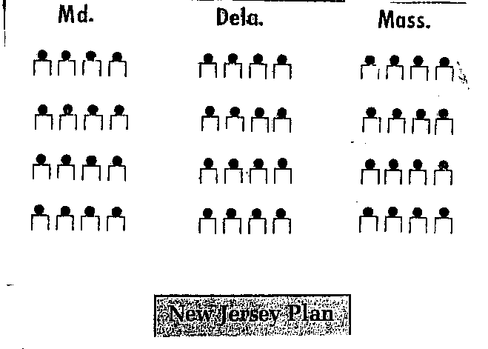

Slide 10
A. Solution = The Great Compromise:
Used parts of both the Virginia & New Jersey Plan.
Set up a bicameral (two-house) legislature.
Proposed by Richard Sherman of Connecticut.

Slide 11
Results:
Senate (small states):
2 Senators per state regardless of population.
100 Senators total (today)
**from New Jersey Plan
House of Representatives (large states):
Votes / delegates per state based on population.
435 members of the House (today).
**from Virginia Plan
Problem of how to organize Congress was solved.
The Great Compromise satisfied both large & small states.

Slide 12
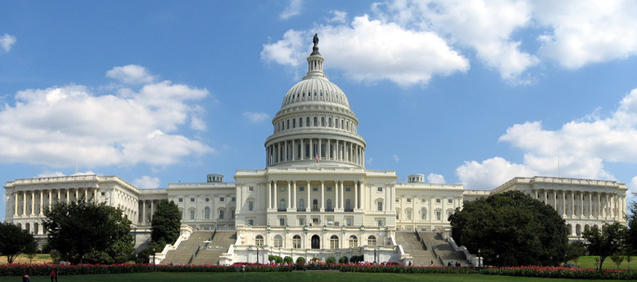
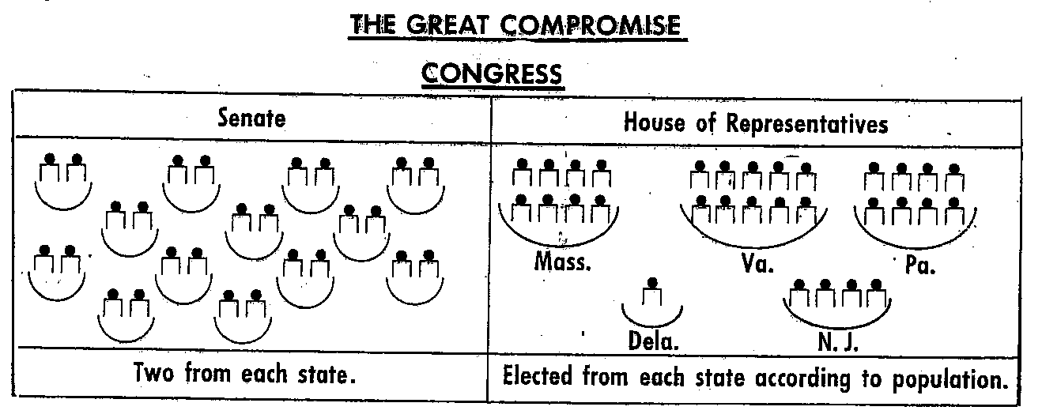

Slide 13
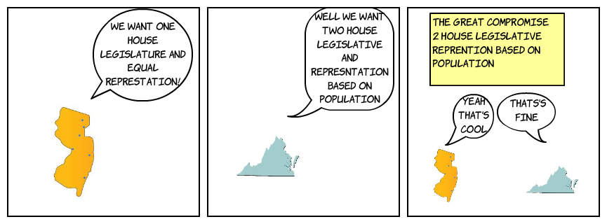
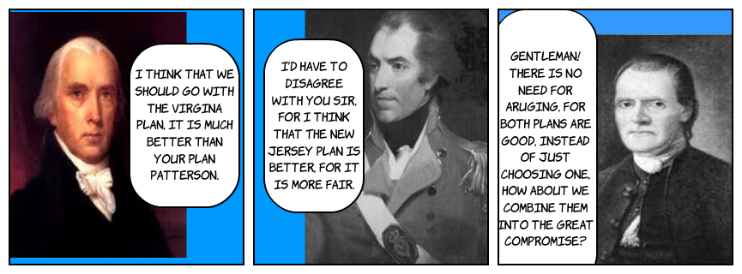

Slide 14
2. Slavery:
Some delegates from northern states wanted to abolish (end) the slave trade and slavery.
Many delegates from southern states threatened to leave the union if the slave trade or slavery were abolished in the U.S.

Slide 15
Results:
The word slavery does not appear in the Constitution.
Delegates agreed that;
  The slave trade would not be discussed in Congress until 1808.
  A $10 tax would be placed on the importation of each slave.
  Runaway slaves would be returned to a state of slavery.
  *Slavery was formally abolished with the ratification of the 13th Amendment (1865).

Slide 16
“The Migration or Importation of such Persons as any of the States now existing shall think proper to admit, shall not be prohibited by the Congress prior to the Year one thousand eight hundred and eight, but a Tax or duty may be imposed on such Importation, not exceeding ten dollars for each Person”.

Slide 17
“No Person held to Service or Labour in one State, under the Laws thereof, escaping into another, shall, in Consequence of any Law or Regulation therein, be discharged from such Service or Labour, but shall be delivered up on Claim of the Party to whom such Service or Labour may be due”.

Slide 18
3. Representation of the Slave Population:
Southern states wanted to count their slave population toward representation.
Southern states would get more delegates in The House of Representatives & have more electoral votes for the presidency.
Northern states did not want the slave population counted.
Results:
Solution = The 3/5’s Compromise:
Every 5 slaves counted as 3 free people for both taxation and representation.
*Without the 3/5’s Compromise, Thomas Jefferson would not have won the election of 1800.

Slide 19
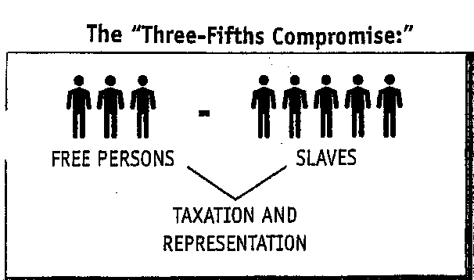

Slide 20
4. Ratification of the Constitution:
ratification = approval, acceptance
9 of 13 states had to ratify (accept) the Constitution before it became law.
Result:
Two groups fought over this issue (Federalists & Anti-Federalists).

Slide 21
A. Anti-Federalists:
Opposed the new Constitution.
Believed the Constitution would create too strong a central (federal) government that would threaten individual freedom.
Wanted individual freedoms (Bill of Rights) to be outlined in the Constitution.
Anti-Federalists were supported by men like Patrick Henry, Samuel Adams, and George Clinton, New York’s first governor.

Slide 22
B. Federalists:
Supported the new Constitution.
Argued that a much stronger central (federal) government was needed to preserve (keep) the United States.
Believed the U.S. would not survive under the Articles of Confederation.
Federalist Papers = a series of essays written in favor of the Constitution that were printed around the country.
Federalists papers were written by James Madison, Alexander Hamilton, and John Jay**

Slide 23
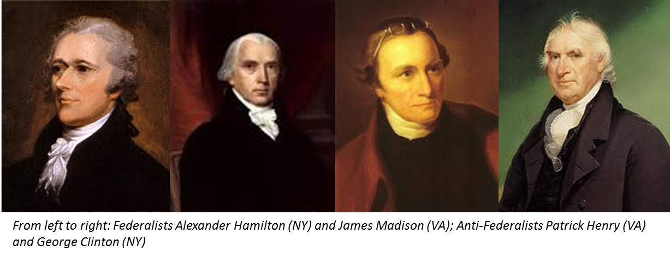

Slide 24
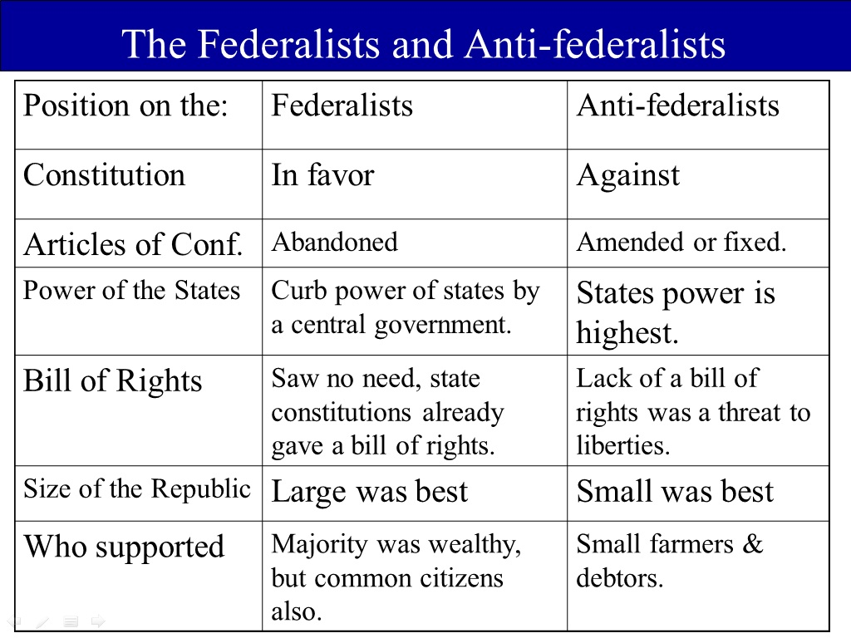

Slide 25
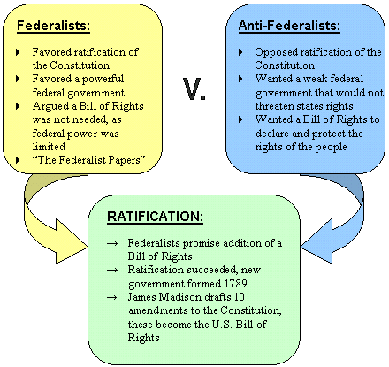

Slide 26
III. The Constitution Was Ratified (1789):
11 of 13 states’ delegates ratified the Constitution.
The delegates had to get approval from their states’ legislature.
The Preamble (Introduction) clearly states where the power to govern came from; “We The People…”
Results:
It took almost 2 ½ years for all 13 states to ratify the Constitution.
Many delegates believed that a bill of rights needed to be added to the Constitution to protect individual rights, liberties, and freedoms.

Slide 27
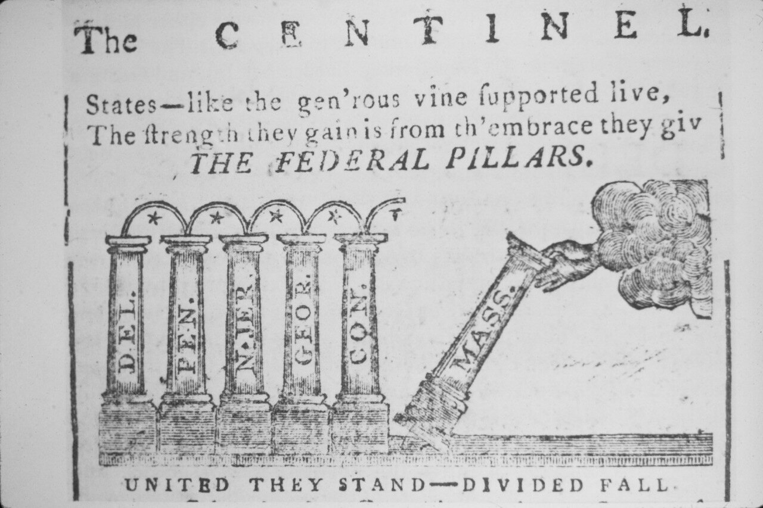

Slide 28
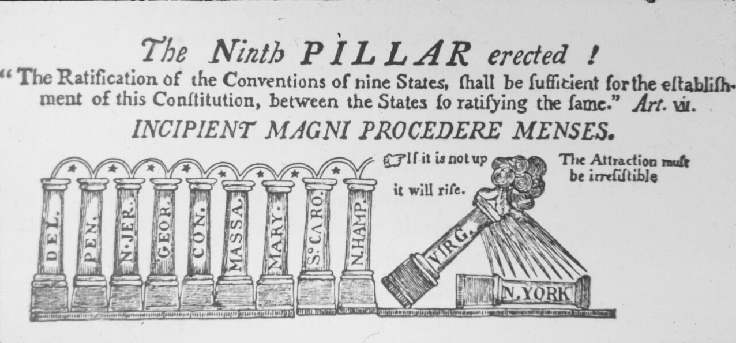

Slide 29
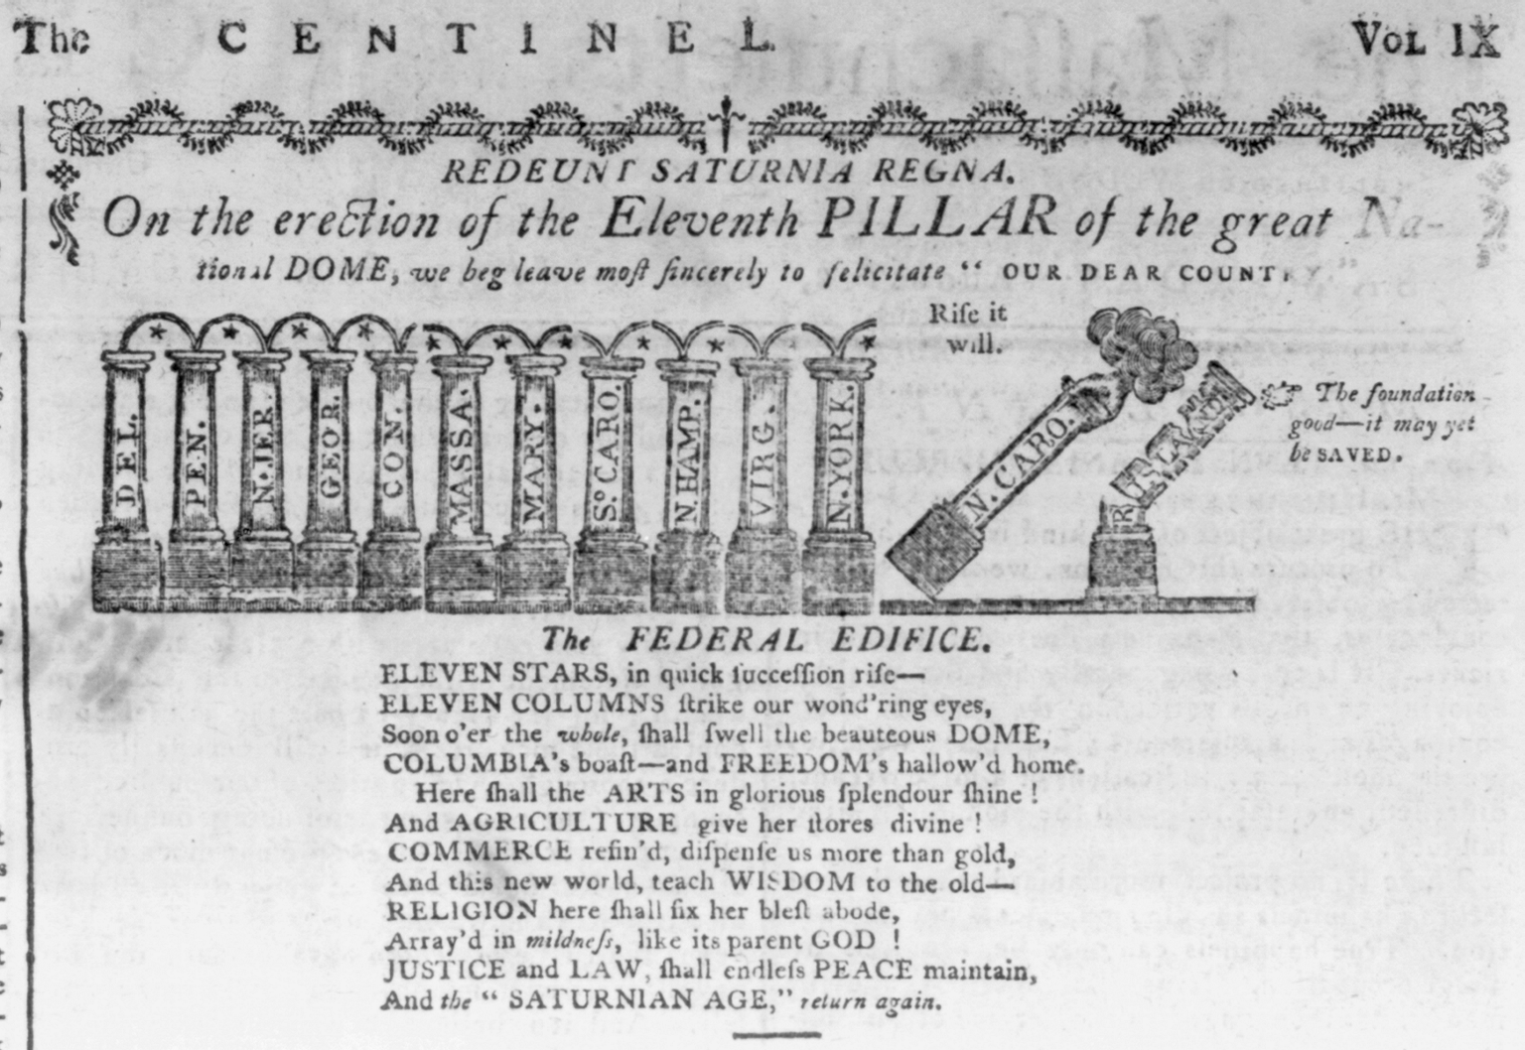

Slide 30
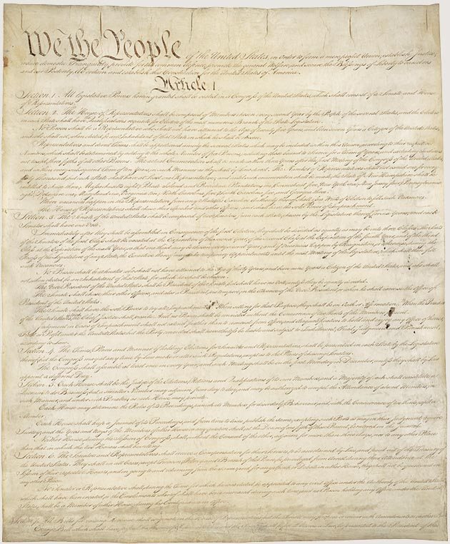
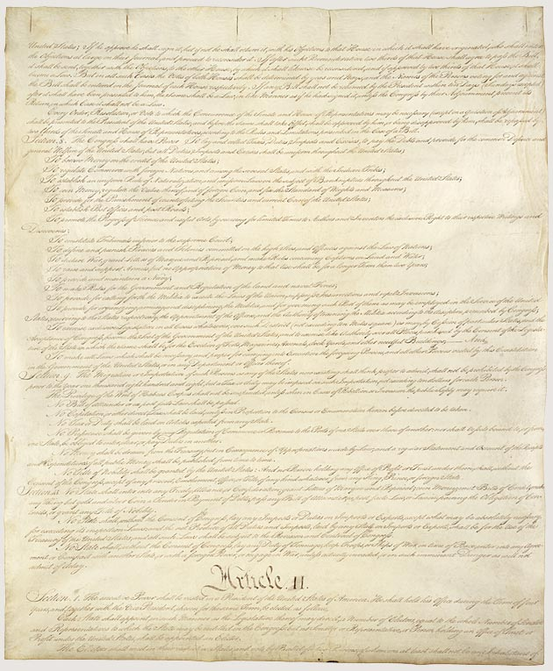

Slide 31
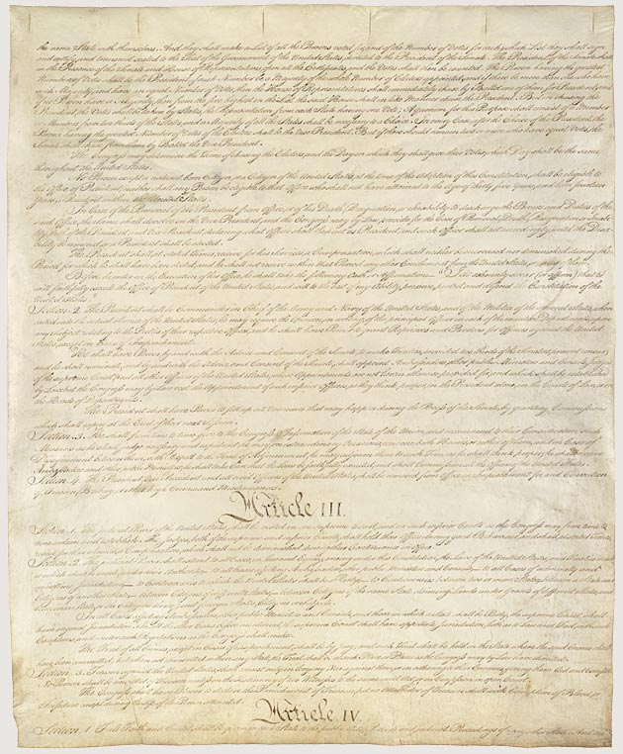
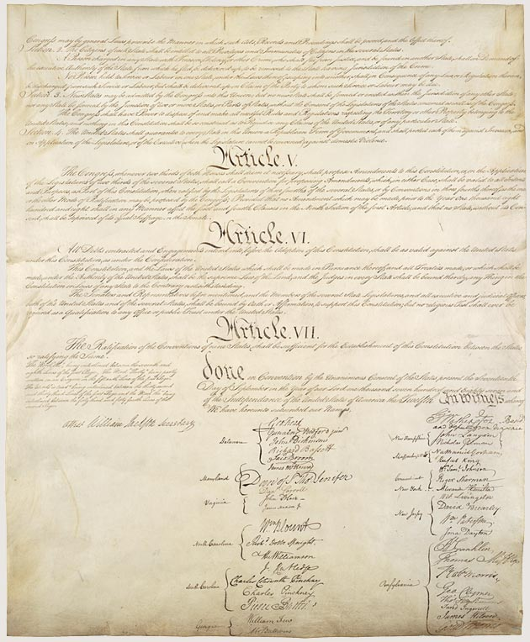

Slide 32
