Slide 1
Instructions to logging on to Quia

Slide 2
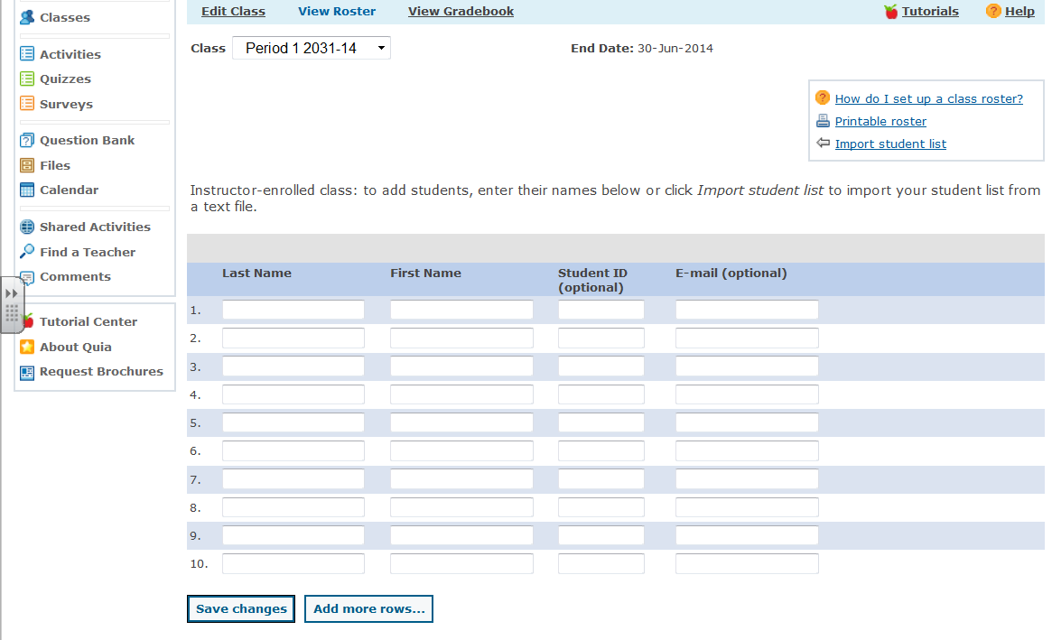
Enter your last name and first initial in the spaces provided.

Slide 3
2. You can enter your email to get updates. Do not enter anything under Student ID.

Slide 4
3. Click Save changes.

Slide 5
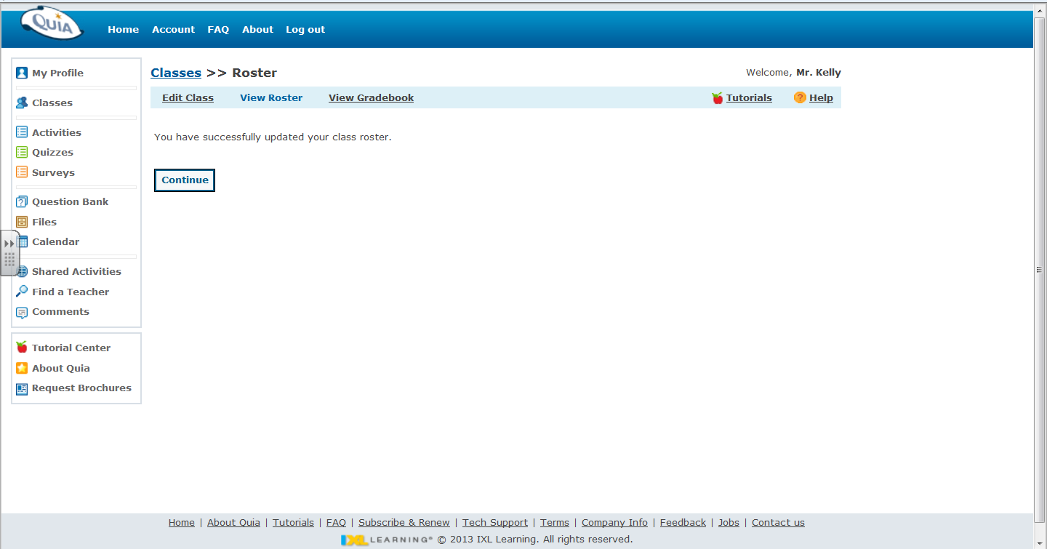
4. Click on continue.

Slide 6
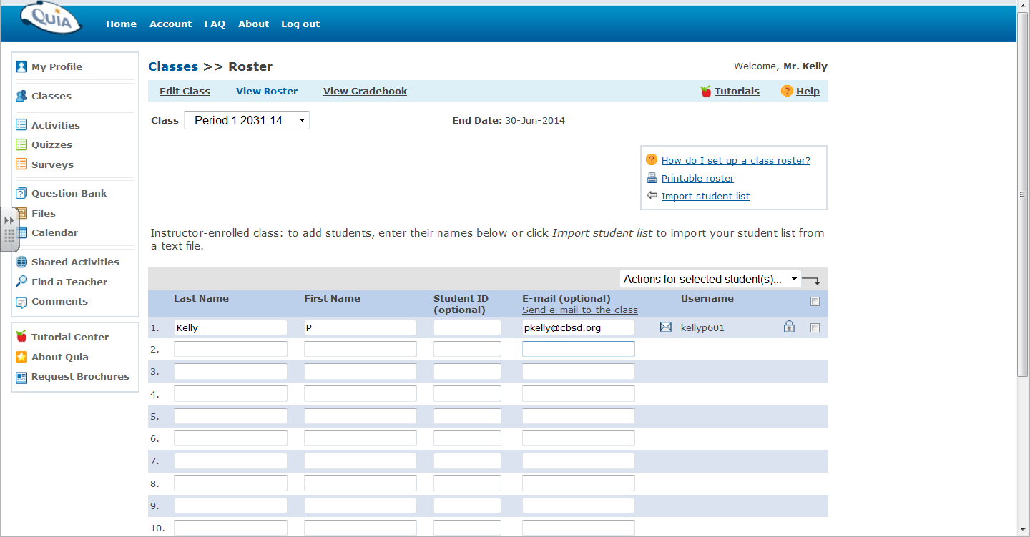
5. Write down your Username. (It will end in 601)

Slide 7
6. Click on the Lock icon.

Slide 8
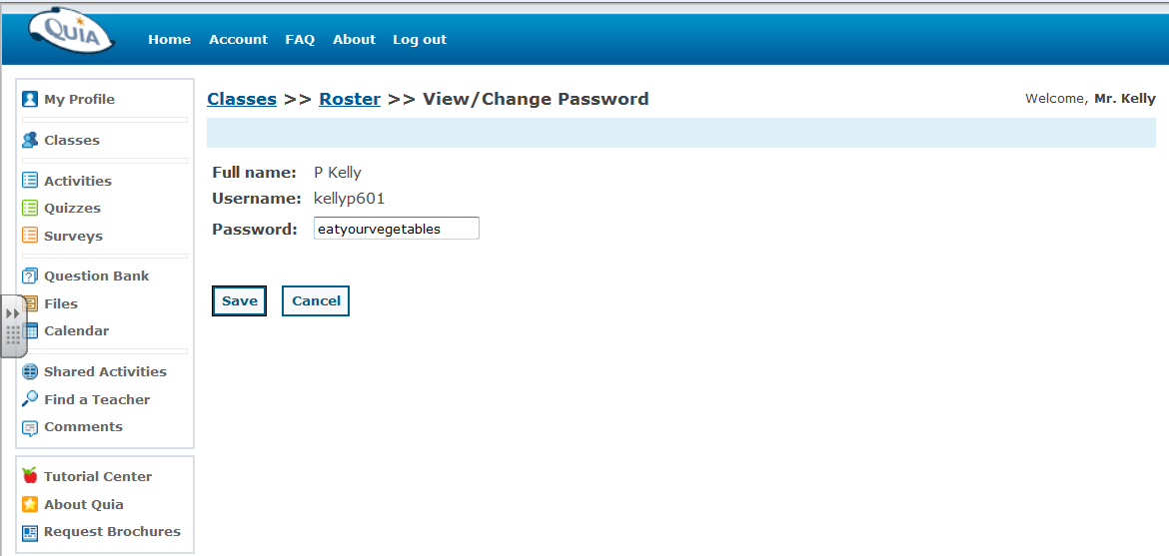
7. Create a password you will remember. (It should be the same for all of your Quia accounts.)

Slide 9
8. Click save and write down your password.

Slide 10
You now have an account for Mr. Kelly’s class.

