Slide 1
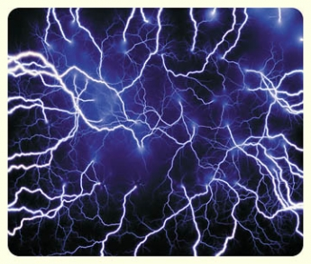
Static Electricity

Slide 2
How do things become electrically charged?
Rub it!

Slide 3
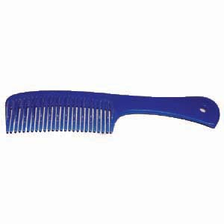
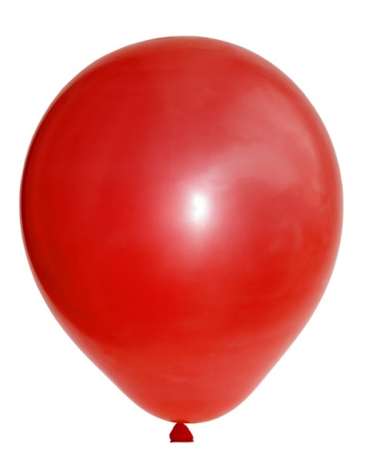
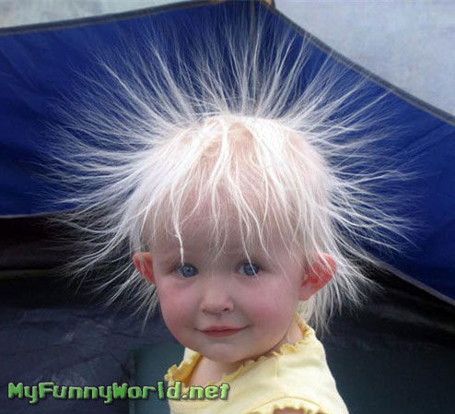
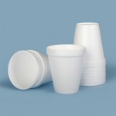
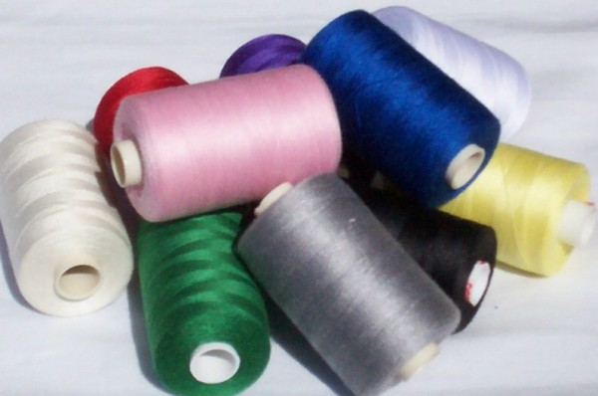
What objects ATTRACT?
Styrofoam to an electrically charged balloon
Thread to an electrically charged comb
Electrically charged hair to a hat

Slide 4
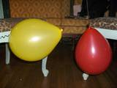
What objects REPEL?
Two electrically charged balloons!

Slide 5
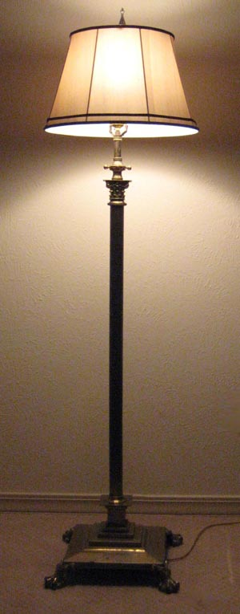
Can static electricity power a lamp?

Slide 6
NO!
Why not?
Static electricity is electrical charges that cause forces of attraction and repulsion between two objects. The charges produced do not move.

