Slide 1


Being a young adult can be stressful at times.
The Student Assistance Program is here to help.

Slide 2
What is the student assistance Program?
The Student Assistance Program’s mission is to confidentially support students with potential substance abuse or mental health issues.

Slide 3
Student Assistance Program members
Ms. Blankenburg
Mrs. Coyne
Mrs. DiFrancesco
Mr. Kriney
Mrs. Nolan
Mrs. Rogers
Ms. Steen
Mrs. Tyburski
Mrs. Schmon
Mrs. Weller-Reilly

Slide 4
The Student assistance Team is:
Confidential
Supportive
Committed to helping students and families
Not disciplinary

Slide 5
Are you concerned about a friend?
Do they seem more withdrawn or upset lately?
Have they told you they are struggling or hurting themselves?
Is your friend having an issue with alcohol or drug use?
Are they struggling with family issues – divorce, grief, loss, illness, social or emotional issues
Have their grades, appearance, or attendance dramatically changed recently?

Slide 6
How can someone get support?
Students can be referred by a teacher, nurse, counselor, parent, or friend.
Referral forms are available on the Lenape website, in the gym locker rooms and in the Guidance office

Slide 8
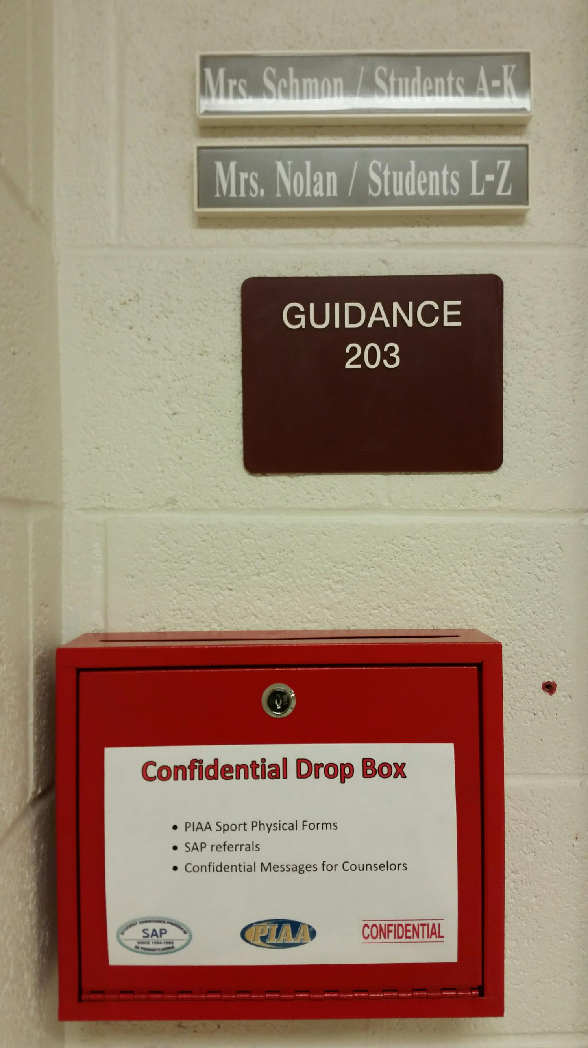
Drop referral into the Confidential DROP Box

Slide 9
What happens when you refer a friend?
The Student Assistance Team confidentially reviews the concerns to determine whether or not a meeting with the parent and student is needed.

Slide 10
see any Student assistance Program team member with questions
Look for this logo indicating a
Student Assistance Program Member

