Slide 1
Warm-up
Copy HW
Start page 19 of your notes w/ the title:
Laws of the Middle Ages
Please begin this page by listing 3 rights you have as an American citizen and 2 laws we must live by

Slide 2
Essential Questions
How has the relationship between citizens and their government changed?
How do societies stabilize in the face of adversity?

Slide 3
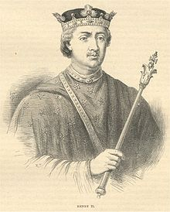
Middle Ages Laws of England
Henry II –King of England 1154-1189
I used ______________ to increase my power
I created a __________ court at the castle with lawyers and judges
I also had _____________ judges that traveled between towns
I established ________________: laws that are the same throughout the Kingdom

Slide 4
Do we have common law in the U.S. ?
Should we?

Slide 5
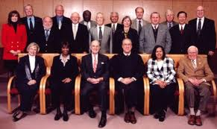
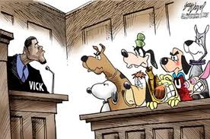
Two Types of Juries
Grand Jury-
Should you go to trial???????
Trial Jury-
Are you guilty??????????

Slide 6
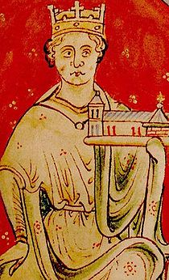
King John of England 1199
I raised _______ and punished people without ______
Many _________ resented my power so…

Slide 7
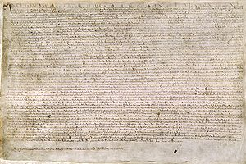
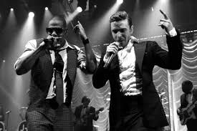
1215- MAGNA CARTA
Limited the King’s ___________
Great Council approved _____________
Trial of ____________ for freemen
King and nobles share certain ______________

Slide 8
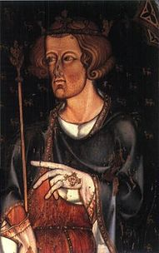
King Edward I
1200s
I asked for _______________ from all over England to “help rule”…
Parliament-England
_____________________-US
It started with 2_______from each county and 2 _______from each town…
House of Commons
________________________-US
All high-level __________ and ___________ leaders…
House of Lords
_________________-US

Slide 9

The Legislative Branch of the Federal Government

Slide 10
Closure
List three comparisons between our government and England in the 12th and 13th centuries
1.
2.
3.
4.
5.

