Slide 1
Study abroad:France
July 2016

Slide 2
Basic Information
July 25, 2016 – August 3, 2016
Preference given to rising Seniors, then rising Juniors and finally rising Sophomores. All students must fill out an application, obtain 2 teacher recommendations and complete all components of the course.
7 chaperones/42 Students (Six to one ratio). All students comply with CB policies before and during course/trip.
There are 5 elements to this course;
Pre-Travel Sessions at night on the following; Trip Logistics, Travel Tips,
Foreign Customs & Etiquette, Cultural Overview
Research Project
Classwork Abroad
Travel
Reflection

Slide 3
World Language Standards; Communication, Cultures, Connections, Comparisons, Communities.
Study Abroad: France - Essential Questions
1. How does an individual express his or her basic needs in the target
language? (Communication and Comparisons standards)
2. Which linguistic and cultural competencies must one have in order to function within another culture? (Culture and Communication standards)
3. How does the past experience of an individual influence their perspective? (Comparisons, Communities and Connections standards)
4. How does first-hand exposure to other cultures impact one’s perspective? (Culture, Connections, Comparisons and Communities standards)
5. What are similarities and differences between the United States and France? (Culture, Comparison, Communities, Connections and Connections standards)

Slide 4
Current CB French Curriculum
French 1- French speaking cities/countries, Food, Leisure activities
French 2- Shopping, Expressing Opinions, Traveling
French 3 – Arts & Entertainment, Vacations
French 4- Making observations & comparisons, Music, Recommendations
French 4 Honors – Feelings, Asking for & obtaining help, Future travel plans
AP French – Global challenges, Science & Technology, Contemporary Life, Personal & Public Identities, Families & Communities, Beauty & Aesthetics

Slide 5
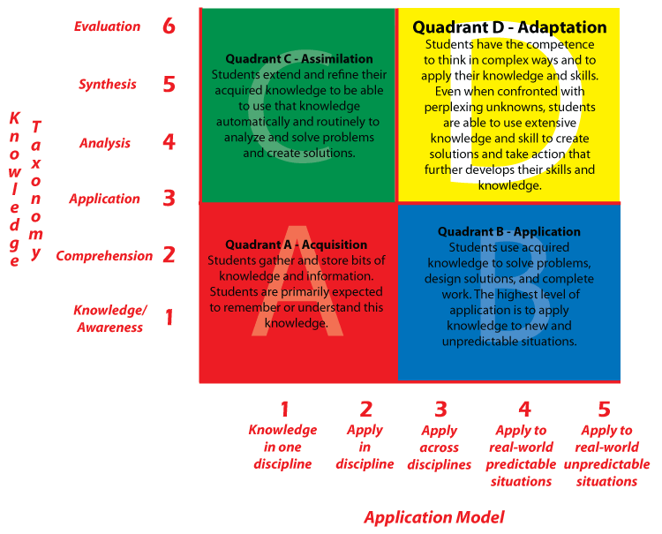

Slide 6
EF Educational Tours
EFTOURS.COM
800.665.5364
EF stands for Education First and is the world leader in international education
Fully accredited
450 schools and offices in over 50 countries worldwide
EF is the second largest purchaser of airline tickets after the U.S. government

Slide 8
Itinerary
Day 1 – Depart PHL for France
Day 2 - Arrive in Paris, Transfer to Orleans, Visit Joan of Arc Museum
Day 3 – Class from 9-12, Lunch, Walking tour of Orleans
Day 4 – Class from 9-12, Excursion to Chartres
Day 5 – Class from 9-12, Excursion to the Loire Valley; Visit Chateau d’Amboise, Chateau de Chenonceau, Troglodyte Dinner, Light and Sound Show
Day 6 – Class from 9-12, Transfer to Paris
Day 7 – Bus tour of Paris, Excursion to Versailles
Day 8 – Visit Louvre Museum, Walking tour of Paris, Notre Dame, Montmartre (dinner)
Day 9 – Excursion to Giverny (home of Claude Monet 1883-1926), Seine River Cruise Eiffel Tower
Day 10 – Depart Paris for PHL

Slide 9
What is included?
Round trip airfare
All ground transfers
All bus and walking tours
Breakfast and Dinner each day
Full time EF Tour Director
Insurance
Hotels
Online Resources provided by EF
Classes taught by CB Professionals

Slide 10
What is not included
Optional Excursions
Tip for tour director and bus driver (appx. $89/pp)
Lunch
Bus transfer to and from PHL (appx. $40/pp)

Slide 11
Cost
$4,189.00
$241/month on the monthly payment plan
Airfare search on 2/10/15 –Flights alone are $1845-$1964 non-stop for July 2015

Slide 12
Important to know…
Chaperones are certified CB teachers only
CB Nurse will chaperone as well
Classes taught by CB French teachers
All chaperones are experienced travelers
Tour Director is accessible 24/7
Insurance is mandatory

