Slide 1
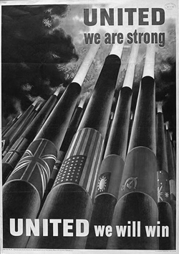
World War II Self-Directed Learning – Nonfiction Books

Slide 2
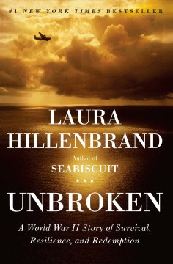
Unbroken
In boyhood, Louis Zamperini was an incorrigible delinquent. As a teenager, he channeled his defiance into running, discovering a prodigious talent that had carried him to the Berlin Olympics. But when World War II began, the athlete became an airman, embarking on a journey that led to a doomed flight on a May afternoon in 1943. When his Army Air Forces bomber crashed into the Pacific Ocean, against all odds, Zamperini survived, adrift on a foundering life raft. Ahead of Zamperini lay thousands of miles of open ocean, leaping sharks, thirst and starvation, enemy aircraft, and, beyond, a trial even greater. Driven to the limits of endurance, Zamperini would answer desperation with ingenuity; suffering with hope, resolve, and humor; brutality with rebellion. His fate, whether triumph or tragedy, would be suspended on the fraying wire of his will.

Slide 3
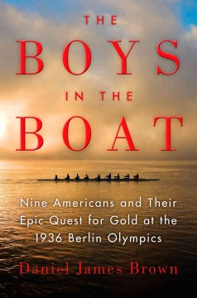
The Boys In The Boat
Tells how in 1936 the University of Washington's eight-oar crew, composed of the sons of loggers, shipyard workers, and farmers who had mastered collegiate rowing, went on to the Berlin Olympics where they defeated Adolf Hitler's German team to achieve the Olympic gold medal.

Slide 4
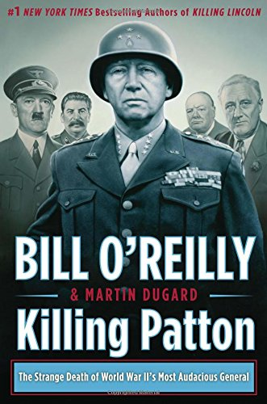
Killing Patton
General George S. Patton, Jr. died under mysterious circumstances in the months following the end of World War II. For almost seventy years, there has been suspicion that his death was not an accident--and may very well have been an act of assassination. Killing Patton takes readers inside the final year of the war and recounts the events surrounding Patton's tragic demise, naming names of the many powerful individuals who wanted him silenced.

Slide 5
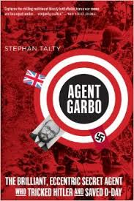
Agent Garbo
Agent Garbo is the fascinating story of a man whose wit, cunning, and steely nerves made the Allied victory possible in World War II. Stephan Talty's unsurpassed research brings forth one of the war's greatest agents in a must-read book for those who think they know all the great World War II stories.

Slide 6
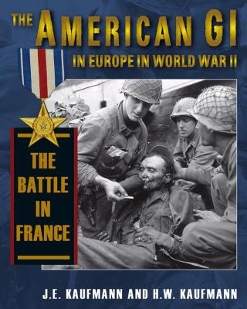
The American GI In Europe In World War II
The final installment of this trilogy details the U.S. Army's battles in France following the D-Day landings on June 6, 1944. After establishing beachheads at Omaha and Utah Beaches, American troops slogged inland for almost two months, battling through Normandy hedgerow by hedgerow before breaking out in Operation Cobra. Several weeks later, an Allied force that included American GIs invaded southern France and began the hard fight northward. Weaving together veterans' testimonies, the Kaufmanns capture the complete experience of the individual soldier during the brutal summer of 1944.

Slide 7
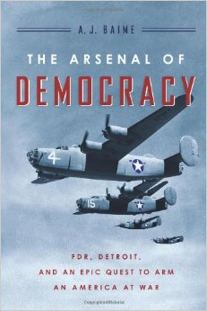
The Arsenal Of Democracy
The Arsenal of Democracy tells the incredible story of how Detroit answered the call, centering on Henry Ford and his tortured son Edsel, who, when asked if they could deliver 50,000 airplanes, made an outrageous claim: Ford Motor Company would erect a plant that could yield a “bomber an hour.” Critics scoffed: Ford didn’t make planes; they made simple, affordable cars. But bucking his father’s resistance, Edsel charged ahead. Ford would apply assembly-line production to the American military’s largest, fastest, most destructive bomber; they would build a plant vast in size and ambition on a plot of farmland and call it Willow Run; they would bring in tens of thousands of workers from across the country, transforming Detroit, almost overnight, from Motor City to the “great arsenal of democracy.” And eventually they would help the Allies win the war.

Slide 8
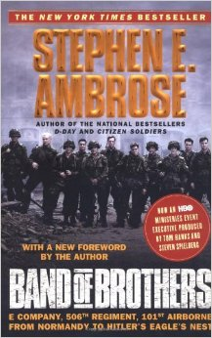
Band Of Brothers
Stephen E. Ambrose’s iconic story of the ordinary men who became the World War II’s most extraordinary soldiers: Easy Company, 506th Parachute Infantry Regiment, 101st Airborne Division, US Army.
They came together, citizen soldiers, in the summer of 1942, drawn to Airborne by the $50 monthly bonus and a desire to be better than the other guy. And at its peak—in Holland and the Ardennes—Easy Company was as good a rifle company as any in the world.
This is the story of the men who fought, of the martinet they hated who trained them well, and of the captain they loved who led them. E Company was a company of men who went hungry, froze, and died for each other, a company that took 150 percent casualties, a company where the Purple Heart was not a medal—it was a badge of office.

Slide 9
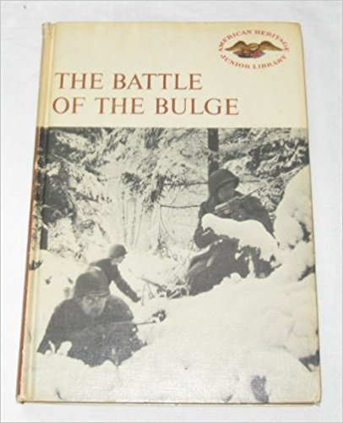
The Battle Of The Bulge
Describes the events leading to and during the Battle of Ardennes, often called the Battle of the Bulge as well as the "fiercest battle of World War II."

Slide 10
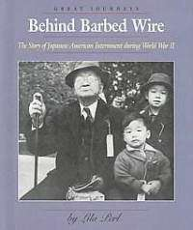
Behind Barbed Wire
Among the authors of this highly acclaimed series are Laura Ingalls Wilder Award winner Milton Meltzer, Coretta Scott King Award winner James Haskins and noted author Raymond Bial. The series itself focuses on major population shifts in America and the driving forces behind them. The authors' vivid accounts are given additional immediacy with the inclusion of excerpts from diaries, newspaper articles and letters.

Slide 11
Beyond Courage
Provides detailed accounts of twenty-one acts of defiance committed against Nazis in Nazi-occupied countries during World War II.

Slide 12
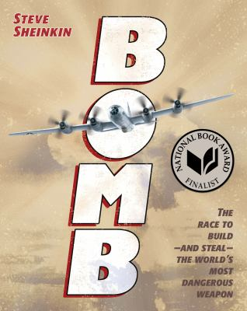
Bomb
In December of 1938, a chemist in a German laboratory made a shocking discovery: When placed next to radioactive material, a Uranium atom split in two. That simple discovery launched a scientific race that spanned 3 continents. In Great Britain and the United States, Soviet spies worked their way into the scientific community; in Norway, a commando force slipped behind enemy lines to attack German heavy-water manufacturing; and deep in the desert, one brilliant group of scientists was hidden away at a remote site at Los Alamos. This is the story of the plotting, the risk-taking, the deceit, and genius that created the world's most formidable weapon. This is the story of the atomic bomb. Bomb is a 2012 National Book Awards finalist for Young People's Literature. Bomb is a 2012 Washington Post Best Kids Books of the Year title. Bomb is a 2013 Newbery Honor book.

Slide 13
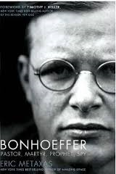
Bonhoeffer
As Adolf Hitler and the Nazis seduced a nation, bullied a continent, and attempted to exterminate the Jews of Europe, a small number of dissidents and saboteurs worked to dismantle the Third Reich from the inside. One of these was Dietrich Bonhoeffer—a pastor and author. In this New York Times best-selling biography, Eric Metaxas takes both strands of Bonhoeffer’s life—the theologian and the spy—and draws them together to tell a searing story of incredible moral courage in the face of monstrous evil. Metaxas presents the fullest accounting of Bonhoeffer’s heart-wrenching decision to leave the safe haven of America to return to Hitler’s Germany, and sheds new light on Bonhoeffer’s involvement in the famous Valkyrie plot and in “Operation 7,” the effort to smuggle Jews into neutral Switzerland.

Slide 14
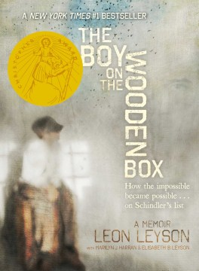
The Boy On The Wooden Box
Leon Leyson (born Leib Lezjon) was only ten years old when the Nazis invaded Poland and his family was forced to relocate to the Krakow ghetto. Leon Leyson (born Leib Lezjon) was only ten years old when the Nazis invaded Poland and his family was forced to relocate to the Krakow ghetto. With incredible luck, perseverance, and grit, Leyson was able to survive the sadism of the Nazis, including that of the demonic Amon Goeth, commandant of Plaszow, the concentration camp outside Krakow. Ultimately, it was the generosity and cunning of one man, a man named Oskar Schindler, who saved Leon Leyson's life, and the lives of his mother, his father, and two of his four siblings, by adding their names to his list of workers in his factory-a list that became world renowned: Schindler's List. This, the only memoir published by a former Schindler's List child, perfectly captures the innocence of a small boy who goes through the unthinkable. Most notable is the lack of rancor, the lack of venom, and the abundance of dignity in Mr. Leyson's telling. The Boy on the Wooden Box is a legacy of hope, a memoir unlike anything you've ever read.

Slide 15
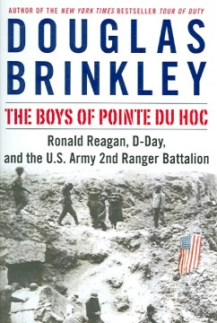
The Boys Of Pointe Du Hoc
Recounts the experiences of the men who served in the U.S. Army Ranger troops that stormed the coast of Normandy on D-Day and describes President Ronald Reagan's efforts to pay them homage forty years later.

Slide 16
The Cage
A teenage girl recounts the suffering and persecution of her family under the Nazis--in a Polish ghetto, during deportation, and in a concentration camp.

Slide 17
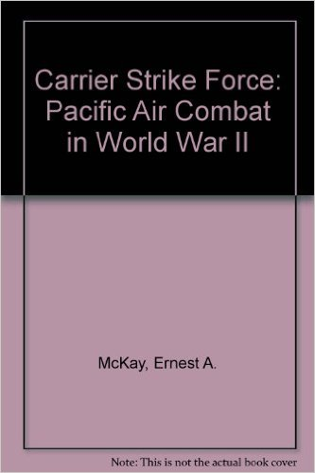
Carrier Strike Force
Describes the creation of a new American carrier fleet in the pacific following the attack on Pearl Harbor and its success in blocking enemy expansion and leading the attack on Japan.

Slide 18
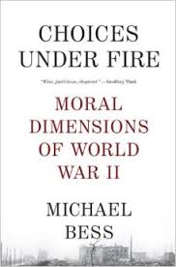
Choices Under Fire
World War II was the quintessential “good war.” It was not, however, a conflict free of moral ambiguity, painful dilemmas, and unavoidable compromises. Was the bombing of civilian populations in Germany and Japan justified? Were the Nuremberg and Tokyo war crimes trials legally scrupulous? What is the legacy bequeathed to the world by Hiroshima? With wisdom and clarity, Michael Bess brings a fresh eye to these difficult questions and others, arguing eloquently against the binaries of honor and dishonor, pride and shame, and points instead toward a nuanced reckoning with one of the most pivotal conflicts in human history.

Slide 19
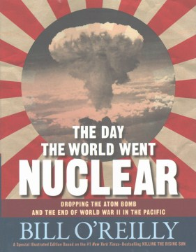
The Day The World Went Nuclear
Explores the decision to use the atom bomb and the end of World War II in the Pacific

Slide 20
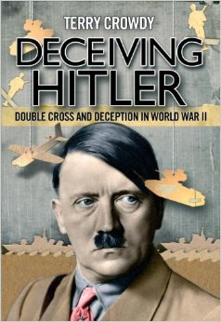
Deceiving Hitler
During the Second World War the Allies controlled every active German agent in Britain. This placed Allied Intelligence services in a unique position. The Allies were able to feed spurious information back to Germany which mixed scraps of truthful information with misleading details in a believable mix of information. Out of this process of deception grew an entire organization which specialized in the manufacture of elaborate deceptions to confuse and hinder Axis powers. To maintain the deception, complex camouflage and tactical deception operations were to be undertaken on the ground, involving the use of inflatable tanks, fake towns which misdirected the German blitz, bogus troop formations and a catalog of Hollywood-style special effects.
At times bizarre and often intriguing, these operations were used in all the major theaters of the war and saved countless Allied lives. From disappearing North African pipelines to bogus radio stations, this book is an entertaining and absorbing account of the deceptions used by the Allies in World War II.

Slide 21
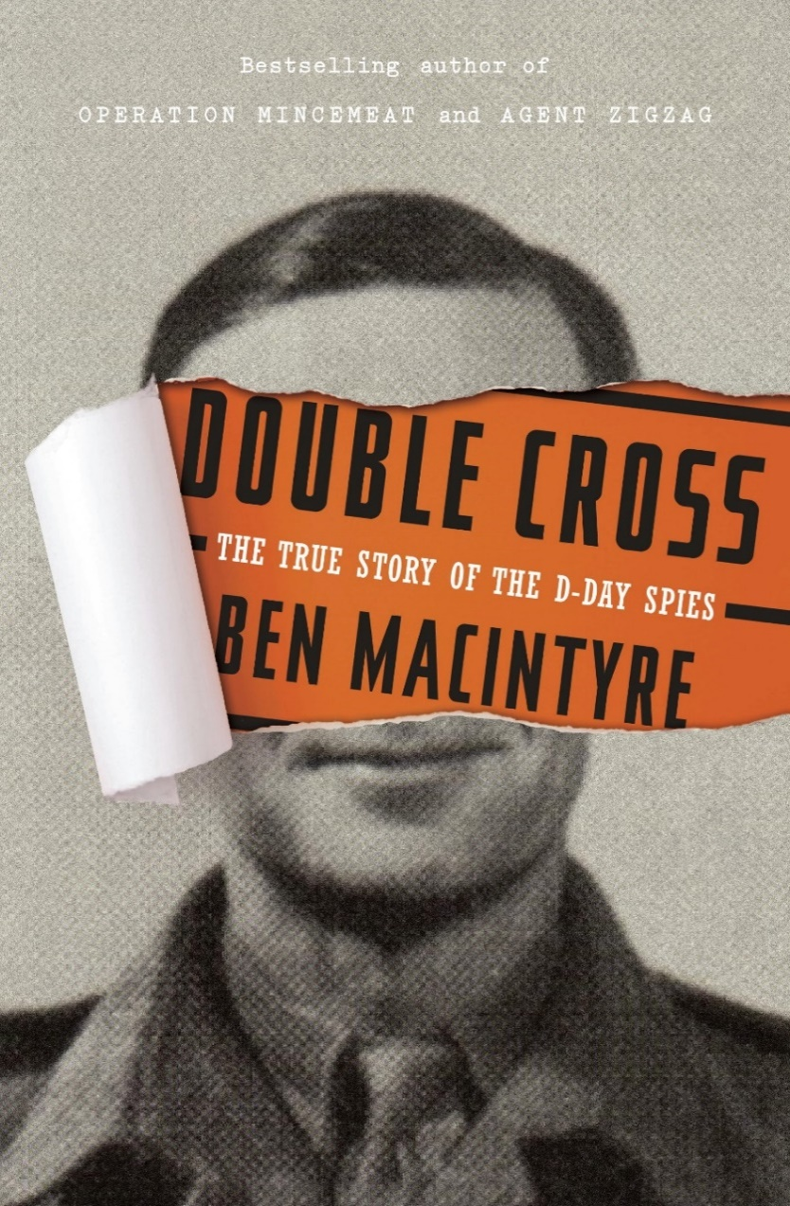
Double Cross
On June 6, 1944, 150,000 Allied troops landed on the beaches of Normandy and suffered an astonishingly low rate of casualties. A stunning military accomplishment, it was also a masterpiece of trickery. Operation Fortitude, which protected and enabled the invasion, and the Double Cross system, which specialized in turning German spies into double agents, tricked the Nazis into believing that the Allied attacks would come in Calais and Norway rather than Normandy. It was the most sophisticated and successful deception operation ever carried out, ensuring Allied victory at the most pivotal point in the war. This epic event has never before been told from the perspective of the key individuals in the Double Cross system, until now. Together they made up one of the oddest and most brilliant military units ever assembled.

Slide 22
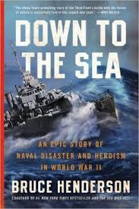
Down To The Sea
This epic story opens at the hour the Greatest Generation went to war on December 7, 1941, and follows four U.S. Navy ships and their crews in the Pacific until their day of reckoning three years later with a far different enemy: a deadly typhoon. In December 1944, while supporting General MacArthur's invasion of the Philippines, Admiral William "Bull" Halsey neglected the Law of Storms, placing the mighty U.S. Third Fleet in harm's way. Drawing on extensive interviews with nearly every living survivor and rescuer, as well as many families of lost sailors, transcripts and other records from naval courts of inquiry, ships' logs, personal letters, and diaries, Bruce Henderson finds some of the story's truest heroes exhibiting selflessness, courage, and even defiance.

Slide 23
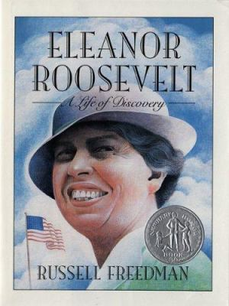
Eleanor Roosevelt
The intriguing story of Eleanor Roosevelt traces the life of the former First Lady from her early childhood through the tumultuous years in the White House to her active role in the founding of the United Nations after World War II. A Newberry Honor Book.

Slide 24
Escape From Germany
This contemporary acount of prisoner of war escapes, prepared for the Art Ministry in 1951, draws upon first-hand experiences of Germany's notorious camps. It portrays events at Colditz, the 'escapers' gaol', and at Stalag Luft III, where the famous tunnel is described by two of the officers who created it.

Slide 25
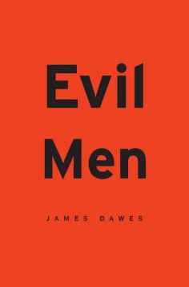
Evil men
A searching meditation on our all-too-human capacity for inhumanity, Evil Men confronts atrocity head-on how it looks and feels, what motivates it, how it can be stopped. James Dawes s unflinchingly honest account, drawing on firsthand interviews, is not just about the things Japanese war criminals did, but about what it means to befriend them.

Slide 26
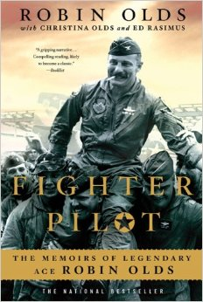
Fighter Pilot
Robin Olds was many things to many people. To his West Point football coach he was an All American destined for the National College Football Hall of Fame. To his P-38 and P-51 wartime squadrons in WWII he was the aggressive fighter pilot who made double ace and became their commander in nine short months. For the pioneers of the jet age, he was the wingman on the first jet demo team, a racer in the Thompson Trophy race, and the only U.S. exchange officer to command an RAF squadron. In the tabloid press he was the dashing flying hero who married the glamorous movie star. For the current crop of fighter pilots he is best known as the leader of the F-4 Wolfpack battling over North Vietnam. For cadets at the Air Force Academy he was a role model and mentor. He was all of those things and more.

Slide 27
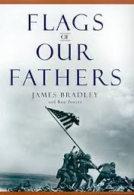
Flags Of Our Fathers
In this unforgettable chronicle of perhaps the most famous moment in American military history, James Bradley has captured the glory, the triumph, the heartbreak, and the legacy of the six men who raised the flag at Iwo Jima. Here is the true story behind the immortal photograph that has come to symbolize the courage and indomitable will of America.
In February 1945, American Marines plunged into the surf at Iwo Jima—and into history. Through a hail of machine-gun and mortar fire that left the beaches strewn with comrades, they battled to the island's highest peak. And after climbing through a landscape of hell itself, they raised a flag.
Now the son of one of the flag raisers has written a powerful account of six very different young men who came together in a moment that will live forever.

Slide 28
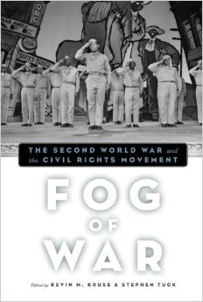
Fog Of War
It is well known that World War Ii gave rise to human rights rhetoric, discredited a racist regime abroad, and provided new opportunities for African Americans to fight, work, and demand equality at home. It would be all too easy to assume that the war was a key stepping stone to the modern civil rights movement. But Fog of War shows that in reality the momentum for civil rights was not so clear cut, with activists facing setbacks as well as successes and their opponents finding ways to establish more rigid defenses for segregation. While the war set the scene for a mass movement, it also narrowed some of the options for black activists. This collection is a timely reconsideration of the intersection between two of the dominant events of twentieth-century American history, the upheaval wrought by the Second World War and the social revolution brought about by the African American struggle for equality.

Slide 29
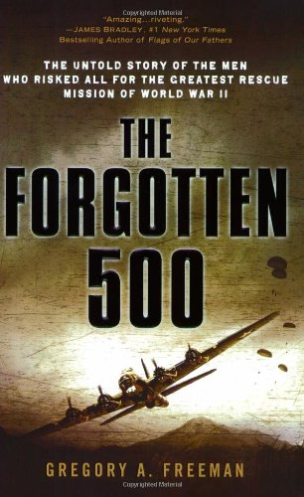
The Forgotten 500
Bombing of the Ploiesti, Romania, oil refineries, a key German resource, started in 1942. Allied pilots sustaining damage frequently bailed out over Serbia in German-occupied Yugoslavia, where the resistance and others hid them. By 1944, more than 500 were stranded and slowly starving. The OSS concocted the daring Operation Halyard to airlift them, but they had to construct a landing strip without tools and without alerting the Germans or endangering local villagers, and then the rescuers had to avoid being shot down themselves. The operation's story is an exciting tale, but it was kept from general knowledge for decades; the resistance leader most responsible was a rival to Tito. Nazi-baited by a Stalinist mole in British intelligence, he was executed in 1946 with the consent of Britain and America, which thereafter refused to acknowledge having been snookered (the State Department kept many details classified more than 50 years). Evoking the rescuees' successive desperation, wild hope, and joy, and their gratitude to the Serbians who risked their lives to help, Freeman produces a breathtaking popular account. Murray, Frieda

Slide 30
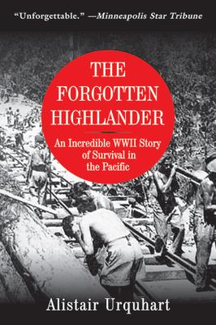
The Forgotten Highlander
Alistair Urquhart was among the Gordon Highlanders captured by the Japanese in Singapore during World War II. He not only survived 750 days in the jungle working as a slave on the notorious "death railway" and the bridge on the River Kwai, but he was subsequently taken prisoner on one of the Japanese "hellships" which was later torpedoed, killing nearly everyone on board--but not Urquhart. He spent five days adrift on a raft in the South China Sea before being rescued by a Japanese whaling ship. He was then taken to Japan and forced to work in a mine near Nagasaki. Two months later he was struck by the blast from the atomic bomb--dropped just ten miles away. In late August 1945, now a barely-living skeleton, he was freed by the American Navy and was able to bathe for the first time in three and a half years. This is the extraordinary story of a young man, conscripted at nineteen, who survived not just one but three separate encounters with death--encounters which killed nearly all his comrades. Silent for over fifty years, this is Urquhart's extraordinary, moving, and inspirational tale as an ex-POW.

Slide 31
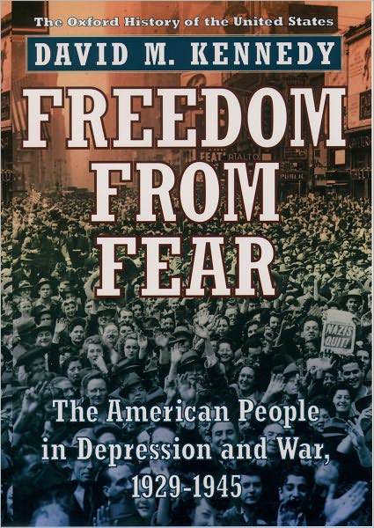
Freedom From Fear
Between 1929 and 1945, two great travails were visited upon the American people: the Great Depression and World War II. This book tells the story of how Americans endured, and eventually prevailed, in the face of those unprecedented calamities.
Freedom From Fear explores how the nation agonized over its role in World War II, how it fought the war, why the United States won, and why the consequences of victory were sometimes sweet, sometimes ironic. In a compelling narrative, Kennedy analyzes the determinants of American strategy, the painful choices faced by commanders and statesmen, and the agonies inflicted on the millions of ordinary Americans who were compelled to swallow their fears and face battle as best they could.

Slide 32
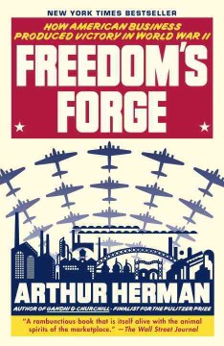
Freedom’s Forge
Remarkable as it may seem today, there once was a time when the president of the United States could pick up the phone and ask the president of General Motors to resign his position and take the reins of a great national enterprise. And the CEO would oblige, no questions asked, because it was his patriotic duty.
In Freedom’s Forge, bestselling author Arthur Herman takes us back to that time, revealing how two extraordinary American businessmen—automobile magnate William Knudsen and shipbuilder Henry J. Kaiser—helped corral, cajole, and inspire business leaders across the country to mobilize the “arsenal of democracy” that propelled the Allies to victory in World War II.

Slide 33
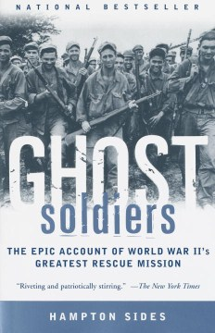
Ghost Soldiers
Chronicles the raid by 121 U.S. troops to rescue 513 prisoners of war, including the last survivors of the Bataan Death March, from the Philippines in January 1945.

Slide 34
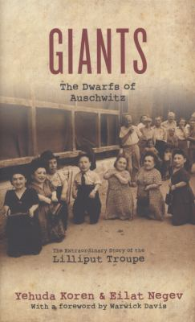
Giants
In this account of the Ovitz family, seven of whose ten members were dwarves, readers bear witness to the terrible irony of the Ovitz's fate: being burdened with dwarfism helped them to endure the Holocaust. Through research and interviews with the youngest Ovitz daughter, Perla, the troupe's last surviving member, and other relatives, the authors weave the tale of a beloved and successful family of performers who were famous entertainers in Central Europe until the Nazis deported them to Auschwitz in May 1944.

Slide 35
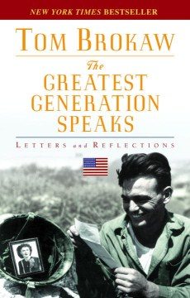
The Greatest Generation Speaks
Collects letters sent to the author in response to "The Greatest Generation," his tribute to the generation of Americans who fought in World War II and came home to build a new America during the post war era

Slide 36
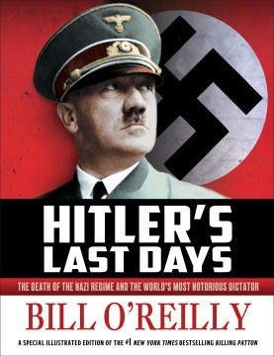
Hitler’s Last Days
By early 1945, the destruction of the German Nazi State seems certain. The Allied forces, led by American generals George S. Patton and Dwight D. Eisenhower, are gaining control of Europe, leaving German leaders scrambling. Facing defeat, Adolf Hitler flees to a secret bunker with his new wife, Eva Braun, and his beloved dog, Blondi. It is there that all three would meet their end, thus ending the Third Reich and one of the darkest chapters of history

Slide 37
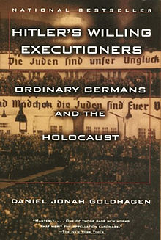
Hitler’s Willing Executioners
This groundbreaking international bestseller lays to rest many myths about the Holocaust: that Germans were ignorant of the mass destruction of Jews, that the killers were all SS men, and that those who slaughtered Jews did so reluctantly. Hitler's Willing Executioners provides conclusive evidence that the extermination of European Jewry engaged the energies and enthusiasm of tens of thousands of ordinary Germans. Goldhagen reconstructs the climate of "eliminationist anti-Semitism" that made Hitler's pursuit of his genocidal goals possible and the radical persecution of the Jews during the 1930s popular. Drawing on a wealth of unused archival materials, principally the testimony of the killers themselves, Goldhagen takes us into the killing fields where Germans voluntarily hunted Jews like animals, tortured them wantonly, and then posed cheerfully for snapshots with their victims.

Slide 38
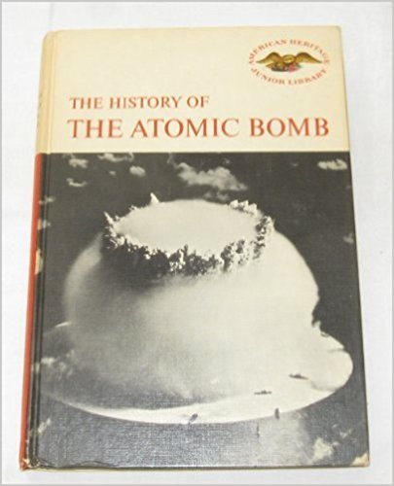
The History Of The Atomic Bomb
Chronicles the scientific developments that resulted in the invention of the atomic bomb, beginning with the late 1890's theories up to the mid 1960's tests.

Slide 39
Irena’s Children
Relates how Irena Sendler helped save 2,500 children from death and deportation in Nazi-occupied Poland during World War II.

Slide 40
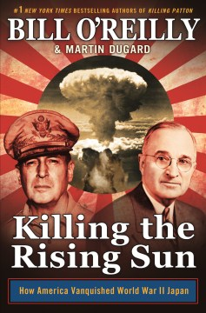
Killing The Rising Sun
A latest entry in the best-selling series dramatically portrays the events of World War II in 1944, when escalating Pacific battles between the forces of General Douglas MacArthur and the Japanese army lead to the development of humanity's deadliest weapon and newly appointed President Truman's impossible choice.

Slide 41
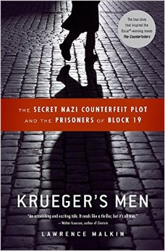
Krueger’s Men
The true story that inspired the Oscar-winning movie The Counterfeiters. "An astonishing and exciting tale. The drama of how the Nazis mounted a complex counterfeiting operation inside a concentration camp is matched by the chilling life-or-death saga of the prisoners involved. It reads like a thriller, but it's all true." -Walter Isaacson, author of The Wise Men and Benjamin Franklin Only a fortnight after the start of WWII, at a meeting that has remained a secret for more than half a century, Nazi leaders and officials of the German Reichsbank approved an audacious plot to counterfeit millions of British pounds. Drawing upon top-secret bank records, German and British correspondence, and interrogation transcripts, Lawrence Malkin reveals how an unremarkable SS officer named Bernhard Krueger attempted to bring down the world financial system. But when Krueger discovered that forging pounds, and later dollars, was no easy task, he made a crucial decision: he would seek out the greatest counterfeiters of pre-war Europe and enlist them in the effort. He found them in an unexpected place: a Nazi concentration camp. KRUEGER'S MEN is the remarkable story of how these Jews managed to save themselves. Part Schindler's List, part The Great Escape, this account of the Nazi plot is a fascinating portrait of deception, courage, and moral awakening.

Slide 42
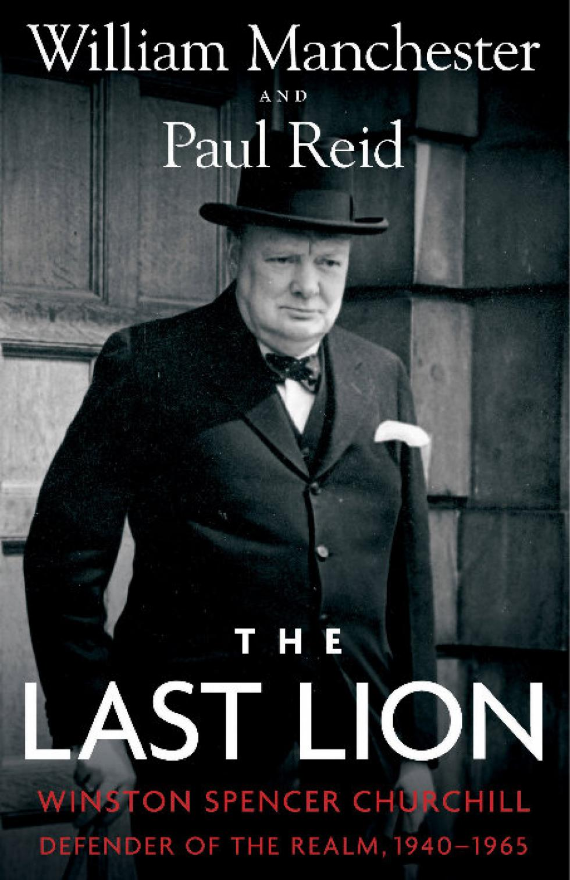
The Last Lion
Spanning the years 1940 to 1965, The Last Lion: Defender of the Realm begins shortly after Winston Churchill became prime minister—when Great Britain stood alone against the overwhelming might of Nazi Germany. In brilliant prose and informed by decades of research, William Manchester and Paul Reid recount how Churchill organized his nation’s military response and defense, convinced FDR to support the cause, and personified the “never surrender” ethos that helped win the war. We witness Churchill, driven from office, warning the world of the coming Soviet menace. And after his triumphant return to 10 Downing Street, we follow him as he pursues his final policy goal: a summit with President Dwight Eisenhower and Soviet leaders. And in the end, we experience Churchill’s last years, when he faces the end of his life with the same courage he brought to every battle he ever fought.

Slide 43
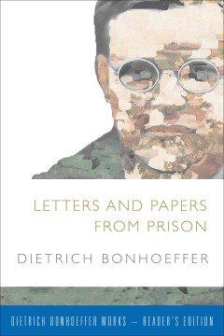
Letters And Papers From Prison
Despite Dietrich Bonhoeffer's earlier theological achievements and writings, it was his correspondence and notes from prison that electrified the postwar world six years after his death in 1945. The materials gathered and selected by his friend Eberhard Bethge in Letters and Papers from Prison not only brought Bonhoeffer to a wide and appreciative readership, especially in North America, they also introduced to a broad readership his novel and exciting ideas of religionless Christianity, his open and honest theological appraisal of Christian doctrines, and his sturdy, if sorely tried, faith in face of uncertainty and doubt.

Slide 44
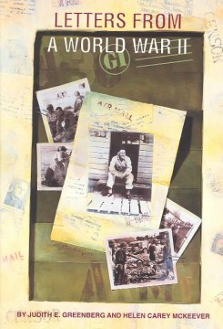
Letters From A World War II G.I.
A collection of letters from Keith Wilson to his wife, describing what it was like to serve in the U.S. Army during World War II.

Slide 45
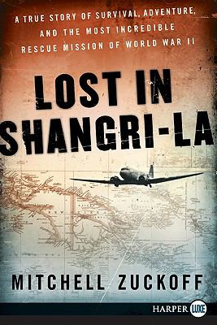
Lost In Shangri-La
In 1945, twenty-four American servicemen and women boarded a plane to see "Shangri-La," a beautiful valley deep within Dutch New Guinea. But when the plane crashed, only three pulled through to battle for survival. Emotionally devastated and badly injured, the trio faced certain death. Caught between spear-carrying tribesmen and enemy Japanese, they trekked down the jungle-covered mountainside and straight into superstitious natives rumored to be cannibals. Drawn from interviews, Army documents, photos, diaries, and original film footage, Lost in Shangri-La recounts this true-life adventure for the first time. Mitchell Zuckoff reveals how the trio traversed the jungle; how brave Filipino-American paratroopers risked their lives to save the survivors; how a native leader protected the Americans; and how a cowboy colonel attempted an untried rescue mission to get them out. A riveting work of nonfiction that brings to life an odyssey at times terrifying, enlightening, and comic, Lost in Shangri-La is a thrill ride from beginning to end.

Slide 46
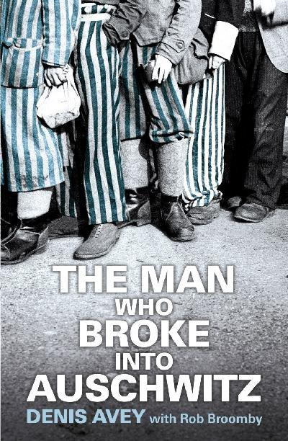
The Man Who Broke Into Auschwitz
The Man Who Broke into Auschwitz is the extraordinary true story of a British soldier who marched willingly into the concentration camp, Buna-Monowitz, known as Auschwitz III. In the summer of 1944, Denis Avey was being held in a British POW labour camp, E715, near Auschwitz III. He had heard of the brutality meted out to the prisoners there and he was determined to witness what he could. He hatched a plan to swap places with a Jewish inmate and smuggled himself into his sector of the camp. He spent the night there on two occasions and experienced at first-hand the cruelty of a place where slave workers, had been sentenced to death through labor. Astonishingly, he survived to witness the aftermath of the Death March where thousands of prisoners were murdered by the Nazis as the Soviet Army advanced. After his own long trek right across central Europe he was repatriated to Britain. For decades he couldn't bring himself to revisit the past that haunted his dreams, but now Denis Avey feels able to tell the full story--a tale as gripping as it is moving--which offers us a unique insight into the mind of an ordinary man whose moral and physical courage are almost beyond belief.

Slide 47
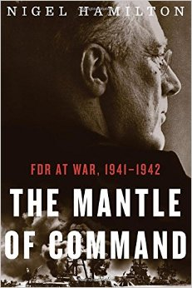
The Mantle OF Command
Based on years of archival research and interviews with the last surviving aides and Roosevelt family members, Nigel Hamilton offers a definitive account of FDR’s masterful—and underappreciated—command of the Allied war effort. Hamilton takes readers inside FDR’s White House Oval Study—his personal command center—and into the meetings where he battled with Churchill about strategy and tactics and overrode the near mutinies of his own generals and secretary of war. Time and again, FDR was proven right and his allies and generals were wrong. When the generals wanted to attack the Nazi-fortified coast of France, FDR knew the Allied forces weren’t ready. When Churchill insisted his Far East colonies were loyal and would resist the Japanese, Roosevelt knew it was a fantasy. As Hamilton’s account reaches its climax with the Torch landings in North Africa in late 1942, the tide of war turns in the Allies’ favor and FDR’s genius for psychology and military affairs is clear. This intimate, sweeping look at a great president in history’s greatest conflict is must reading.

Slide 48
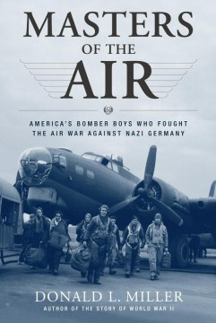
Masters Of The Air
Presents a narrative of the American bomber crews who flew hundreds of missions against Nazi Germany during World War II, and describes life in wartime England and in German POW camps.

Slide 49
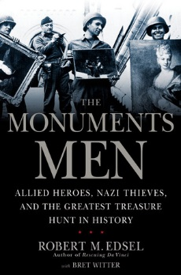
The Monuments Men
At the same time Adolf Hitler was attempting to take over the western world, his armies were methodically seeking and hoarding the finest art treasures in Europe. The Fuehrer had begun cataloguing the art he planned to collect as well as the art he would destroy: "degenerate" works he despised.
In a race against time, behind enemy lines, often unarmed, a special force of American and British museum directors, curators, art historians, and others, called the Monuments Men, risked their lives scouring Europe to prevent the destruction of thousands of years of culture.
Focusing on the eleven-month period between D-Day and V-E Day, this fascinating account follows six Monuments Men and their impossible mission to save the world's great art from the Nazis.

Slide 50
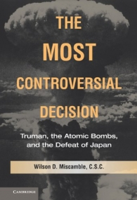
The Most Controversial Decision
This book explores the American use of atomic bombs, and the role these weapons played in the defeat of the Japanese Empire in World War II. It focuses on President Harry S. Truman's decision making regarding this most controversial of all his decisions. The book relies on notable archival research, and the best and most recent scholarship on the subject to fashion an incisive overview that is fair and forceful in its judgments. This study addresses a subject that has been much debated among historians, and it confronts head-on the highly disputed claim that the Truman administration practiced "atomic diplomacy." The book goes beyond its central historical analysis to ask whether it was morally right for the United States to use these terrible weapons against Hiroshima and Nagasaki. It also provides a balanced evaluation of the relationship between atomic weapons and the origins of the Cold War.

Slide 51
The Nazi Doctors And The Nuremberg Code
The atrocities committed by Nazi physicians and researchers during World War II prompted the development of the Nuremberg Code to define the ethics of modern medical experimentation utilizing human subjects. Since its enunciation, the Code has been viewed as one of the cornerstones of modern bioethical thought. The sources and ramifications of this important document are thoroughly discussed in this book by a distinguished roster of contemporary professionals from the fields of history, philosophy, medicine, and law. Contributors also include the chief prosecutor of the Nuremberg Military Tribunal and a moving account by a survivor of the Mengele Twin Experiments.

Slide 52
The Nazis Next Door
Until recently, historians believed America gave asylum only to key Nazi scientists after World War II, along with some less famous perpetrators who managed to sneak in and who eventually were exposed by Nazi hunters. But the truth is much worse, and has been covered up for decades: the CIA and FBI brought thousands of perpetrators to America as possible assets against their new Cold War enemies. When the Justice Department finally investigated and learned the truth, the results were classified and buried.
Using the dramatic story of one former perpetrator who settled in New Jersey, conned the CIA into hiring him, and begged for the agency’s support when his wartime identity emerged, Eric Lichtblau tells the full, shocking story of how America became a refuge for hundreds of postwar Nazis.

Slide 53
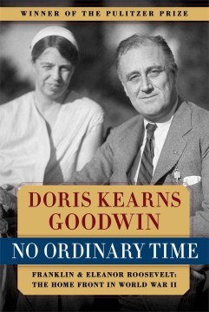
No Ordinary Time
Winner of the Pulitzer Prize for History, No Ordinary Time is a monumental work, a brilliantly conceived chronicle of one of the most vibrant and revolutionary periods in the history of the United States.
With an extraordinary collection of details, Goodwin masterfully weaves together a striking number of story lines—Eleanor and Franklin’s marriage and remarkable partnership, Eleanor’s life as First Lady, and FDR’s White House and its impact on America as well as on a world at war. Goodwin effectively melds these details and stories into an unforgettable and intimate portrait of Eleanor and Franklin Roosevelt and of the time during which a new, modern America was born.

Slide 54
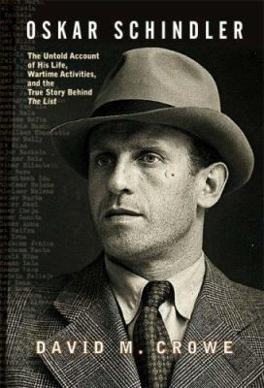
Oskar Schindler
Spy, businessman, bon vivant, Nazi Party member, Righteous Gentile. This was Oskar Schindler, the controversial savior of almost 12,000 Jews during the Holocaust who struggled afterwards to rebuild his life and gain international recognition for his wartime deeds. Author David Crowe examines every phase of the subject's life in this landmark biography, presenting a figure of mythic proportions that one prominent Schindler Jew described as "an extraordinary man in extraordinary times."

Slide 55
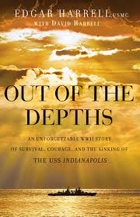
Out Of The Depths
July 30, 1945--The USS Indianapolis and its 1,196-man crew is making its way toward a small island in the South Pacific. The ship is sailing unescorted, assured by headquarters the waters are safe. It is midnight, and Marine Edgar Harrell and several others have sacked out on deck rather than spend the night in their hot and muggy quarters below. Fresh off a top-secret mission to deliver uranium for the atomic bombs that would ultimately end World War II, they are unaware their ship is being watched. Minutes later, six torpedoes are slicing toward the Indy . . . This is one man's story of courage, ingenuity, and faith in God's providence in the midst of the worst naval disaster in U.S. history.

Slide 56
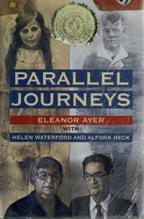
Parallel Journeys
She was a young German Jew. He was an ardent member of the Hitler Youth. This is the story of their parallel journey through World War II. Helen Waterford and Alfons Heck were born just a few miles from each other in the German Rhineland. But their lives took radically different courses: Helen's to the Auschwitz extermination camp; Alfons to a high rank in the Hitler Youth. While Helen was hiding in Amsterdam, Alfons was a fanatic believer in Hitler's "master race." While she was crammed in a cattle car bound for the death camp Auschwitz, he was a teenage commander of frontline troops, ready to fight and die for the glory of Hitler and the Fatherland. This book tells both of their stories, side-by-side, in an overwhelming account of the nightmare that was WWII. The riveting stories of these two remarkable people must stand as a powerful lesson to us all.

Slide 57
Pacific Crucible
On the first Sunday in December 1941, an armada of Japanese warplanes appeared suddenly over Pearl Harbor, Hawaii, and devastated the U.S. Pacific Fleet. Six months later, in a sea fight north of the tiny atoll of Midway, four Japanese aircraft carriers were sent into the abyss. Pacific Crucible tells the epic tale of these first searing months of the Pacific war, when the U.S. Navy shook off the worst defeat in American military history and seized the strategic initiative. Ian W. Toll's dramatic narrative encompasses both the high command and the "sailor's-eye" view from the lower deck. Relying predominantly on eyewitness accounts and primary sources, Pacific Crucible also spotlights recent scholarship that has revised our understanding of the conflict, including the Japanese decision to provoke a war that few in the country's highest circles thought they could win. The result is a page-turning history that does justice to the breadth and depth of a tremendous subject.

Slide 58
The Pacific War
Harold Guard became a war correspondent quite by chance, after he had been invalided out of the navy following a submarine accident. Thereafter, working for United Press, he gained a front row seat to many of the most dramatic battles and events of the century. In March 1942 Guard arrived in Australia, having narrowly escaped from Japanese forces invading Singapore and Java. His dispatches from that disastrous front prompted one observer to comment on "the crisis days when everybody except Harold Guard was trying to hush up the real situation." At the time he was acclaimed by the Australian press as being one of the top four newspapermen covering the war in the Pacific. Over the next three years Guard was to have many more adventures reporting on the Pacific War, including firsthand experience of flying with the US Air Force on 22 bombing missions, camping with Allied forces in the deadly jungles of New Guinea, and taking part in attacks from amphibious landing craft on enemy occupied territory.

Slide 59
The Power Of The Zoot
Flamboyant zoot suit culture, with its ties to fashion, jazz and swing music, jitterbug and Lindy Hop dancing, unique patterns of speech, and even risqué experimentation with gender and sexuality, captivated the country's youth in the 1940s. The Power of the Zoot is the first book to give national consideration to this famous phenomenon. Providing a new history of youth culture based on rare, in-depth interviews with former zoot-suiters, Luis Alvarez explores race, region, and the politics of culture in urban America during World War II. He argues that Mexican American and African American youths, along with many Nisei and white youths, used popular culture to oppose accepted modes of youthful behavior, the dominance of white middle-class norms, and expectations from within their own communities.

Slide 60
The Rape Of Nanking
In December 1937, the Japanese army swept into the ancient city of Nanking. Within weeks, more than 300,000 Chinese civilians and soldiers were systematically raped, tortured, and murdered—a death toll exceeding that of the atomic blasts of Hiroshima and Nagasaki combined. Using extensive interviews with survivors and newly discovered documents, Iris Chang has written the definitive history of this horrifying episode.

Slide 61
Rèsistance
This riveting diary by a key female member of the French Resistance in WWII is translated into English for the first time. Agnès Humbert was an art historian in Paris during the German occupation in 1940. Though she might well have weathered the oppressive regime, Humbert was stirred to action by the atrocities she witnessed. In an act of astonishing bravery, she joined forces with several colleagues to form an organized resistance--very likely the first such group to fight back against the occupation. In the throes of their struggle for freedom, the members of Humbert's group were betrayed to the Gestapo; Humbert herself was imprisoned. In immediate, electrifying detail, Humbert describes her time in prison, her deportation to Germany, where for more than two years she endured a string of brutal labor camps, and the horror of discovering that seven of her friends were executed by a firing squad. But through the direst of conditions, and ill health in the labor camps, Humbert retains hope for herself, for her friends, and for humanity. Originally published in France in 1946, the book was soon forgotten and is now translated into English for the first time. Résistance is more than a firsthand account of wartime France: it is the work of a brave, witty, and forceful woman, a true believer who refused to go quietly.

Slide 62
Resistance And Betrayal
"Enthralling and intelligent, a masterly exploration of the sinister labyrinth that was wartime France . . . It is a remarkable book, utterly fascinating." --Allan Massie Not long after 2:00 p.m. on June 21, 1943, eight men met in secret at a doctor's house in Lyon. They represented the warring factions of the French Resistance and had been summoned by General de Gaulle's new envoy, a man most of them knew simply as "Max." Minutes after the last man entered the house, the Gestapo broke in, led by Klaus Barbie, the infamous "Butcher of Lyon." The fate awaiting Barbie's prisoners was torture, deportation, and death. "Max" was tortured sadistically but never broke: he took his many secrets to his grave. In that moment, the legend of Jean Moulin was born. Who betrayed Jean Moulin? And who was this enigmatic hero, a man as skilled in deception as he was in acts of heroism? After the war, his ashes were transferred to the Panthéon--France's highest honor--where his memory is revered alongside that of Voltaire and Victor Hugo.

Slide 63
Retribution
By the summer of 1944 it was clear that Japan's defeat was inevitable, but how the drive to victory would be achieved remained unclear. The ensuing drama—that ended in Japan's utter devastation—was acted out across the vast theater of Asia in massive clashes between army, air, and naval forces.
In recounting these extraordinary events, Max Hastings draws incisive portraits of MacArthur, Mao, Roosevelt, Churchill, Stalin, and other key figures of the war in the East. But he is equally adept in his portrayals of the ordinary soldiers and sailors caught in the bloodiest of campaigns.

Slide 64
Sabotage And Subversion
The shadowy undercover work of the American OSS and the British SOE, usually behind enemy lines or close to the action, makes a story of extraordinary daring and great personal heroism. In a compilation of actual events in World War II, this book demonstrates the important role of these two undercover organizations in the Allied victory. Using first-hand research with veterans and original archive material, it describes many covert actions and tactics: codebreaking, blockade running, guerilla action, bombing missions, sniper work, assassinations, running double agents, training work and recruitment methods in both the American OSS and the British SOE.

Slide 65
The Secret Armies
Describes the activities of famous spies, Resistance movements, and saboteurs and discusses how they helped turn the tide of the Second World War.

Slide 66
Shadow Divers
Tells the story of the discovery in 1991 of a World War II German U-boat, sunk sixty miles off the coast of New Jersey, by deep sea divers John Chatterton and Richie Kohler, and their six year obsession with identifying the submarine which sank with its crew onboard.

Slide 67
Shadow On The Mountain
In Nazi-occupied Norway, fourteen-year-old Espen joins the resistance movement, graduating from deliverer of illegal newspapers to courier and spy.

Slide 68
Snow & Steel
Between December 16, 1944 and January 15, 1945, American forces found themselves entrenched in the heavily forested Ardennes region of Belgium, France, and Luxembourg defending against an advancing German army amid freezing temperatures, deep snow, and dense fog. Operation Herbstnebel--Autumn Mist--was a massive German counter-offensive that stunned the Allies in its scope and intensity. In the end, the 40-day long Battle of the Bulge, as it has come to be called, was the bloodiest battle fought by U.S. forces in World War II, and indeed the largest land battle in American history. Before effectively halting the German advance, some 89,000 of the 610,000 American servicemen committed to the campaign had become casualties, including 19,000 killed.

Slide 69
Soe’s Ultimate Deception
In the closing months of World War II, General Eisenhower exhorted the Western Allied forces to redouble their efforts to break the German will to resist. In considering this appeal, General Gubbins, whose Special Operations Executive was making a significant contribution to the liberation of occupied territory, was faced with a fundamental difficulty in the case of Germany. Although opposition to Nazism was present in some areas, it was neither organized nor pro-Allied. Then someone had the idea of creating an entirely fictional German resistance movement and "selling it" to the Nazi security authorities. From January until April 1945, SOE rained propaganda leaflets on the hapless population fleeing the ruins of their cities and the oncoming Allied ground forces; they broadcast messages to the "resistance;" they planted the most scandalous lies about eminent Nazis; and at the end they even dropped four agents on fictitious missions. This imaginative response to Ike's exhortation and the sheer audacity of the operation itself demand to be told to a wider audience.

Slide 70
Spielberg’s Holocaust
"This anthology of essays on Steven Spielberg's 1993 film is a solid achievement. It is a repository of considerable critical insight and frequently passionate argument." --Holocaust and Genocide Studies "An excellent collection; highly recommended for general readers and students at all levels." –Choice "This collection of essays opens further the debate on how to represent the Holocaust as Holocaust representation and memory move into ever-greater areas of daily American and Jewish American culture." –Tikkun Schindler's List not only afforded director Steven Spielberg a cinematic vehicle loaded with Hollywood-hardware to create his master narrative about the Holocaust, the film also invited a renewed scholarly and intellectual discussion about racism, "historical voyeurism" and the "limits of representation." This thought-provoking critical anthology tackles these issues and many others.

Slide 71
Survival In Auschwitz
The true and harrowing account of Primo Levi's experience at the German concentration camp of Auschwitz and his miraculous survival; hailed by The Times Literary Supplement as a "true work of art, this edition includes an exclusive conversation between the author and Philip Roth. In 1943, Primo Levi, a twenty-five-year-old chemist and "Italian citizen of Jewish race," was arrested by Italian fascists and deported from his native Turin to Auschwitz. Survival in Auschwitz is Levi's classic account of his ten months in the German death camp, a harrowing story of systematic cruelty and miraculous endurance. Remarkable for its simplicity, restraint, compassion, and even wit, Survival in Auschwitz remains a lasting testament to the indestructibility of the human spirit. Included in this new edition is an illuminating conversation between Philip Roth and Primo Levi never before published in book form.

Slide 72
Taps For A Jim Crow Army
" Many black soldiers serving in the U.S. Army during World War II hoped that they might make permanent gains as a result of their military service and their willingness to defend their country. They were soon disabused of such illusions. Taps for a Jim Crow Army is a powerful collection of letters written by black soldiers in the 1940s to various government and nongovernment officials. The soldiers expressed their disillusionment, rage, and anguish over the discrimination and segregation they experienced in the Army. Most black troops were denied entry into army specialist schools; black officers were not allowed to command white officers; black soldiers were served poorer food and were forced to ride Jim Crow military buses into town and to sit in Jim Crow base movie theaters. In the South, German POWs could use the same latrines as white American soldiers, but blacks could not.

Slide 73
Top Secret Projects Of WWII
Describes the top secret missions and projects of both sides during World War II and discusses the impact of these projects on the outcome of the war and their effects on the course of history.

Slide 74
Twelve Desperate Miles
The Dirty Dozen meets Band of Brothers in this true story of how a rusty old New Orleans banana boat staffed with an unlikely crew of international merchant seamen, a gang of inmates from a local jail, and a French harbor pilot spirited out of Morocco by O.S.S. agents in the trunk of a Chevy, were drafted into service in WWII -- and heroically succeeded in setting the stage for Patton's epic invasion of North Africa. In Twelve Desperate Miles , veteran history writer Tim Brady chronicles one of the great untold stories of the war. This surprising and entertaining account of the baptism of American forces on the Western Front is a mix of Moroccan intrigue, portraits of some of the great figures of the war (Patton, Eisenhower, Marshall, General Lucian Truscott) at its outset, snapshots of the daily workings of the colorful crew of a merchant ship, along with a thrilling account of the invasion of French Morocco. Twelve Desperate Miles offers a unique and fascinating picture of the war in its opening moments.

Slide 75
Unlikely Warrior
As a young adult in wartime Vienna, Georg Rauch helped his mother hide dozens of Jews from the Gestapo behind false walls in their top-floor apartment and arrange for their safe transport out of the country. His family was among the few who worked underground to resist Nazi rule. Then came the day he was drafted into Hitler's army and shipped out to fight on the Eastern front as part of the German infantry--in spite of his having confessed his own Jewish ancestry. Thus begins the incredible journey of a nineteen year old thrust unwillingly into an unjust war, who must use his smarts, skills, and bare-knuckled determination to stay alive in the trenches, avoid starvation and exposure during the brutal Russian winter, survive more than one Soviet labor camp, and somehow find his way back home.

Slide 76
Vanished
In the fall of 1944, a massive American bomber carrying eleven men vanished over the Pacific islands of Palau, leaving a trail of mysteries. According to mission reports from the Army Air Forces, the plane crashed in shallow water—but when investigators went to find it, the wreckage wasn’t there. Witnesses saw the crew parachute to safety, yet the airmen were never seen again. Some of their relatives whispered that they had returned to the United States in secret and lived in hiding. But they never explained why.
For sixty years, the U.S. government, the children of the missing airmen, and a maverick team of scientists and scuba divers searched the islands for clues. With every clue they found, the mystery only deepened.

Slide 77
Victory In The Pacific
Victory in the Pacific covers events from the surprise attack on Pearl Harbor through the battles of Midway, Guadalcanal, the Solomon Islands, Savo Island, the Doolittle raid on Tokyo, Corregidor Island, Leyte Gulf, Iwo Jima , and Okinawa. In each case, readers see the battles through the eyes of the men who were there, landing on the beaches, running raids in PT boats, dodging kamikaze bombers, and flying missions over Japan. In an easily accessible style, Marrin relates not only the important details of these conquests but also explains the military strategies of both the Allied forces and the Japanese. Readers get an overarching view of the war that helps to bring understanding especially as American forces drew increasingly closer to Japan and the Japanese grew ever more determined to fight to the bitter end. Marrin helps readers to understand the Japanese mindset that made surrender impossible and ultimately led to the decision to drop the atomic bomb in the interests of saving millions of lives. For the young adult reader, or even an adult unfamiliar with this period of WWII history, this book provides a sobering but inspiring look and the men and women , the nations and ideologies, that battled over half a century ago in the Pacific theater. Illustrated with diagrams, maps and photographs.

Slide 78
We Are Witnesses
We are the bleeding clouds, and from the seas of blood have we come... We are witnesses... we were brought into being by an inferno of suffering; and we are a sign of peace to you. - Moshe Ze'ev Flinker, Age 17. On the eve of Passover, 1944, shortly after he wrote these words, Moshe and his family were betrayed to the Nazis and sent to Auschwitz. Like the other four diarists in this book, he did not survive the war. But their words did. Written in the midst of "an inferno of suffering," these fragile yet powerful records are a "sign of peace" to all of us. Each diary reveals one voice, one teenager coping with the impossible. We see David Rubinowicz struggling against fear and terror in Poland. Yitzhak Rudashevski in Lithuania shows us how Jews clung to culture, to learning, and to hope, until there was no hope at all. In Belgium, Moshe is the voice of religion, constantly seeking answers from God for relentless tragedy. Finally, in Hungary, Eva Heyman demonstrates the unquenchable hunger for life that sustained her until the very last moment.

Slide 79
We Band Of Angels
In the fall of 1941, the Philippines was a gardenia-scented paradise for the American Army and Navy nurses stationed there. War was a distant rumor, life a routine of easy shifts and dinners under the stars. On December 8 all that changed, as Japanese bombs began raining down on American bases in Luzon, and this paradise became a fiery hell. Caught in the raging battle, the nurses set up field hospitals in the jungles of Bataan and the tunnels of Corregidor, where they tended to the most devastating injuries of war, and suffered the terrors of shells and shrapnel.
But the worst was yet to come. After Bataan and Corregidor fell, the nurses were herded into internment camps where they would endure three years of fear, brutality, and starvation.

Slide 80
When Paris Went Dark
On June 14, 1940, German tanks entered a silent and nearly deserted Paris. Eight days later, France accepted a humiliating defeat and foreign occupation. Subsequently, an eerie sense of normalcy settled over the City of Light. Many Parisians keenly adapted themselves to the situation-even allied themselves with their Nazi overlords. At the same time, amidst this darkening gloom of German ruthlessness, shortages, and curfews, a resistance arose. Parisians of all stripes-Jews, immigrants, adolescents, communists, rightists, cultural icons such as Colette, de Beauvoir, Camus and Sartre, as well as police officers, teachers, students, and store owners-rallied around a little known French military officer, Charles de Gaulle.

Slide 81
Why Germany Nearly Won
Conventional wisdom explains German defeat during World War II as almost inevitable, primarily for reasons of Allied economic or military brute force created when Germany attacked the Soviet Union in 1941 and entered into a two-front war.
Why Germany Nearly Won: A New History of the Second World War in Europe challenges this conventional wisdom, highlighting how the re-establishment of the traditional German art of war—updated to accommodate new weapons systems—paved the way for Germany to forge a considerable military edge over its much larger rivals by playing to its qualitative strengths as a continental power. Ironically, these methodologies also created and exacerbated internal contradictions that undermined the very war machine they enabled and left it vulnerable to enemies with the capacity to adapt and build on potent military traditions of their own.

Slide 82
The Wild Blue
Stephen E. Ambrose, acclaimed author , carries us along in the crowded and dangerous B-24s as their crews fought to destroy the German war machine during World War II.
The young men who flew the B-24s over Germany in World War II fought against horrific odds, and, in The Wild Blue, Ambrose recounts their extraordinary heroism, skill, daring, and comradeship with vivid detail and affection.
Ambrose describes how the Army Air Forces recruited, trained, and selected the elite few who would undertake the most demanding and dangerous jobs in the war. These are the boys—turned pilots, bombardiers, navigators, and gunners of the B-24s—who suffered over fifty percent casualties.

Slide 83
The Wolves At The Door
Provides an in-depth biography of the life and times of Virginia Hall, a World War II American spy in France, from her privileged Baltimore roots to her work with the British SOE and American OSS, assessing her critical role in bringing about the end of the Third Reich.

Slide 84
World War II In Europe
From military maneuvers to mass murder, history's most lethal conflict is thoroughly explained including the actions of the instigator, Adolf Hitler.

Slide 85
Year Zero
Year Zero is a landmark reckoning with the great drama that ensued after war came to an end in 1945. One world had ended and a new, uncertain one was beginning. Regime change had come on a global scale: across Asia (including China, Korea, Indochina, and the Philippines, and of course Japan) and all of continental Europe. Out of the often vicious power struggles that ensued emerged the modern world as we know it. In human terms, the scale of transformation is almost impossible to imagine. Great cities around the world lay in ruins, their populations decimated, displaced, starving. Harsh revenge was meted out on a wide scale, and the ground was laid for much horror to come. At the same time, in the wake of unspeakable loss, the euphoria of the liberated was extraordinary, and the revelry unprecedented. The postwar years gave rise to the European welfare state, the United Nations, decolonization, Japanese pacifism, and the European Union. Social, cultural, and political “reeducation” was imposed on vanquished by victors on a scale that also had no historical precedent.

